Slide 1

Well-Widget
Final Capstone Project
by
Michelle Griffith

Slide 2
The Internet is not always a happy place
“Longer screen time (more than two hours a day) was associated with lower levels of life satisfaction and optimism, and higher levels of anxiety and depressive symptoms [for teens and young adults, especially girls]”
2020 University of British Columbia study on screen time and mental health
Understatement of the new millennium?

Slide 3
The Internet is not always a happy place
Screen time for young people is up 50% since the pandemic began
Axios.com, 2021

Slide 4
The Internet is not always a happy place
“Globally, more than 70% of people with mental illness receive no treatment from health care staff. Evidence suggests that factors increasing the likelihood of treatment avoidance or delay before presenting for care include:
(1) lack of knowledge to identify features of mental illnesses
(2) ignorance about how to access treatment
(3) prejudice against people who have mental illness
(4) expectation of discrimination against people diagnosed with mental illness.”
American Public Health Association

Slide 5
Data Can Help
Researchers from Stanford published a pre-aggregated dataset containing over a million tweets
Each tweet is classified as either positive or negative sentiment
This data can be used to train a model that can predict whether a tweet, message, or comment is positive or negative
It
always
can!

Slide 6
Data Can Help
Introducing…
Well-Widget
… A FREE Browser App
Well-Widget will be a sidebar for your browser, and can scan the content of a page, process the text, and classify the text as positive or negative

Slide 7
Data Can Help
Introducing…
Well-Widget
… A FREE Browser App
The percentage of negative texts on the page will determine the “tier”
Tier 1: 0-25% negative texts
Tier 2: 25-50% negative text
Tier 3: 50-75% negative text
Tier 4: > 75% negative text

Slide 8
Data Can Help
Introducing…
Well-Widget
… A FREE Browser App
Based on the tier, different programming will be displayed on the sidebar, from positive quotes and suggestions for “mental flossing”, to online counseling resources and emergency hotline numbers

Slide 9
Data Can Help
Introducing…
Well-Widget
… A FREE Browser App
Regular reports can be sent to parents or users who are concerned if negative content is being regularly consumed

Slide 10
Models
Logistic Regression
Random Forest Classifier
Gradient Boosting Classifier
This is where it gets nerdy (and fun!), with science-y words… buckle up!

Slide 11
Models
FEATURES
Textual Data Vectorized into 300-dimensional vectors with Word2Vec from gensim
TARGET
Sentiment “Rating” of Tweet
‘4’ for positive, ‘0’ for negative
Class distribution is 50/50

Slide 12

Text
Preprocessing
TWEETS ARE MESSY!
Example Tweets:
"@switchfoot http://twitpic.com/2y1zl - Awww, that's a bummer. You shoulda got David Carr of Third Day to do it. ;D"
'@goodlaura What about Reese dying on #TTSC? And season finale next week. #24 boring, Madame President is a crazy woman.'

Slide 13
Text
Preprocessing
TWEETS ARE MESSY!
Cleaning Involved:
Paring down data from 1.6 million data points to 30,000 for quicker processing
Converting Emoticons to words
Removing @userhandles and hyperlinks
Removing the ‘#’ (hashtag symbol) but keeping the text
Removing tweets not in english

Slide 14
Text
Parsing
A TALE OF TWO DATASETS:
Internet lingo contains intentional misspellings and slang that SpaCy does not recognize
DATA SET 1
Stop words, punctuation, & frequent and rare words removed, remaining text lemmatized and tokenized with functions written by hand using
nltk libraries
DATA SET 2
Stop words and punctuation removed with SpaCy
Lemmatized and Tokenized with SpaCy
Frequent and Rare words removed during vectorization
To SpaCy or not to SpaCy? That is the question.
Notes:
Paring down data from 1.6 million data points to 30,000 for quick processing for the beta model
Random sampling, but maintaining the 50/50 class balance
The “tweet id” column was preserved in order to keep track of what data has already trained the model, so for further training, there are no duplicates
Converting Emoticons to words, in order to keep the emotion and sentiment behind including an emoticon

Slide 15
So which dataset is the best one then?

Slide 16
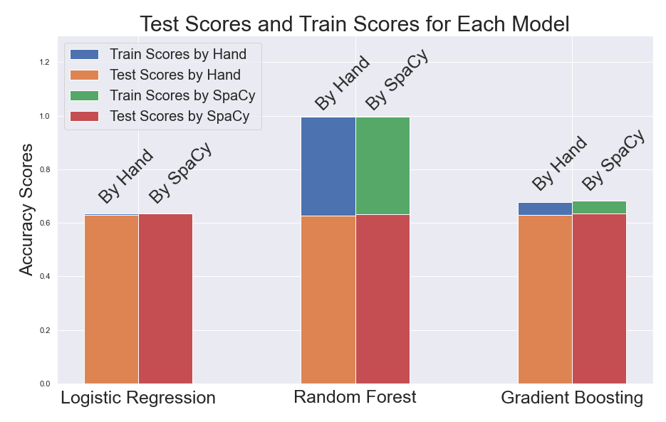

Slide 17
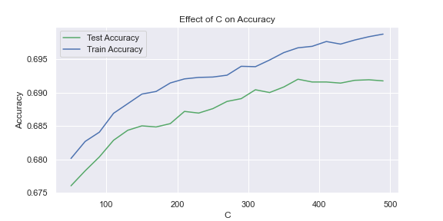
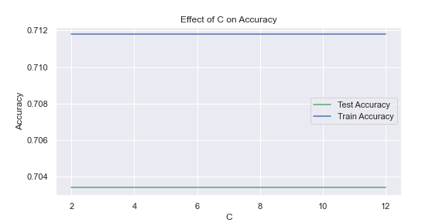
Logistic Regression
Best Parameters***
Solver: ‘newton-cg’
C: any
penalty: none
*** Searched for best parameters by comparing different solvers, and creating validation curves for C and max_iter
TRAINING DATA
Accuracy: 0.7117
Precision: 0.7061
Recall: 0.7210
TESTING DATA
Accuracy: 0.7018
Precision: 0.7021
Recall: 0.7115

Slide 18
Random Forest Classifier
Best Parameters from GridSearchCV
bootstrap: True
max_depth: 40
max_features: ‘sqrt’
min_samples_leaf: 5
Min_samples_split: 7
N_estimators: 300
OVERFITTING
TRAINING DATA
Accuracy: 0.9864
Precision: 0.9841
Recall: 0.9887
TESTING DATA
Accuracy: 0.6361
Precision: 0.6479
Recall: 0.6126

Slide 19
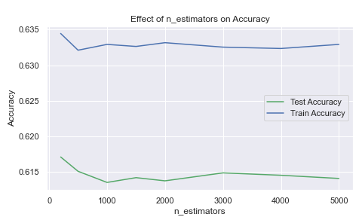
Random Forest Classifier
OVERFITTING IS NO MATCH FOR MAX_DEPTH!
Best Parameters from GridSearchCV
bootstrap: True
max_depth: 5
max_features: ‘sqrt’
min_samples_leaf: 5
Min_samples_split: 7
N_estimators: 300
Still not good though
TRAINING DATA
Accuracy: 0.6345
Precision: 0.6496
Recall: 0.5767
TESTING DATA
Accuracy: 0.6171
Precision: 0.6496
Recall: 0.5613

Slide 20
Gradient Boosting Classifier
Why so much overfitting? Does varying the parameters affect overfitting?
Best Parameters from GridSearch CV
learning_rate: 0.1
loss: ‘deviance’
max_features: None
subsample: 0.7
n_estimators: 200
TRAINING DATA
Accuracy: 0.7100
Precision: 0.7127
Recall: 0.7011
TESTING DATA
Accuracy: 0.6326
Precision: 0.6363
Recall: 0.6293

Slide 21
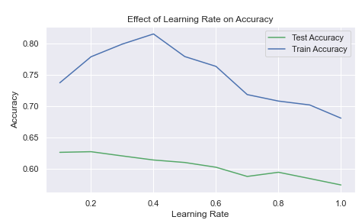
learning_rate?
Gradient Boosting Classifier
OVERFITTING OR POOR PERFORMANCE!
PARAMETERS:
max_depth: 2
loss: ‘deviance’
max_features: ‘sqrt’
n_estimators: 1000
subsample: 0.5

Slide 22
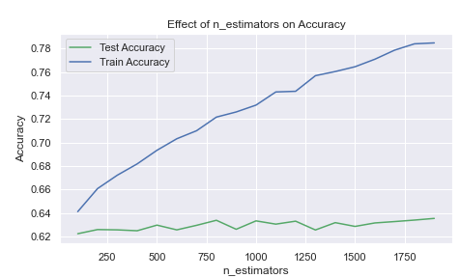
n_estimators?
Gradient Boosting Classifier
OVERFITTING OR POOR PERFORMANCE!
PARAMETERS:
max_depth: 2
loss: ‘deviance’
max_features: ‘sqrt’
learning_rate: 0.1
subsample: 0.5

Slide 23
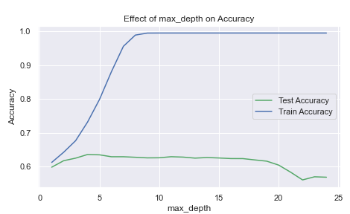
max_depth?
Gradient Boosting Classifier
OVERFITTING OR POOR PERFORMANCE!
PARAMETERS:
n_estimators: 100
loss: ‘deviance’
max_features: ‘sqrt’
learning_rate: 0.1
subsample: 0.5

Slide 24
Varying
subsample, min samples split, or min samples leaf were boring straight lines with overfitting.
Gradient Boosting Classifier
OVERFITTING AND POOR PERFORMANCE!

Slide 25
So which model is the best one then?

Slide 26
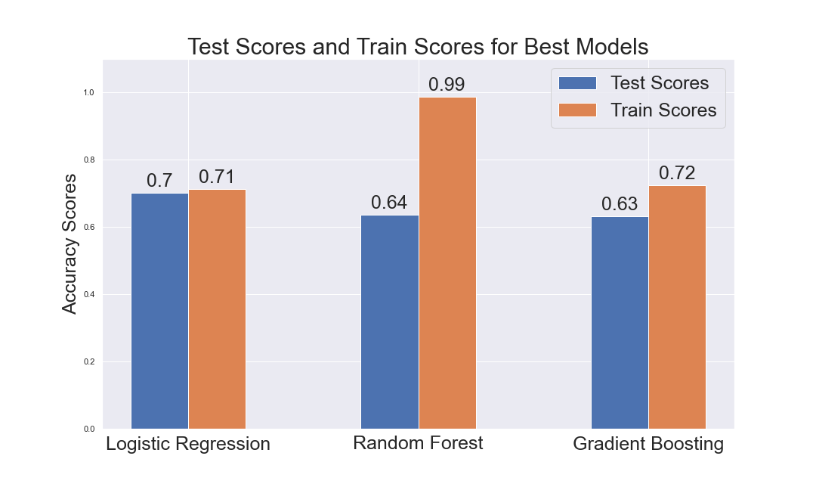
LOGISTIC REGRESSION
FOR THE WIN!

Slide 27
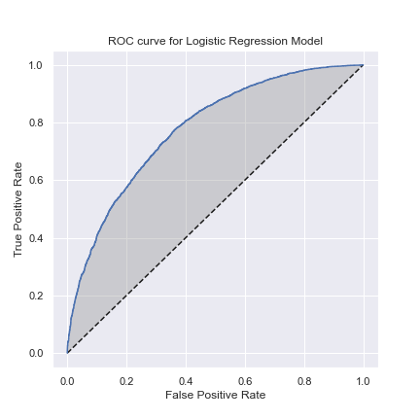
Analyzing Results
AUC:
~78%
Not bad!
K, so accuracy is 70%, but how about AUC?

Slide 28
Can a Dummy
Do Better?
Analyzing Results
50%
Dummy Accuracy Is...
(with strategy = ‘stratified’)
That’s not as good as 70% right?

Slide 29
Analyzing Results
The “positive class” is also the “positive sentiment” tweets
False positives are troubling considering they are actually negative sentiment texts that are not classified as such
SOLUTION: Maximizing Precision by Minimizing False Positives with a threshold of 0.7
What about the False Positives?

Slide 30
Analyzing Results
A threshold of
0.7
puts the precision at
~81%
Those negative tweets won’t get by us!!!

Slide 31
What’s Next?
This model’s only the beta version!
MODEL OPTIMIZATION
Train the model with additional data
Further optimize the model and experiment with more classifiers
More effectively clean the data, misspellings were still rampant!
Train the model to detect sarcasm
How do we make the model better?

Slide 32
What’s Next?
MODEL DEPLOYMENT
Research and employ the best API and/or method to scrape text from social media sites
Partner with psychologist to determine content for each tier
Partner with a web/ browser app developer to create the widget
Market the widget, obtain investors based on profit potential of advertisements
How do we make this an actual product?

Slide 33
Questions?
Thank You!
Open Source Downloadable Dataset Can Be Found Here: http://help.sentiment140.com/for-students/

