Slide 1
How Income & Age Affect Political Opinions
Analysis of Voter Survey Data
by
Michelle Griffith

Slide 2
Overview & Problem Statement
How do campaigns effectively connect with voters of different income and age levels
Where is the best place to allocate campaign funding to make the biggest impact in terms of changing opinions?
Data analysis will be useful for:
Campaign managers, strategists
Campaign finance departments
Those working in voter mobilization and canvassing
Political social media managers
Notes:
Political opinions and leanings of different Americans can be shaped by a multitude of different factors, both visible and psychological, of which many may seem intangible and immeasurable. Income and age are two of the most easily measured and concrete variables that could potentially inform an American’s political leanings and more subtle opinions, so that’s where we’ll start
These entities can consider this analysis as a piece of data-informed evidence on how to conduct their campaigns, which demographics to target and how, and which issues to address and speak to, based on how this survey sample of Americans leans towards different opinions and political self-identifications based on their age and income.

Slide 3
Data Analyzed
“Pulse of the Nation” October 2017 Data Set by “Cards Against Humanity Saves America”
Unorthodox research questions cast light on valuable cultural insights
Research Questions: “How does income level and age affect…”
Whether or not one mostly agrees or mostly disagrees with the beliefs of white nationalists?
Whether or not one believes that government policies should help those who are poor and struggling in America?
Whether or not one believes that most white people in America are racist?
Whether or not one approves or disapproves of how Donald Trump is handling his job as president?
Whether or not one is more likely to identify as a republican, democrat, or independent?
Whether or not one has ever eaten a kale salad, if only for comedic relief.
Notes:
-“Cards Against Humanity” (yes, thes same game you might not want to play with your mom) is the increasingly popular risque card game played by many Americans, which touches on subjects that many Americans think about but wouldn’t dare to address publicly.
-“Are you a social scientist or academic who studies public opinion? Want to ask Americans something that no funding agency or internal review board would approve in a million years? Maybe we can help!”
-

Slide 4
Hypotheses
H_{o} :
H_{a} :
There is no difference between the distribution of income level and/ or age for the opinion/belief in question
There is a difference between the distribution of income level and/or age for the opinion/belief in question, and those differences could affect how one engages with voters

Slide 5
Most
Interesting
Results

Slide 6
Age
had no effect
on opinion
“If you are not a liberal when you are young, you have no heart, and if you are not a conservative when you are old, you have no brain.”
Winston Churchill, supposedly...
Notes:
No matter which research question, there is not enough evidence to say that there age will be a determining factor in ones opinion.
“If you are not a liberal when you are young, you have no heart, and if you are not a conservative when you are old, you have no brain.”

Slide 7
Income
had no effect on
Whether or Not A Survey Participant Agreed or Disagreed with White Nationalists
(About 10% did agree though, yikes)
Whether or Not A Survey Participant Believed That the Government Should Help Those Who are Poor and Struggling
Notes:
No matter which research question, there is not enough evidence to say that there age will be a determining factor in ones opinion.

Slide 8
Income Affects Opinions on Racism
“Do you think that most white people in America are racist?”
Median Income of People who think YES: $43,500
Median Income of People who think NO: $57,000

Slide 9
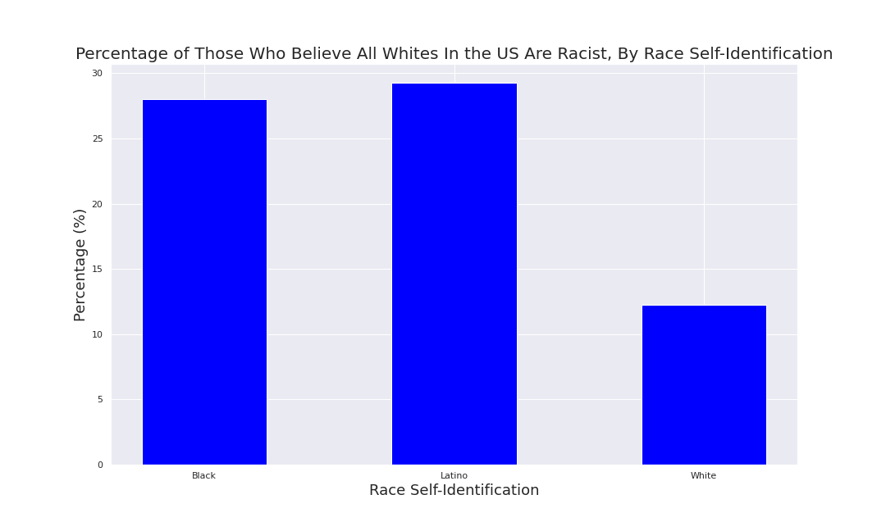
This could be explained by racial differences
Median Income of People Who Identified As NOT WHITE: $40,000
Median Income of People Who Identified As WHITE: $62,500
Do you think that most white people in America are racist?
29.3%
said
YES
28.0%
said
YES
12.2%
said
YES
Black
Latino
White
Notes:
This may have to do with the fact that a higher percentage of those surveyed who are black or latino believe that most whites in the US are racist, and those identified as white have a statistically significant higher median income (62,500 USD) than those who identified as other than white (40,000 USD).
Specifically, 28.0% of those who identify as black believe all whites in the US are racist, 29.27% of those who identify as latino believe all whites in the US are racist, while only 12.23% of those who identify as white believe all whites in the US are racist.

Slide 10
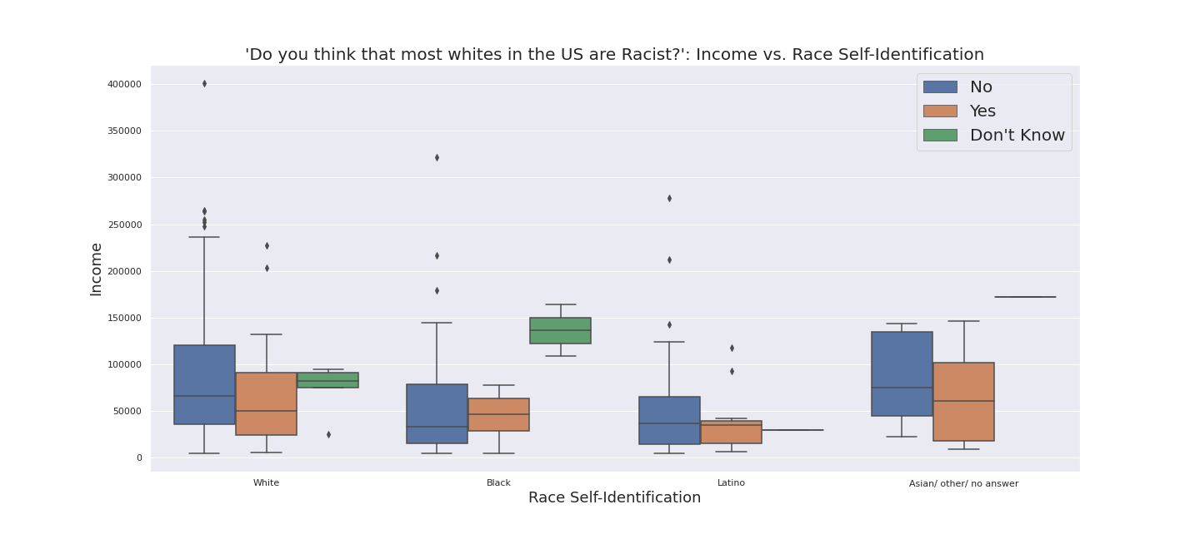
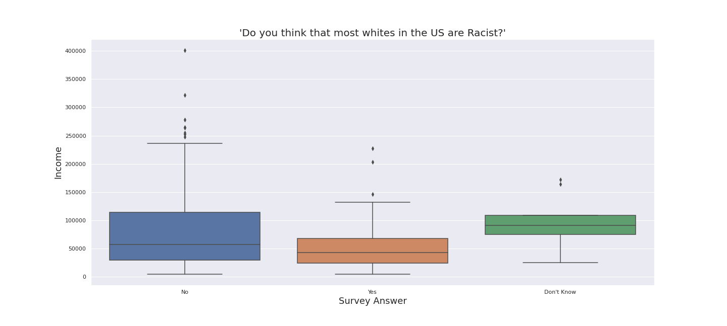
Income By Survey Answer, Then Also By Race
No
Yes
Don’t Know
White Black Latino Asian/Other/No Answer
Notes:
Looking at the boxplot of survey answer by income, we see that those who said no have a higher income
Adding a hue of race self-identification to the box plot adds an even deeper level to this story. Among whites, those who said no have a higher income like with the overall pattern. This is not true among blacks and latinos. Among blacks, those with a higher income said yes, while among Latinos there doesn’t seem to be much of a difference in median income between those who said no and yes.
And in both black and white, those who said “don’t know” had the highest incomes than either answer, which if income can be associated with education level, we can maybe say that as often is the case, those who are willing to say they don’t know are the smartest ones

Slide 11
Income Affects Approval of Trump
“Do you approve or disapprove of how Donald Trump is handling his job as president?”
Median Income of People who APPROVE: $67,000
Median Income of People who DISAPPROVE: $43,000
33.67% of those surveyed approve

Slide 12
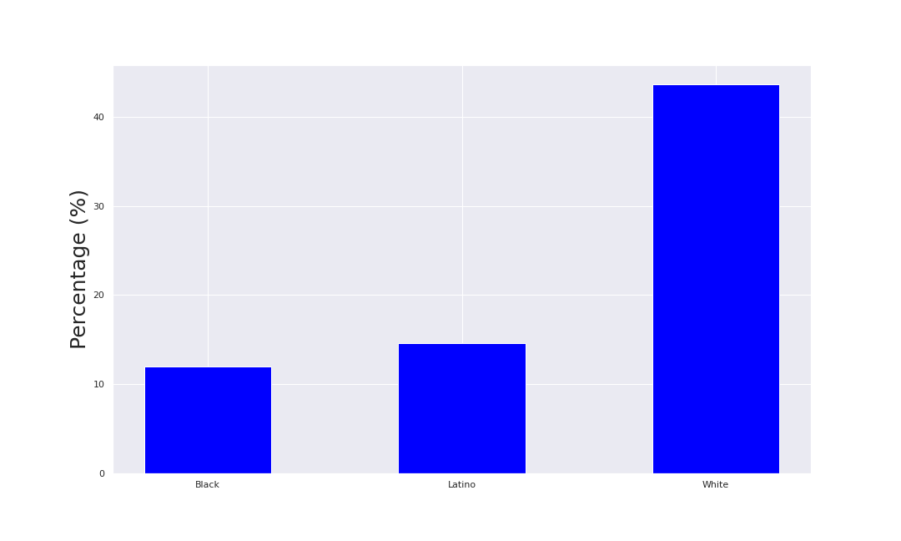
Approval Rating By Race
REMINDER:
Median Income of People Who Identified As NOT WHITE: $40,000 Median Income of People Who Identified As WHITE: $62,500
43.6%
Approve
14.6%
Approve
12.0%
Approve
Black
Latino
White

Slide 13
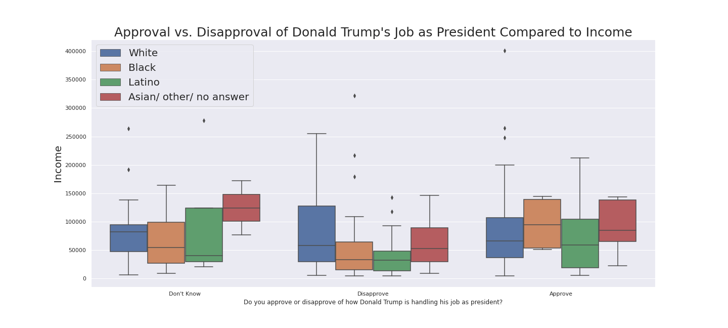
Approval vs Income Separated By Race
Don’t Know Disapprove Approve
Notes:
LOOKING AT APPROVE :
we see that those with the highest median income are those who self identified as black, or Asian/other/no answer. The highest maximum incomes for this section are for those identified as white or latino.
those who self identified as black who approve have a significantly higher median income than those who disapprove and self-identified as black.
LOOKING AT DISAPPROVE :
those who identified as white have a higher median income than black or latino. This aligns with our analysis in comparing income to race self-identification, in that whites surveyed tended to have a higher median income. Additionally, for those identified as white who Disapprove, there is a much higher upper quartile, indicating that those identified as white of many incomes disapprove, so income is not a determining factor of approval or disapproval if you identify as white.
We can perhaps say that if you self-identify as black or latino, that income is one of the major factors in whether or not you approve or disapprove of Trumps job as president.
There doesn't seem to be too much of a difference in median income between whites who disapprove or approve of Trump's job as president, so we could say that income is not as much of a factor here and we'd have to examine other factors besides income in why one who self-identifies as white does or does not support Trump's job as president.

Slide 14
Income May Determine Political Affiliation...
… With Republicans Having the Highest Median Income
Median Income of REPUBLICANS: $77,500
Median Income of NON-REPUBLICANS: $49,000
With most statistically significant difference being between Republicans and Independent/Undecided
Median Income of INDEPENDENT/UNDECIDED: $46,000

Slide 15
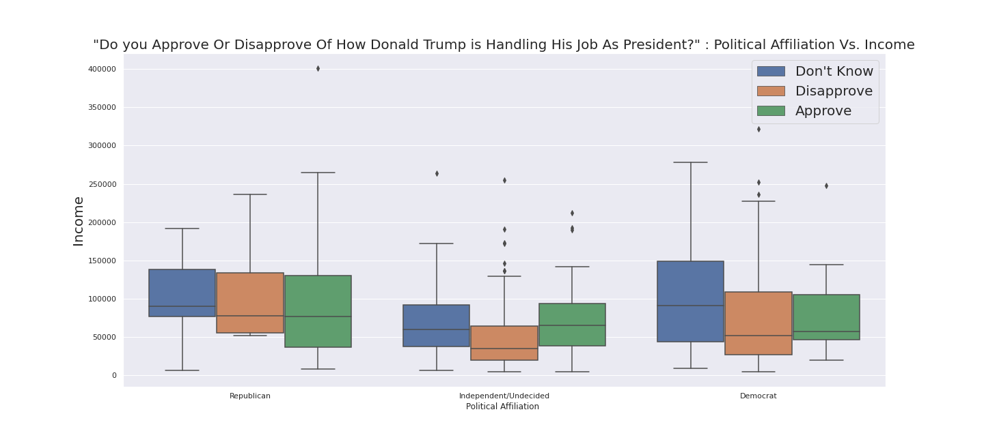
Things Start to Get Interesting...
Let’s revisit the question of Approval vs Disapproval of Trump in office, but with a twist….
79% of Republicans Approve of Trump
But that difference is pretty interesting!
12% of Democrats Approve of Trump
Income Differences Not Statistically Significant Between Approve and Disapprove
Income Differences Not Statistically Significant Between Approve and Disapprove
Republican
Independent/Undecided
Democrat
Notes:
This is animated, it must be done in order.

Slide 16
If You Identify As Independent/Undecided...
… It is likely that income will determine whether or not you approve of Trump
30%
of Independent/Undecided Survey Participants
APPROVE
of Trump’s job in office
Median Income of Independent/Undecided who APPROVE: $65,000
Median Income of Independent/Undecided who DISAPPROVE: $35,000

Slide 17
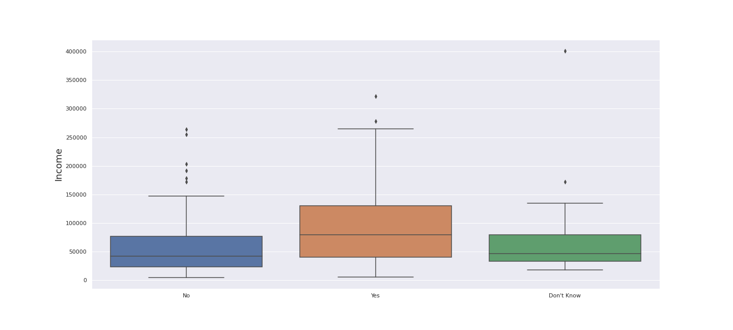
Income Affects Kale Salad Consumption
“Have you ever eaten a kale salad?”
Median Income of People who said YES: $79,500
Median Income of People who said NO: $42,000
Income
NO
YES
DON’T KNOW
Notes:
Perhaps the most stark differences in income that are statistically significant is in whether or not those surveyed have ever eaten a kale salad. The median income for those who have eaten a kale salad is 79,500 USD, and the median income for those who have not is 42,000 USD.
For those who have not eaten a kale salad, there exist outliers with a very high income, and the minimum income in either case is about the same. So it does appear that income may be a determining factor in whether someone has eaten a kale salad or not, but not the only factor.

Slide 18
What’s Next
More data needs to be taken in general, from more people, in more places.
More recent data needs to be taken.
More data from higher income earners needs to be taken.
More culturally minded questions need to be asked.
Notes:
In order to expand this data, by far more and more voters in the US need to be surveyed. This data list after cleaning only had 300 records
Considering this data is from as far back as October 2017 (now eons, especially in the context of 2020, a global pandemic and the largest civil rights movements the US has seen since the era of Martin Luther King Jr., I'd be curious to see how the ethos of American voters is shifting, most likely in increasingly opposite directions.
The highest income of those surveyed here is ~400,000 USD, which although it is almost in the 99th percentile of earners in the United States, there are still 19 million people who make much more, and exponentially more, and it'd be interestingto see how that much different of an income changes ones political views.
Questions like "have you ever eaten a kale salad" may seem frivolous, but understanding the culture differences between demographics helps to address these demographics more effectively.

Slide 19
Questions?

Slide 20
Thank You

