Slide 1
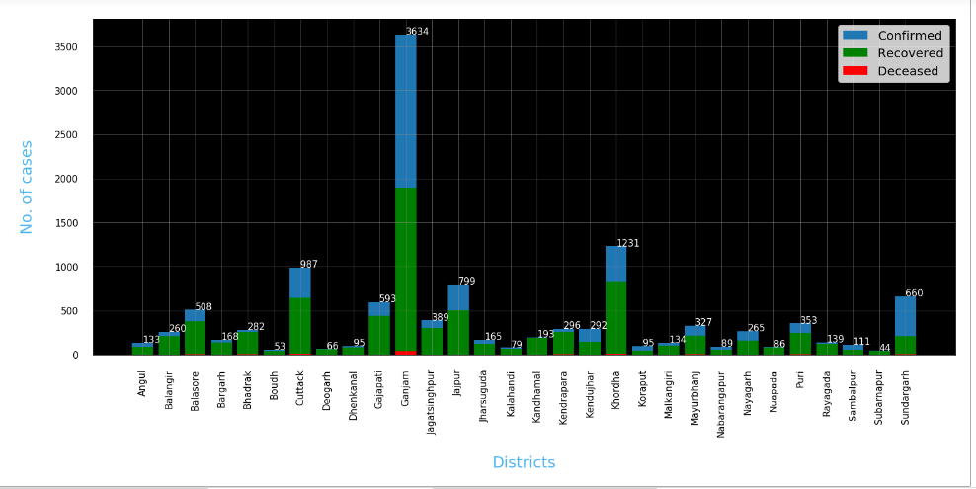
Question 1- Present state analytics – Odisha
Ganjam district of Odisha has higher reported, recovered and deceased cases of COVId19 and followed up with Khorda

Slide 2
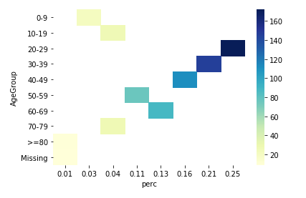
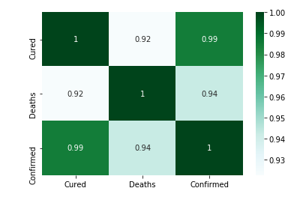
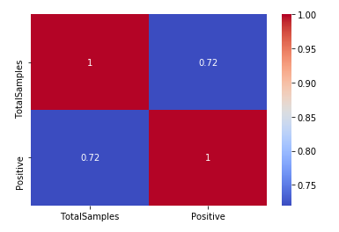
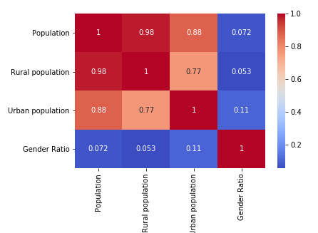
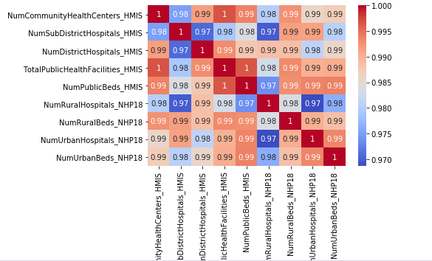
Question 2- Correlation heat map for various parameters
Age wise details- 25% cases reported among age group of 20-29 age group, with 172 counts followed with 21% in age bracket of 30-39 age with 146 cases
Covid19 cases- strong positive relationship between confirmed/cured- 99% whereas in case of death its 94%
Population- Rural/Urban/gender ratio-
Hospital facilities-
Testing details- out of total samples, 72% cases are tested COVID19 positive

Slide 3
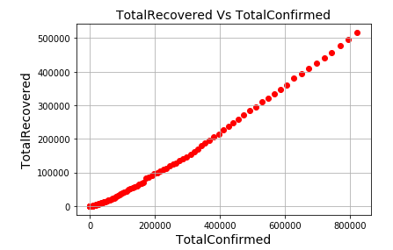
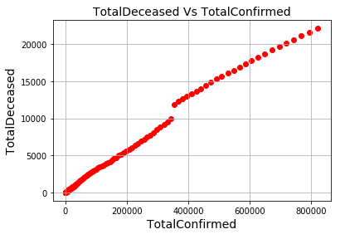
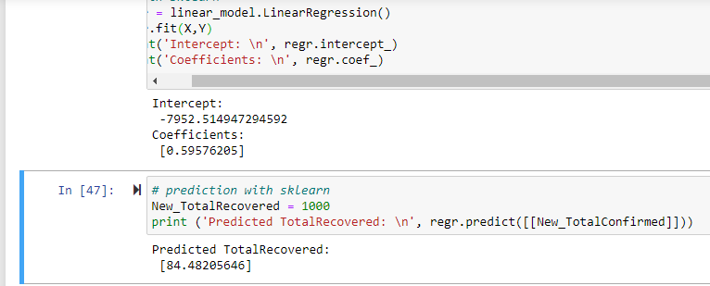
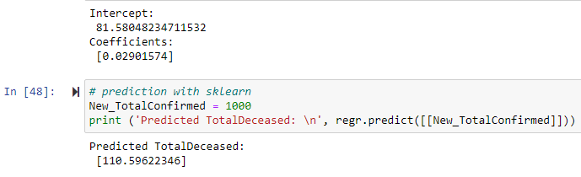
Question 3- Build a model for predicting the confirmed and recovered on any dates past 15th July 2020
Based on the model- out of new 1000 cases, 84 would be recovered and 110 will be deceased

