Slide 1
GearVR Framework Tutorial
Lesson 2: Application Structure and the Scene Graph

Slide 2
GearVRf Approach
GearVRf is a framework
Controls the flow of execution
Application responds to events via callbacks
Scripts can be attached to scene objects
3D Graphics represented as a scene graph
Application does not make OpenGL calls
Instead it constructs data structures describing 3D objects
GearVRf takes care of all the graphics and animation

Slide 3
GearVRf Application Structure
SampleActivity
onCreate
onKeyXXX
Subclass GVRActivity
override onCreate to start your application
override onTouch to capture touch events
Supply XML settings file
Subclass GVRMain
override onInit to construct your 3D scene
Every activity has a GVRViewManager
task scheduling
3D rendering
animation
GVRViewManager
drawing
animation
camera control
scene management
SampleViewManager
onInit: create scene
onStep: per frame
GVRActivity
application
keyboard
setup
GVRMain
splash screen
GVRContext
scheduling
asset loading
IScriptEvents
onInit
onStep
GVRSceneObject
3D transform
culling
level of detail
hierarchy
GVRScene
scene management
camera
GVRSceneObject
GVRSceneObject

Slide 4
Application Startup
public class MYActivity extends GVRActivity { MYMain main = new MYMain(); @Override protected void onCreate(Bundle icicle) { super.onCreate(icicle); setMain(main, "gvr.xml"); } @Override public boolean onTouchEvent(MotionEvent event) { main.onTouchEvent(event); return super.onTouchEvent(event); } }

Slide 5
Setting up the Camera Rig
GVRCameraRig has a GVRCamera for each eye
GVRCamera has background color and render mask
They can be set independently for each eye
GVRCameraRig and it’s children track the user’s head motion
This example sets the background color for both eyes to white and attaches a textured square to act as a head tracking cursor
public void onInit(GVRContext gvrContext)
{ GVRScene scene = gvrContext.getNextMainScene(); scene.getMainCameraRig().getLeftCamera().setBackgroundColor(1.0f, 1.0f, 1.0f, 1.0f); scene.getMainCameraRig().getRightCamera().setBackgroundColor(1.0f, 1.0f, 1.0f, 1.0f); GVRSceneObject headTracker = new GVRSceneObject(gvrContext, gvrContext.createQuad(0.1f, 0.1f), gvrContext.loadTexture(new GVRAndroidResource(gvrContext, R.drawable.headtrackingpointer))); headTracker.getTransform().setPosition(0.0f, 0.0f, -1.0f); headTracker.getRenderData().setDepthTest(false); headTracker.getRenderData().setRenderingOrder(100000); scene.getMainCameraRig().addChildObject(headTracker); }

Slide 6
The Scene Graph
3D scene is a tree of 3D objects
GVRSceneObject is a node in the tree
It has children (GVRSceneObjects)
It has components (GVRComponents)
Only one type of component per object
GVRTransform 4x4 matrix relative to parent
GVRRenderData what to render
GVRMesh indexed triangle mesh (shape)
GVRMaterial material properties (appearance)
GVRCameraRig tracks head movement
GearVRf examines the scene graph every frame and renders the visible objects
More than 100 renderable objects not recommended
Scene objects
components
GVRSceneObject
3D transform
culling
level of detail
hierarchy
GVRTransform
4x4 matrix
GVRMesh
vertices
triangles
bones
GVRRenderData
mesh
material
render properties
GVRMaterial
color
texture
shader
GVRSceneObject
GVRSceneObject

Slide 7
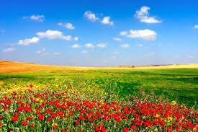
Scene Object Example 1
This example makes a large sphere, loads a cube map texture and applies it. The viewer is inside the sphere looking out. It also adds a light from above to emulate sunlight.
GVRSceneObject makeBackground(GVRContext context) { Future<GVRTexture> tex = ctx.loadFutureCubemapTexture(new GVRAndroidResource(context, R.raw.lycksele3)); GVRMaterial material = new GVRMaterial(context, GVRMaterial.GVRShaderType.Cubemap.ID); material.setMainTexture(tex); GVRSphereSceneObject environment = new GVRSphereSceneObject(context, 18, 36, false, material , 4, 4); environment.getTransform().setScale(20.0f, 20.0f, 20.0f); GVRDirectLight sunLight = new GVRDirectLight(context); sunLight.setAmbientIntensity(0.4f, 0.4f, 0.4f, 1.0f); sunLight.setDiffuseIntensity(0.6f, 0.6f, 0.6f, 1.0f); environment.attachComponent(sunLight); return environment; }

Slide 8
Scene Object Example 2
This example shows how to render a transparent sphere. To enable transparency you need to enable alpha blending and set the rendering order in the GVRRenderData. The rendering order controls when an object is rendered. Transparent objects are drawn after opaque ones.
By default the camera is at the origin looking down the negative Z axis. This example moves the object backwards so it is visible.
GVRSceneObject makeBalloon(GVRContext context) { GVRSceneObject sphere = new GVRSphereSceneObject(context, true); GVRRenderData rdata = sphere.getRenderData(); GVRMaterial mtl = new GVRMaterial(context); mtl.setDiffuseColor(1.0f, 0.0f, 1.0f, 0.5f); sphere.setName("balloon"); rdata.setShaderTemplate(GVRPhongShader.class); rdata.setAlphaBlend(true); rdata.setMaterial(mtl); rdata.setRenderingOrder(GVRRenderingOrder.TRANSPARENT); sphere.getTransform().setPositionZ(-3.0f); return sphere; }

Slide 9
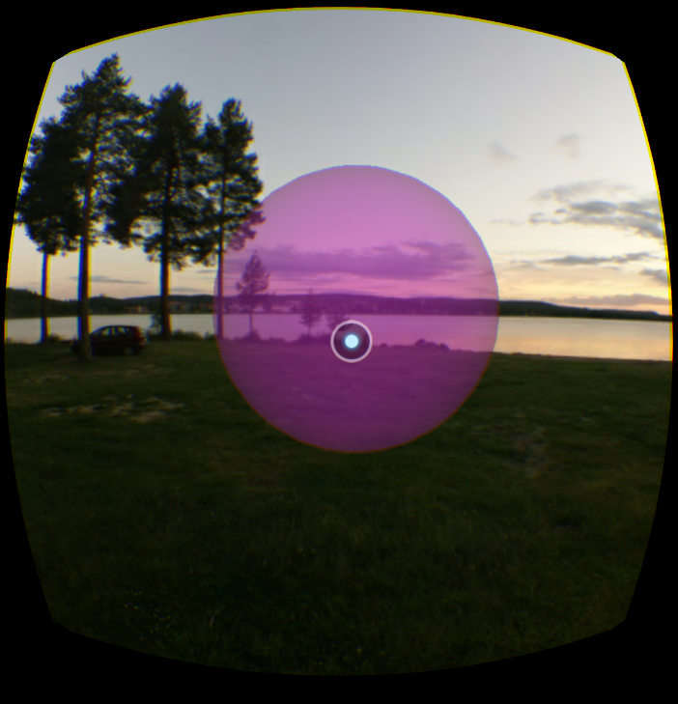

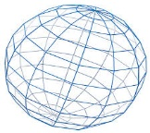

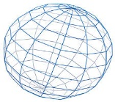
Lesson 2 Scene Graph
Transform
GearVRF constructs this part
Left
camera
Transform
Center
camera
Transform
root
camera
rig
Transform
CameraRig
Right
camera
Transform
Mesh
headtracker
Transform
RenderData
Material
environment
Transform
RenderData
DirectLight
balloon
Transform
RenderData
Mesh
Material
Mesh
Material

