Slide 1
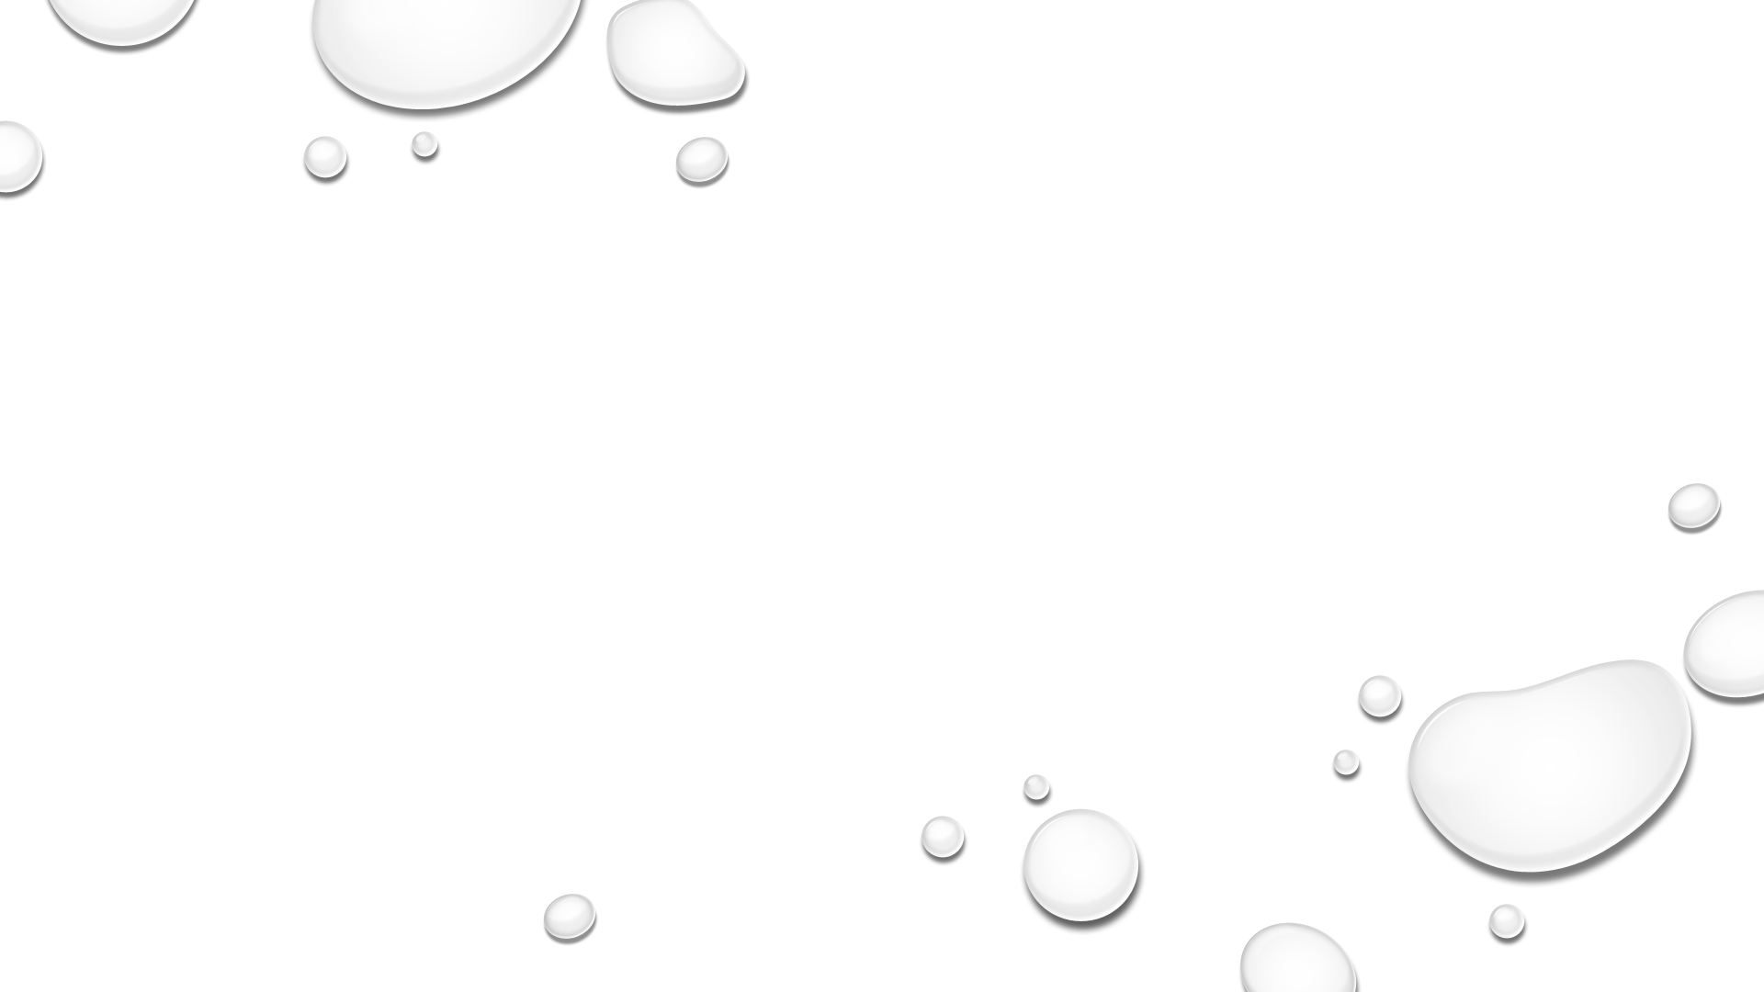
Water Potability Prediction Model
Tyler Meester
Data Science Capstone Project, August 2021

Slide 2
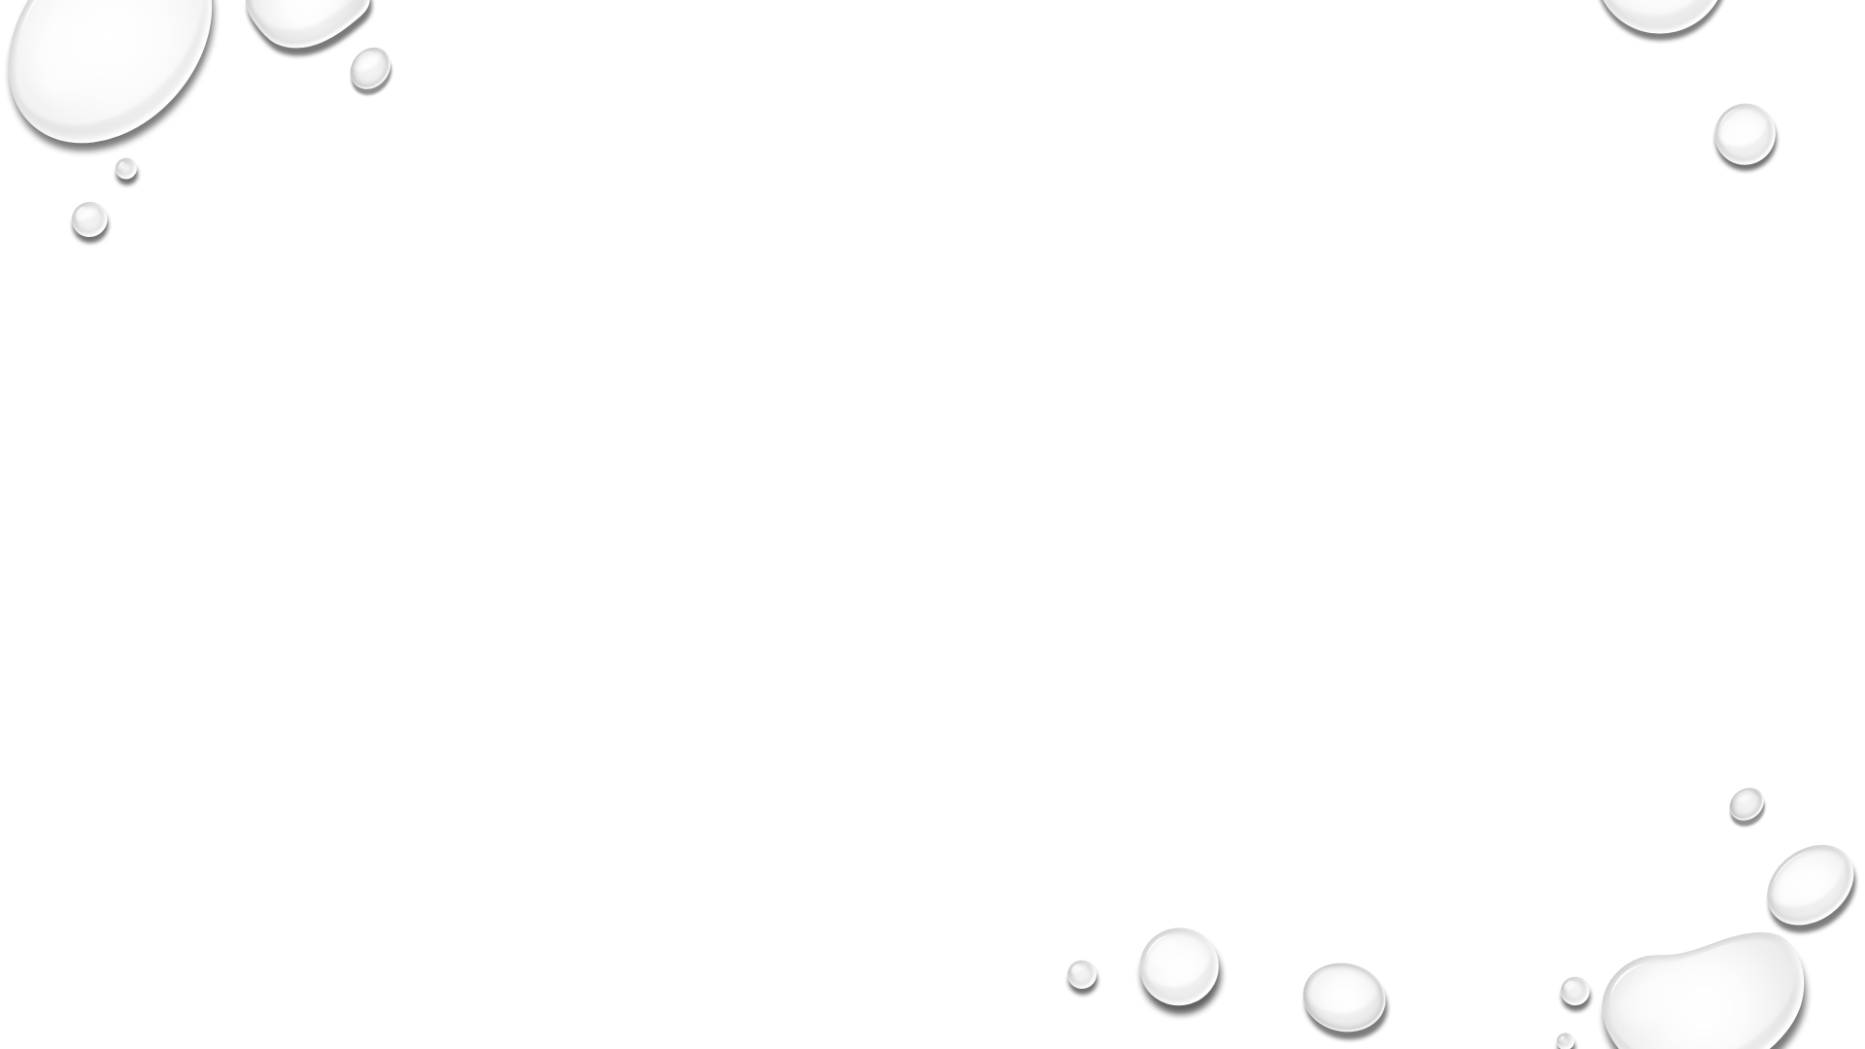
The Problem
Water is arguably the most essential resource for civilization, yet countries around the world struggle to find water that is safe for consumption.
Nearly 800 Million people (10% of the global population) do not have access to safe drinking Water, which severely impacts economic growth and health.

Slide 3
The Problem
As more and more people strive to enter the developed world, we need to be able to quickly assess whether water is potable.
Securing healthy drinking water is a crucial first step in helping to lift a community out of poverty.

Slide 4
Who will use the model?
This model will be useful for non-profit organizations and governments to help secure healthy drinking water for poverty stricken communities
This model could even be incorporated into a cheap water testing process that would allow communities to check the water potability of their own water sources.

Slide 5
Data Information
The data for this project was acquired through Kaggle, a repository for datasets on various subjects.
The CSV file contains water quality metrics for 3276 different bodies of water (location data not included), metrics included in the original dataset are:
Ph Value
Hardness
Total Dissolved Solids
Chloramines
Sulfate
Conductivity
Organic Carbon
Trihalomethanes
Turbidity

Slide 6
Methods
To solve this problem I created a binary classification model to predict whether a water source is potable or non-potable.
It is more important to correctly identify non-potable water sources and avoid False positives. I want to limit describing water as potable when it is not. Thus, the model was optimized for ‘precision’.
Models that were tested and compared were:
Random Forest Classifier
Bagging Classifier
Gradient Boosting Classifier
Kneighbors Classifier
Logistic Regression

Slide 7
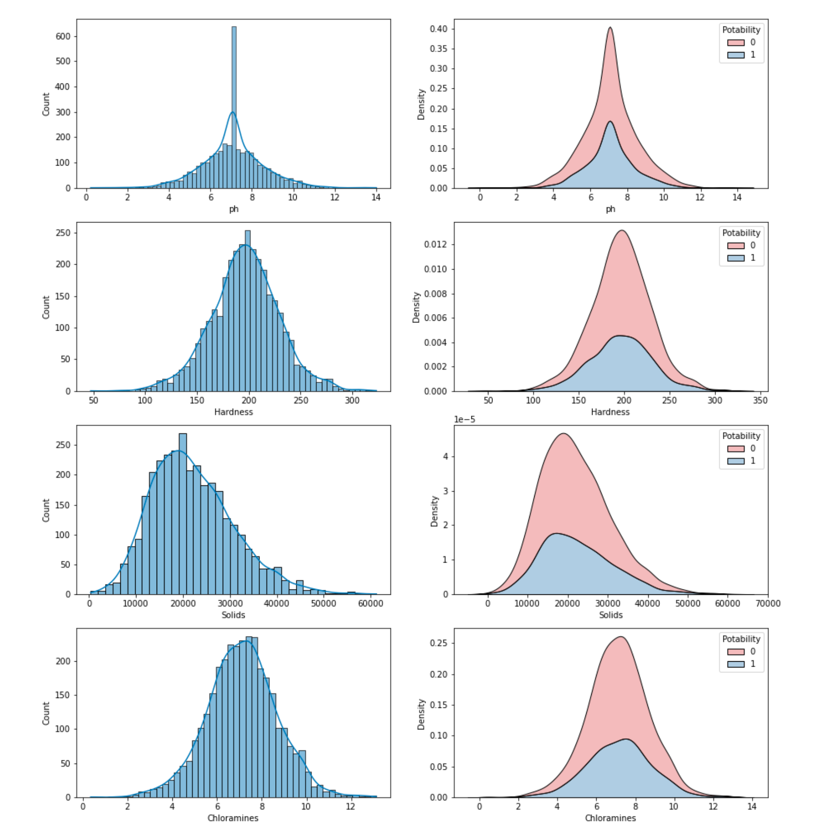
EXPLORATORY
DATA ANALYSIS
The Histograms of the data show that most features follow a normal distribution, which makes preprocessing the data much easier

Slide 8
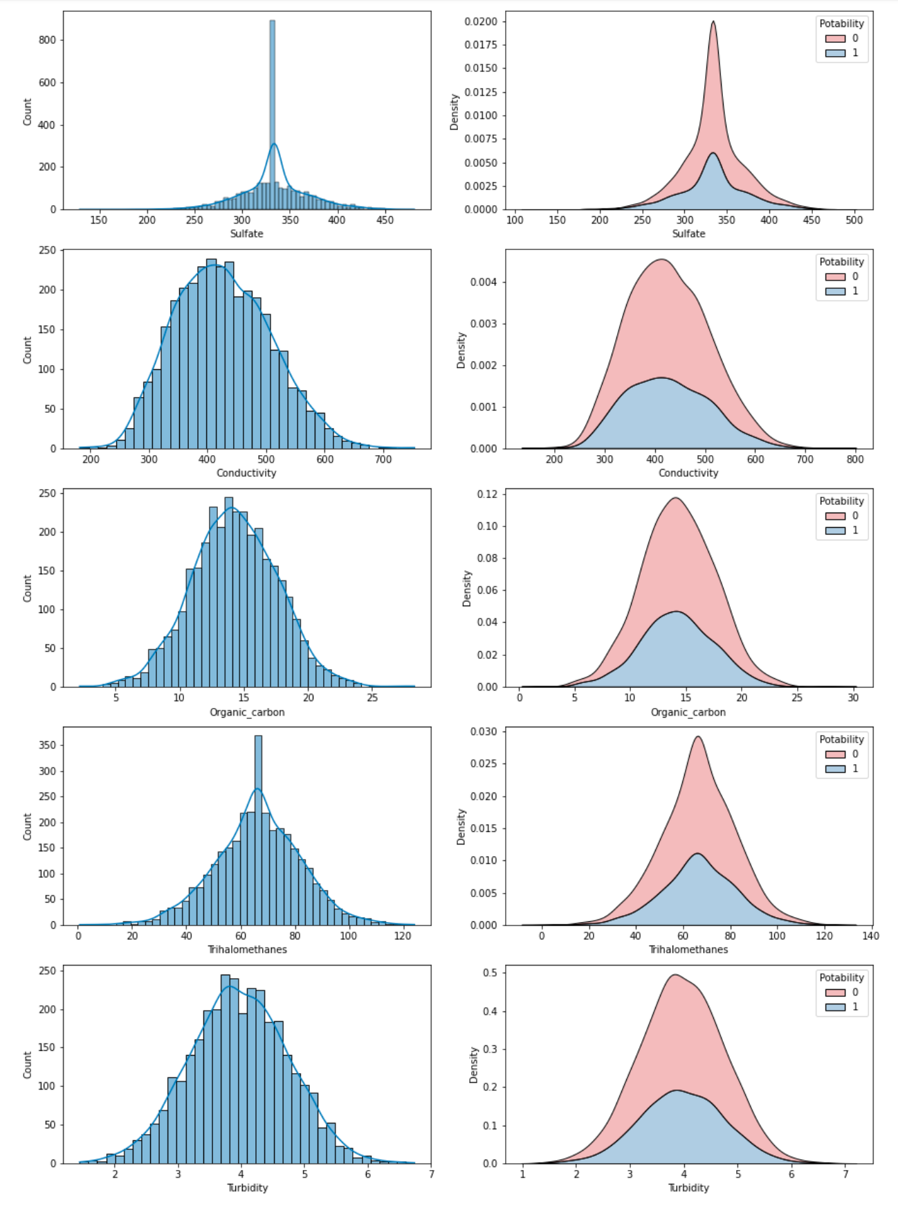
EXPLORATORY
DATA ANALYSIS
The Histograms of the data show that most features follow a normal distribution, which makes preprocessing the data much easier

Slide 9
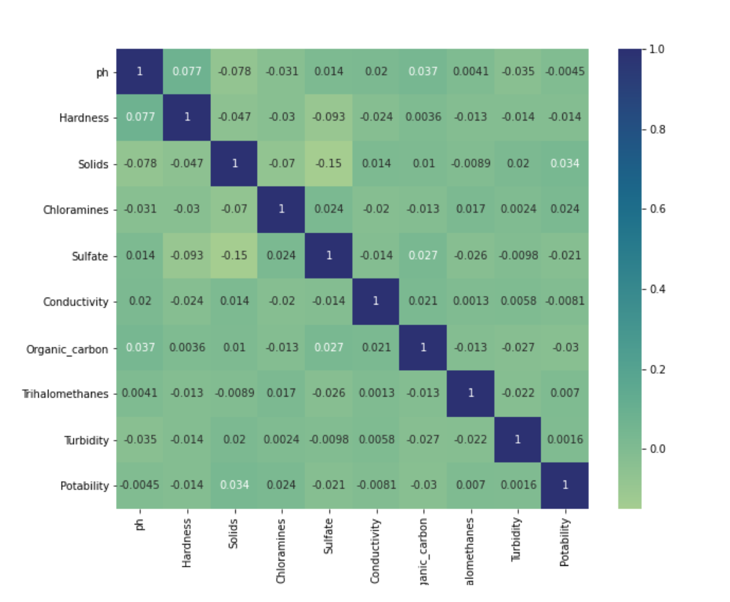
EXPLORATORY
DATA ANALYSIS
From this Correlation heatmap we can see that there isn’t one particular feature that is highly correlated with water potability

Slide 10
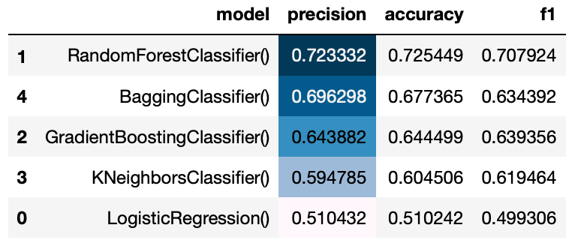
Generic Model Performances
After visually exploring the data, I tested various models
to assess which ones would be the best to hyperparameter tune. Random Forest Classifier, Bagging Classifier, and Gradient Boosting Classifier were the most effective generic models.

Slide 11
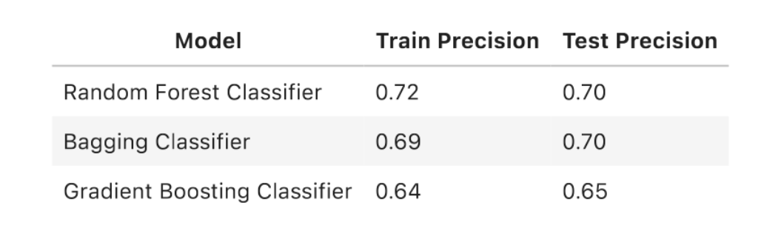
Hyperparameter Tuning
After tuning the hyperparameters of the three most effective models, the Random Forest Classifier was the best performing model with a test precision of 70%.

Slide 12
Future improvements
There is a lot of room for improvement with this model, but I believe that it would require the incorporation of additional data.
Location data would probably be very informative for the model and would improve performance.

