Slide 1

INSY 5392 Probability Modeling in R
Meet Chauhan
1001529779

Slide 2
Data
Three Independent Variables
AdSpent: Money spent on Advertisement
Rebate: certain part of the purchase amount is returned to the buyer by the seller
Xmas: Binary Data(Dummy Variable)
0: Not a Christmas Time
1: Is a Christmas Time
Dependent Variable
Sales

Slide 3
Sales VS Rebate

Slide 4
Sales VS Adspent

Slide 5
Sales VS Xmas

Slide 6
What to Analyze?
Dependent Variable: Sales
Independent Variables:
Adspent (Continuous)
Xmas(Categorical)
Rebate (Continuous)

Slide 7
Where To Start?
Simple Thing First
Linear Model: sales = a + b (price) + c (promotion) + d (ad spend) + e
Not Enough!
We need to consider diminishing returns as well as interaction within parameters

Slide 8
The Model
Full Model : (b0 + b1 * ((1-exp(-r1*rebate))/r1) + b2 * ((1-exp(r2*adspent))/r2) + b3*xmas + b4*rebate*adspent + b5*rebate*xmas + b6*adspent*xmas)
R1 : Diminishing Return on Rebate
R2: Diminishing Return on AdSpent
We also add 3 interaction term in the model

Slide 9
Results
Coefficients | P Values
Intercept | 0
Rebate | 0
AdSpent | 0
Xmas | 0
Rebate * Adspent | 0.2286087
Rebate * Xmas+3 | 0
AdSpent * Xmas | 0
Diminishing Return on Rebate | 0
Diminishing Return on AdSpent | 0.1431134

Slide 10
Final Model
We can remove Rebate*AdSpent and Diminishing return on AdSpent as they are Insignificant
Final Model: (b0 + b1 * ((1-exp(-r1*rebate))/r1) + b2 * adspent
+ b3*xmas + b5*rebate*xmas + b6*adspent*xmas)

Slide 11
Final Model Result
Parameters | Value of Coefficient
Slope | 1885.68922663
Rebate | 74.15886280
AdSpent | 0.21978408
Xmas | 176.24262743
Rebate * Xmas | -39.06704160
AdSpent * Xmas | -0.04720981
Diminishing Return on Rebate | 0.08463514

Slide 12
Business Conclusions
As R2 is insignificant, we can conclude that there is no diminishing factor on AdSpent.
This means Sales and AdSpent are linearly related
In other words, the more we spent on Adverstisement, the more the sales will be

Slide 13
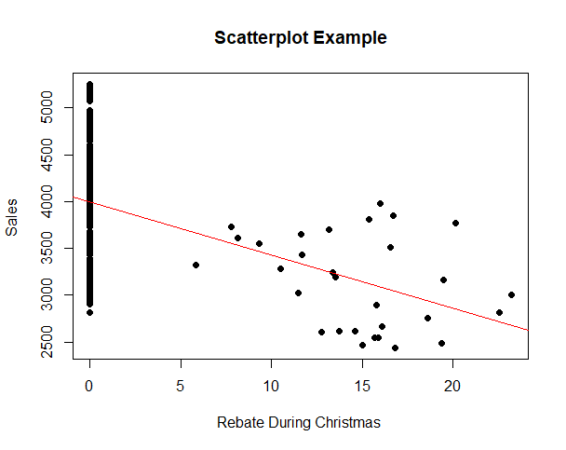
Business Conclusions
Rebate * Xmas has negative cooficent value. This means, for every $1 of rebate during Christmas, the sales will decrease by around $39
Lesson Learned: No Rebate during Christmas!!!

Slide 14
Business Conclusions
AdSpent * Xmas also has negative coefficient value. This means, for every $1 spent on Adverstisement during Christmas, the sales will decrease by around 5 Cents
Lesson Learned: No Advertisement during Christmas!!!

Slide 15
Thank You

