Slide 1
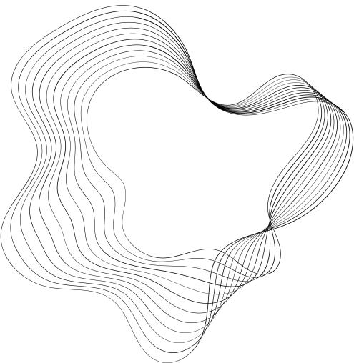

DIGITAL MARKETING CAMPAIGN CONVERSION PREDICTION
MEET DODIYA

Slide 2


This project aims to develop a machine learning model to predict customer conversions in digital marketing campaigns. By analyzing demographic and engagement data, the model will enhance campaign targeting, increase conversion rates, and maximize ROAS. Through data exploration, feature engineering, and applying various classification models, the project will provide insights to optimize marketing strategies and improve campaign performance.

Slide 3

OBJECTIVES:
DATA EXPLORATION: CONDUCT COMPREHENSIVE EDA USING VISUALIZATION TECHNIQUES TO UNDERSTAND FEATURE DISTRIBUTIONS AND RELATIONSHIPS WITH SURVIVAL OUTCOMES.
Feature Engineering: Apply appropriate scaling techniques for numerical variables and consider feature importance analysis. And adding new features with using of dataset columns for better performance.
Model Selection: Evaluate various classification algorithms including Logistic Regression, Decision Tree, Random Forest, Gradient Boosting and XGBoost.
Performance Evaluation: Use appropriate metrics such as accuracy, Classification Report, Confusion Mstrix to assess model performance.
Visualization: Create clear and informative visualizations using libraries like matplotlib and seaborn to communicate survival analysis results and model performance.

Slide 4


Work-Flow
1
INTRODUCTION
6
MODEL TRAINING
2
QUESTION
7
MODEL SELECTION
2
3
DATASET OVERVIEW
8
MODEL DEPLOYMENT
4
EDA
9
DASHBOARD
5
PREPROCESSING
10
CONCLUSION

Slide 5
INTRODUCTION
This project leverages machine learning to predict customer conversions in digital marketing campaigns. By analyzing demographic and engagement factors, the model aims to improve targeting, increase conversion rates, and optimize Return on Advertising Spend (ROAS). Through data exploration, feature engineering, and model evaluation, the project provides actionable insights to enhance campaign performance and maximize marketing efficiency.

Slide 6

2. QUESTION
Does the model predict of a customer will convert(desired action in campaign like making purchase, subscribing newsletter, signing up for service, download app) or not?

Slide 7
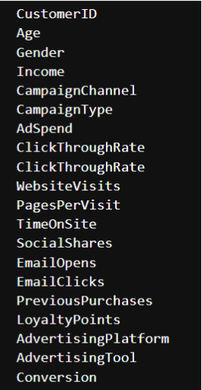
3. DATASET OVERVIEW
8000 rows
Data set
20 columns
Features
(columns)
Input Features
X
19 COLUMNS
Output variables
Y
Overall Conversion Status

Slide 8
4. EDA
For our Exploratory Data Analysis (EDA), we'll take it in two main steps:
1. Univariate Analysis:
Here, we'll focus on one feature at a time to understand its distribution and range.
2. Bivariate Analysis:
In this step, we'll explore the relationship between each feature and the target variable. This helps us figure out the importance and influence of each feature on the target outcome.
---> With these two steps, we aim to gain insights into the individual characteristics of the data and also how each feature relates to our main goal: predicting the target variable.

Slide 9
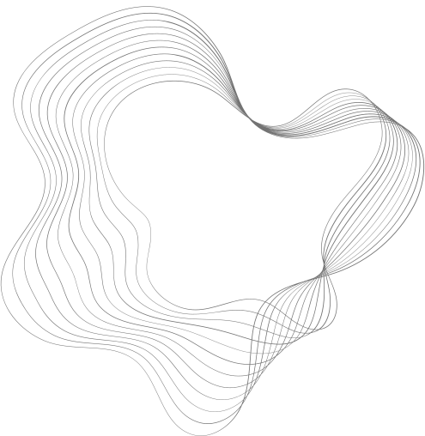
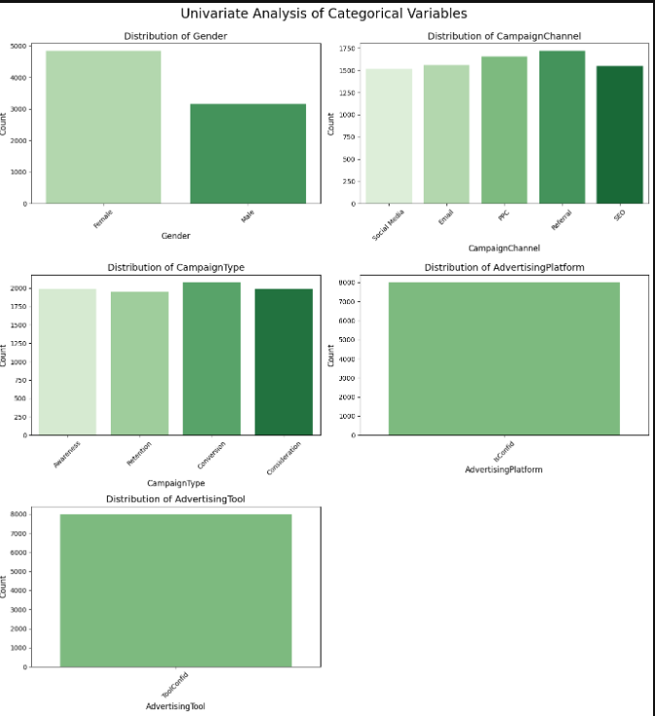
UNIVERSAL ANALYSIS

Slide 10
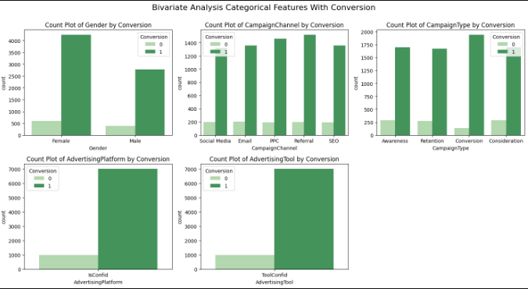
BIVERIATE ANALYSIS

Slide 11

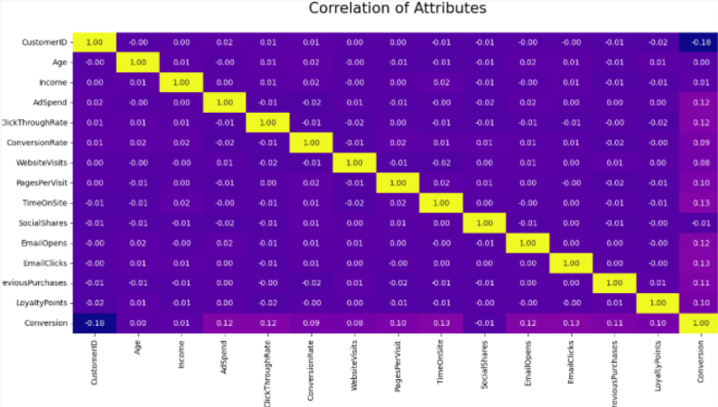
CORRELATION OF ATTRIBUTES

Slide 12
CUSTOMERID: HAS NO SIGNIFICANT CORRELATION WITH OTHER VARIABLES.
Age: Shows a weak positive correlation with Income and Click Through Rate.
Income: Exhibits a weak positive correlation with Click Through Rate, Conversion Rate, and Loyalty Points.
AdSpend: Has a strong positive correlation with Click Through Rate.
Click Through Rate: Shows a strong positive correlation with Conversion Rate.
Conversion Rate: Shows a weak positive correlation with Website Visits and Pages Per Visit.
Website Visits: Has a weak positive correlation with Pages Per Visit, Time On Site, and Conversion Rate.
Pages Per Visit: Exhibits a weak positive correlation with Time On Site, Social Shares, and Conversion Rate.
Time On Site: Shows a weak positive correlation with Social Shares and Conversion Rate.
Social Shares: Shows a weak positive correlation with Email Opens, Email Clicks, and Conversion Rate.
Email Opens: Has a weak positive correlation with Email Clicks and Conversion Rate.
Email Clicks: Shows a weak positive correlation with Previous Purchases, Loyalty Points, and Conversion Rate.
Previous Purchases: Has a weak positive correlation with Loyalty Points and Conversion Rate.
Loyalty Points: Shows a strong positive correlation with Conversion Rate

Slide 13



PREPROCESSING
Irrelevant Feature Removal:
All features in the dataset appears to be relevant based on EDA, CustomerId and Conversionrate So I removed this Column.
Missing Value Treatment:
In our dataset there is no any missing values, but when missing values appears we fill them with mean, median and mode.
Outlier Treatment:
In our dataset there is not any outlies available, we can handle outlier with z-score method, IQR etc.
create a dummies:
To use a standardization to transform data into binary first we need to convert categorical columns data using dummy function so I created dummies for that columns and then done standard scaler.

Slide 14

6.MODEL TRAINING
Logistic Regression: logistic Regression is commonly used for binary classification problems. it's preferred because it provides a simple an efficient way to model the relationship between the independent variables and the probability of a certain outcome.
Decision Tree: Decision Tree algorithms are used for classification because they are simple, computationally efficient, and effective in handling high-dimensional data.
Works best for categorical independent columns.
Random Forest Algorithm: Random Forest: Random Forest is a robust supervised algorithm suitable for both regression and classification tasks.
Gradient Boosting: Gradient boosting is a machine learning algorithm that builds multiple decision trees sequentially, where each tree corrects the errors of the previous one to improve model’s accuracy.
XGBoost: XGBoost is an optimized version of gradient boosting that improves speed, accuracy, and efficiency, often used for classification and regression tasks.

Slide 15
7. MODEL SELECTION
Model | Accuracy | Precision | Recall | F1-Score
LOGISTIC REGRESSION | 0.94 | 0.73 | 0.87 | 0.80
DECISION TREE | 0.98 | 1.00 | 0.84 | 0.92
RANDOM FOREST | 0.97 | 0.94 | 0.84 | 0.89
GRADIENT BOOSTING | 0.98 | 0.88 | 0.99 | 0.93
XGBoost | 0.99 | 0.99 | 0.97 | 0.98

Slide 16
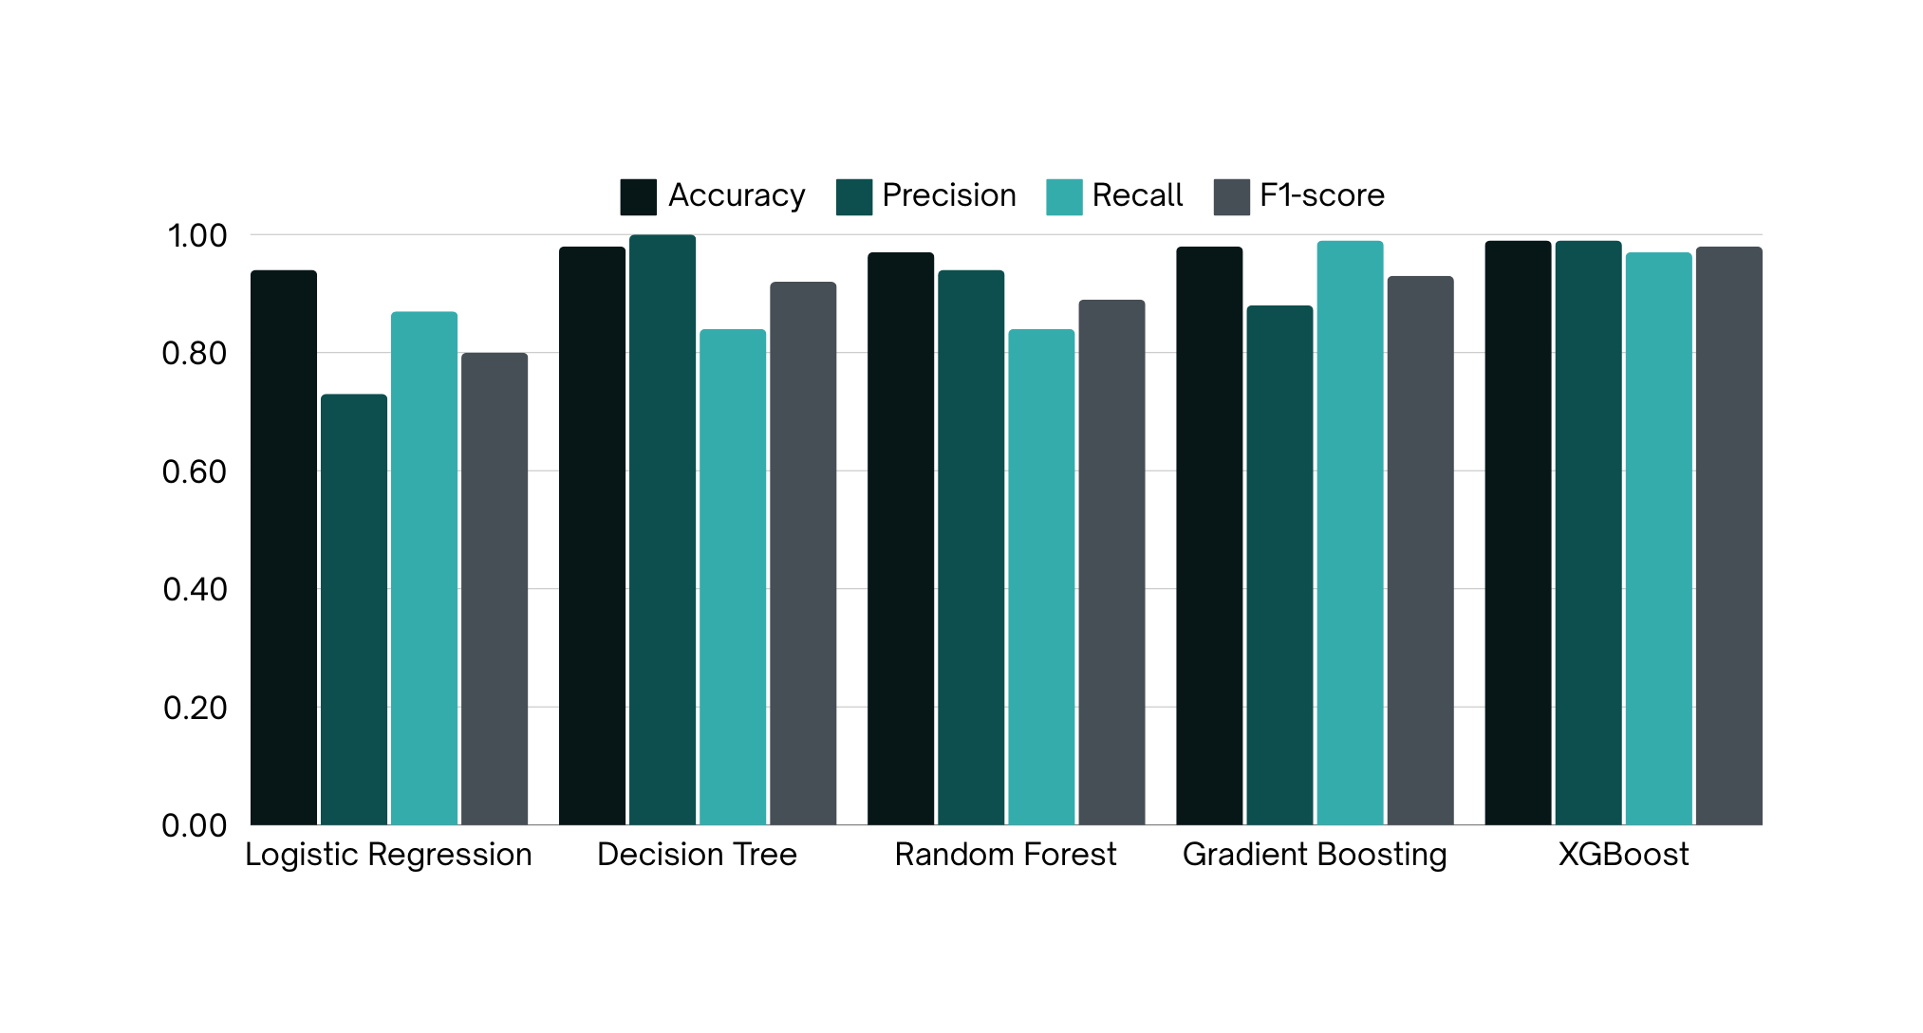
MODEL COMPARISON

Slide 17
8. MODEL DEPLOYMENT
Digital Marketing Campaign Classification Web App
Built an interactive web application using Streamlit to classify digital marketing campaign outcomes.
Allows users to upload a CSV file and explore the dataset with summary statistics, data visualizations, and feature engineering.
Displays preprocessing steps like handling missing values, feature scaling, and encoding categorical variables.
Users can choose from five machine learning models: Decision Tree, Random Forest, Gradient Boosting, XGBoost, and Logistic Regression.
Displays performance metrics such as accuracy, classification report, and confusion matrix for the selected model.

Slide 18
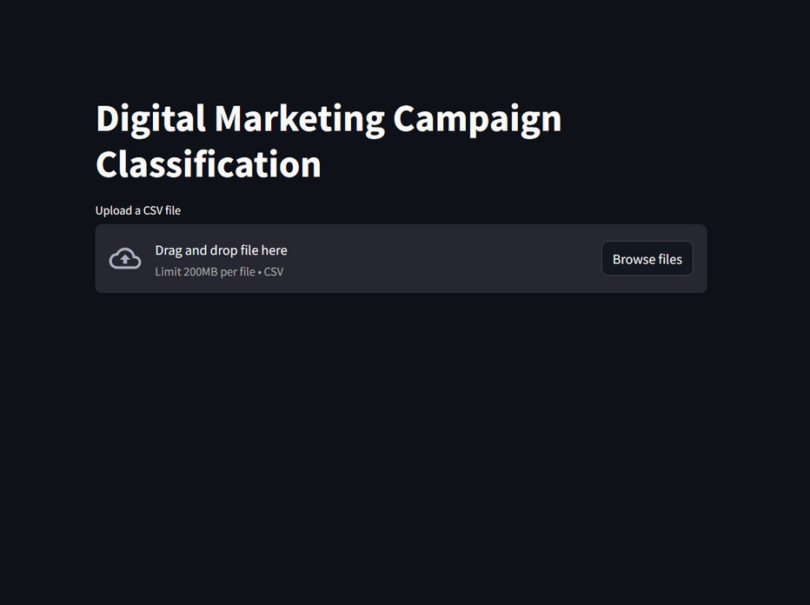
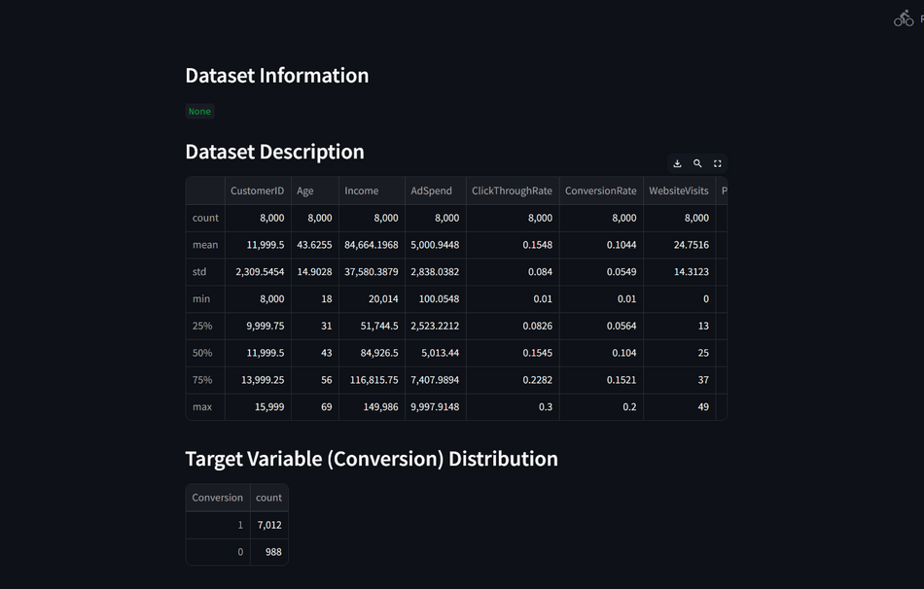
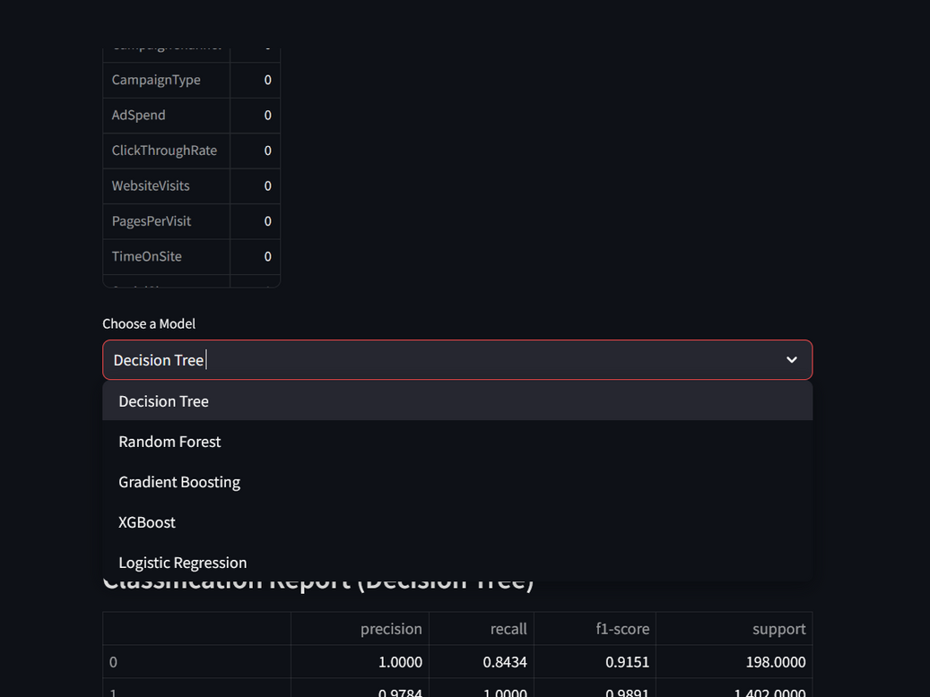
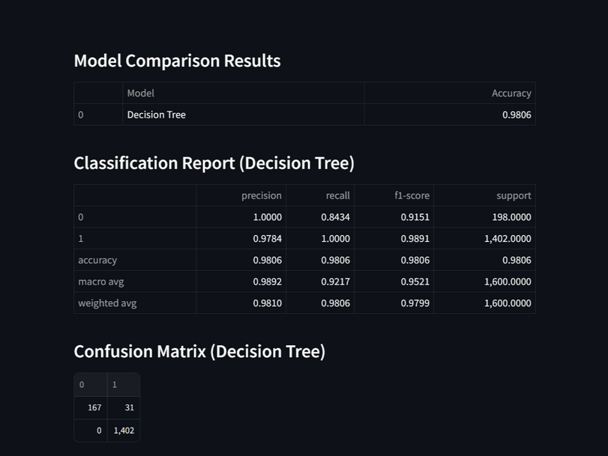

Slide 19
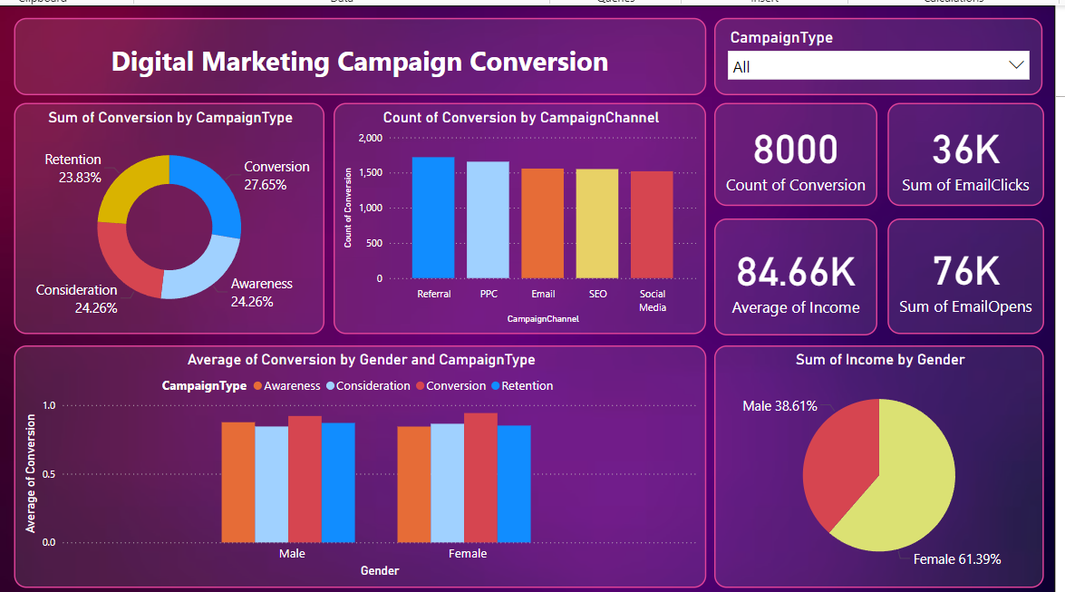
9. DASHBOARD
Digital Marketing Campaign Conversion Dashboard
Objective: To analyze and visualize the performance of various digital marketing campaigns, their conversion rates, and key influencing factors.
Use Case:This dashboard provides actionable insights to optimize campaign strategies, prioritize high-performing channels, and tailor campaigns based on demographic and income data for improved ROI.

Slide 20
10. CONCLUSION
Various machine learning algorithms were applied to predict customer conversion based on the given dataset.
The models tested include Logistic Regression, Decision Tree, Random Forest, Gradient Boosting, XGBoost.
Among these, the Decision Tree model, Gradient Boosting and XGBoost demonstrated the highest performance in terms of accuracy and robustness. This suggests that these both models particularly effective in capturing the complex relationships within the data, making it a suitable choice for this classification task.
The superior performance of these models highlights its capability to handle the nuances of customer conversion data.

Slide 21


THANK
YOU

