Slide 1
Stock Market Screener and Prediction
Using Machine Learning and Streamlit
By Meet & Team

Slide 2
Project Objective
Build an efficient Machine Learning model to predict future values of financial stocks.
Assist retail investors using a third-party web app developed with Streamlit.
Provide critical features including fundamental information, technical indicators, screeners, and pattern recognition.
Integrate historical data and visualize it dynamically.

Slide 3
Technology Stack
Programming Language: Python
Machine Learning Packages: Scikit-learn, Pandas, Numpy, Tensorflow, Keras
Data Visualization: Matplotlib, Plotly
Technical Indicators: FinTA, TALib
Data Retrieval: yfinance (OHLC data)
Web App Framework: Streamlit

Slide 4
Model Comparison
Models Trained: Moving Average, K-Nearest Neighbors, Linear Regression, LSTM.
Tested on: Large Cap (TCS), Mid Cap (Tata Motors), Small Cap (Trident).
Evaluation Metric: Root Mean Square Error (RMSE).
Result: LSTM performed incredibly well with the lowest error rates across all capitalization tiers.
Conclusion: Deployed LSTM as the primary prediction module in the final Web App.

Slide 5
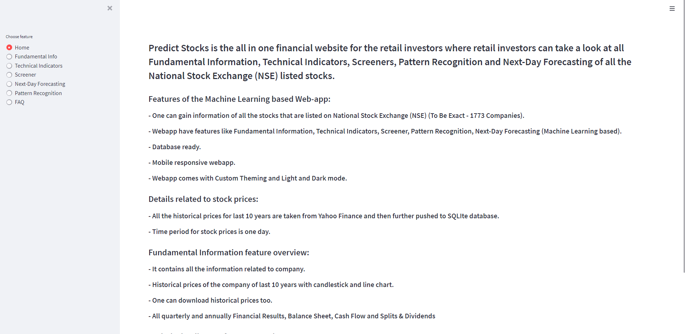
Web Application Overview
Summary: The interactive dashboard home interface showing real-time selection of stock symbols.

Slide 6
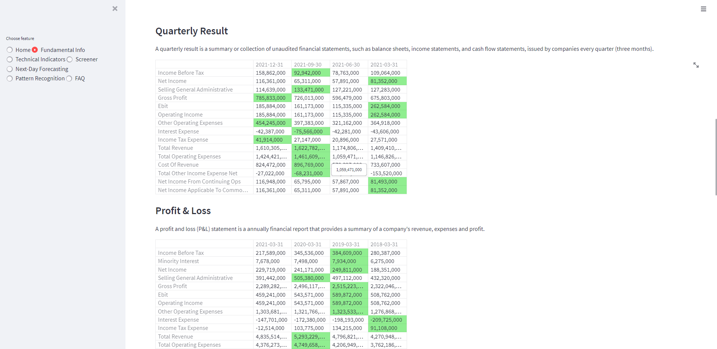
Fundamental Information Module
Summary: Detailed historical prices, balance sheet, financials, and company fundamentals visually presented.

Slide 7
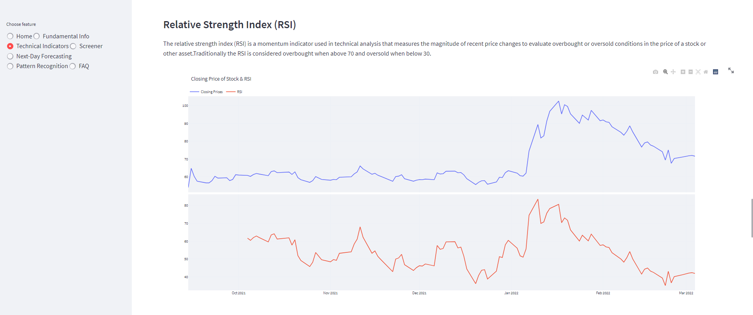
Technical Indicators Analysis
Summary: Interactive charts plotting crucial technical indicators like Moving Averages, RSI, MACD, and Bollinger Bands.

Slide 8
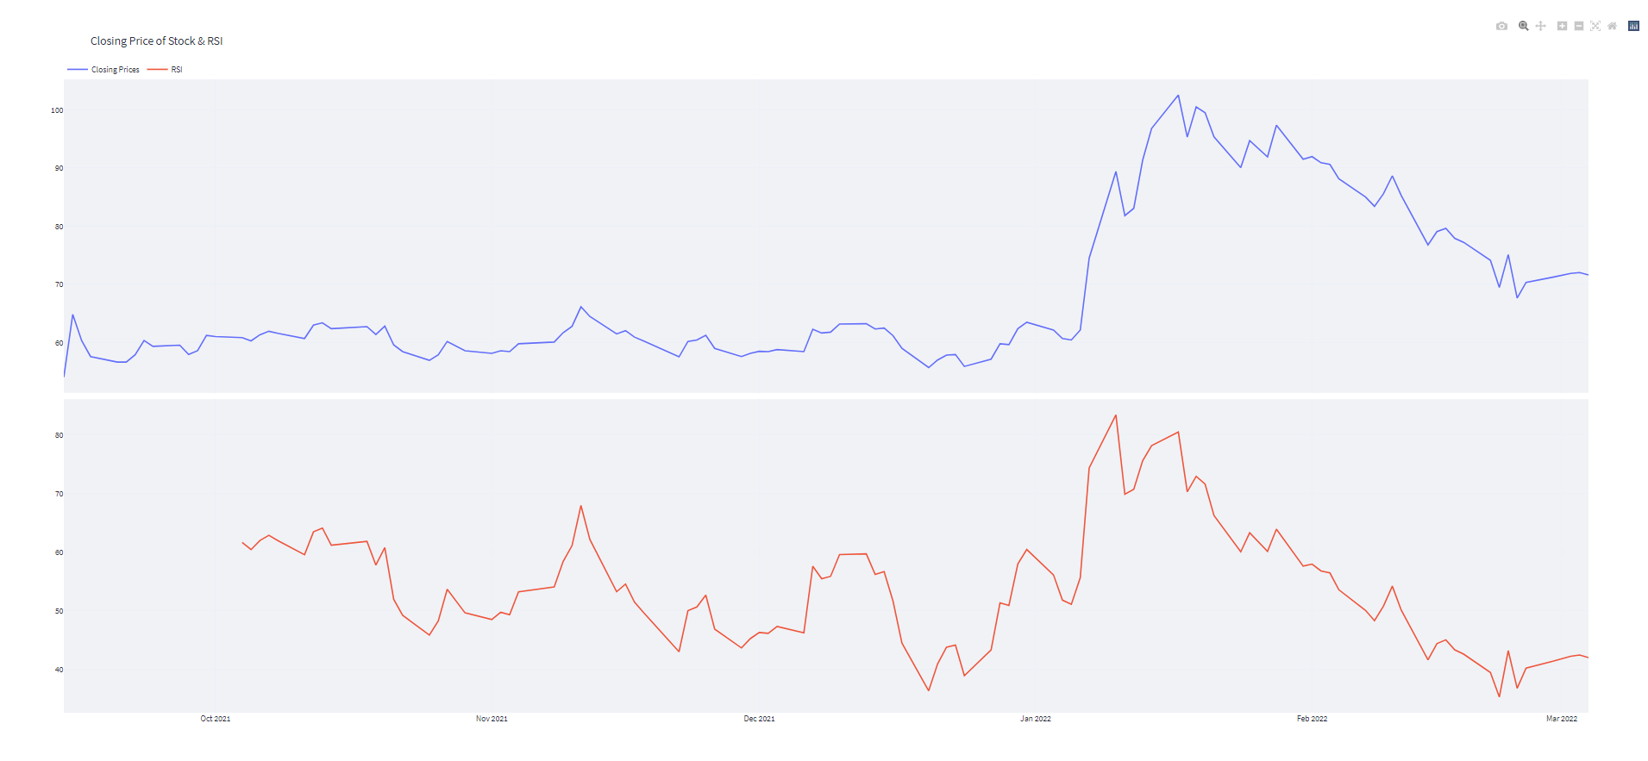
Technical Screener
Summary: Filtering parameters like 52-week highs/lows and RSI to strategically screen and select winning stocks.

Slide 9
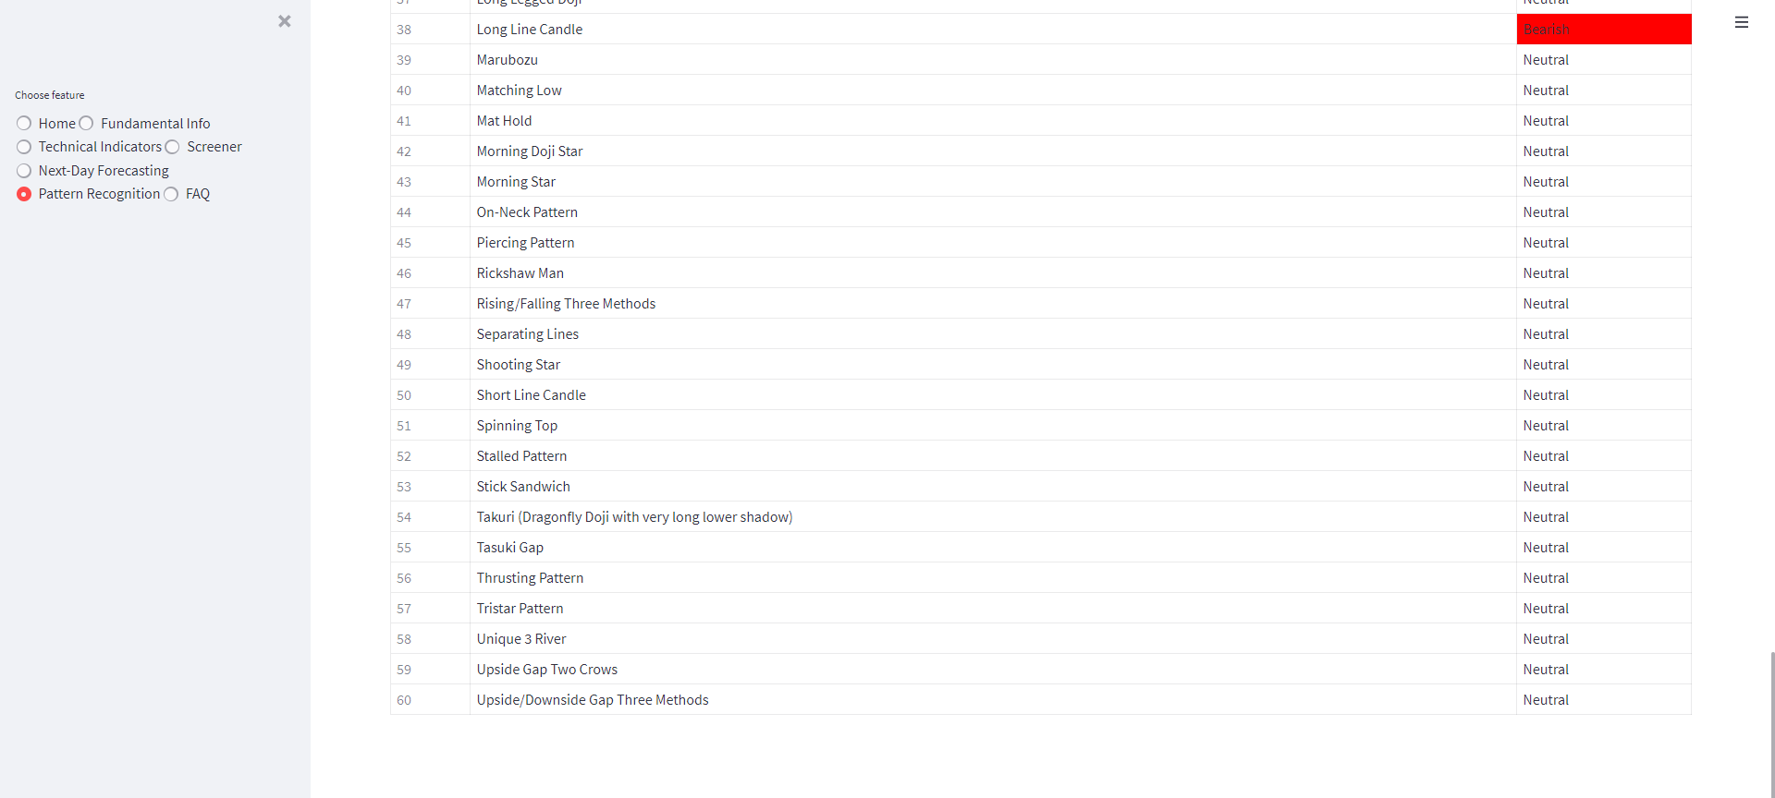
Pattern Recognition System
Summary: Automated detection of Japanese candlestick patterns, offering bullish or bearish signals instantly.

Slide 10
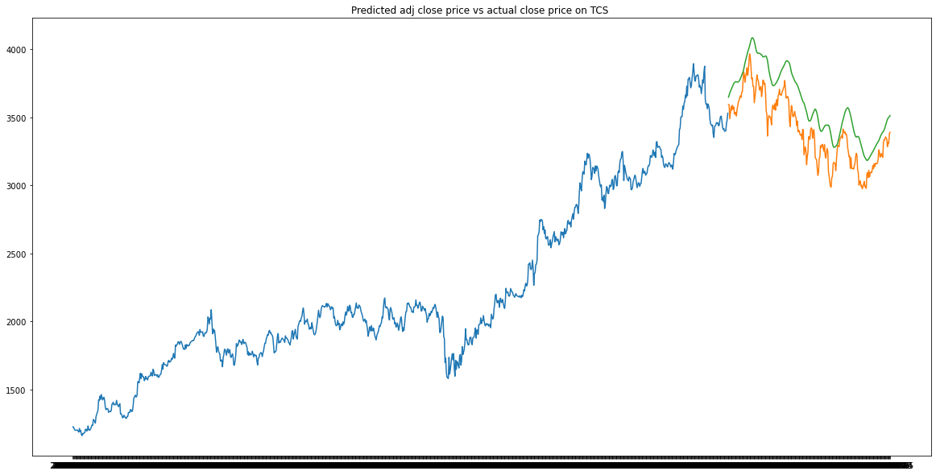
Next-Day Price Forecasting
Summary: Displaying our LSTM Deep Learning model's actual vs predicted prices on large tech stocks like TCS.

Slide 11
Limitations and Future Scope
Limitations: Stock market volatility makes extremely precise absolute prediction challenging. Physical, psychological, and irrational market behavior factors persist.
Future Scope: Expansion of prediction horizons. Currently focusing on the 1-day timeframe; future versions can accommodate intra-day (minutes) and weekly/monthly timeframes.
Future Scope: Continual model hyperparameter tuning and integration of natural language sentiment analysis.

Slide 12
Thank You
Any Questions?

