Slide 1
What is Django??

Slide 2
Django is an open-source python web framework used for rapid development, pragmatic, maintainable, clean design, and secure websites.
A web application framework is a toolkit of all components needed for application development.

Slide 3
The main goal of the Django framework is to allow developers to focus on components of the application that are new instead of spending time on already developed components.
Django is fully featured than many other frameworks on the market. It takes care of a lot of hassles involved in web development; enables users to focus on developing components needed for their application.

Slide 4
Why Django??

Slide 5
Django is built to encourage rapid development and clean, practical design. Like any web application framework, it’s a toolkit of components needed when developing a site.
Its purpose is to provide a concrete foundation of the basics, allowing developers to focus on parts of their site that are unique to their project and not waste time with the fundamental boilerplate stuff.

Slide 6
This makes it a good choice when you’re building a highly customisable app, such as a social media website.
You don’t have to worry about reinventing the wheel. Just let Django cover the basics, and focus on the unique parts you need to tweak and experiment with, such as the interaction between users, or the ability to share different types of media.

Slide 7
When you need an app that can grow in depth and complexity to any scale and is capable of handling as many visitors and/or transactions as demanded, Django shines.

Slide 8
Top Uses of Django

Slide 9
It’s fast and simple
One of Django’s main goals is to simplify work for developers. To do that, the Django framework uses:
  The principles of rapid development, which means developers can do more than one iteration at a time without starting the whole schedule from scratch
  DRY philosophy — Don’t Repeat Yourself — which means developers can reuse existing code and focus on the unique one.

Slide 10
It’s secure
Security is also a high priority for Django. It has one of the best out-of-the-box security systems out there, and it helps developers avoid common security issues, including
  clickjacking,
  cross-site scripting
  SQL injection.
Django promptly releases new security patches. It’s usually the first one to respond to vulnerabilities and alert other frameworks.

Slide 11
It suits any web application project
With Django, you can tackle projects of any size and capacity, whether it’s a simple website or a high-load web application. Why use Django for your project? Because:
  It’s fully loaded with extras and scalable, so you can make applications that handle heavy traffic and large volumes of information
  It is cross-platform, meaning that your project can be based on Mac, Linux or PC
  It works with most major databases and allows using a database that is more suitable in a particular project, or even multiple databases at the same time

Slide 12
About Django and Flask

Slide 13
Django:-
Django is a free and open-source Python web development framework that follows the Model–Template–View (MTV) pattern.
It was created in the fall of 2003 by Adrian Holovaty and Simon Willison. Django was built to simplify the website development process. It focuses on reusable components, less code, and rapid development.
It was influenced by several earlier frameworks including Zope and Plone and, in turn, has inspired lots of other frameworks that have come after it including Pyramid, CherryPy, Bottle, and Web2py.

Slide 14
Flask
Flask is a microframework that has a surprising beginning. It actually started as an April Fool’s joke.
Before Flask was developed, Armin Ronacher ― the creator of Flask ― had written two other solutions called Werkzeug (a server framework) and Jinja2 (a template library).
Armin thought it would be fun to take these two solutions and put them together in a zip file, so he wrote the Denied Framework (as he called it before named it Flask) .
When a developer install this Denied Framework, installation program automatically unzip the file and run those two solutions at the same time. Believe it or not, Flask received a positive reaction.

Slide 15
Difference Between Flask vs Django

Slide 16
ORM and Data Model
Django provides its own Django ORM (object-relational mapping) and uses data models.
while Flask doesn’t have any data models at all.
Data models allow developers to link database tables with classes in a programming language so they can work with models in the same way as database references.
Why does Flask have no data model? Because the Flask philosophy is different from the Django philosophy. Django bundles everything together, while Flask is more modular.

Slide 17
Provide Features
Django provides a full-featured Model–View–Controller framework. Its aim is to simplify the process of website development. It relies on less code, reusable components, and rapid development.
Flask, on the other hand, is a microframework based on the concept of doing one thing well. It doesn’t provide an ORM and comes with only a basic set of tools for web development.

Slide 18
Application
Flask applications are mostly single-page applications (SPAs). It’s a good choice for small and medium-sized sites such as forums and personal blogs.
Django is perfectly suited for large projects like e-commerce sites and CMSs

Slide 19
Advantages and disadvantages of these frameworks

Slide 20
Performance
Flask vs Django performance is an important indicator of system functionality. If a framework is highly performant, it will result in a scalable, speedy, and secure app. Weak performance can lead to scaling pains and architectural issues.
If we consider Django vs Flask performance both have good results and are used by high-traffic websites, which is a great indicator of their effectiveness.

Slide 21
Packages
Flask is minimalistic and has no restrictions, meaning developers can implement exactly what they want using external libraries. This makes Flask flexible and extensible.
Django, on the other hand, has a huge number of built-in packages. To be precise, there were 4,046 Django packages as of September 2019. This means you’re likely will find a package to build and run your application with less effort.

Slide 22
Community
In case of Python Django vs Flask comparison, Django has a huge and active developer community. If you have any questions, you can ask them on various web portals and forums such as Stack Overflow and are likely will get an answer. Also, it’s not hard to find a Django job.
Flask’s community is not as big as Django’s. Therefore, if you have difficulty coding in Flask or have questions about Flask, it can take a while to find answers.

Slide 23
Security
Django has options for protecting your application from the following issues:
  Cross-site scripting (XSS). XSS attacks enable an attacker to inject client-side scripts into browsers. Django templates protect your project from the majority of XSS attacks.
  Cross-site request forgery (CSRF). CSRF attacks allow a malicious user to execute actions using the credentials of another user. Django has built-in protection against most types of CSRF attacks.
  SQL injection. SQL injection is an attack where a malicious user is able to execute arbitrary SQL code on a database. Django’s querysets are protected from SQL injection since queries are constructed using parameterization.
The Flask-Security library provides almost the same mechanisms as Django to prevent data leaks and other web attacks.

Slide 24
Project Build In Django

Slide 25
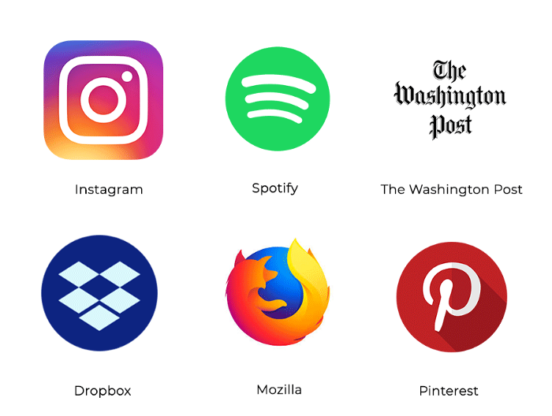

Slide 26
Project Build In Flask

Slide 27
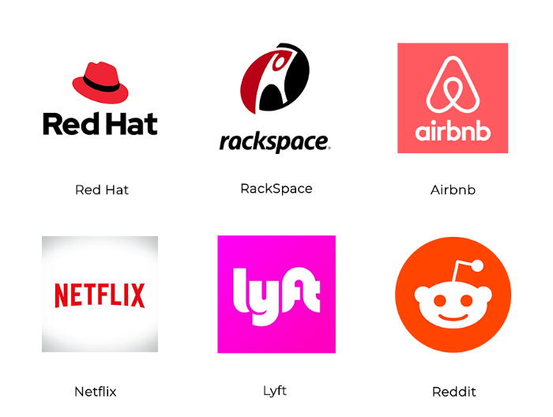

Slide 28
Dirctory Structure of Django

Slide 29
Step 1: Django Project Creation and Understanding Generated Files
$ django-admin startproject “project-name”
$ django-admin startproject django_demo
After creation of the our django project our directory structure will look like.
[projectname]/
├── [projectname]/
│ ├──__init__.py
│ ├──settings.py
│ ├── urls.py
│ └── wsgi.py
└── manage.py
[django_demo]/
├── [django_demo]/
│ ├──__init__.py
│ ├──settings.py
│ ├── urls.py
│ └── wsgi.py
└── manage.py

Slide 30
Now we will dive into the files generated automatically, why they are created , what are the purposes they will solve for our project.
__init__.py
This file is used to mark directories on a disk as a python package and add django_demo directory to the python path so that you can import the python packages and if you delete this file , python no longer look for modules inside it and your imports for python packages will fail.
settings.py
This is the master configuration file for your project. We will be connecting our mysql database. We can configure Middle wares , LDAP (Light Weight Directory Access Protocol ) Settings , Django Email Settings,Production Settings Static and Media Files Root Directory through this file only.

Slide 31
urls.py
This file can define the routes / API Endpoints itself or You can just write your Endpoints in the respective django application and include the application urls.py file here. This file will be the single point of source for finding Endpoints once the HTTP Requests come from the client side.
wsgi.py
WSGI is a standard described on PEP 3333 and basically, provides a standard interface between web applications written in Python and Webservers. That means, WSGI gives portability to your Python Web Application across many different Web Servers, without any additional configurations on your NGINX, Apache, etc.
manage.py
It’s a convenience script that allows you to run administrative tasks like runserver , createsuperuser , migrations of your database models.

Slide 32
How Django Works(workflow)?

Slide 33
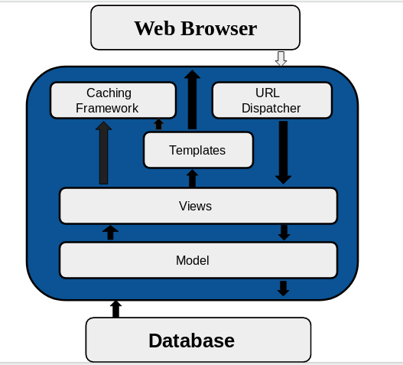

Slide 34
1. URL Dispatcher
Django gets user requests by URL locator and responds back to it. django.urls module is used by it to manage the URL’s requests. For any application in Django we create Python Module named as URLconf(URL configuration) as per Django Documentation. This module is responsible for mapping between URL path expressions to some specified view.
Syntax of the module is path(route,view,kwargs,name)
//urls.py
from django.contrib import admin
from django.urls import path
urlpatterns = [
path('admin/', admin.site.urls),
]

Slide 35
2. Views
A view is a part of your web application , which is a Python function responsible for accepting a web requests and returning corresponding web response to it. The response can be of HTML type containing HTML contents , or an image , or an XML document , or sometimes even errors like 404 error.
It is a part of our application where main logic of our application is written there ,remember that you have to link view to URL to see it as web page. For example,
//urls.py
from django.conf.urls import url
from app_name import views
urlpatterns = [
url('/load_index”', views.index ,name = 'index')
]
//view.py
from django.http import HttpResponse
def index(request):
return HttpResponse('<h1>Hello World</h1>')
Output — Hello World

Slide 36
3. Model
Django model is a class which contains certain fields and methods and every attribute of class is field of database table. Django Model is a subclass of django.db.models.Model .
Models are described in your respective applications as app_name/models.py where each model class is mapped to single table of your database . Whatever field you create in your model it will added to your database automatically , thereby reducing extra line of codes for creating table in database.
One important point to notice here is ‘id’ field is created automatically which changes with each record input by the user.

Slide 37
For example
from django.db import models
class College(models.Model):
first_name = models.CharField(max_length=50)
last_name = models.CharField(max_length=50)
Here first_name and last_name are respective class attributes and they are mapped to database as their attributes with ‘id’ as additional one.
CREATE TABLE app_college (
"id" INT NOT NULL PRIMARY KEY,
"first_name" varchar(50) NOT NULL,
"last_name" varchar(50) NOT NULL
);

Slide 38
4. Template
Django provides template system which helps to distinguish between python and html contents. Dynamic HTML pages are generated by using template system.
Here I have quoted how to write HTML content and thereby returns HttpResponse but before that you have to understand what does Render function do and what are their arguments?
Render function basically links your python code to HTML with following as arguments,
1)Request
2)Path to your template
3)Dictionary of parameters

Slide 39
For example
from django.db import models
class College(models.Model):
first_name = models.CharField(max_length=50)
last_name = models.CharField(max_length=50)
Here first_name and last_name are respective class attributes and they are mapped to database as their attributes with ‘id’ as additional one.
CREATE TABLE app_college (
"id" INT NOT NULL PRIMARY KEY,
"first_name" varchar(50) NOT NULL,
"last_name" varchar(50) NOT NULL
);

Slide 40
//view.py
from django.http import HttpResponse
from django.template import loader
def index(request):
template = loader.get_template('index.html')
context = {
}
return HttpResponse(template.render(context , request))

Slide 41
//index.html
<!DOCTYPE html>
<html>
<head>
<title>My first Program</title>
</head>
<body>
<h1>Hello World</h1>
</body>
</html>

Slide 42
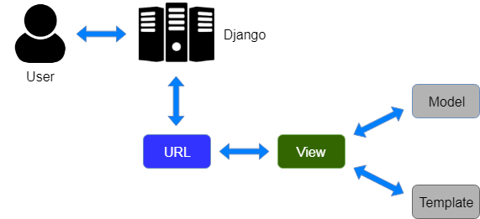

Slide 43
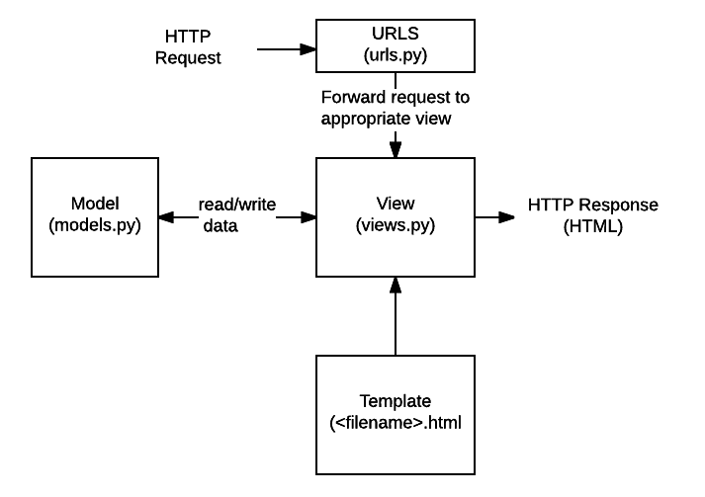

Slide 44
5. Caching Framework
For dynamic webpages , when user requests a particular page , then all following sort of queries takes place like from database queries to template rendering to business logic to make the requested page visible to user.
Sometimes it is expensive. To resolve this task caching plays an important role.
To cache something means to save the result of an expensive calculation so that you don’t have to perform the calculation next time. Here is a pseudo code as per Django Documentation,

Slide 45
given a URL, try finding that page in the cache,
if the page is in the cache:
return the cached page
else:
generate the page
save the generated page in the cache (for next time)
return the generated page

Slide 46
Django comes with a robust cache system that lets you store the dynamic pages so that they don’t have to be calculated after these sophisticated process each time . Django provides different levels of cache granularity . You can cache output of your specified views as per your need , or cache those views which are difficult to produce , or you can even cache the entire site .
So this was the workflow of Django , i.e how these components interact with each other and makes Django a powerful Web Development Framework.

