Slide 1

Subject Name :Web Development with Java
Unit No:I
Unit Name :Java Database Connectivity
Faculty Name :Dr. Saloni Bhushan

Slide 2
Unit No.1
Faculty Name :

Slide 3

Index
Lecture No & Topic Name | Slide No

Slide 4
Unit No:1
Lecture No: 1

Slide 5
Content
Java Database Connectivity
• Introduction to JDBC and its role in Java applications
• JDBC architecture and components
• Types of JDBC drivers
• Steps to create a JDBC application
• Types of JDBC statements:
Statement
PreparedStatement
CallableStatement
• Types of ResultSet:
Scrollable ResultSet
Updatable ResultSet
• Database operations using JDBC:
Insert, Update, Select, Delete
• Development of console-based JDBC applications

Slide 6
Overview (1/2)
JDBC
JDBC (Java Database Connectivity) is a standard Java API that enables Java applications to interact with databases.
It provides a set of classes and interfaces to connect to a database, execute SQL queries, and process the results. Classes and Interfaces are in the java.sql package
JDBC acts as a bridge between Java applications and databases such as MySQL, Oracle, PostgreSQL, SQL Server, etc.
Need of JDBC
Most real-world applications need to store, retrieve, update, and delete data. Java alone cannot directly communicate with databases, so JDBC is required to:
Establish a connection with a database
Send SQL commands from Java to the database
Receive and process results in Java form
Ensure database-independent programming
JAVA Applet/
Application
JDBC Driver
Database
Command
Database
JDBC Call

Slide 7
Overview (2/2)
Reason for JDBC
Database vendors (Microsoft Access, MySQL, Oracle etc.) provide proprietary (non standard) API for sending SQL to the server and receiving results from it
Languages such as C/C++ can make use of these proprietary APIs directly
High performance
Can make use of non standard features of the database
All the database code needs to be rewritten if you change database vendor or product
JDBC is a vendor independent API for accessing relational data from different database vendors in a consistent way
CCTM: Course material developed by James King (james.king@londonmet.ac.uk)

Slide 8
JDBC Architecture
JDBC architecture can be implemented using two-tier or three-tier architecture, depending on how the application is designed.
Two-tier and Three-tier Processing Models
The JDBC API supports both two-tier and three-tier processing models for database access.

Slide 9
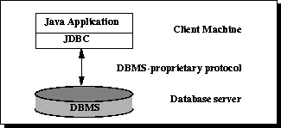
Two-tier Architecture for Data Access.
In two-tier architecture, the Java application directly communicates with the database using JDBC.
The client application contains:
User Interface
Business logic
JDBC code
JDBC driver directly connects the client to the database.
SQL queries are executed directly from the client.

Slide 10
Example Applications
Java Swing applications
Standalone desktop applications
Small-scale systems
Advantages
Simple to design and implement
Faster communication (direct connection)
Suitable for small applications
Disadvantages
Poor scalability
Database credentials exposed to client
Difficult to manage for large users

Slide 11
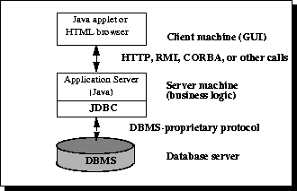
Three-tier Architecture for Data Access.
In three-tier architecture, the client does not directly access the database. A middle layer (application server) handles JDBC operations.

Slide 12
Explanation
Client layer:
User interface (browser, desktop app)
Middle layer:
Business logic
JDBC code
Security and transaction management
Database layer:
Stores and manages data
Example Applications
Web applications using JSP/Servlets
Enterprise applications
Banking and e-commerce systems

Slide 13
Advantages
High scalability
Better security
Easy maintenance
Supports large number of users
Disadvantages
More complex design
Higher development cost
Requires application server

Slide 14
JDBC Model
JAVA Applet/
Application
Java Application Developer
JDBC consists of two parts:
JDBC API, a purely Java-based API
JDBC driver manager
Communicates with vendor-specific drivers
JDBC API
Driver Manager
JDBC Developer
Driver API
Vender Specific JDBC developer
Vendor Specific
JDBC Driver
JDBC-ODBC Bridge
Vender Specific
ODBC Driver
Database
Database

Slide 15

A JDBC Driver
Is an interpreter that translates JDBC method calls to vendor-specific database commands
Implements interfaces in java.sql
Can also provide a vendor’s extensions to the JDBC standard
Database commands
JDBC calls
Driver
Database
Notes:
About JDBC Drivers
A JDBC driver implements the interfaces in the java.sql package, providing the code to connect to and query a specific database. A JDBC driver can also provide a vendor’s own extensions to the standard; Oracle drivers provide extensions to support special Oracle data types.
Oracle provides three drivers:
Thin client driver
OCI-based driver
Server-based driver
These are described on the following pages.

Slide 16
JDBC Driver Type
JDBC-ODBC bridge plus ODBC driver
Native-API partly-Java driver
Network Protocol Driver - Type 3 Driver (Fully Java Driver)
Thin Driver - Type 4 Driver (Fully Java Driver)

Slide 17
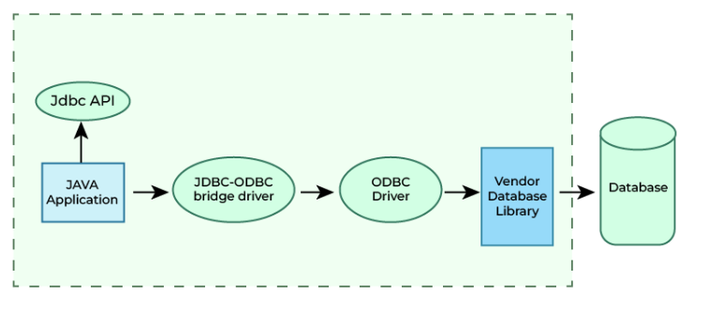
JDBC-ODBC bridge plus ODBC driver
Converts JDBC calls into ODBC calls
Platform dependent
Very slow performance
Removed after Java 8
Usage: Learning purpose only

Slide 18
Advantages
This driver software is built-in with JDK so no need to install separately.
It is a database independent driver.
Disadvantages
The data transferred through this driver is not so secured.
The ODBC bridge driver is needed to be installed in individual client machines.
Type-1 driver isn't written in java, that's why it isn't a portable driver.
2.

Slide 19
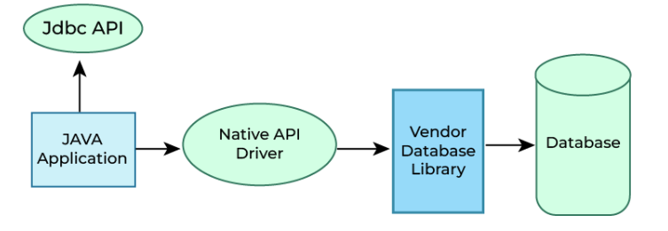
2. Native-API Driver - Type 2 Driver ( Partially Java Driver)
Uses database-specific native libraries Faster than Type 1 Platform dependent Requires the client -side libraries of the database
not fully written in Java that is why it is also called Partially Java driver.

Slide 20
2. Native-API Driver - Type 2 Driver ( Partially Java Driver)
Advantage
Native-API driver gives better performance than JDBC-ODBC bridge driver.
More secure compared to the type-1 driver.
Disadvantages
Driver needs to be installed separately in individual client machines
The Vendor client library needs to be installed on client machine.
Type-2 driver isn't written in java, that's why it isn't a portable driver
It is a database dependent driver.

Slide 21
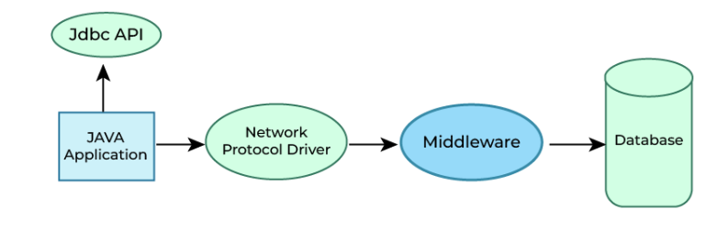
3. Network Protocol Driver - Type 3 Driver (Fully Java Driver)
Uses middleware between client and database
Platform independent
No client-side database libraries required
Slower due to network overhead

Slide 22
Advantages
Type-3 drivers are fully written in Java, hence they are portable drivers.
No client side library is required
Database independent , Easy to switch databases
Disadvantages
Network support is required on client machine.
Maintenance of Network Protocol driver becomes costly because it requires database-specific coding to be done in the middle tier.

Slide 23
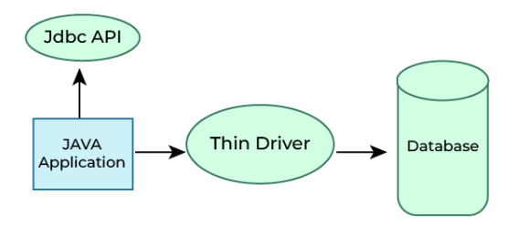
4. Thin Driver - Type 4 Driver (Fully Java Driver)
Pure Java driver
Platform independent
Best performance
Most widely used driver
Example: MySQL → com.mysql.cj.jdbc.Driver

Slide 24
JDBC Programming Steps
Connect
Register the driver
Create a connection to the database
Query
Create a statement
Query the database
Process Results
Get a result set
Assign results to Java variables
Close
Close the result set
Close the statement
Close the connection

Slide 25
Difference between type 3 & type 4
Type 3 Driver uses a middleware server to communicate with the database.
JDBC calls are sent over the network to the middleware, which converts them into database-specific calls.
It is platform independent but slower due to network overhead.
Type 4 Driver directly converts JDBC calls into database protocol calls.
It does not require middleware or native libraries.
It is platform independent and provides the best performance.
Therefore, Type 4 driver is most commonly used.

Slide 26
Skeleton Code
Loading a JDBC driver
Class.forName(DRIVERNAME);
Connection con = DriverManager.getConnection(
CONNECTIONURL, DBID, DBPASSWORD);
Statement stmt = con.createStatement();
ResultSet rs = stmt.executeQuery(“SELECT a, b, c FROM member);
While(rs.next())
{
Int x = rs.getInt(“a”);
String s = rs.getString(“b”);
Float f = rs.getFloat(“c”);
}
rs.close();
stmt.close();
con.close();
Connecting to a database
Executing SQL
Processing the result set
Closing the connections

Slide 27
Step 1 : Loading a JDBC Driver
A JDBC driver is needed to connect to a database
Loading a driver requires the class name of the driver.
Ex
com.mysql.cj.jdbc.Driver
Loading the driver class
Class.forName("com.mysql.cj.jdbc.Driver");
It is possible to load several drivers.
The class DriverManager manages the loaded driver(s)

Slide 28
Step 2 : Connecting to a Database (1/2)
JDBC URL for a database
Identifies the database to be connected
Consists of three-part:
jdbc:<subprotocol>:<subname>
Protocol: JDBC is the only protocol in JDBC
Protocol: JDBC is the only protocol in JDBC
Sub-protocol: identifies a database driver
Sub-protocol: identifies a database driver
Subname: indicates the location and name of the database to be accessed. Syntax is driver specific
Subname: indicates the location and name of the database to be accessed. Syntax is driver specific
Ex) // 2. Establish Connection
Connection con = DriverManager.getConnection(
"jdbc:mysql://localhost:3306/college", "root", "Mysql@1234" );
The syntax for the name of the database is a little messy and is unfortunately vendor specific

Slide 29
Step 2 : Connecting to a Database (2/2)
The DriverManager allows you to connect to a database using the specified JDBC driver, database location, database name, username and password.
It returns a Connection object which can then be used to communicate with the database.
// 2. Establish Connection
Connection con = DriverManager.getConnection(
"jdbc:mysql://localhost:3306/college", "root", "Mysql@1234"
);
JDBC URL
Vendor of database, Location of database server and name of database
JDBC URL
Vendor of database, Location of database server and name of database
Password
Username
Password
Username

Slide 30

Step 3 : Executing SQL (1/2)
Statement object
Can be obtained from a Connection object
Sends SQL to the database to be executed
Statement has three methods to execute a SQL statement:
executeQuery() for QUERY statements
Returns a ResultSet which contains the query results
executeUpdate() for INSERT, UPDATE, DELETE, or DDL statements
Returns an integer, the number of affected rows from the SQL
execute() for either type of statement
Statement statement = connection.createStatement();

Slide 31
Step 3 : Executing SQL (2/2)
Execute a select statement
Statement stmt = conn.createStatement();
ResultSet rset = stmt.executeQuery ("select STUDENT_ID, STATUS from STUDENT");
Execute a delete statement
Statement stmt = conn.createStatement();
int rowcount = stmt.executeUpdate ("delete from STUDENT
where STUDENT_ID = 1011");
Notes:
Dynamically Executing an Unknown SQL Statement
The following example uses execute() to dynamically execute an unknown statement:
public void executeStmt (String statement) throws SQLException { Statement stmt = conn.createStatement(); // Execute the statement boolean result = stmt.execute(statement); if (result) { // statement was a query ResultSet rset = stmt.getResultSet(); // Process the results ... } else { // statement was an update or DDL int updateCount = stmt.getUpdateCount(); // Process the results ... } }

Slide 32
Step 4 : Processing the Results (1/2)
JDBC returns the results of a query in a ResultSet object
ResultSet object contains all of the rows which satisfied the conditions in an SQL statement
A ResultSet object maintains a cursor pointing to its current row of data
Use next() to step through the result set row by row
next() returns TRUE if there are still remaining records
getString(), getInt(), and getXXX() assign each value to a Java variable
Internal Pointer
ResultSet
Record 1
Record 2
Record 3
Record 4
The internal pointer starts one before the first record

Slide 33
Step 4 : Processing the Results (2/2)
Example
Statement stmt = con.createStatement();
ResultSet rs = stmt.executeQuery(“SELECT ID, name, score FROM table1”);
While (rs.next()){
int id = rs.getInt(“ID”);
String name = rs.getString(“name”);
float score = rs.getFloat(“score”);
System.out.println(“ID=” + id + “ ” + name + “ ” + score);}
NOTE
You must step the cursor to the first record before read the results
This code will not skip the first record
ID | name | score
1 | James | 90.5
2 | Smith | 45.7
3 | Donald | 80.2
Output
ID=1 James 90.5
ID=2 Smith 45.7
ID=3 Donald 80.2
Table1

Slide 34
Step 5 : Closing Database Connection
It is a good idea to close the Statement and Connection objects when you have finished with them
Close the ResultSet object
rs.close();
Close the Statement object
stmt.close();
Close the connection
connection.close();

Slide 35
Putting It All Together – A Simple Example
Let’s put all these pieces together and develop a Java application that will connect to our college database , execute a query, and return the results.
This application will show, in the simplest terms, how to load the JDBC driver, establish a connection, create a statement, have the statement executed, and return the results to the application.

Slide 36
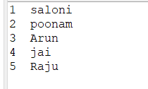
Console based JDBC example
import java.sql.Connection;
import java.sql.DriverManager;
import java.sql.ResultSet;
import java.sql.Statement;
public class DBTestClass {
public static void main(String[] args) {
try {
// 1. Load JDBC Driver
Class.forName("com.mysql.cj.jdbc.Driver");
// 2. Establish Connection
Connection con = DriverManager.getConnection(
"jdbc:mysql://localhost:3306/college",
"root",
"Mysql@1234"
);
// 3. Create Statement
Statement stmt = con.createStatement();
// 4. Execute Query
ResultSet rs = stmt.executeQuery("SELECT * FROM student");
// 5. Process Result
while (rs.next()) {
System.out.println(
rs.getInt("id") + " " + rs.getString("name")
);
}
// 6. Close Connection
rs.close();
stmt.close();
con.close();
} catch (Exception e) {
e.printStackTrace();
}
}
}

Slide 37
Note Regarding Static Method forName
The database driver must be loaded before connecting to the database. The static method forName of class Class is used to load the class for the database driver.
This method throws a checked exception of type java.lang.ClassNotFoundException if the class loader cannot locate the driver class.
To avoid this exception, you need to include the mysql-connector-j-9.6.0.jar in your program’s classpath when you execute the program.

Slide 38
Connection Interface
The Connection interface is part of the java.sql package. It represents a session between a Java application and a database.
A Connection object is used to:
Establish communication with the database
Create SQL statements
Manage transactions
The Connection object is obtained using the DriverManager class.
Connection con = DriverManager.getConnection(
"jdbc:mysql://localhost:3306/college", "root", "" );

Slide 39
Selected Methods In java.sql.Connection
Method | Purpose
Statement createStatement() | Returns a statement object that is used to send SQL to the database.
PreparedStatement prepareStatement(String sql) | Returns an object that can be used for sending parameterized SQL statements.
CallableStatement prepareCall(String sql) | Returns an object that can be used for calling stored procedures.
DatabaseMetaData getMetaData() | Gets an object that supplied database configuration information.
boolean isClosed() | Reports whether the database is currently open or not.
void commit() | Makes all changes permanent since previous commit.rollback.
void rollback() | Undoes and discards all changes done since the previous commit/rollback.
void setAutoCommit (boolean yn) | Restores/removes auto-commit mode, which does an automatic commit after each statement. The default case is AutoCommit is on.
void close() | Closes the connection and releases the JDBC resources for the connection.

Slide 40
JDBC Statements
If the Connection object can be viewed as a cable between your application program and the database, an object of Statement can be viewed as a cart that delivers SQL statements for execution by the database and brings the result back to the application program.
Once a Connection object is created, you can create statements for executing SQL statements as follows:
Statement statement = connection.createStatement();
JDBC provides three types of statements:
Statement
PreparedStatement
CallableStatement

Slide 41
Creating Statements (cont.)
The methods illustrated in the previous table are invoked on the Connection object returned by the JDBC driver manager.
The connection is used to create a Statement object.
The Statement object contains the methods that allow you to send the SQL statements to the database.
Statement objects are very simple objects which allow you to send SQL statements as Strings.
Here is how you would send a select query to the database:
Statement myStmt = connection.createStatement();
ResultSet myResult;
myResult = myStmt.executeQuery( “SELECT * FROM bikes;”);
More on ResultSet later

Slide 42
Creating Statements (cont.)
The different SQL statements have different return values. Some of them have no return value, some of them return the number of rows affected by the statement, and others return all the data extracted by the query.
To handle these varied return results, you’ll need to invoke a different method depending on what type of SQL statement you are executing.
The most interesting of these is the SELECT statement that returns an entire result set of data.
The following table highlights some of the methods in java.sql.statement to execute SQL statements.

Slide 43
Some Methods in java.sql.statement to Execute SQL Statements
SQL statement | JDBC statement to use | Return Type | Comment
SELECT | executeQuery(String sql) | ResultSet | The return value will hold the data extracted from the database.
INSERT, UPDATE, DELETE, CREATE, DROP | executeUpdate(String sql) | int | The return value will give the count of the number of rows changed , or zero otherwise.
Stored procedure with multiple results | execute(String sql) | boolean | The return value is true if the first result is a ResultSet, false otherwise.

Slide 44
Exercise Questions
Write a console-based JDBC program to:
Connect to MySQL database
Display all records from the student table
Table: student(id, name, marks)
Write a console-based JDBC program to:
Insert record into the database
Write a JDBC program to:
Accept student ID from user
Display student details if found
Display message if record does not exist
Add GUI to all programs .

Slide 45
The PreparedStatement Interface
In the previous examples, once we established a connection to a particular database, it was used to send an SQL statement from the application to the database.
The Statement interface is used to execute static SQL statements that contain no parameters.
The PreparedStatement interface, which extends the Statement interface, is used to execute a precompiled SQL statement with or without IN parameters.
Since the SQL statements are precompiled, they are extremely efficient for repeated execution.

Slide 46
The PreparedStatement Object
A PreparedStatement object holds precompiled SQL statements
Use this object for statements you want to execute more than once
A PreparedStatement can contain variables (?) that you supply each time you execute the statement
// Create the prepared statement
PreparedStatement pstmt = con.prepareStatement(“
UPDATE table1 SET status = ? WHERE id =?”)
// Supply values for the variables
pstmt.setString (1, “out”);
pstmt.setInt(2, id);
// Execute the statement
pstmt.executeUpdate();

Slide 47
The PreparedStatement Interface (cont.)
A PreparedStatement object is created using the prepareStatement method in the Connection interface.
PreparedStatement pstmt = connection.prepareStatement
(“insert into bikes (bikename, size, color,
cost, purchased, mileage) +
values ( ?, ?, ?, ?, ?, ?)” );
Placeholders for the values that will be dynamically provided by the user.

Slide 48
The PreparedStatement Interface (cont.)
As a subinterface of Statement, the PreparedStatement interface inherits all the methods defined in Statement. It also provides the methods for setting parameters in the object of PreparedStatement.
These methods are used to set the values for the parameters before executing statements or procedures.
In general, the set methods have the following signature:
setX (int parameterIndex, X value);
where X is the type of parameter and parameterIndex is the index of the parameter in the statement.

Slide 49
The PreparedStatement Interface (cont.)
As an example, the method
setString( int parameterIndex, String value)
sets a String value to the specified parameter.
Once the parameters are set, the prepared statement is executed like any other SQL statement where executeQuery() is used for SELECT statements and executeUpdate() is used for DDL or update commands.
These two methods are similar to those found in the Statement interface except that they have no parameters since the SQL statements are already specified in the prepareStatement method when the object of a PreparedStatement is created.

Slide 50
import java.sql.*;
class InsertPrepared{
public static void main(String args[]){
try{
Class.forName("com.mysql.cj.jdbc.Driver");
Connection con=DriverManager.getConnection(
"jdbc:mysql://localhost:3306/college","root","");
PreparedStatement stmt=con.prepareStatement("insert into Emp values(?,?)");
stmt.setInt(1,101);//1 specifies the first parameter in the query
stmt.setString(2,"Ratan");
int i=stmt.executeUpdate();
System.out.println(i+" records inserted");
con.close();
}catch(Exception e){ System.out.println(e);}
}}

Slide 51
Find studentUsingPreparedStatement
import javax.swing.*;
import java.awt.event.*;
import java.sql.*;
public class StudentSearchPS implements ActionListener {
JFrame frame;
JLabel lblId;
JTextField txtId;
JButton btnSearch;
JTextArea taResult;
Connection con;
PreparedStatement ps;
public StudentSearchPS() {
frame = new JFrame("Student Search Using JDBC");
frame.setSize(400, 350);
frame.setLayout(null);
lblId = new JLabel("Student ID:");
lblId.setBounds(30, 30, 100, 25);
frame.add(lblId);

Slide 52
txtId = new JTextField();
txtId.setBounds(130, 30, 150, 25);
frame.add(txtId);
btnSearch = new JButton("Search");
btnSearch.setBounds(130, 70, 100, 30);
frame.add(btnSearch);
taResult = new JTextArea();
taResult.setBounds(30, 120, 320, 150);
taResult.setEditable(false);
frame.add(taResult);
btnSearch.addActionListener(this);
frame.setVisible(true);
frame.setDefaultCloseOperation(JFrame.EXIT_ON_CLOSE);
connectDB();
}
// Database connection method
void connectDB() {
try {
Class.forName("com.mysql.cj.jdbc.Driver");
con = DriverManager.getConnection(
"jdbc:mysql://localhost:3306/college",
"root",
"Mysql@123"
);
ps = con.prepareStatement(
"SELECT * FROM student WHERE id = ?"
);
} catch (Exception e) {
taResult.setText("Database connection error");
}
}

Slide 53
// Event handling
public void actionPerformed(ActionEvent e) {
try {
int id = Integer.parseInt(txtId.getText());
ps.setInt(1, id);
ResultSet rs = ps.executeQuery();
if (rs.next()) {
taResult.setText(
"ID : " + rs.getInt("id") + "\n" +
"Name : " + rs.getString("name") + "\n" +
"Dept : " + rs.getString("dept")
);
} else {
taResult.setText("No record found");
}
} catch (Exception ex) {
taResult.setText("Invalid input or error");
}
}
public static void main(String[] args) {
new StudentSearchPS();
}

Slide 54
Output

Slide 55
The CallableStatement Object
A CallableStatement object holds parameters for calling stored procedures.
A callable statement can contain variables that you supply each time you execute the call.
When the stored procedure returns, computed values (if any) are retrieved through the CallabableStatement object.
Notes:
The CallableStatement Object
The way to access stored procedures using JDBC is through the CallableStatement class which is inherited from the PreparedStatement class. CallableStatement is like PreparedStatement in that you can specify parameters using the question mark (?) notation, but it contains no SQL statements.
Both functions and procedures take parameters represented by identifiers. A function executes some procedural logic and it returns a value that can be any data type supported by the database. The parameters supplied to the function do not change after the function is executed.
A procedure executes some procedural logic but does not return any value. However, some of the parameters supplied to the procedure may have their values changed after the procedure is executed.
Note: Calling a stored procedure is the same whether the stored procedure was written originally in Java or in any other language supported by the database, such as PL/SQL. Indeed, a stored procedure written in Java appears to the programmer as a PL/SQL stored procedure.

Slide 56
How to Create a Callable Statement
Register the driver and create the database connection.
Create the callable statement, identifying variables with a question mark (?).
CallableStatement cstmt = conn.prepareCall("{call " +
ADDITEM + "(?,?,?)}");

Slide 57
How to Execute a Callable Statement
1. Set the input parameters.
Execute the statement.
Get the output parameters.
cstmt.setXXX(index, value);
cstmt.execute(statement);
var = cstmt.getXXX(index);
Notes:
How to Execute a Callable Statement
There are three steps in executing the stored procedure after you have registered the types of the OUT variables:
1. Set the IN parameters.
Use the setXXX() methods to supply values for the IN parameters. There is one setXXX() method for each Java type: setString(), setInt(), and so on. You must use the setXXX() method that is compatible with the SQL type of the variable. You can use setObject() with any variable type. Each variable has an index. The index of the first variable in the prepared statement is 1, the index of the second is 2, and so on. If there is only one variable, its index is 1.
2. Execute the call to the stored procedure.
Execute the procedure using the execute() method.
3. Get the OUT parameters.
Once the procedure is completed, you retrieve OUT variables, if any, using the getXXX() methods. Note that these methods must match the types you registered in the previous slide.
Instructor Note
The stored procedures lesson contains an example of executing a callable statement.

Slide 58
Result Sets
A ResultSet object is similar to a 2D array. Each call to next() moves to the next record in the result set. You must call next() before you can see the first result record, and it returns false when there are no more result records (this makes it quite convenient for controlling a while loop). (Also remember that the Iterator next() returns the next object and not a true/false value.)
The class ResultSet has “getter” methods getBlob(), getBigDecimal(), getDate(), getBytes(), getInt(), getLong(), getString(), getObject(), and so on, for all the Java types that represent SQL types for a column name and column number argument.

Slide 59
Result Sets (cont.)
A default ResultSet object is not updatable and has a cursor that only moves forward.
Many database drivers support scrollable and updatable ResultSet objects.
Scrollable result sets simply provide a cursor to move backwards and forwards through the records of the result set.
Updatable result sets provide the user with the ability to modify the contents of the result set and update the database by returning the updated result set.
NOTE: Not all updates can be reflected back into the database. It depends on the complexity of the query and how the data in the result set was derived. In general, base relation attribute values can be modified through an updatable result set.

Slide 60
ResultSet Constants for Specifying Properties
ResultSet static type constant | Description
TYPE_FORWARD_ONLY | Specifies that the ResultSet cursor can move only in the forward direction, from the first row to the last row in the result set.
TYPE_SCROLL_INSENSITIVE | Specifies that the ResultSet cursor can scroll in either direction and that the changes made to the result set during ResultSet processing are not reflected in the ResultSet unless the database is queried again.
TYPE_SCROLL_SENSITIVE | Specifies that the ResultSet cursor can scroll in either direction and that changes made to the result set during ResultSet processing are reflected immediately in the ResultSet.
ResultSet static concurrency constant | Description
CONCUR_READ_ONLY | Specifies that the ResultSet cannot be updated (i.e. changes to it will not be reflected into the database).
CONCUR_UPDATABLE | Specifies that the ResultSet can be updated (i.e. changes to it will be reflected into the database using ResultSet update methods).

Slide 61
ResultSet Examples
Syntax for Creating a Scrollable ResultSet
Statement stmt = con.createStatement(
ResultSet.TYPE_SCROLL_INSENSITIVE,
ResultSet.CONCUR_READ_ONLY
);
ResultSet rs = stmt.executeQuery("SELECT * FROM student");
Cursor can move forward & backward
Data cannot be modified

Slide 62
Syntax for Creating an Updatable ResultSet
Statement stmt = con.createStatement(
ResultSet.TYPE_SCROLL_INSENSITIVE,
ResultSet.CONCUR_UPDATABLE
);
ResultSet rs = stmt.executeQuery("SELECT * FROM student");
Cursor can move both directions
Data can be updated directly

Slide 63
Common Cursor Methods
rs.next(); // Move to next record
rs.previous(); // Move to previous record
rs.first(); // Move to first record
rs.last(); // Move to last record
rs.absolute(3); // Move to 3rd row

Slide 64
Scrollable and updatable ResultSet must be created explicitly using createStatement().
Default ResultSet is forward-only and read-only.

