Slide 1

Subject Name :Web Development with Java
Unit No:II
Unit Name :Java Servlet Technology
Faculty Name :Dr. Saloni Bhushan

Slide 2
Unit No.2
Faculty Name :

Slide 3

Index
Lecture No & Topic Name | Slide No

Slide 4
Unit No:1
Lecture No: 1

Slide 5
Content
Java Servlet Technology
· Introduction to Java Servlets
· J2EE architecture
· Web server and web container
· Servlet life cycle
· HTTP protocol and HTTP methods
· Types of servlets:
o GenericServlet
o HttpServlet
· Writing, deploying, and executing simple servlet applications
· Handling client requests and server responses (GET and POST)
· Session tracking techniques:
· HttpSession
· Cookies
· ServletConfig and ServletContext
· Database connectivity using Servlets

Slide 6
What Is a Servlet?
A servlet is a Java class that is used to extend the capabilities of servers that host applications which can be accessed via a request-response programming model.
Although servlets can respond to any type of request, they are commonly used to extend the applications hosted by web servers. For such applications, Java Servlet technology defines HTTP-specific servlet classes.
The javax.servlet and javax.servlet.http packages provide interfaces and classes for writing servlets.
All servlets must implement the Servlet interface, which defines life-cycle methods.
When implementing a generic service, you can extend the GenericServlet class provided with the Java Servlet API.
The HttpServlet class provides methods, such as doGet and doPost, for handling HTTP-specific services.

Slide 7
Java Servlets
Java’s answer to CGI + ASP
A little more general than CGI/ASP, etc.
Work with all major web servers
Need web server servlet engine
Need servlet development kit
Notes:
CGI (Common Gateway Interface) is a standard protocol that defines how a web server interacts with external programs to generate dynamic content
ASP (Active Server Pages) is a Microsoft technology for creating dynamic web pages,

Slide 8
What’s good about them?
Concurrency(A servlet can handle multiple request, concurrently)
Forward request
Portability
Efficiency
Safety

Slide 9
J2EE architecture
J2EE (now called Java EE / Jakarta EE) is a platform used to develop enterprise-level, distributed, and web-based applications.
It extends Java SE by providing:
Web services
Distributed computing
Database connectivity
Security
Transaction management
Component-based development
It is mainly used for:
Banking applications
E-commerce systems
ERP systems
Government portals

Slide 10
Multi-Tier Architecture of J2EE
J2EE follows a Multi-Tier (N-Tier) Architecture.
The four main tiers are:
Client Tier
Web Tier
Business Tier
Enterprise Information System (EIS) Tier

Slide 11
Client Tier (Presentation Client)
This is the user interface layer.
It can be:
Web Browser (Chrome, Edge, etc.)
Mobile App
Desktop Application
Responsibilities:
Accept user input
Send request to server
Display response to user
Example: User fills a login form → Clicks submit → Request goes to Web Server

Slide 12
Web Tier (Presentation Logic Layer)
This tier runs on the Web Server.
Technologies used:
Servlet
JSP (Java Server Pages)
JSF
HTML, CSS, JavaScript
Responsibilities:
Receive HTTPequest
Process request
Forward to business layer
Generate dynamic response
Components:
Web Container (like Apache Tomcat)
The web container:
Manages servlets
Handles lifecycle
Provides security
Manages sessions

Slide 13
Business Tier (Application Logic Layer)
This is the core processing layer.
Technologies used:
EJB (Enterprise Java Beans)
Spring Framework (modern applications)
Responsibilities:
Business rules
Validations
Transaction management
Decision making
Example:
Checking login credentials
Calculating bank interest
Processing online payment
Runs inside:
Application Server (GlassFish, JBoss, WebLogic)

Slide 14
EIS Tier (Enterprise Information System Tier)
This is the data storage layer.
The Data Storage Layer stores data permanently using databases.
It is responsible for saving, updating, and retrieving information such as user details, transactions, and records.
Technologies used:
JDBC
JPA
Hibernate
Notes:
JPA-Java persistent API
Hibernate - framework to implement JPA

Slide 15
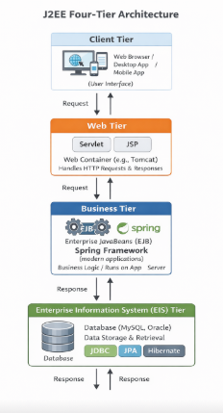
Complete Flow of J2EE Architecture
Let’s understand the flow:
1. User sends request from Browser
2. Web Tier (Servlet/JSP) receives request
3. Web Tier calls Business Tier (EJB)
4. Business Tier accesses Database using JDBC
5. Database sends response
6. Response goes back through layers to client

Slide 16
Web Server
A Web Server is software that:
Handles HTTP requests
Serves static content
Communicates with the client (browser)
It works at the presentation level.

Slide 17
What Does a Web Server Do?
Receives HTTP request
Returns:
HTML files
CSS files
JavaScript files
Images
Static content
Manages basic security
Manages connections

Slide 18
Examples of Web Servers
Apache HTTP Server
Microsoft IIS
Limitations
A web server cannot execute Java code like Servlets or JSP by itself.
It can only serve static files.

Slide 19
Web Container
A Web Container (also called Servlet Container) is a component that:
Executes Servlets
Executes JSP
Manages web components
It is part of the application server or can run standalone (like Tomcat).

Slide 20
Types of Servlet
GenericServlet
Package: javax.servlet
Class: GenericServlet
Implements: javax.servlet.Servlet (indirectly implements the Servlet interface)
Type: Protocol-independent servlet
Important Method:
service(ServletRequest request, ServletResponse response)
✔ Key Points:
Used for developing protocol-independent servlets.
We must override the service() method.
It is the parent class of HttpServlet.
HttpServlet
Package: javax.servlet.http
Class: HttpServlet
Extends: javax.servlet.GenericServlet
Type: HTTP protocol-specific servlet
Important Methods:
doGet(HttpServletRequest request, HttpServletResponse response)
doPost(HttpServletRequest request, HttpServletResponse response)
doPut()
doDelete()
doHead()
✔ Key Points:
Used for handling HTTP requests.
We override doGet() or doPost() instead of service().
It is more commonly used in web applications.

Slide 21
Genericservlet example
import java.io.*;
import javax.servlet.*;
public class MyGenericServlet extends GenericServlet {
@Override
public void service(ServletRequest request, ServletResponse response)
throws ServletException, IOException {
// Set response content type
response.setContentType("text/html");
// Get writer object
PrintWriter out = response.getWriter();
// Write response
out.println("<html>");
out.println("<body>");
out.println("<h2>Hello, this is a GenericServlet example!</h2>");
out.println("</body>");
out.println("</html>");
}
}

Slide 22
Generic Servlet
Client sends request to: http://localhost:8080/YourApp/generic
Web container calls the service() method.
Servlet generates HTML response.
GenericServlet is protocol-independent.
We must override service() method.
It is the parent class of HttpServlet.
Used when application is not strictly HTTP-based.

Slide 23
Basic http Servlet example
import java.io.*;
import javax.servlet.*;
import javax.servlet.http.*;
public class Test extends HttpServlet{
public void doGet(HttpServletRequest in, HttpServletResponse out) throws ServletException, IOException {
out.setContentType(“text/html”);
PrintWriter p = out.getWriter();
p.println("<html>");
p.println("<body>");
p.println("<h2>Hello, this is a HTTPServlet example!</h2>");
p.println("</body>");
p.println("</html>");
}
}

Slide 24
Servlet example
Client types URL in browser.
Browser sends GET request.
Web container calls doGet().
Servlet generates HTML response.
Browser displays "HELLO, WORLD!".

Slide 25
Servlet Life Cycle
The life cycle of a servlet is controlled by the container in which the servlet has been deployed. When a request is mapped to a servlet, the container performs the following steps.
If an instance of the servlet does not exist, the web container Loads the servlet class.
Creates an instance of the servlet class.
Initializes the servlet instance by calling the init method.
Invokes the service method, passing request and response objects.
If the container needs to remove the servlet, it finalizes the servlet by calling the servlet's destroy method.

Slide 26
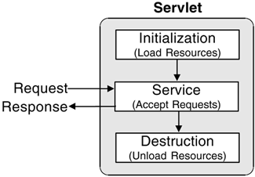
Life Cycle
Initialize
Service
Destroy

Slide 27
Life Cycle: Initialize
Servlet is created when servlet container receives a request from the client
public void init() throws ServletException
init() method is called only once

Slide 28
Initializing a Servlet
After the web container loads and instantiates the servlet class and before it delivers requests from clients, the web container initializes the servlet.
To customize this process to allow the servlet to read persistent configuration data, initialize resources, and perform any other one-time activities, you override the init method of the Servlet interface.
A servlet that cannot complete its initialization process should throw UnavailableException.

Slide 29
Life Cycle: Service
Any requests will be forwarded to the service() method
public void service(ServletRequest request, ServletResponse response) throws ServletException, IOException
Other methods used in HttpServlet to serve client
doGet()
doPost()
doDelete()
doOptions()
doPut()
doTrace()
public void doGet(HttpServletRequest request, HttpServletResponse response) throws ServletException, IOException
public void doPost(HttpServletRequest request, HttpServletResponse response) throws ServletException, IOException

Slide 30
Writing Service Methods
The service provided by a servlet is implemented in the service method of a GenericServlet, the doMethod methods (where Method can take the value Get, Delete, Options, Post, Put, Trace) of an HttpServlet, or any other protocol-specific methods defined by a class that implements the Servlet interface. the term service method will be used for any method in a servlet class that provides a service to a client.
The general pattern for a service method is to extract information from the request, access external resources, and then populate the response based on that information.
For HTTP servlets, the correct procedure for populating the response is to first fill in the response headers, then retrieve an output stream from the response, and finally write any body content to the output stream. Response headers must always be set before a PrintWriter or ServletOutputStream is retrieved because the HTTP protocol expects to receive all headers before body content.

Slide 31
Life Cycle: Destroy
destroy() method is called only once
Occurs when
Application is stopped
Servlet container shuts down
Allows resources to be freed
public void destroy()

Slide 32
Servlet Life Cycle Demo
public class LifeCycleServlet extends HttpServlet {
public void init() {
System.out.println("Servlet Initialized");
}
public void doGet(HttpServletRequest request,
HttpServletResponse response)
throws IOException {
PrintWriter out=response.getWriter();
out.println("Service Method Called");
}
public void destroy() {
System.out.println("Servlet Destroyed");
}
}

Slide 33
What is HTTP?
HTTP stands for:
HyperText Transfer Protocol
It is the protocol used for communication between:
Client (Browser) ↔ Web Server
Whenever you:
Open a website
Submit a form
Click a link
HTTP is used.

Slide 34
Characteristics of HTTP Protocol
Application Layer protocol
Stateless protocol
Request–Response based

Slide 35
How HTTP Works
Step 1:
Client sends HTTP Request
Step 2:
Server processes request
Step 3:
Server sends HTTP Response

Slide 36
HTTP Request Structure
Request Line
Headers
Blank Line
Body (optional)
Example:
GET /index.html HTTP/1.1
Host: www.example.com

Slide 37
HTTP Response Structure
Status Line
Headers
Blank Line
Body
Example:
HTTP/1.1 200 OK
Content-Type: text/html

Slide 38
HTTP Methods
HTTP methods define what action the client wants to perform.
GET Method-Used to retrieve data from server.
Example:Opening a webpage, Searching data
Characteristics: Data sent in URL, Visible in address bar, Limited data size, Not secure for sensitive data
Example:GET /search?name=saloni

Slide 39
HTTP Methods- POST Method
Used to send data to server.
Example: Login form, Registration form, Upload file.
Characteristics: Data sent in request body, Not visible in URL, No size limitation (practically large), More secure than GET

Slide 40
Other HTTP Methods
Method | Purpose
PUT | Replace or update an existing resource completely
DELETE | Remove a resource from the server
PATCH | Partially update an existing resource
HEAD | Retrieve only headers of a resource (no body)
OPTIONS | Retrieve the list of supported HTTP methods
TRACE | Echo the received request for debugging
CONNECT | Establish a secure tunnel to the server (used in HTTPS)

Slide 41
Getting Information from Requests
A request contains data passed between a client and the servlet.
All requests implement the ServletRequest interface.
This interface defines methods for accessing all request Information.

Slide 42
Input to a servlet
A GET request supplies parameters in the form URL ? name=value & name=value & name=value
(Illegal spaces added to make it more legible)
Actual spaces in the parameter values are encoded by + signs
Other special characters are encoded in hex; for example, an ampersand is represented by %26
Parameter names can occur more than once, with different values
A POST request supplies parameters in the same syntax, only it is in the “body” section of the request and is therefore harder for the user to see

Slide 43
Getting the parameters
Input parameters are retrieved via messages to the HttpServletRequest object request
Most of the interesting methods are inherited from the superinterface ServletRequest
public Enumeration getParameterNames()
Returns an Enumeration of the parameter names
If no parameters, returns an empty Enumeration
public String getParameter(String name)
Returns the value of the parameter name as a String
If the parameter doesn’t exist, returns null
If name has multiple values, only the first is returned
public String[] getParameterValues(name)
Returns an array of values of the parameter name
If the parameter doesn’t exist, returns null

Slide 44
Handling HTTP get Requests
get request
Retrieve the content of a URL
Example: GreetServlet
a servlet handles HTTP get requests

Slide 45
HTML Form
index.html
<html>
<body>
<form action="GreetServlet" method="get">
Enter Name: <input type="text" name="username">
<input type="submit" value="Submit">
</form>
</body>
</html>

Slide 46
Example of input parameters-GreetServlet.java
import java.io.*;
import javax.servlet.*;
import javax.servlet.http.*;
public class GreetServlet extends HttpServlet {
public void doGet(HttpServletRequest request,
HttpServletResponse response)
throws ServletException, IOException {
String name = request.getParameter("username");
response.setContentType("text/html");
PrintWriter out = response.getWriter();
out.println("<html><body>");
out.println("<h2>Welcome " + name + "!</h2>");
out.println("</body></html>");
}
}

Slide 47
24.5 Handling HTTP post Requests
HTTP post request
Post data from an HTML form to a server-side form handler
Browsers cache Web pages
Servlet WelcomeServlet3
Responds to a post request that contains data

Slide 48
WelcomeServlet3 responds to a post request that contains data.
1 // Fig. 24.14: WelcomeServlet3.java
2 // Processing post requests containing data.
3
4 import javax.servlet.*;
5 import javax.servlet.http.*;
6 import java.io.*;
7
8 public class WelcomeServlet3 extends HttpServlet {
9
10 // process "post" request from client
11 protected void doPost( HttpServletRequest request,
12 HttpServletResponse response )
13 throws ServletException, IOException
14 {
15 String firstName = request.getParameter( "firstname" );
16
17 response.setContentType( "text/html" );
18 PrintWriter out = response.getWriter();
19
20
Declare a doPost method to responds to post requests.

Slide 49
WelcomeServlet3.java
31 // head section of document
32 out.println( "<head>" );
33 out.println(
34 "<title>Processing post requests with data</title>" );
35 out.println( "</head>" );
36
37 // body section of document
38 out.println( "<body>" );
39 out.println( "<h1>Hello " + firstName + ",<br />" );
40 out.println( "Welcome to Servlets!</h1>" );
41 out.println( "</body>" );
42
43 // end XHTML document
44 out.println( "</html>" );
45 out.close(); // close stream to complete the page
46 }
47 }

Slide 50
HTML document in which the form’s action invokes WelcomeServlet3
<html>
<body>
<form action="WelcomeServlet3" method="post">
Enter Name: <input type="text" name="username">
<input type="submit" value="Submit">
</form>
</body>
</html>
Provide a form in which the user can input a name in the text input element firstname, then click the Submit button to invoke WelcomeServlet3.

Slide 51
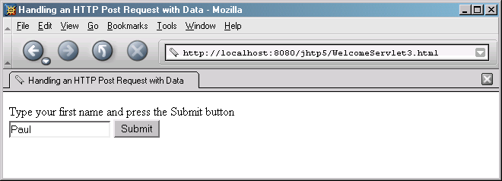
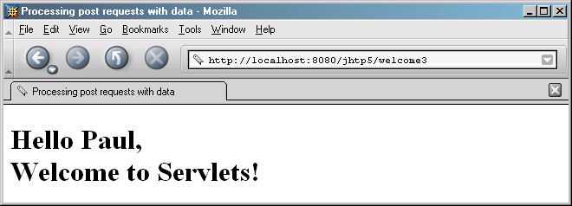
Program output

Slide 52
Display Current Date (Server-Side Processing Demo)
import java.io.*;
import java.util.Date;
import javax.servlet.*;
import javax.servlet.http.*;
public class DateServlet extends HttpServlet {
public void doGet(HttpServletRequest request,
HttpServletResponse response)
throws ServletException, IOException {
response.setContentType("text/html");
PrintWriter out = response.getWriter();
out.println("<h2>Current Date & Time:</h2>");
out.println(new Date());
}
}

Slide 53
Persistent information
A server site typically needs to maintain two kinds of persistent (remembered) information:
Information about the session
A session starts when the user logs in or otherwise identifies himself/herself, and continues until the user logs out or completes the transaction (for example, makes a purchase)
Information about the user
User information must generally be maintained much longer than session information (for example, remembering a purchase)
This information must be stored on the server, for example on a file or in a database

Slide 54
Summary
A session is a continuous interaction with the user
HTTP is stateless, so the programmer must do something to remember session information
There are multiple ways to remember session information
The session ends when the user quits the browser (or a session may be set to time out)
Some information must be kept longer than just within a session
For example, if the user orders a product, that information must be kept in a database
Long-term storage of information requires that the servlet have some additional privileges

Slide 55
Session tracking
HTTP is stateless: When it gets a page request, it has no memory of any previous requests from the same client
This makes it difficult to hold a “conversation”
Typical example: Putting things one at a time into a shopping cart, then checking out--each page request must somehow be associated with previous requests
The server must be able to keep track of multiple conversations with multiple users
Session tracking is keeping track of what has gone before in this particular conversation
Since HTTP is stateless, it does not do this for you
You have to do it yourself, in your servlets

Slide 56
Session tracking solutions
Java’s Session Tracking API can be used to do most of the work for you
Cookies are small files that the servlet can store on the client computer, and retrieve later

Slide 57
The Session Tracking API
Sessions are represented by an HttpSession object.
The session tracking API is in javax.servlet.http.HttpSession and is built on top of cookies
In a Servlet, an HttpSession object is created by calling the getSession() method on the HttpServletRequest object (named request). The HttpServletRequest object represents the client’s HTTP request.
When request.getSession() is called, it returns the existing session if one already exists for that client, or it creates a new session if none exists.

Slide 58
The Session Tracking API
To use the session tracking API:
Create a session:
HttpSession session = request.getSession();
Returns the session associated with this request
If there was no associated session, one is created
Store information in the session and retrieve it as needed:
session.setAttribute(name, value);
Object obj = session.getAttribute(name);
Session information is automatically maintained across requests

Slide 59
HttpSession Examples
import java.util.*;
import java.io.*;
import javax.servlet.*;
import javax.servlet.http.*;
public class DateServlet extends HttpServlet
{
public void doGet(HttpServletRequest request,HttpServletResponse response)throws ServletException,IOException
{
HttpSession hs=request.getSession(true);
response.setContentType("text/html");
PrintWriter pw=response.getWriter();
pw.println(“<HTML><HEAD><TITLE>Session example</TITLE></HEAD>”);
pw.println("<BODY><b>");
Date date=(Date)hs.getValue("date");
if(date!=null)
{
pw.println("Last access:" +date+"<br>");
}
date=new Date();
hs.putValue("date",date);
pw.println("Current date :"+date);
pw.println(“</BODY></HTML>”);
}
}

Slide 60
Servlet code can obtain a session by calling the getSession method thus if the following servlet is run, it will store the value of the parameter username in the session and print it out with subsequent requests to the page.
/** * How to use session tracking
* with the HttpServlet interace * ***/
import java.io.*;
import javax.servlet.*;
import javax.servlet.http.*;
public class MyServlet extends HttpServlet
{
String sUserName;
protected void doGet(HttpServletRequest request, HttpServletResponse response) throws ServletException, IOException {
PrintWriter out = response.getWriter();
HttpSession session = request.getSession();
String rUserName = request.getParameter("username");
if(sUserName!=null){
String sUserName = (String) session.getAttribute("username");
}else{ session.setAttribute("username",rUserName);
} out.print("UserName="+session.getAttribute("username")) ;
}
}

Slide 61
Cookies
A cookie is a small bit of text sent to the client that can be read again later
Limitations (for the protection of the client):
Not more than 4KB per cookie (more than enough in general)
Not more than 20 cookies per site
Not more than 300 cookies total
Cookies are not a security threat
Cookies can be a privacy threat
Cookies can be used to customize advertisements
Outlook Express allows cookies to be embedded in email
A servlet can read your cookies

Slide 62
using cookies to hold states between servlet requests.
Cookie is a file on a web user’s hard disk that is used by web sites to hold information about the web users. So, the idea with cookies is to put state information into cookies and retrieve the information from the cookie in the successive requests.
there is a specific javax.servlet.http.Cookie class in Servlet API.
They can also be added and retrieved easily using methods in HttpServletRequest and HttpServletResponse objects.

Slide 63

Using cookies
import javax.servlet.http.*;
Constructor: Cookie(String name, String value)
Assuming request is an HttpServletRequest and response is an HttpServletResponse,
response.addCookie(cookie);
Cookie[ ] cookies = request.getCookies();
String name = cookies[i].getName();
String value = cookies[i].getValue();
There are, of course, many more methods in the HttpServletRequest, HttpServletResponse, and Cookie classes in the javax.servlet.http package

Slide 64
Some more Cookie methods
public void setComment(String purpose)
public String getComment()
public void setMaxAge(int expiry)
public int getMaxAge()
Max age in seconds after which cookie will expire
If expiry is negative, delete when browser exits
If expiry is zero, delete cookie immediately
setSecure(boolean flag)
public boolean getSecure()
Indicates to the browser whether the cookie should only be sent using a secure protocol, such as HTTPS or SSL

Slide 65
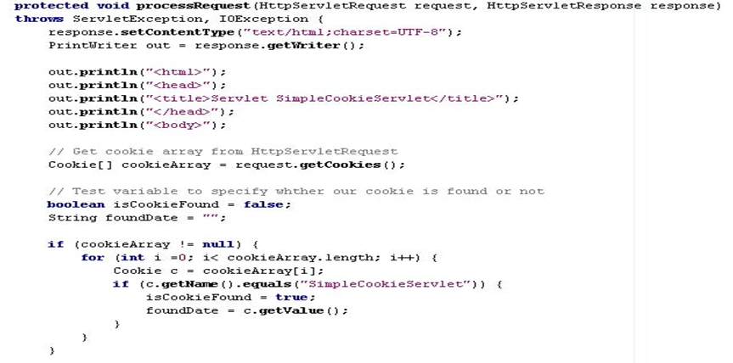

Slide 66
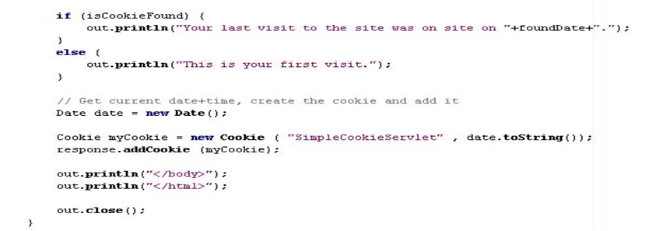

Slide 67
What is web.xml?
web.xml is the deployment descriptor of a web application.
A Deployment Descriptor is an XML configuration file used to describe how a web application should be deployed and configured in a servlet container.
Location - WEB-INF/web.xml
Defines servlet configuration
Maps URL to servlet
Stores initialization parameters
Defines context parameters
It is read when the server starts.

Slide 68
Why Do We Need Configuration in Servlets?
Some data is specific to one servlet
Some data is common to the entire web application
How do we manage both?
How can we configure individual servlets and also share common data?

Slide 69
Two Levels of Data in Web Applications
Servlet API provides two interfaces:
ServletConfig
ServletContext
Level | Example
Servlet Level | Admin email for LoginServlet
Application Level | Company Name, Visitor Count

Slide 70
ServletConfig and ServletContext
In a web application, sometimes we need configuration that is specific to a single servlet, and sometimes we need data that is common to the entire application. To handle this, the Servlet API provides two interfaces: ServletConfig and ServletContext. ServletConfig is used to configure a particular servlet, while ServletContext is used to share information across the entire web application.

Slide 71
ServletConfig
Interface in javax.servlet
Used to configure a specific servlet
One object per servlet
Created during servlet initialization
Defined Using: <init-param>
Key Methods:
getInitParameter()
getServletName()
getServletContext()

Slide 72
Demonstrating ServletConfig
A servlet that reads an initialization parameter (admin email) specific to that servlet using ServletConfig and displays it in the browser.
Servlet-specific configuration
Uses <init-param>
One ServletConfig per servlet
Defined Using: <context-param>

Slide 73
web.xml Configuration
<web-app>
<servlet>
<servlet-name>ConfigServlet</servlet-name>
<servlet-class>com.test.ConfigServlet</servlet-class>
<init-param>
<param-name>adminEmail</param-name>
<param-value>admin@test.com</param-value>
</init-param>
</servlet>
<servlet-mapping>
<servlet-name>ConfigServlet</servlet-name>
<url-pattern>/config</url-pattern>
</servlet-mapping>
</web-app>

Slide 74
Servlet Code
package com.test;
import java.io.*;
import javax.servlet.*;
import javax.servlet.http.*;
public class ConfigServlet extends HttpServlet {
public void doGet(HttpServletRequest request,
HttpServletResponse response)
throws IOException {
response.setContentType("text/html");
PrintWriter out = response.getWriter();
ServletConfig config = getServletConfig();
String email = config.getInitParameter("adminEmail");
out.println("<html><body>");
out.println("<h2>ServletConfig Example</h2>");
out.println("<p>Admin Email: " + email + "</p>");
out.println("</body></html>");
}
}
To run
http://localhost:8080/testWeb/config
1️Server starts
Servlet is initialized
Container creates ServletConfig object
<init-param> value is stored in ServletConfig
Browser sends request
doGet() is called
getInitParameter() retrieves adminEmail
Response sent to browser
Output
ServletConfig Example
Admin Email: admin@test.com
✔ This parameter belongs only to ConfigServlet ✔ Cannot be shared with other servlets

Slide 75
ServletContext
Interface in javax.servlet
Used to share data across entire application
One object per application
Created when application starts
Key Methods:
setAttribute()
getAttribute()
getInitParameter()
getServerInfo()

Slide 76
WebContext (ServletContext)
Used by servlets to
Set and get context-wide (application-wide) object-valued attributes
Get request dispatcher
To forward to or include web component
Access Web context-wide initialization parameters set in the web.xml file
Access Web resources associated with the Web context
Log
Access other misc information

Slide 77
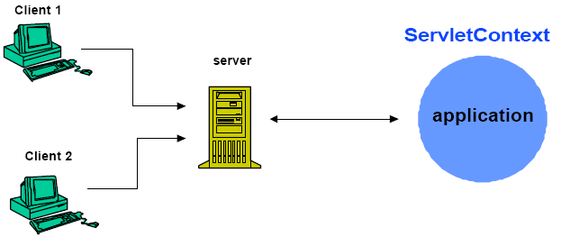
Scope of ServletContext
There is one ServletContext object per "web application" per Java Virtual Machine

Slide 78
How to Access ServletContext?
Within your servlet code, call
getServletContext()
public class CatalogServlet extends HttpServlet {
private BookDB bookDB;
public void init() throws ServletException {
// Get context-wide attribute value from
// ServletContext object
bookDB = (BookDB)getServletContext().
getAttribute("bookDB");
if (bookDB == null)
throw new UnavailableException(
"Couldn't get database");
}

Slide 79
Demonstrating ServletContext
Develop a servlet that reads a global application parameter (company name) using ServletContext and displays it.
Application-wide configuration
Uses <context-param>
One ServletContext per application

Slide 80
web.xml Configuration
<web-app>
<context-param>
<param-name>companyName</param-name>
<param-value>D.Y.Patil University</param-value>
</context-param>
<servlet>
<servlet-name>ContextServlet</servlet-name>
<servlet-class>com.test.ContextServlet</servlet-class>
</servlet>
<servlet-mapping>
<servlet-name>ContextServlet</servlet-name>
<url-pattern>/context</url-pattern>
</servlet-mapping>
</web-app>

Slide 81
Servlet Code
package com.test;
import java.io.*;
import javax.servlet.*;
import javax.servlet.http.*;
public class ContextServlet extends HttpServlet {
public void doGet(HttpServletRequest request,
HttpServletResponse response)
throws IOException {
response.setContentType("text/html");
PrintWriter out = response.getWriter();
ServletContext context = getServletContext();
String company = context.getInitParameter("companyName");
out.println("<html><body>");
out.println("<h2>ServletContext Example</h2>");
out.println("<p>Company Name: " + company + "</p>");
out.println("</body></html>");
}
}
How to Run
http://localhost:8080/testWeb/context
Server starts Web application is loaded Container creates ServletContext object <context-param> is stored in ServletContext Client sends request doGet() is executed getInitParameter() retrieves companyName Response sent to browser
Output ServletContext Example
Company Name: D.Y.Patil University

Slide 82
Dispatching to Another Component
public void doGet (HttpServletRequest request, HttpServletResponse response)
throws ServletException, IOException {
HttpSession session = request.getSession(true);
String messages = (String)session.getAttribute("messages");
// set headers and buffer size before accessing the Writer
response.setContentType("text/html");
response.setBufferSize(8192);
PrintWriter out = response.getWriter();
// then write the response
out.println("<html>head><title>" + messages + "</title></head></html>");
// Get the dispatcher; it gets the banner to the user
RequestDispatcher dispatcher =
getServletContext().getRequestDispatcher("/banner");
if (dispatcher != null)
dispatcher.include(request, response);
...

Slide 83
Servlet calls other resources
RequestDispatcher Object allows another resource to be called:
Example of calling an html file from a servlet:
getServletContext().getRequestedDispatcher(“examples/applications/bookstore/bookstore.html”);
Returns the html page .
The resources called can be
Another servlet
A Java Server Page
Html
Other

Slide 84
Servlet calls other resources
Two types of requests for resources:
Forward request
Include request.
Servlet 1
Servlet 2
……………….
2 …………………..
3 …………………..
4 …………………..
5…………………..
6……………………
.
……………….
2 …………………..
3 …………………..
4 …………………..
5…………………..
6……………………
.
Request object from
container
Response object to container
Request/Response objects sent to servllet 2
Forward Request

Slide 85
Servlet calls other resources
Servlet 1
Servlet 2
……………….
2 …………………..
3 …………………..
4 …………………..
5…………………..
6……………………
.
……………….
2 …………………..
3 …………………..
4 …………………..
5…………………..
6……………………
.
Request object from
container
Request/Response objects sent to servllet 2.
Servlet 2 return s objects to calling servlet.
Response object to container
Include Request

Slide 86
Servlet calls other resources
Forwarding using Dispatcher object:
Servlet1:
1. HttpSession session=request.getSession(true);
………..do something with request and response………….
2. RequestDispatcher dispatcher= getServletContext().getRequestDispatcher(“/AnotherServlet”);
3. dispatcher.forward(request, response);
Servlet 2:
After execution of line 3 servler AnotherServlet starts execution of its doGet or doPost method. It receives the request and response obejcts with whatever information has been encapsulated, does its tasks and proceeds to write into the proper streams using the response object.

Slide 87
Servlet calls other resources
Including using the Dispatcher object:
Servlet1:
1. HttpSession session=request.getSession(true);
………..do something with request and response………….
2. Dispatcher dispatcher= getSevletContext().getRequestDispatcher(“/AnotherServlet”);
3. dispatcher.include(request, response);
4. Other code
Servlet 2:
Servlet AnotherServlet receives the request and response objects after execution of line 3. Adds information to the response object and finishes its tasks. Servlet 1 captures the request and response objects returned from servlet 2at the eend of line 3 execution.
It proceeds with line 4.

Slide 88
Servlet calls other resources
Another approach besides the usage of the Dispatcher object is to use the redirect command:
response.sendRedirect(String name_of_resource);
Sends a temporary redirect response to a client using the resource specified. The String passed in the argument can be a URL.
A slash / in the URL means that the resource is relative to the servlet folder root (WEB_INF/classes).
The response will be sent to the client by the redirected resource.

Slide 89
Servlet calls other resources
A chain of servlets can be formed:
Request/
response
Request/
response
Request/
response
response
request
Servlet 1
Servlet 2
Servlet 3
Servlet 4

Slide 90
ServletConfig vs ServletContext
ServletConfig | ServletContext
One per servlet | One per application
Servlet-specific | Application-wide
Used for init parameters | Used for sharing data
Cannot share between servlets | Can share between servlets

Slide 91
Database connectivity with servlet
<form action="login" method="post">
Username: <input type="text" name="username"><br>
Password: <input type="password" name="password"><br>
<input type="submit" value="Login">
</form>

Slide 92
package com.test;
import java.io.*;
import java.sql.*;
import javax.servlet.*;
import javax.servlet.annotation.*;
import javax.servlet.http.*;
@WebServlet("/login")
public class LoginServlet extends HttpServlet {
protected void doPost(HttpServletRequest request,
HttpServletResponse response)
throws ServletException, IOException {
response.setContentType("text/html");
PrintWriter out = response.getWriter();
String user = request.getParameter("username");
String pass = request.getParameter("password");
try {
// 1. Load Driver
Class.forName("com.mysql.cj.jdbc.Driver");
// 2. Establish Connection
Connection con = DriverManager.getConnection(
"jdbc:mysql://localhost:3306/college",
"root",
"Mysql@1234");
// 3. Create Statement
PreparedStatement ps = con.prepareStatement(
"SELECT * FROM student WHERE name=? ");
ps.setString(1, user);
//ps.setString(2, pass);
// 4. Execute Query
ResultSet rs = ps.executeQuery();
if (rs.next()) {
out.println("<h2>Login Successful</h2>");
} else {
out.println("<h2>Invalid Credentials</h2>");
}
// 5. Close Resources
rs.close();
ps.close();
con.close();
} catch (Exception e) {
out.println(e);
}
}
}

Slide 93
Session Management
Create a session object in your web component:
HttpSession session = request.getSession(true);
Either a new object is created or an existing one is returned to the servlet by the web container each time a request is made.
You can store attribute_name/value pairs in the session object.
There are pieces of information that you can extract using the session object:
session.getID(); returns the session id for the client as a String.
session.isNew(); returns true if the client has never seen a session.
session,getCreationTime(); returns the time in milliseconds since the session was created.
session.getLastAccessedTime(); returns the time in milliseconds since the last request generated a session.
session.getMaxInactiveInterval(); returns the time in milliseconds that the session can go without access before it gets invalidated.
session.getAttributeName(String name); returns the object bound by the name in the session.
session.setAttribute(String name, Object obj); bounds an object obj by the String name. In the session

Slide 94
Session Management
Example of session management:
HttpSession session= request.getSession(true);
session.setAttribute("userName",request.getParameter("myname"));
-----We store in the session object, as an object, the name retrieved from parameter myname (assuming that the user has entered a name captured by myname).

Slide 95
Session Management
-------Later on we check for the session:
session = request.getSession(true);
if (session.getAttribute("userName") == null)
{ session.setAttribute("userName", "Stranger"); }
else
PrintWriter out = response.getWriter();
out.println("Welcome " + (String) session.getAttribute("userName") + "!");

Slide 96
Session Management
Another example:
Suppose class ShoppingCart stores selected items in a shopping cart object.
HttpSession session = request.getSession(true); ShoppingCart cart = (ShoppingCart)session.getAttribute(session.getId()); // If the user has no cart, create a new one
if (cart == null) { cart = new ShoppingCart(); session.setAttribute(session.getId(), cart); }
The card object is associated with the particular session id associated with the client.

Slide 97
Session Management
Because an object can be associated with a session, the Duke's Bookstore example keeps track of the books that a user has ordered within an object. The object is type ShoppingCart and each book that a user orders is stored in the shopping cart as a ShoppingCartItem object.
Retrieving the shopping cart from the session in order to add new item in it:
HttpSession session = request.getSession(true); ShoppingCart cart = (ShoppingCart)session.getAttribute(session.getId());

