Slide 1
Smart Ambulance
Project – I

Slide 2

Team members:
1) 130070107025 - GAURAV JINDAL
2) 130070107029 - ANKUR KIYADA
3) 130070107040 - MEET PATEL
4) 130070107048 - KUNAL SAHITYA
7th Semester (2016), Computer Engineering Department,
B.V.M. Engineering College, Vallabh Vidyanagar,
College Code - 007

Slide 3
Purpose
To allow ambulance to reach hospital in least amount of time.
Analyse the current situation(traffic) of the shortest path(obtained from past analysis) for making decision.
To send current status of patient to doctor while ambulance is on its way.

Slide 4
Technologies Used
IoT - Internet of Things (For Connectivity Purpose)
Big Data Framework Tools(MR, Hive, R etc.)(For Data Analysis)
Android (For Operational purpose)

Slide 5
Project Modules
Heuristic Analysis
IoT Device
Real Time Analysis
Android Auto
Situation Update

Slide 6
Heuristic Analysis
Data collected from past can help to get an overview of required shortest path.
Uses:
MR or R Programming
Hive or Pig
Anyone of the NoSQL DB like Neo4j or Hbase or MongoDB

Slide 7
IoT Device
These devices will be the source of data.
They will be fitted in each car of the city and will provide data(location + speed) at regular intervals.
Uses:
Arduino
GSM/GPRS & GPS

Slide 8
Real Time Analysis
Current Traffic status needs to be measured for perfect result.
Real time analysis will shown how much traffic is there on a particular path.
Uses:
Spark
R or SparkR

Slide 9
Android Auto
It will be the interface between driver and our system.
Features Provided:
Audio Support to guide the driver.
Map display for the path.

Slide 10
Situation Update
To send the patient’s current situation to hospital while ambulance is on its way.
Provides:
Android Device or Windows Desktop Application
Push Notification service to inform.

Slide 11
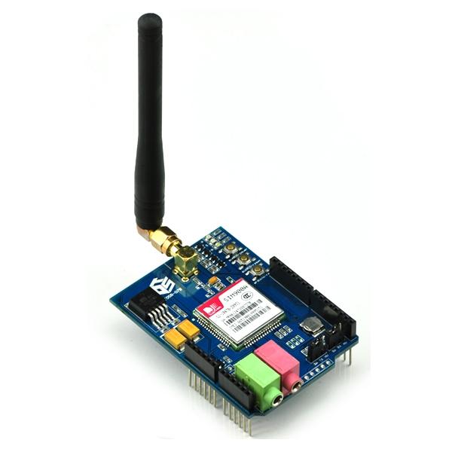
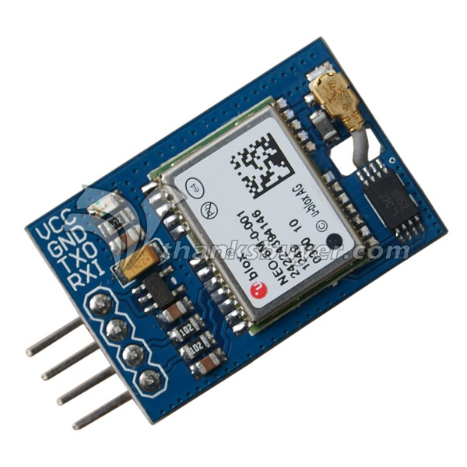
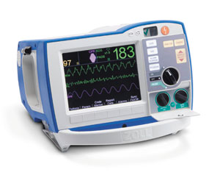

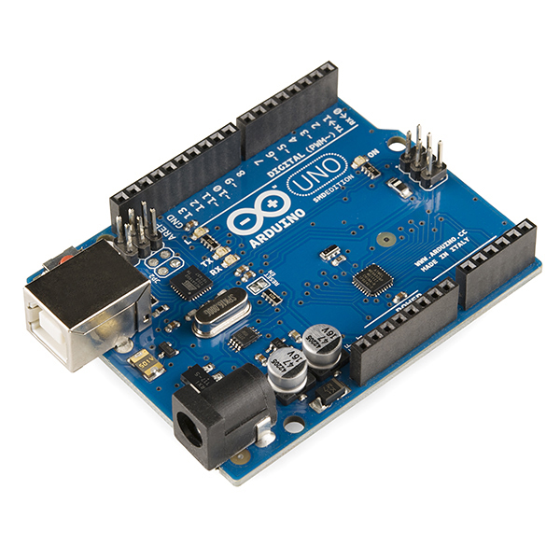

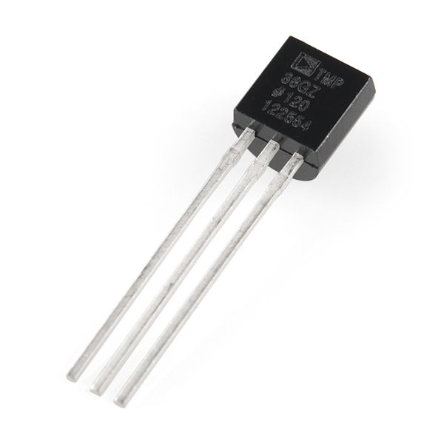
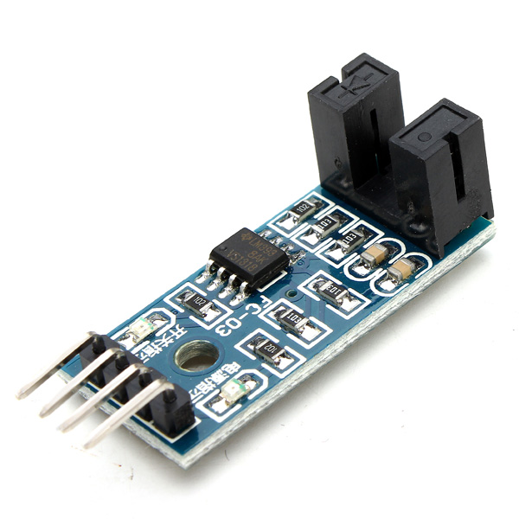
Possible Architecture
GSM/GPRS
GPS
Heartbeat sensor
Controller
Operating
Android Application
Server
Temperature sensor
Speed Sensor

Slide 12
Conclusion
Moment has to be an emergency in this case.
Ambulance coming home to reaching till hospital is a critical time
Doesn’t save persons’ lives but increases the chances of same very effectively
Patient’s health regarding data being sent to hospital increases the chances of patient being saved drastically

Slide 13
References
https://developer.android.com/about/android.html
http://www.edgefxkits.com/automatic-irrigation-system-on-sensing-soil-moisture-content
http://www.sswm.info/content/automatic-irrigation
http://electronut.in/IoT-temp-sensor/
http://www.instructables.com/id/Temperature-Monitor-with-ESP8266-IoT/
https://www.fcc-fac.ca/en/ag-knowledge/ag-economist/the-automation-of-agriculture-part-one.html

Slide 14
Thank You

