Slide 1
Smart Farm
Project – I
/* remove these names if the above title looks good
1.Automation in Agriculture
2.sustainable agriculture automation
3.automation in Sustainable agriculture
*/

Slide 2

Team members:
1) 130070107025 - GAURAV JINDAL
2) 130070107029 - ANKUR KIYADA
3) 130070107040 - MEET PATEL
4) 130070107048 - KUNAL SAHITYA
7th Semester (2016), Computer Engineering Department,
B.V.M. Engineering College, Vallabh Vidyanagar,
College Code - 007

Slide 3
Purpose
To automate most part of the agriculture process.
To make the irrigation process easy, automatic and water efficient.
For Water management.
To make framers’ job easy for odd jobs like maintaining grown crops, spraying pesticides etc.

Slide 4
Introduction & Basic Idea
Why Sustainable Agriculture?
Enhance Environment Quality & Natural Resource
Support Economic Viability
Why Automation?
Improved Productivity, Quality & Consistency
Reduced Human Labor Costs & Errors
Why Automation in Sustainable Agriculture?
Plays Significant role for 1.4M km² Cultivation Land in India
Affects Different Phases of Agriculture Like Irrigation, Storage, Plant Health, etc.

Slide 5
Technologies Used
IoT - Internet of Things (For Connectivity Purpose)
Big Data Framework Tools(MR, Hive, R etc.)(For Data Analysis)
Android (For Operational purpose)
Web Development(HTML, CSS, JS etc.) (For Making a Web Portal)

Slide 6
IoT – Internet of Things
Defined as Network of Physical Devices Embedded with Electronics, Software, Sensors, Actuators & Network Connectivity.
Aim is to Collect & Exchange Data + Act Accordingly as Programmed.
Devices to be used are:
Moisture Sensor
Micro Controller (Ardunio etc.)
Temperature Sensor

Slide 7
Big Data Framework Tools
Tools like Hive, R or MR will be used for Analysis.
Data collected from IoT devices will be processed.
Possible list of tools to be used:
Hadoop and/or Spark
Hive or Pig
MR or R programming

Slide 8
Android App And Web Development
Android App will be one of the 2 user interfaces.
Will be used by Framers.
While a website will be the other user interface, for reporting of analysis results.
Technology used for website will be:
HTML & CSS
JS ( and D3.js)

Slide 9
Project Modules
Automatic Irrigation
Data Analysis & Prediction
Warehouse Maintenance
Android Application
Website

Slide 10
Automatic Irrigation
Handles the irrigation work without any input requirement from the farmer.
Uses:
Moisture Sensor
Switch
Electro Magnetic Valve
Used for:
Moisture Maintenance
Compatible to all types of irrigation

Slide 11
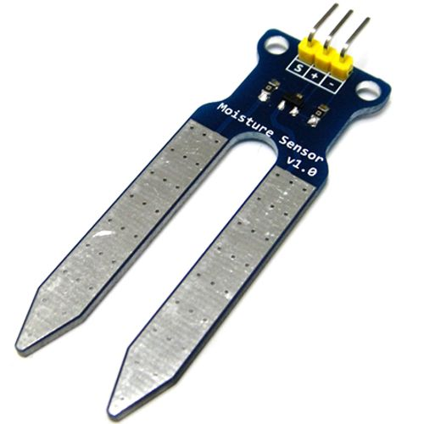
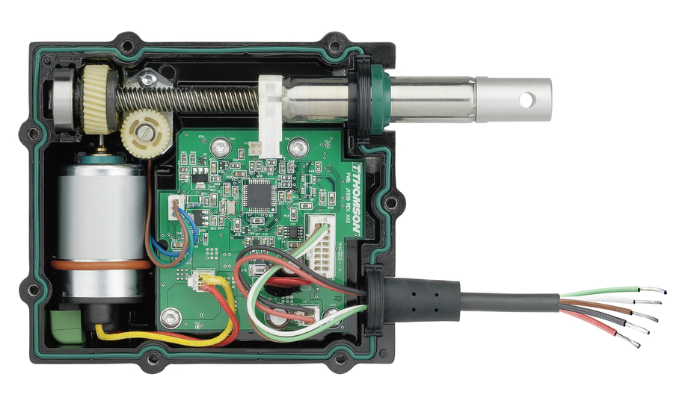

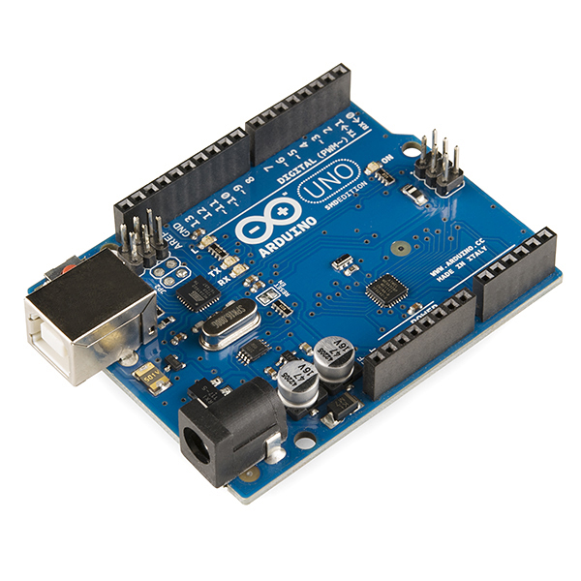

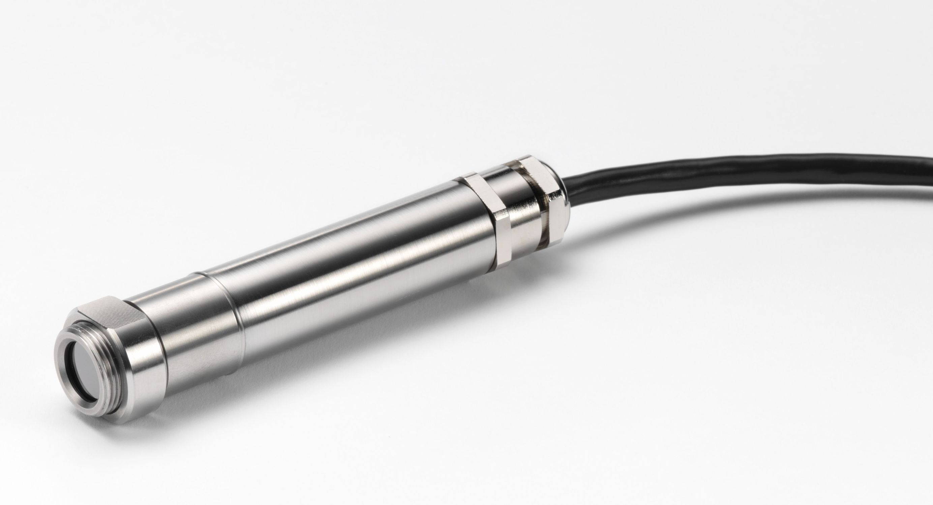
Possible Architecture
Sensor1
Actuator1
Controller
Operating
Android Application
Server
Actuator2
Sensor2

Slide 12
Data Analysis & Prediction
Based on the data collected from all the sources, several results can be drawn.
Analysis will be done for:
Water Consumption
Crop Properties
Crop Suggestions

Slide 13
Warehouse Maintenance
Crops are to be maintained even after harvesting.
Factors that can affect crops:
Humidity
Moisture
Temperature, etc.
Devices used for keeping check on them:
Temperature Sensor
Alarm etc.

Slide 14
Android App
It will the interface between farmer and our system.
Features Provided:
Crop Suggestions: Helps farmer to decide which crop will be best based on the analysis done.
Crop Selection: Used to notify new crop planted.
Pest Control: A control switch which can spray pesticides.

Slide 15
Website
It will be the 2nd interface but not specifically for farmer.
Features Provided:
All graphs showing the result of analysis.
APIs

Slide 16
Conclusion
Conclusion really???
We have just started how can we conclude???
Chalo keh he rahe ho to: “So from this presentation we can conclude that this is one of the best project. THANK YOU”

Slide 17
References
https://developer.android.com/about/android.html
http://www.edgefxkits.com/automatic-irrigation-system-on-sensing-soil-moisture-content
http://www.sswm.info/content/automatic-irrigation
http://electronut.in/IoT-temp-sensor/
http://www.instructables.com/id/Temperature-Monitor-with-ESP8266-IoT/
https://www.fcc-fac.ca/en/ag-knowledge/ag-economist/the-automation-of-agriculture-part-one.html

Slide 18
Thank You

