Slide 1
Smart Farm
Project – I
/* remove these names if the above title looks good
1.Automation in Agriculture
2.sustainable agriculture automation
3.automation in Sustainable agriculture
*/

Slide 2

Team members:
1) 130070107025 - GAURAV JINDAL
2) 130070107029 - ANKUR KIYADA
3) 130070107040 - MEET PATEL
4) 130070107048 - KUNAL SAHITYA
7th Semester (2016), Computer Engineering Department,
B.V.M. Engineering College, Vallabh Vidyanagar,
College Code - 007

Slide 3
Introduction & Basic Idea
Why Sustainable Agriculture?
Enhance Environment Quality & Natural Resource
Support Economic Viability
Why Automation?
Improved Productivity, Quality & Consistency
Reduced Human Labor Costs & Errors
Why Automation in Sustainable Agriculture?
Plays Significant role for 1.4M km² Cultivation Land in India
Affects Different Phases of Agriculture Like Irrigation, Storage, Plant Health, etc.

Slide 4
Technologies Used
IoT - Internet of Things (For Connectivity Purpose)
Big Data Framework Tools(MR, Hive, R etc.)(For Data Analysis)
Android (For Operational purpose)
Web Development(HTML, CSS, JS etc.) (For Making a Web Portal)

Slide 5
IoT – Internet of Things
Network of Physical Devices Embedded with Electronics, Software, Sensors, Actuators & Network Connectivity.
Aim is to Collect & Exchange Data + Act Accordingly as Programmed.
Devices to be used are:
Moisture Sensor
Micro Controller (Ardunio etc.)
Temperature Sensor

Slide 6
Big Data Framework Tools
Tools like Hive, R or MR will be used for Analysis.
Data collected from IoT devices will be processed.
Possible list of tools to be used:
Hadoop and/or Spark
Hive or Pig
MR or R programming

Slide 7
Android App And Web Development
Android App will be one of the 2 user interfaces.
Will be used by Framers.
While a website will be the other user interface, for reporting of analysis results.
Technology used for website will be:
HTML & CSS
JS ( and D3.js)

Slide 8
Project Modules
Automatic Irrigation
Data Analysis & Prediction
Warehouse Maintenance
Android Application
Website

Slide 9
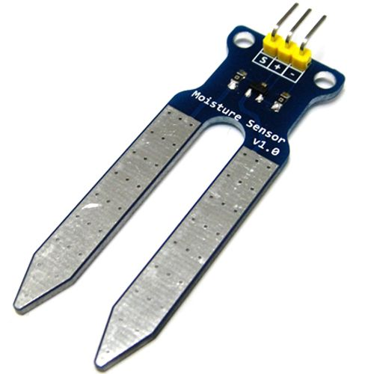
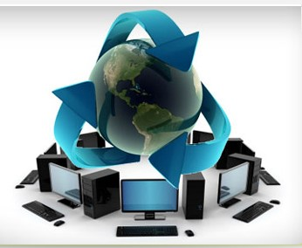
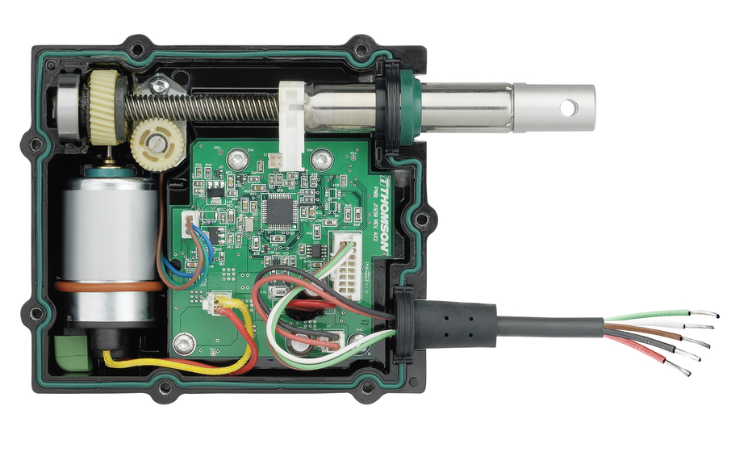

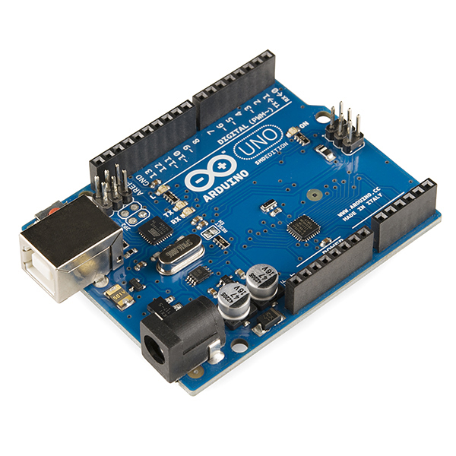

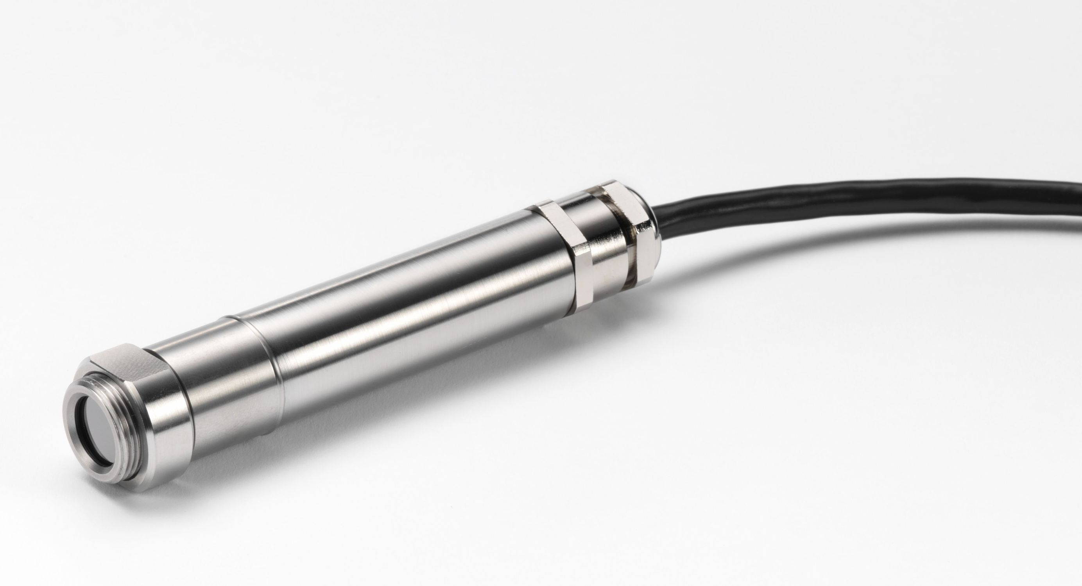
Possible Architecture
Sensor1
Actuator1
Web Portal
Controller
Server
Actuator2
Operating
Android Application
Sensor2

Slide 10
Automatic Irrigation
Handles the irrigation work without any input requirement from the farmer.
Uses:
Moisture Sensor
Switch
Electro Magnetic Valve
Used for:
Moisture Maintenance
Compatible to all types of irrigation

Slide 11
Data Analysis & Prediction
Based on the data collected from all the sources, several results can be drawn.
Analysis will be done for:
Water Consumption
Crop Properties
Crop Suggestions

Slide 12
Warehouse Maintenance
Crops are to be maintained even after harvesting.
Factors that can affect crops:
Humidity
Moisture
Temperature, etc.
Devices used for keeping check on them:
Temperature Sensor
Alarm etc.

Slide 13
Android App
It will the interface between farmer and our system.
Features Provided:
Crop Suggestions: Helps farmer to decide which crop will be best based on the analysis done.
Crop Selection: Used to notify new crop planted.
Pest Control: A control switch which can spray pesticides.

Slide 14
Website
It will be the 2nd interface but not specifically for farmer.
Features Provided:
All graphs showing the result of analysis.
APIs

Slide 15
Conclusion
Some Facts to conclude:
Approximately 1.4 Million KM² area is under cultivation
Fifth part of total water consumption is for agriculture
For that 80% of ground water is used from total ground water consumption
One step towards improvement in these vital things
Moreover Ease and automation for farmers

Slide 16
References
https://developer.android.com/about/android.html
http://www.edgefxkits.com/automatic-irrigation-system-on-sensing-soil-moisture-content
http://www.sswm.info/content/automatic-irrigation
http://electronut.in/IoT-temp-sensor/
http://www.instructables.com/id/Temperature-Monitor-with-ESP8266-IoT/
https://www.fcc-fac.ca/en/ag-knowledge/ag-economist/the-automation-of-agriculture-part-one.html

Slide 17
Thank You

