Slide 1







AgroBrain
INTRODUCTION TO
AGROBRAIN
A SMART COMPANION FOR FARMERS
START NOW

Slide 2

AgroBrain
WHAT IS THE AGROBRAIN ?
• AgroBrain is a tech-driven platform for farmers
• It provides essential tools for weather forecasting, soil analysis, crop management, and market insights
• Our goal is to optimize farming with data-driven decisions

Slide 3
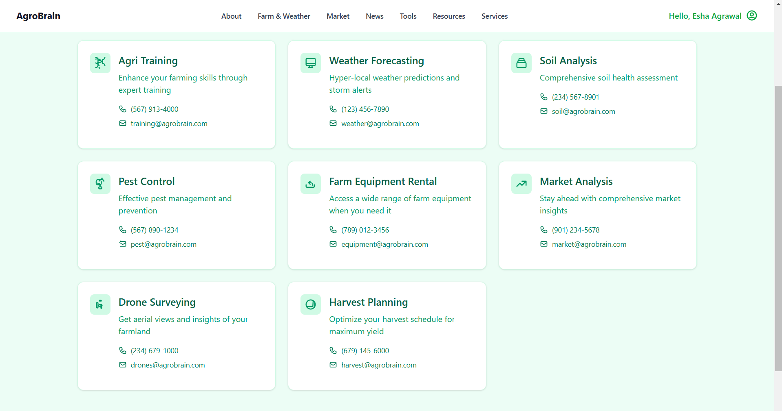
AgroBrain
FEATURES OVERVIEW
• Weather Forecasting
• Soil Analysis
• Crop Management
• Market Analysis
• Farm Mapping
• Trade, Tools, Resources, and News
.

Slide 4
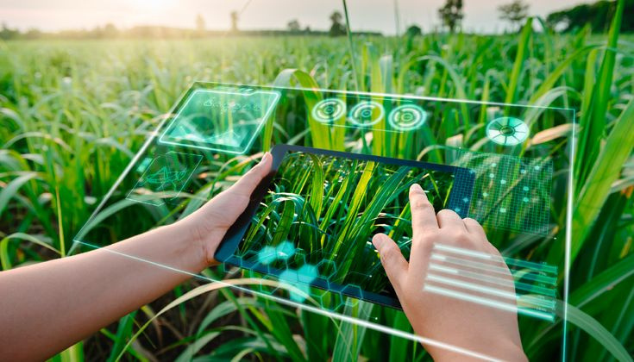

AgroBrain
INSIGHTS BOARD
• The central hub of AgroBrain
• Provides real-time updates on weather, news, and market trends
• Easy access to all features

Slide 5

AgroBrain
ENVIRONMENTAL CHALLENGES
PRECISION FORECAST
CLIMATE CHANGE
SMART FARMING
Our advanced technology ensures accurate predictions, helping you plan your day with confidence. Stay ahead of changing weather conditions with real-time updates!
Get precise weather updates with real-time data on temperature, humidity, wind speed, UV index, and precipitation. Stay informed and plan your day with confidence, no matter the conditions
Optimize farming with accurate weather insights! Plan sowing, irrigation, and harvesting efficiently with real-time updates on temperature, humidity, and rainfall

Slide 6

AgroBrain
ADVANCED SOIL DIAGNOSTICS
• Monitors soil moisture, temperature, and nutrients
• Helps determine soil health and fertility
• Provides insights for better crop yield

Slide 7

AgroBrain
SMART CROP MANAGEMENT
• Guides farmers on planting schedules, pest control, and fertilizers
• Maximizes crop yield and reduces losses
• AI-driven suggestions for better farm productivity

Slide 8


AgroBrain
MARKET ANALYSIS
• Provides real-time pricing for different crops
• Tracks market trends and demand
• Helps farmers sell at the best price

Slide 9

AgroBrain
FARM MAPPING
• Uses satellite imagery for field mapping
• NDVI analysis to monitor crop health
• Helps optimize land use and farm operations
Trade & Resources
• Farmers can connect with buyers & sellers
• Educational resources and guides available
• Have direct link for tools and resouces which a farmer can access directly with a price range

Slide 10
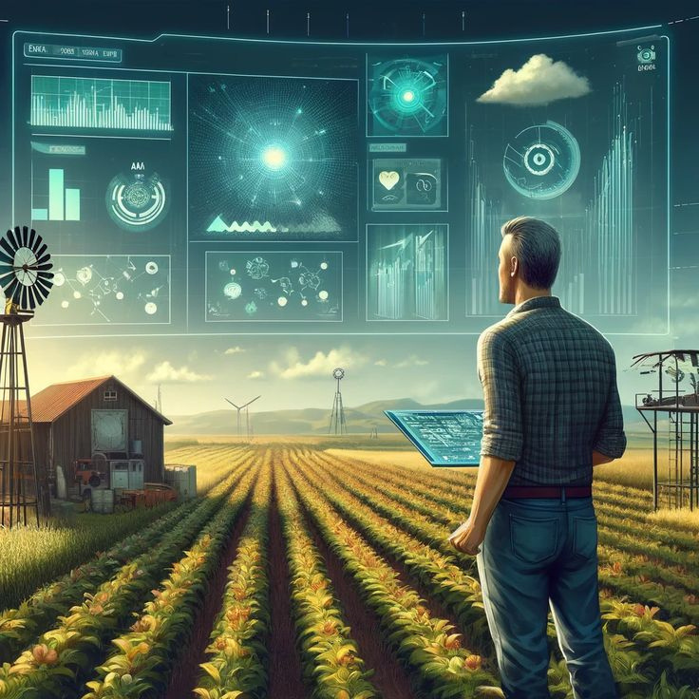
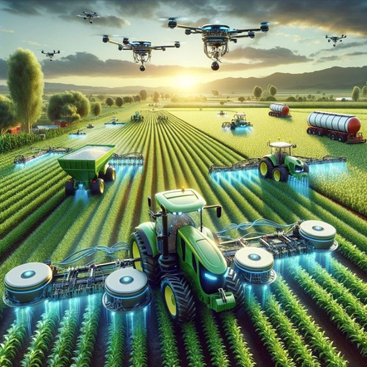
AgroBrain
UNIQUE SELLING POINTS & ADVANTAGES
• Data-Driven Farming
• All-in-One Agriculture Platform
• Smart Decision Making with Real-Time Insights
• Easy-to-Use Interface for Farmers

Slide 11
AgroBrain
THE FUTURE IS IN OUR HANDS
CONCLUSION – A CALL TO ACTION
AgroBrain enhances productivity and efficiency in farming
and A smart companion for modern farmers
Join us in revolutionizing agriculture with technology!

Slide 12
AgroBrain
THANK YOU
FOR ATTENTION
presented by:
Meet Doshi
Aditya Kumar Roy
Sai Balaji
Soumya Apurva
Aanya Singh Pawar

