Slide 1
INTERACTIVE TIC-TAC-TOE GAME
A GUI-Based Gaming Application
Developed by: Gunisha Agarwal (XI-B) & Anushka S (XI-A) Subject: Computer Science Academic Year: 2025-2026 Programming Language: Python

Slide 2


ACKNOWLEDGMENTS
We would like to express our sincere gratitude to Ms. Divya Saini (Teacher - Computer Science) for her invaluable guidance, continuous support, and expert mentorship throughout the development of this project, and to Ms. Sinia Sajith (Principal - Euro School, Whitefield) for providing the necessary resources, computer lab facilities, and fostering an environment that encourages innovation and learning in computer science education.

Slide 3

PROJECT OVERVIEW
The Tic-Tac-Toe Game Application is an interactive, GUI-based implementation of the classic 3×3 grid game.
The application features:
Multi-page Interface: Menu, Easy Mode, and Hard Mode
Two Difficulty Levels:
Easy Mode: Random computer moves
Hard Mode: Strategic AI with intelligent decision-making
User-Friendly GUI: Clean, colorful interface with intuitive controls
Game Logic: Complete win/lose/tie detection and board reset functionality

Slide 4
TIC TAC TOE
How Our Application Works
Player vs Computer: Human player always uses 'X', computer uses 'O'
Turn-Based Play: Player clicks a square to make a move, computer responds immediately
Visual Feedback: Buttons disable after use and display the chosen symbol
Win Conditions: Three in a row (horizontal, vertical, or diagonal) triggers game end
Result Display: Pop-up messages announce the winner

Slide 5
Easy vs Hard Mode
Easy Mode:
Random Strategy: Our code selects any available empty square randomly
Hard Mode:
Strategic Moves: Our code analyzes the board state and makes calculated moves
Intelligent Defense: Our code blocks player's winning moves automatically
Offensive Play: Our code actively seeks winning opportunities
Special Note: It is impossible to beat the computer in hard mode due to the advance intelligence of our code ☺

Slide 6
LIBRARIES USED
Tkinter (Built-in) import tkinter as tk from tkinter import messagebox Purpose: Creating the graphical user interface Features Used: Windows and frames for multi-page navigation Buttons for game interaction Message boxes for game results Grid layout management | Random (Built-in) import random Purpose: Implementing computer AI moves Features Used: Random choice selection for easy mode Strategic move selection in hard mode

Slide 7
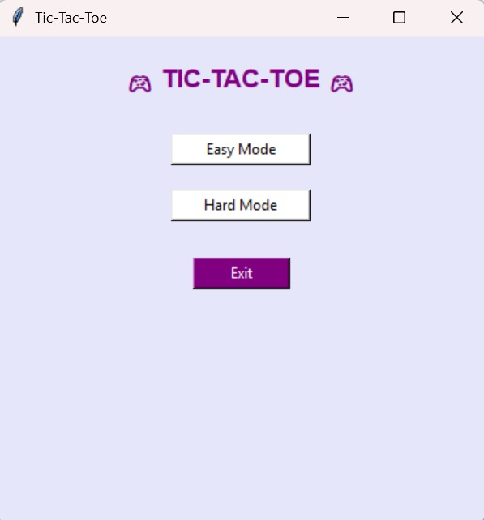
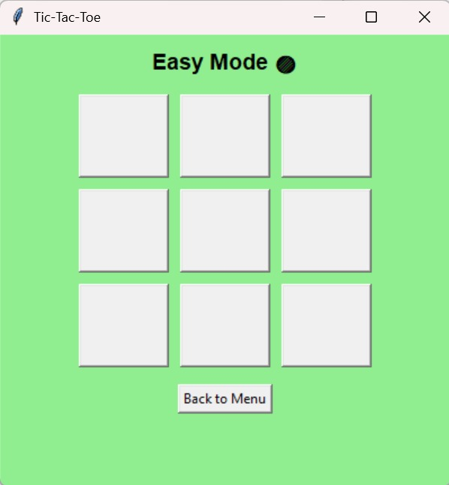
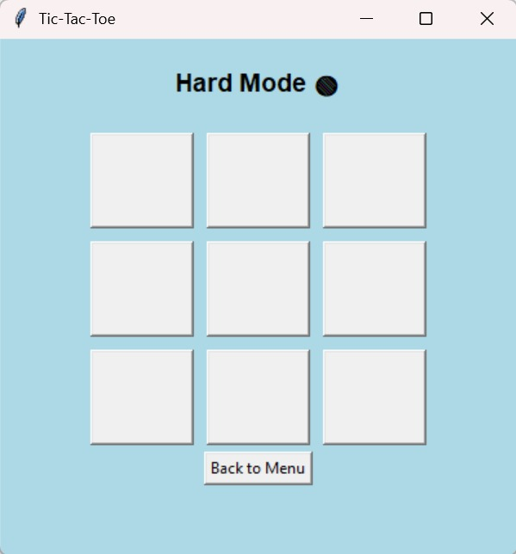
APPLICATION SCREENSHOTS

Slide 8
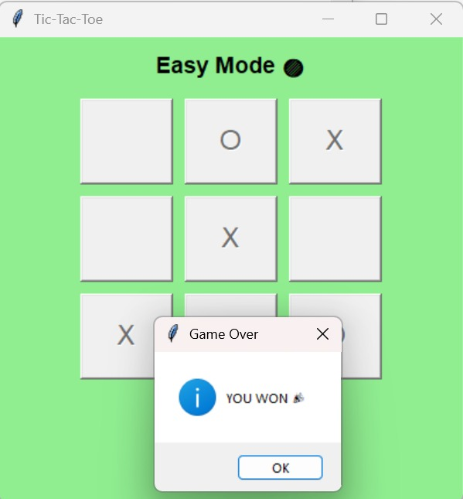
APPLICATION SCREENSHOTS

Slide 9
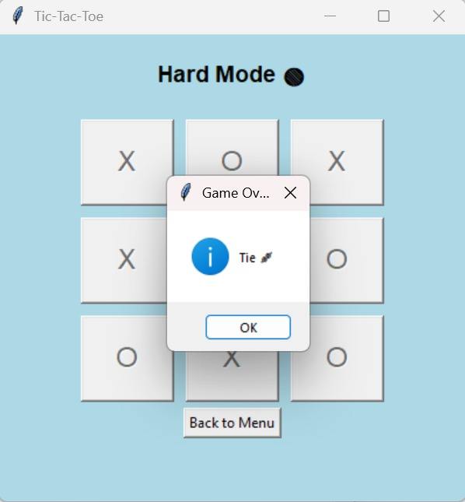
APPLICATION SCREENSHOTS

Slide 10
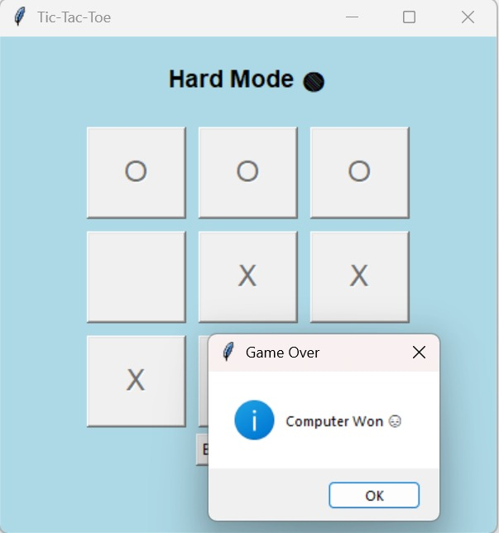
APPLICATION SCREENSHOTS

Slide 11
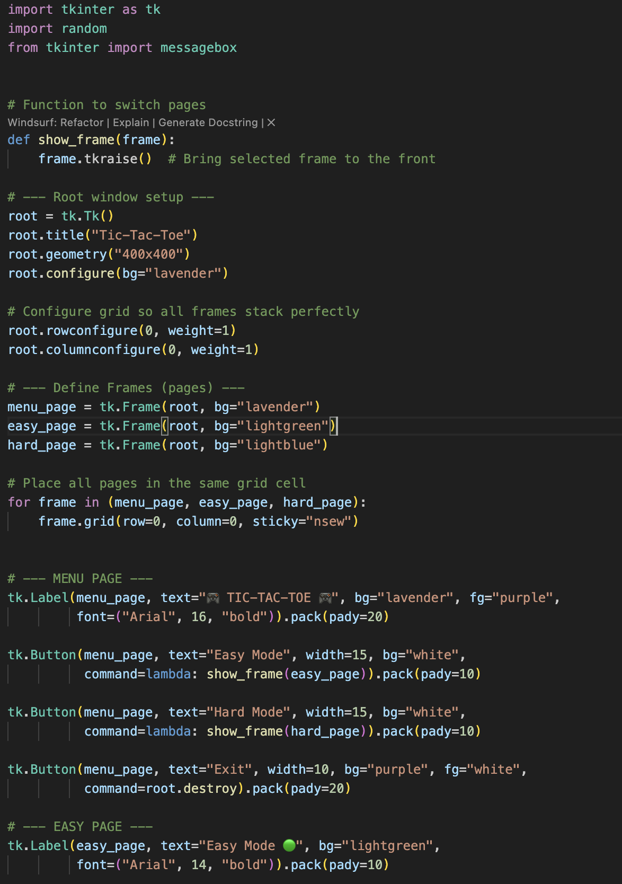
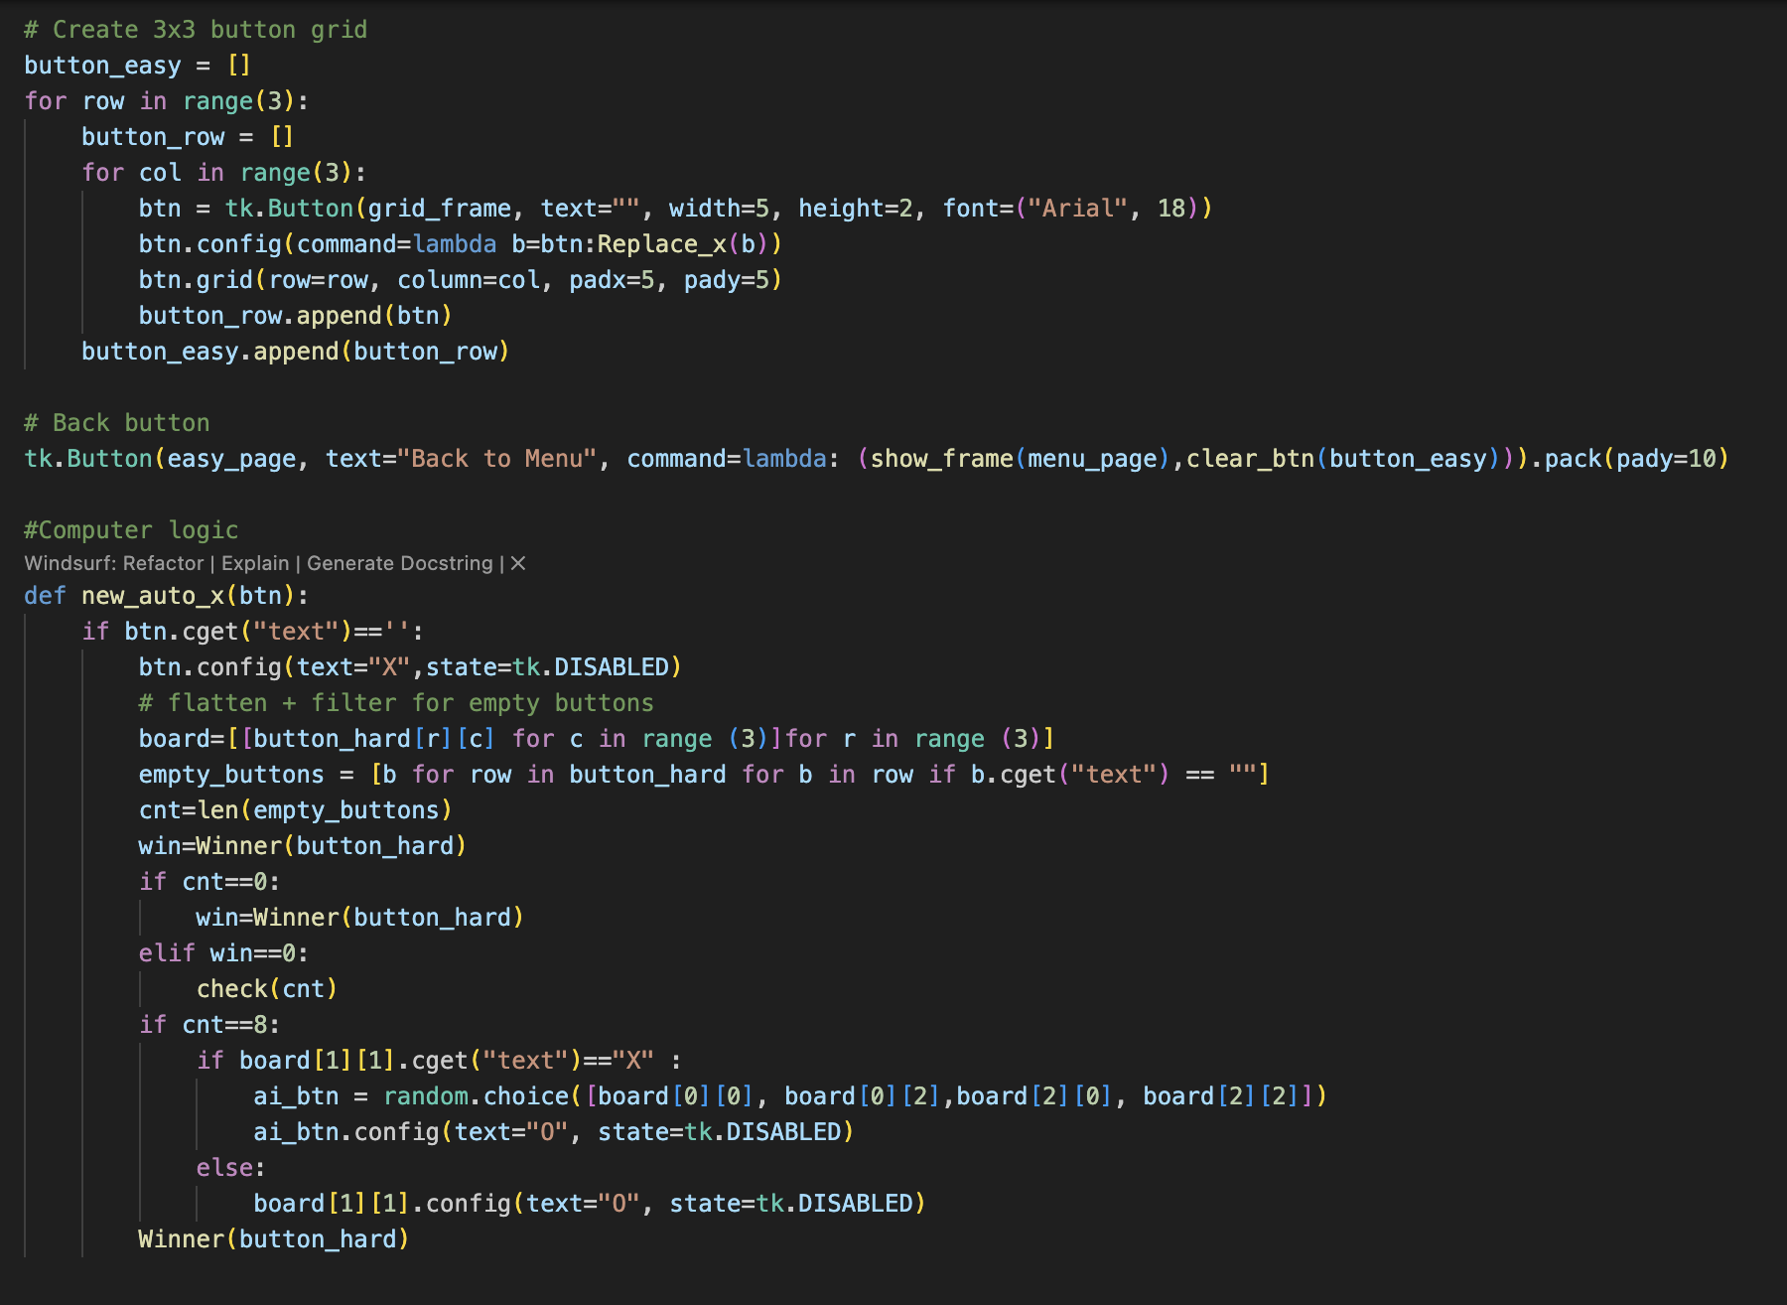
APPLICATION CODE SAMPLE

Slide 12
SCOPE FOR FUTURE DEVELOPMENT (GRADE 12)
Database Integration & Enhanced Features
Database Management System
User Profile Management
User registration and login system
Statistics tracking and analytics
Leaderboard and ranking system
Game State Management
Save and resume game functionality
Tournaments between player and computer
Timer based game control

Slide 13
CONCLUSION
Project Achievements
This Tic-Tac-Toe application successfully demonstrates:
Programming Fundamentals: Proper use of variables, functions, and control structures
GUI Development: Creating interactive user interfaces with Python Tkinter
Algorithm Implementation: Game logic, win detection, and AI strategy
Problem Solving: Breaking down complex problems into manageable components
Code Organization: Writing clean, readable, and maintainable code
Real-World Applications
The concepts learned in this project are applicable to:
Mobile app development
Web application development
Game development industry
Human-computer interaction design

Slide 14
BIBLIOGRAPHY
Books and References
”Computer Science with Python" Author: Sumita Arora
”Computer Science Textbook for Class XI" – NCERT
Online Resources
Python Official Documentation URL: https://docs.python.org/3/
Tkinter Documentation URL: https://docs.python.org/3/library/tkinter.html
Programming Communities
Stack Overflow URL: https://stackoverflow.com/questions/tagged/python For troubleshooting and problem-solving
Python.org Community URL: https://www.python.org/community/ For Python programming best practices

Slide 15

References
Github: https://github.com/meet2gunisha-lang/tictactoe#

Slide 16

Thank YOU

