Slide 1
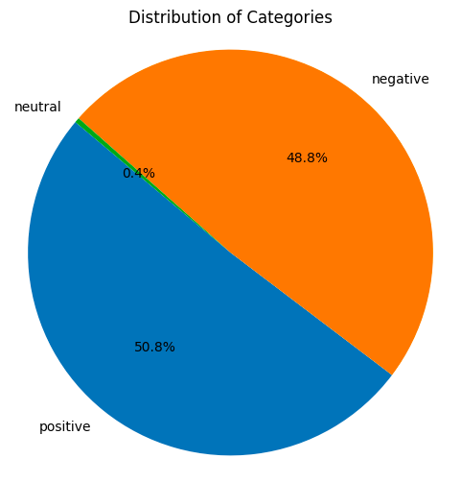
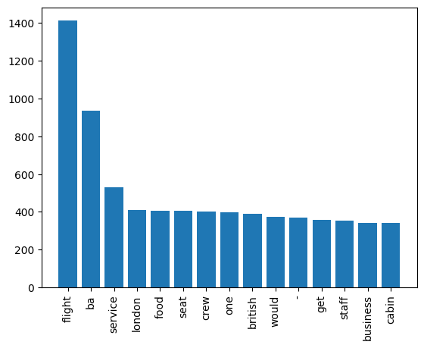
RESULTS
FINDINGS
MOST FREQUENT WORDS
Out of 1000 reviews
508 reviews are positive
488 reviews are negative
4 reviews are neutral
Words such as ‘flight’, ‘service’, ‘seat’, ‘british’, ‘staff’, etc are most used. With this, we can infer that reviews are mostly based on these topics.

Slide 2
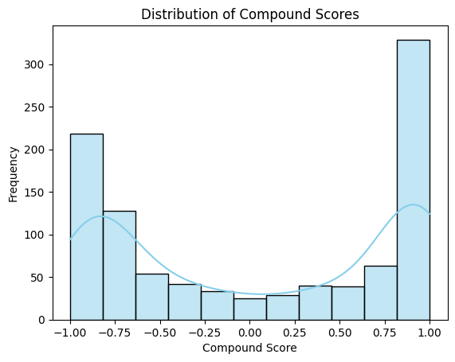
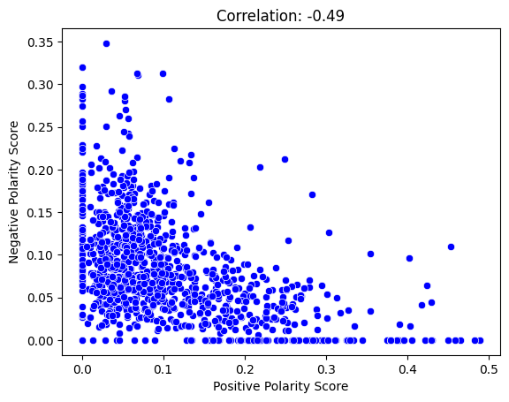
INSIGHTS
The distribution of compound polarity scores is bimodel which means it has two peak values which is revealed by histogram plot. Median is slightly higher than mean, this means positive reviews are slightly greater than negative reviews
A correlation coefficient of 0.49, being positive and less than 1, indicates a moderate positive correlation. This means that there is a tendency for both variables to increase together, but the relationship is not perfectly linear.

