Slide 1
Data Analysis Report
Automated Comprehensive Analysis

Slide 2
Executive Summary
Total Records: 100
Total Columns: 3
Total Missing Values: 0
Overall Missing Percentage: 0.00%
Insight 1
Insight 2

Slide 3
Insights: A
Summary:
  A is a positively skewed numeric variable with an average of 0.50.
Detailed Analysis:
  The variable 'A' contains 100 observations. It ranges from a minimum of 0.00 to a maximum of 1.00, with a standard deviation of 0.00. The average value is 0.50, while the median is 0.00. The mean is higher than the median, indicating a right-skewed distribution with potential high-value outliers. The data is relatively consistent (CV: 0.0%).

Slide 4
Distribution (Numeric): A

Slide 5
Insights: B
Summary:
  B is a positively skewed numeric variable with an average of 50.00.
Detailed Analysis:
  The variable 'B' contains 100 observations. It ranges from a minimum of 0.00 to a maximum of 100.00, with a standard deviation of 0.00. The average value is 50.00, while the median is 0.00. The mean is higher than the median, indicating a right-skewed distribution with potential high-value outliers. The data is relatively consistent (CV: 0.0%).

Slide 6
Distribution (Numeric): B

Slide 7
Insights: C
Summary:
  C is a categorical variable with 3 unique values, dominated by 'X'.
Detailed Analysis:
  The categorical variable 'C' has 3 distinct categories across 100 records. The most frequent category is 'X', appearing 40 times, which accounts for 40.0% of the data. With fewer than 5 unique values, this variable is suitable for use as a grouping dimension in analysis.

Slide 8
Frequency Table: C
Category | Count | Percentage (%)
X | 40 | 40.00%
Y | 33 | 33.00%
Z | 27 | 27.00%

Slide 9
Frequency (Categorical): C

Slide 10
Proportion (Categorical): C

Slide 11
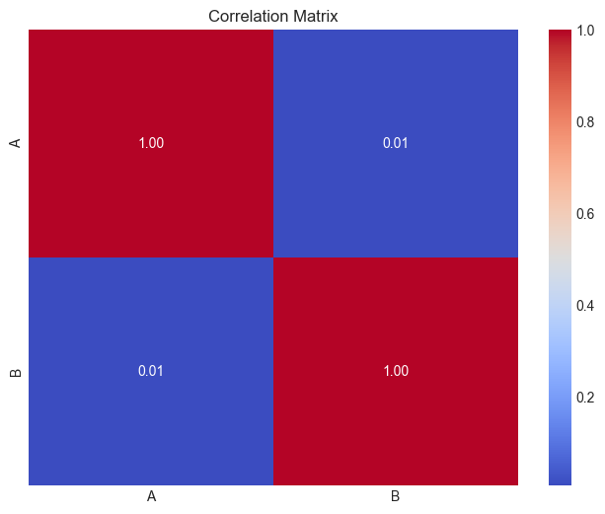
Correlation Matrix

Slide 12
A vs B

