Slide 1
Data Analysis Report
Automated Comprehensive Analysis

Slide 2
Executive Summary
Total Records: 7
Total Columns: 5
Total Missing Values: 1
Overall Missing Percentage: 2.86%
Data distribution suggests a potential correlation between numeric variables.
Recommendation: Visualize the distribution of key metrics to identify skewness.

Slide 3
Summary: id (Identifier)
Total Records | Unique Values | Missing Values
7 | 7 | 0

Slide 4
Insights: name
Summary:
  name is a categorical variable with 7 unique values, dominated by 'Alice'.
Detailed Analysis:
  The categorical variable 'name' has 7 distinct categories across 7 records. The most frequent category is 'Alice', appearing 1 times, which accounts for 14.3% of the data. Every record has a unique value, suggesting this might be an identifier.

Slide 5
Frequency Table: name
Category | Count | Percentage (%)
Alice | 1 | 14.29%
Bob | 1 | 14.29%
Charlie | 1 | 14.29%
David | 1 | 14.29%
Eve | 1 | 14.29%
Frank | 1 | 14.29%
Grace | 1 | 14.29%

Slide 6
Frequency (Categorical): name

Slide 7
Insights: age
Summary:
  age is a positively skewed numeric variable with an average of 30.00.
Detailed Analysis:
  The variable 'age' contains 6 observations. It ranges from a minimum of 22.00 to a maximum of 40.00, with a standard deviation of 6.60. The average value is 30.00, while the median is 29.00. The mean is higher than the median, indicating a right-skewed distribution with potential high-value outliers. The data is relatively consistent (CV: 22.0%).

Slide 8
Distribution (Numeric): age

Slide 9
Insights: score
Summary:
  score is a negatively skewed numeric variable with an average of 83.29.
Detailed Analysis:
  The variable 'score' contains 7 observations. It ranges from a minimum of 70.00 to a maximum of 95.00, with a standard deviation of 8.79. The average value is 83.29, while the median is 85.00. The mean is lower than the median, indicating a left-skewed distribution. The data is relatively consistent (CV: 10.6%).

Slide 10
Frequency (Categorical): score

Slide 11
Insights: category
Summary:
  category is a categorical variable with 3 unique values, dominated by 'A'.
Detailed Analysis:
  The categorical variable 'category' has 3 distinct categories across 7 records. The most frequent category is 'A', appearing 3 times, which accounts for 42.9% of the data. With fewer than 5 unique values, this variable is suitable for use as a grouping dimension in analysis.

Slide 12
Frequency Table: category
Category | Count | Percentage (%)
A | 3 | 42.86%
B | 2 | 28.57%
C | 2 | 28.57%

Slide 13
Frequency (Categorical): category

Slide 14
Proportion (Categorical): category

Slide 15
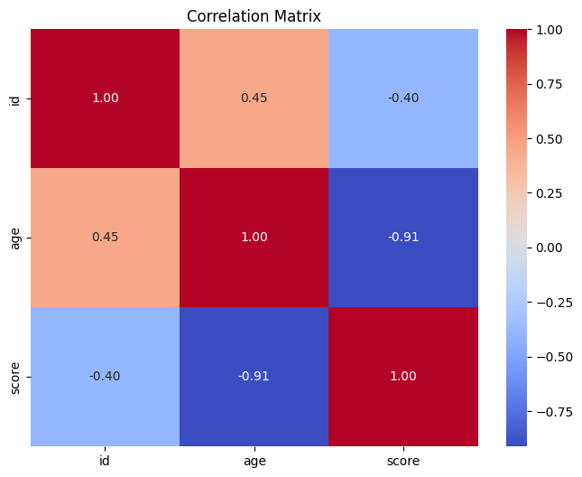
Correlation Matrix

Slide 16
age vs score

Slide 17
id vs age

Slide 18
id vs score

