Slide 1



SMART INDIA HACKATHON 2026
TITLE PAGE
Problem Statement ID – SIH26074
Problem Statement Title – Downscaling of weather forecast from Block level to Panchayat level
Theme – Agriculture, FoodTech & Rural Development
PS Category – Software
Team ID –
Team Name – Aero-Vision

Slide 2























AeroAtmos
AI-Powered Downscaling of Weather Forecast from Block Level to Panchayat Level
CORE CAPABILITIES
AEROATMOS ECOSYSTEM
VALUE FOR STAKEHOLDERS
01 AI-powered downscaling
Learns each panchayat's correction to the block forecast
INPUT DATA SOURCES
Higher accuracy
12–67% lower error than the raw block forecast on unseen panchayats
Block forecast
Panchayat boundaries
Terrain & land cover
Weather history
02 Multi-source data fusion
Block forecast, 9 km weather history, LGD boundaries, terrain, land cover
NOAA GFS, 1–5 days ahead (stand-in for IMD feed)
LGD codes · 87 gram panchayats
Copernicus 90 m DEM · ESA WorldCover 10 m
ECMWF IFS 9 km · Jan 2024–Sep 2026
Early risk awareness
Heavy-rain, heat and frost alerts for each panchayat
03 5-day, IMD-style forecast
Rain, max/min temp, humidity, wind, cloud, chance of rain
AeroAtmos | AI + ML
Gradient-boosted correction models
Block → Panchayat · 5 variables + chance of rain
Local relevance
Advice for the farmer's own panchayat, not the whole block
04 Tested, not assumed
Scored on panchayats it never saw, against the block forecast
Transparent & trusted
Every forecast shows its data source, issue time and tested accuracy
PANCHAYAT-LEVEL OUTPUTS · NEXT 5 DAYS
05 Agromet advisories
IMD rainfall categories + heat, frost, humidity & wind rules
Rainfall (mm)
Max / min temp (°C)
Humidity (%)
Wind speed & direction
Chance of rain
Advisories
Agriculture benefits
When to irrigate, spray, sow or protect a harvest
06 User-friendly access
FastAPI + web dashboard with real panchayat boundary map
Farmers & citizens
Disaster managers
Agromet units / KVKs
Climate resilience
Better-prepared, more resilient villages
Own-panchayat forecast and simple advice
Heavy-rain, heat & frost alerts; risk map
Panchayat inputs for IMD's twice-weekly bulletins
Planned integrations: IMD block feed · SACHET alerts (NDMA) · panchayat rain gauges

Slide 3











TECHNICAL APPROACH
AeroAtmos — Block-to-Panchayat Weather Downscaling Pipeline
7-STEP DOWNSCALING PIPELINE
1
2
3
4
5
6
7
Block forecast input
Panchayat data
Feature building
ML downscaling
Validation
Advisory generation
API / map output
GFS forecast at each block centre, 1–5 days ahead (IMD feed when available)
LGD boundaries → location & area; elevation, terrain relief, land cover
Own-block forecast + neighbouring blocks (distance-weighted) + terrain + season
Gradient boosting learns the correction to the block forecast, one model per variable
Scored on unseen panchayats and the last 6 months against 3 baselines
IMD rainfall categories + heat, frost, humidity & wind rules; 5-day outlook
FastAPI endpoints + dashboard with real panchayat boundary map
SYSTEM ARCHITECTURE
BUILT FOR SCALE
USER / FRONTEND
Web dashboard (Leaflet + Chart.js)
District → Block → Panchayat
5-day forecast & advisory
Boundary map & alerts
Hyperlocal
87 real gram panchayats (LGD) today
AI / ML ENGINE
Python + scikit-learn
Gradient boosting × 5 (corrections)
Chance-of-rain classifier
Validation report
Data-driven
~2.7 years of real forecasts & weather
DATA SOURCES
GFS block forecasts (Open-Meteo)
ECMWF IFS 9 km history
LGD panchayat boundaries
Copernicus DEM + ESA WorldCover
Multi-output
5 variables + chance of rain, 5 days ahead
STORAGE
CSV / GeoJSON data files
Model file (downscaling.joblib)
Download cache (resumable)
PostgreSQL + PostGIS (planned)
Lightweight
Trains in ~3 minutes on a laptop, no GPU
API / OUTPUT
FastAPI (REST)
/forecast — 5-day forecast
/geo — panchayat boundaries
/model/skill · /meta
Scalable
Add any block from LGD with one script
DATA FLOW
Block forecast
GFS today · IMD feed next
Panchayat features
LGD · DEM · land cover
Correction model
One per variable
Panchayat forecast
+ IMD-style advisory
API + dashboard
Map · alerts · CSV

Slide 4








FEASIBILITY AND VIABILITY
AeroAtmos – Block-to-Panchayat Weather Downscaling (SIH26074)
FEASIBLE WITH PROVEN TECHNOLOGY
KEY CHALLENGES / RISKS
MITIGATION STRATEGIES
Proven ML stack
Python, pandas, scikit-learn (gradient boosting), FastAPI, Leaflet
Official IMD data access
IMD's block forecast feed needs approved access; NOAA GFS stands in for now
Official data integration
Plug in IMD's block feed; the pipeline accepts any block forecast
Ground truth
Checked against ECMWF's 9 km analysis, not rain gauges yet
Ground-truth calibration
Train & validate with IMD AWS and Bihar Mausam Sewa Kendra rain gauges
Data available today
Free open data: Open-Meteo (GFS archive, ECMWF IFS, DEM), LGD boundaries, ESA WorldCover
Rain events
Catches fewer moderate-rain days (32% vs 45%); chance of rain not yet better than the monthly average
Rain model upgrade
Separate rain-occurrence model with calibrated probabilities
Software-only deployment
No sensors needed; trains in ~3 min on a laptop and runs on any server
Coverage
5 blocks, 87 real gram panchayats in Patna & Gaya
Expand geography
Build any block's panchayats from LGD boundaries with one script
VALIDATED ON REAL DATA
Truth: ECMWF IFS 9 km analysis · rain days caught 81% vs 64%
IMPLEMENTATION PATH
Mean absolute error on 22 panchayats never seen in training · test period 26 Mar – 21 Sep 2026
✓ Done
Prototype
✓ Done
Real data
✓ Done
Validation
Next
Rain-gauge truth
Next
District-wide
Variable | Our model | Block forecast as-is | Error reduced
Rainfall | 3.8 mm | 4.4 mm | −12%
Max temperature | 1.6 °C | 4.4 °C | −63%
Min temperature | 1.1 °C | 2.5 °C | −57%
Humidity | 6.5 % | 19.6 % | −67%
Wind speed | 2.5 km/h | 5.7 km/h | −56%
Safety: prototype forecasts must not be presented as official IMD forecasts.
Reliability: every forecast carries its data source, issue time and tested accuracy.

Slide 5
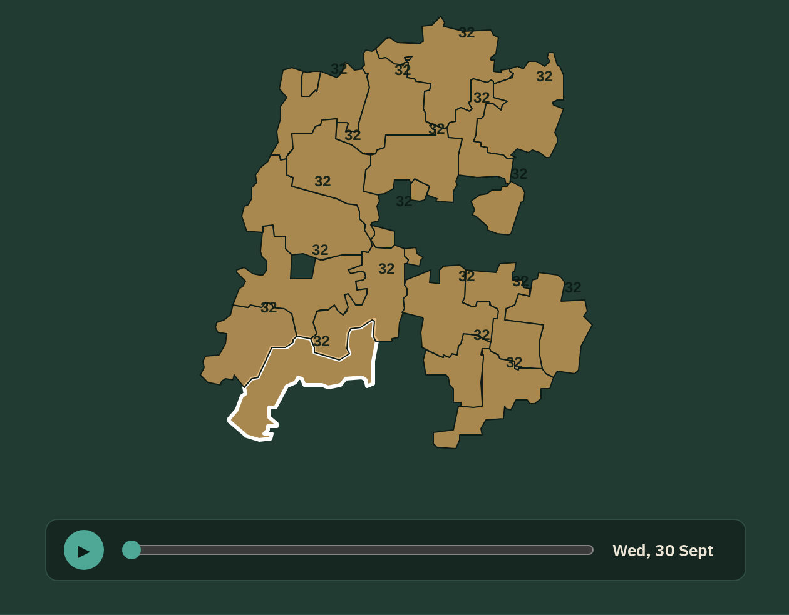




IMPACT AND BENEFITS
AeroAtmos – Panchayat-Level Weather Intelligence from Block-Level Forecasts
WHAT IS AEROATMOS?
MULTIDIMENSIONAL IMPACT & BENEFITS
REAL FORECAST MAP — MASAURHI BLOCK
An AI/ML system that downscales block-level forecasts to every gram panchayat for the next 5 days, using terrain, land cover and ~2.7 years of real weather data.
Agriculture & irrigation
Disaster management
When to irrigate, spray or sow; better crop planning; lower input losses
Heavy-rain, heat & frost alerts; panchayat-level readiness
Get local forecasts
Panchayat-level, 5 days ahead
Water management
Community safety
View weather parameters
Rain, max/min temp, humidity, wind
Local rain estimates for irrigation and reservoir decisions
Timely local alerts; better-informed villages
See panchayat maps
Real LGD boundaries
Rural planning
Climate resilience
Receive actionable advisories
IMD rainfall categories, heat & frost alerts
Panchayat-wise weather data for planning and infrastructure
Adapting farming to local weather risk
Sample panchayat forecast — Bara (Masaurhi, Patna)
Wed 30 Sep 2026 · issued 29 Sep, 18:25 IST · real data
KEY BENEFITS
Granular forecasts
Panchayat-level, not block-level
Better planning
Agriculture, water & infrastructure
Farm advisories
Irrigation & spraying
Faster risk awareness
Heavy rain, heat, frost
Scalable
Any block, any district
0.8 mm
Very light rain
32° / 25°
Max / min °C
82 %
Humidity
6.5 km/h
Wind, from W
Advisory: Dry and calm — a good window for spraying and field work.

Slide 6
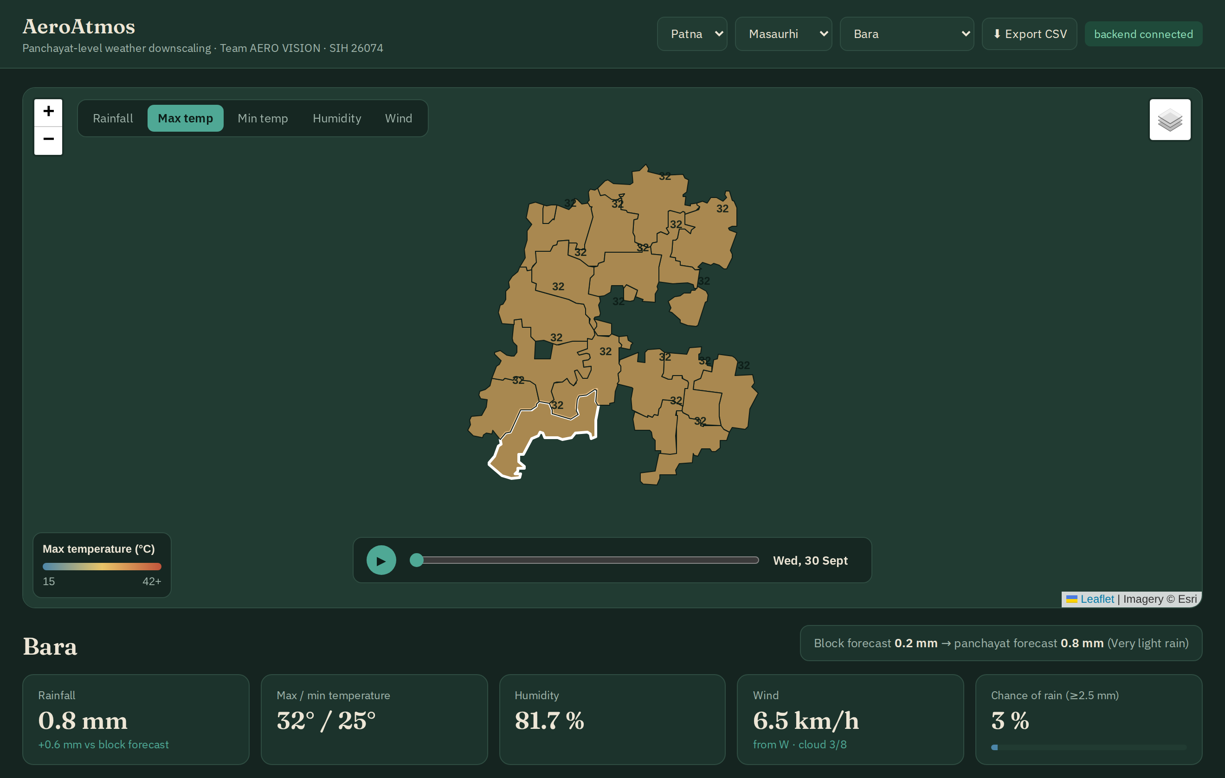

Research and References
AeroAtmos – Panchayat-Level Weather Downscaling (SIH26074)
RESEARCH PAPERS
01
Deep Learning-Based Multi-Hazard Climate Early Warning System Using Machine Learning and Artificial Neural Networks
Astha Raghuwanshi, Climate Lab, National Institute of Technology Delhi, India
02
Exploring Large Language Models for Climate Forecasting
Journal: AIMS Press Atmospheric Science · DOI: 10.3934/aci.202501
DATA SOURCES USED
Open-Meteo API
NOAA GFS forecast archive · ECMWF IFS 9 km · Copernicus DEM — open-meteo.com
LGD boundaries (datameet)
Gram panchayat boundaries & codes — GitHub: ramSeraph/indian_admin_boundaries
ESA WorldCover
10 m land cover — esa-worldcover.org
Planned
IMD MAUSAM API (block feed) · SACHET alerts (NDMA)
AeroAtmos dashboard — real 5-day forecast for Masaurhi block, Patna (issued 29 Sep 2026)
TECHNICAL PLATFORMS
87
real gram panchayats (LGD)
2.7 yrs
of real forecasts & weather
up to 67%
lower error than the block forecast
Python + scikit-learn
FastAPI
Leaflet + Chart.js
Planned: Docker, PostgreSQL + PostGIS

