Slide 1
COMPANION
PROJECT BY :
Anubhav Gupta 1601209421
Disha Kumari 1601209424

Slide 2
CONTENTS
Introduction
Problem statement
Objectives
Design
Future Scope
Conclusion

Slide 3

INTRODUCTION
Remainder software Make life easier” It's a quick,
simple and easy to use reminder app. No Stress,
Feel Relaxed. It will remind you everything!!
Memory like a sieve?

Slide 4
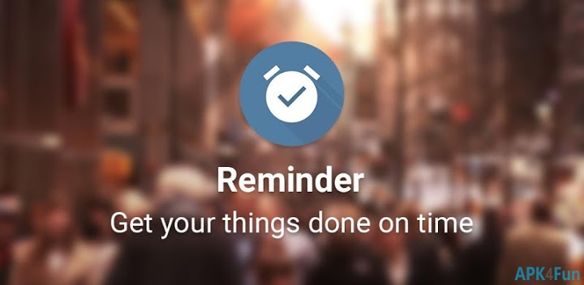
PROBLEM STATEMENT
To provide individual a platform for easy life notifications.
Set reminder once at the start of the day and set
Back and relax it’ll notify at the destined time .
An email will notify you at given time.

Slide 5
OBJECTIVE
No important events will be missed.
One will be stay updated according to his schedule.
Can send emails at a particular time.
No more missing of important life events.

Slide 6
DESIGN

Slide 7
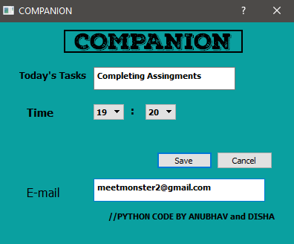
APP UI (Home screen)

Slide 8
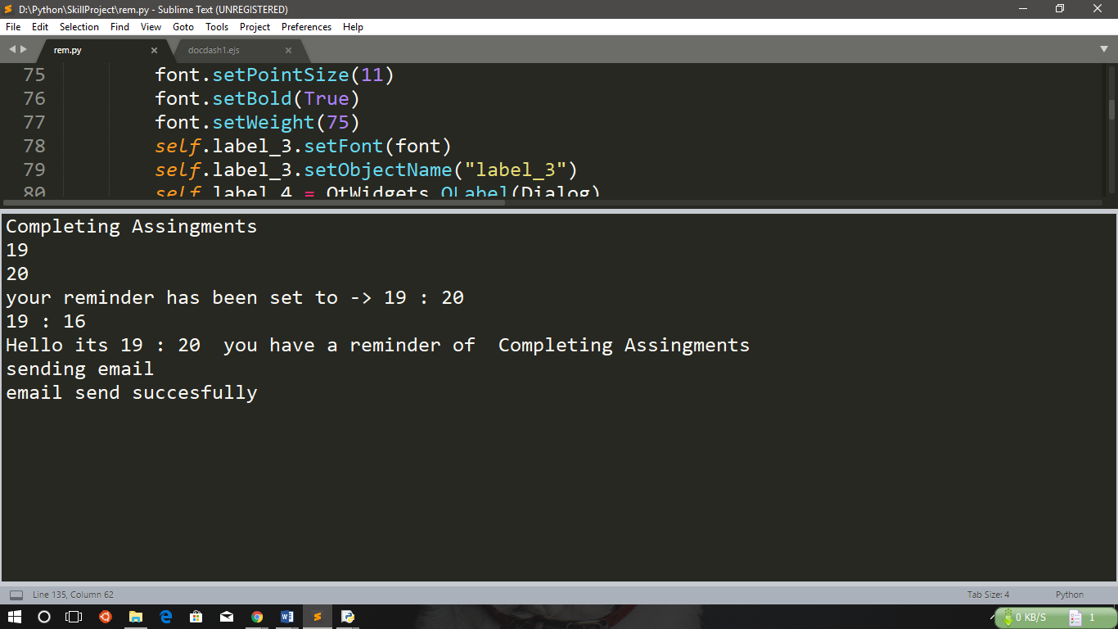
BACKGROUND PROCESS

Slide 9
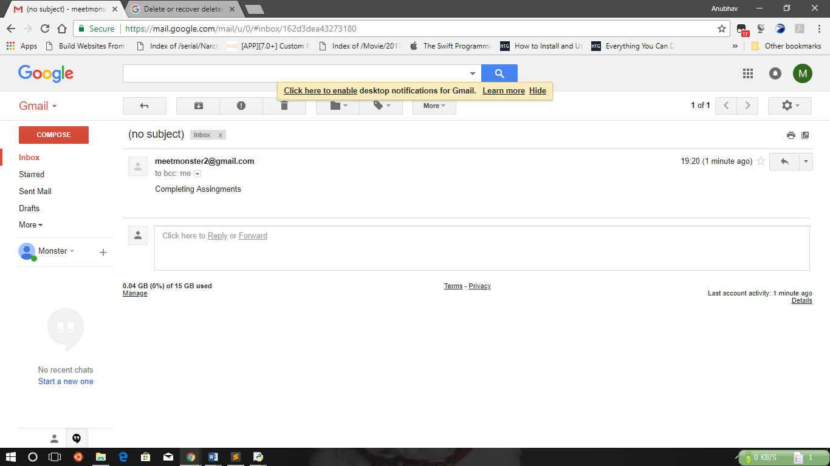
E-MAIL NOTIFICATION

Slide 10

FUTURE SCOPE
In the long-term,we believe that insights and predictions about tasks and
the use of reminders can help with building and fielding systems with the
ability to proactively reserve time, manage conflicts, remind people about
tasks they might forget, and, more generally, to help people achieve their goals.

Slide 11
CONCLUSION
Task reminder is the best solution over missing and forgetting important life events.
One of the most important impacts of technology is the development of sustainable technologies that reduce the stress of an individual and keep them reminding their important tasks of the day along with different methods of sending notification.

Slide 12


