Slide 1
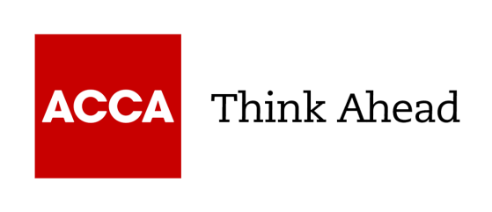


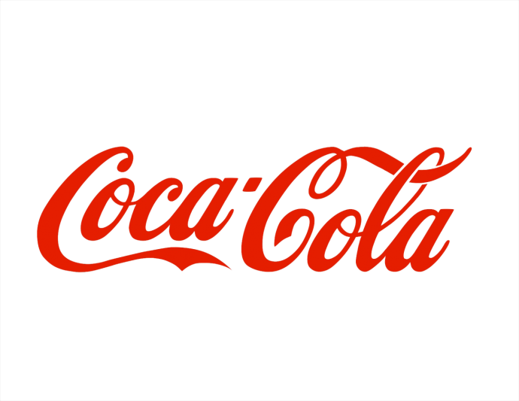
Topic-8
Analysis and evaluation of the business and financial performance of Coca Cola over a three year period
ACCA Registration number: 5593364
Submission period: 51

Slide 2
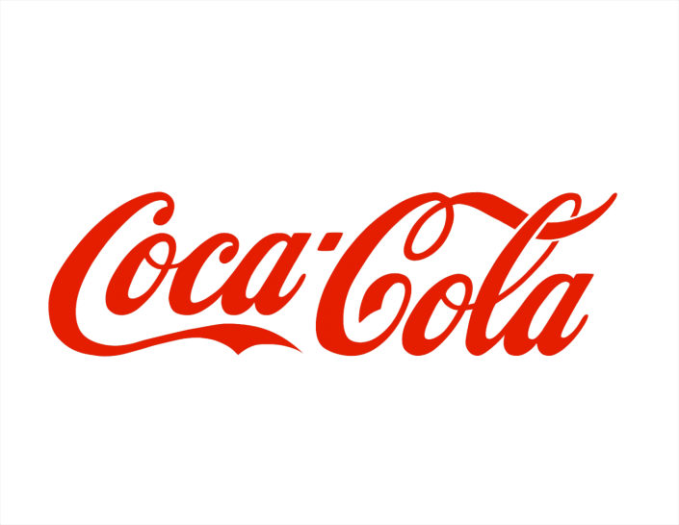
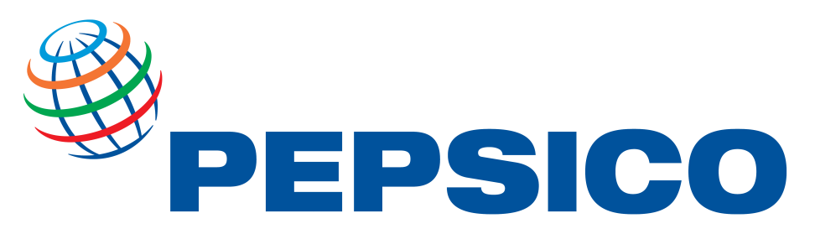
Introduction to The Coca Cola Company and PepsiCo
Established in 1886 in Atlanta, Georgia.
With a global portfolio of more then 200 brands.
Implementing sustainability oriented strategies .
Holds approximately 44.9% of the market share in U.S. Carbonated soft drink market.
Founded in 1965 in New York.
With a global operation in food and beverage in over 200 countries.
Investing in water stewardship, recyclable packing, and carbon-neutral projects.
Owns brands like Tropicana, Lay’s, Gatorade and Quaker.

Slide 3
PESTLE Analysis
Political factors:
Russia-Ukraine war affected global food supply systems, raising prices and increasing market volatility.
To safeguard against legal and financial concerns, FDA food safety and labeling rules are strict.
International trade and markets are limited by sanctions and geopolitics.
Economic Factors:
Supply chain disruptions and geopolitical uncertainty diminish industry resilience.
Inflation raises operational and production expenses, lowering profits.
Consumer spending and demand change due to recession worries and economic uncertainty.

Slide 4
Social Factor:
Health awareness increases demand for low-sugar, natural, and functional drinks.
Lifestyles affect customer preferences for healthier drinks.
Social media and influencer marketing affect younger customers' brand perception and beverage preferences.
Technological Factor:
Industry uses AI, IoT, and machine learning to innovate and improve output.
Generative AI speeds product development and personalises client interactions.
Blockchain and digital traceability boost supply chain food safety, transparency, and investor confidence.

Slide 5
Legal factors:
Food and beverage companies are being sued for false “all-natural” labeling.
The rise of class lawsuits calls for clearer product labels.
Governments ought to improve regulations to protect youngsters from aggressive marketing.
Environmental Factors:
New EU packaging standards seek to increase refilling, reuse, and recycling by 2030.
Plastic recycling mandates improve beverage packaging sustainability.
Purified water and effective resource management help industrial sustainability objectives.

Slide 6
SWOT Analysis
Strengths:
Global distribution networks boost output and market share.
Advanced manufacturing helps beverage companies scale.
Indian soft drink sales are rising due to improved cold-chain logistics and e-commerce.
Weaknesses:
Plastic consumption and waste management are criticised in the beverage business.
Growing environmental concerns drive corporations to use sustainable packaging.
Aspartame's “possibly carcinogenic” warning has raised concerns about soft drink artificial sweeteners.

Slide 7
Opportunities:
The food and beverage industry is using AI and modern technologies to boost efficiency and quality.
Global market growth is possible due to rising earnings and changing tastes.
Rising economies in South America, Africa, and Asia boost industry longevity.
Threats:
The food and beverage industry faces intense competition, projected to reach $4.4 trillion by 2028.
Ongoing conflicts, such as in Sudan, threaten the supply of key ingredients like gum Arabic.
Manufacturers are stockpiling raw materials to manage geopolitical supply risks.

Slide 8
Profitability Ratios:
Coca-Cola’s gross profit fell 4% in 2022 due to the Russia exit and higher input costs. It rose 2.37% in 2023 with 3% global sales growth and pricing gains. In 2024 it was 61.06, due to higher prices and efficiency from its asset-light model.
GP margin of PepsiCo decreased by 1% for FY2022, increased by 2% for FY2023, and for FY2024 rose further by 1%, reflecting improved cost efficiency and strong pricing performance.
Coca-Cola’s operating margin fell 5% in FY2022, due to inflation and market disruptions. Higher pricing and expenditure boosted it decreased 2.
55% in FY2023. decreased further 14% in FY2024, even though their was increase in revenue.
Operating margin of PepsiCo decreased by 5% for FY2022, decreased by 2% for FY2023, and for FY2024 rose by 7%.

Slide 9
Coca-Cola’s ROCE was 14.94% in 2022, above industry average, indicating great financial success. It rose to 15.26% in 2023 due to improved profitability and zero-sugar product demand. It fell by 13%in 2024 because to inflation and growing expenses.
PepsiCo’s ROCE increased by 4% in 2022, decreased by 1% in 2023, and then rose by 9% in 2024 supported by effective capital management, pricing, and worldwide expansion.
Coca-Cola’s ROE was 37.06% in 2022, above the 15% industry average, indicating significant profitability. It rose by 5.1% in 2023 because to rising income and expansion in developing economies like India and Brazil. Strong operating efficiency and better major market profitability boosted ROE by 4% in 2024.
PepsiCo’s ROE increased by 9% in 2022, decreased by 5% in 2023, and rose by 8% in 2024, supported by increased retained profits and robust snack and beverage diversity enhance profitability.

Slide 10
Coca-Cola’s asset turnover rose to 13% in 2022, showing better fixed asset usage and operational effectiveness. Due to organic sales growth and non-current asset utilisation, the ratio rose 4% in 2023. The ratio stood at 0.62 in 2024 owing to inflation and increased operating expenditures.
PepsiCo’s asset turnover increased by 10% in 2022, increased by 1% in 2023, and rose by 2% in 2024 reflecting increased production efficiency and varied product sales
Investors Ratios:
Coca-Cola’s EPS fell by 3% in 2022 owing to decreasing income, plastic pollution backlash, and currency changes. It increased 12.11% in 2023 due to AI-driven marketing and customer interaction. Profit growth was flat in 2024 due to rising input prices and currency rate volatility.
PepsiCo’s EPS increased by 17% in 2022, rose by 2% in 2023, and increased by 6% in 2024, supported by substantial global demand, diverse income sources, and double-digit food and beverage growth in India.

Slide 11
Liquidity Ratios:
Coca-Cola's current ratio improved marginally by 1% in 2022 after starting a supply chain financing program and selling USD 610 million in receivables. After increased dividends, borrowings, and FX losses, it decreased by 0.98% in 2023 and rapidly plummeted by 9% in 2024 as net working capital fell by USD 6.23 billion.
PepsiCo's current ratio was 0.8 in 2022, rose up slightly to 0.85 in 2023, and then went down to 0.82 in 2024 because of greater short-term debt and marketing expenses.
Due to inflation and rising material prices, Coca-Cola's quick ratio dropped to 0.93 in 2022. It reached 0.95 in 2023 with increased revenue and cash flow, but dropped 11% in 2024 as operational cash decreased by 41% and new debt elevated short-term obligations, limiting liquidity.
PepsiCo’s quick ratio decreased by 8% in 2022, further increased to 0.68 in 2023, and decreased by 5% in 2024 even with better receivables collection enhanced cash flow and liquidity.

Slide 12
Solvency Ratios:
Coca-Cola’s debt-to-equity ratio was 1.55 in 2022, showing debt dependence. but It declined to 1.52 in 2023 due to cautious borrowing and greater retained profits but rebounded to 1.72 in 2024 due to debt issuance and leverage.
PepsiCo's debt-to-equity ratio declined by 9% in 2022 but increased by 5% in 2023, and 3% in 2024,Due to increasing long-term borrowings and 90% higher short-term debt
Coca-Cola's interest coverage ratio climbed by 92%in 2022 as cost cuts and increasing volumes increased operating income by 6%. It dropped considerably by 40.11% in 2023 and increased by 19% in 2024 due to global rate rises, raising borrowing rates on 40% floating debt and increasing commercial paper and refinancing costs.
In 2022, PepsiCo's interest coverage ratio increased by 105%, rose 19% in 2023, then fell 4% in 2024 due to increasing refinancing costs and floating-rate loan interest.

Slide 13
Conclusion
Strategic and operational challenges:
Health Regulations: Restrictions on sugar content and the increasing demand for healthier beverages jeopardise Coca-Cola's fundamental goods and pricing strategy.
Competition: Intense regional competitors diminish market share and undermine pricing authority
Ethical Risks: Sourcing and smuggling challenges in war zones provide reputational hazards.
Sustainability: The new 2030 packaging regulations compel Coca-Cola to choose recyclable and refillable alternatives.
Economic Pressures: Inflation and supply chain disruptions increase expenses and diminish profitability.
Rising expenses: Higher input and marketing expenditures to sustain sales lowered profitability ratios.
Debt Dependence: Rising debt-equity ratios indicate dependency on borrowing for operations and expansion, increasing solvency problems.
Liquidity Strain: Cash flow stability was hampered by increased short-term debt and foreign currency losses, lowering current and quick ratios.

Slide 14
Management reaction to issues:
Operational Efficiency: Coca-Cola used its worldwide reach to improve its manufacturing and delivery.
Focus on sustainability: Used recycled packaging to cut down on pollution and reach green goals.
Digital Innovation: Used AI to get customers more involved and make the brand more visible.
Market Expansion: Expanded into emerging areas to compete with local businesses.
Strategic Partnerships: Strengthened relationships with suppliers and to ensure steady product availability.
Price Strategy: Increased prices to offset inflation and maintain profitability.

