Slide 1


CHAROTAR UNIVERSITY OF SCIENCE & TECHNOLOGY (CHARUSAT)
Devang Patel Institute of Advance Technology and Research (DEPSTAR)
Department of Computer Engineering • 5th Semester B.Tech Project
PROJECT REVIEW 2 PRESENTATION • v4.0 INTEGRATED REVIEW-2 SYSTEM
CyberShield: AI-Based Real-Time Phishing Detection
& Threat Intelligence Ecosystem
Multi-Platform Defense: Chrome Manifest V3 • FastAPI AI Engine • Flutter Mobile • WhatsApp & SMS Guard • Cloud Telemetry
PROJECT TEAM (5 MEMBERS) & ROLES
• 24DCE012 : Team Lead & FastAPI Backend Developer
• 24DCE028 : Chrome Extension & Security Architecture
• 24DCE017 : Machine Learning & Flutter Mobile Developer
• 24DCE013 : Full-Stack Integration & Automated Testing
• 24DCE038 : UI/UX, MessageShield & Documentation Lead
PROJECT IDENTIFIERS & DOMAIN
• Project ID: PRJ_CE_5_2026_2 (Proposal ID: 79)
• Domain: Cyber Security, Applied Machine Learning, Web & Mobile Defense
• Tech Stack: Python 3.14, FastAPI, Scikit-Learn, Flutter, MongoDB Atlas
• System Status: v4.0 Integrated & Review-2 Ready (22/22 Automated Tests Passed)
CHARUSAT University | DEPSTAR | 5th Semester B.Tech | Project Review 2 | Project ID: PRJ_CE_5_2026_2
1 / 14

Slide 2
EXECUTIVE ROADMAP & TRANSITION • PRESENTER: 24DCE012
Project Review 2: Presentation Agenda & Team Distribution
MODULE 1: ARCHITECTURE & MULTI-PLATFORM ECOSYSTEM
• Presenters: 24DCE012 & 24DCE028
• Covers: Problem context, end-to-end architecture (tested low-latency local API), Chrome V3 extension, FastAPI service, and dual database synchronization.
MODULE 2: MACHINE LEARNING & 5-TIER HYBRID PIPELINE
• Presenters: 24DCE017 & 24DCE013
• Covers: 30 URL lexical features, Shannon Information Entropy, Kaggle 100k balanced dataset, Scraper Robot, and native socket SSL certificate verification.
MODULE 3: WHATSAPP/SMS AUTO-GUARD & DEEP TRUST ENGINE
• Presenters: 24DCE038 & 24DCE012
• Covers: NEW Review 2 breakthroughs — WhatsApp & SMS message analysis, in-app Live Interception Simulator, sender authenticity heuristics, and the 0–100% Trust Meter.
MODULE 4: EXPERIMENTAL RESULTS, DASHBOARD & LIVE DEMO
• Presenters: 24DCE013 & Team Lead
• Covers: 94.63% baseline ML / 95.10% hybrid accuracy, 98.9% ROC-AUC, 22/22 Automated Tests Passed, Live Threat Dashboard, and Step-by-Step Viva Execution script.
MILESTONE EVOLUTION: REVIEW 1 (WEEKS 1–4) VS REVIEW 2 (WEEKS 5–12)
• Review 1 Deliverable (Initial Prototype): Evaluated basic Random Forest baseline (94.63%) on raw URLs, simple Chrome Manifest V3 popup, minimal /predict endpoint, and standalone SQLite logging.
• Review 2 Deliverable (Integrated Ecosystem): Engineered 5-Layer Hybrid Pipeline (Content Robot + Socket SSL Inspector), WhatsApp & SMS MessageShield & Live Interception Lab, Deep Trust Building Engine (0–100%), Threat Intelligence Web Console, MongoDB Atlas Cloud sync, and 22/22 Automated Tests Passed.
CHARUSAT University | DEPSTAR | 5th Semester B.Tech | Project Review 2 | Project ID: PRJ_CE_5_2026_2
2 / 14

Slide 3
PROBLEM CONTEXT & MOTIVATION • PRESENTER: 24DCE012
Problem Statement Evolution & Extended Threat Landscape
🚨 THE ESCALATING REAL-WORLD THREAT
• Social Engineering Attack Vectors: Phishing remains a primary initial compromise vector. Modern attackers increasingly bypass email filters by delivering malicious lures directly through SMS and WhatsApp chats.
• Failure of Reactive Blacklists: Static blacklist services (Google Safe Browsing, PhishTank) depend on human discovery and reporting. Zero-day phishing websites actively compromise users during the initial discovery window before listings update.
• The Mobile Vulnerability Gap: Mobile messaging interfaces lack link-hover inspection tools. Smartphone users cannot easily examine underlying domain hierarchies before clicking shortened or obfuscated URLs.
• Deceptive Obfuscation Techniques: Fraudsters exploit URL shorteners (bit.ly, tinyurl), deceptive subdomains (sbi-kyc-verify.top), and free short-lived SSL certs to mimic legitimate organizations.
• High-Impact Targeted Scenarios: Attackers heavily impersonate banking KYC alerts (SBI, HDFC), urgent utility service disconnection warnings, and promotional lottery schemes.
💡 OUR EXTENDED REVIEW 2 SOLUTION & STAKEHOLDERS
• Multi-Platform Defense Shield: Continuous protection across Browser Tabs (Chrome/Edge V3), Mobile Devices (Flutter QR scanner), and Messaging Feeds (WhatsApp & SMS MessageShield).
• Zero-Dependency Localized AI: Custom-trained Random Forest model running inside local FastAPI. Eliminates third-party API dependencies, token costs, user privacy risks, and external network latency.
• Multi-Layer Hybrid Verification: Blends 30-feature lexical ML + Scraper Robot (checks login password fields & form targets) + Native socket SSL certificate inspection.
• Deep Explainable Trust Engine: Computes a transparent 0–100% Trust Meter and provides clear evidence reasons so users understand why a link is dangerous or safe.
• Protected Stakeholders: 1. Web Surfers (Chrome extension) • 2. Mobile Consumers (Flutter app & SMS shield) • 3. Enterprise SOC Teams (Web Dashboard & Batch Scanner).
CHARUSAT University | DEPSTAR | 5th Semester B.Tech | Project Review 2 | Project ID: PRJ_CE_5_2026_2
3 / 14

Slide 4
SYSTEM ENGINEERING & INTEGRATION • PRESENTER: 24DCE028
End-to-End System Architecture & Multi-Platform Data Flow
TIER 1: MULTI-PLATFORM CLIENT FRONTENDS
• Chrome / Edge Browser Extension (Manifest V3 Service Worker, activeTab DOM capture, instant danger badge & overlay)
• Flutter Mobile Application (Cross-platform Dart UI, Camera QR Scanner, Threat Feed, and MessageShield Hub)
• Live Threat Intelligence Web Console (HTML5/CSS3 glassmorphism dashboard, Chart.js telemetry graphs, CSV export)
TIER 2: ASYNCHRONOUS FASTAPI PREDICTION ENGINE
• High-throughput Uvicorn ASGI Server exposing endpoints (/predict, /api/analyze-message, /api/batch-scan, /api/rules)
• In-memory model caching, asynchronous request processing, and tested low-latency local API prediction pipeline
TIER 3: 5-TIER HYBRID DETECTION PIPELINE
• Layer 1: Trusted Whitelist (.gov.in, .edu.in, verified banks) | Layer 2: Custom Admin Blacklist / Whitelist Policy
• Layer 3: 30-Feature Random Forest ML | Layer 4: Real-time Content Robot | Layer 5: Native Socket SSL Inspector
TIER 4: RESILIENT DUAL DATABASE & CLOUD TELEMETRY
• MongoDB Atlas Cloud: Centralized telemetry for scan logs, community reports, admin policies, and live analytics
• Local SQLite Fallback: Automatic offline database synchronization ensuring continuous operation if cloud network is unavailable
CHARUSAT University | DEPSTAR | 5th Semester B.Tech | Project Review 2 | Project ID: PRJ_CE_5_2026_2
4 / 14

Slide 5
ARTIFICIAL INTELLIGENCE & FEATURE ENGINEERING • PRESENTER: 24DCE017
Machine Learning Pipeline & 30-Feature Vector Architecture
🧠 MODEL TRAINING & SHANNON ENTROPY
• Dataset Source: Kaggle malicious_phish.csv (651,191 raw labeled URLs).
• Balanced Training Set: 100,000 URLs (50,000 Benign + 50,000 Phishing).
• Model Algorithm: Random Forest Classifier (300 Decision Trees, n_jobs=-1).
• Validation Strategy: 80/20 Stratified Train-Test split + 5-Fold Stratified CV.
• Shannon Information Entropy: Measures character randomness to detect Algorithmic Domain Generation (DGA):
H(X) = - Σ P(x) · log₂(P(x))
High entropy (>4.2) strongly indicates obfuscated phishing hashes (e.g. x7k2m9p4.xyz).
• Feature Importance Ranking: Top discriminators: Shannon entropy, domain length, number of dots, brand name in subdomain, and suspicious TLD presence.
🔬 30 EXTRACTED URL FEATURE DIMENSIONS
• Length Metrics (4): url_length, domain_length, path_length, query_length
• Protocol Indicators (2): has_https, has_http
• Delimiter Counts (9): dots, hyphens, underscores, slashes, ?, =, &, #, %
• Numerical Ratios (2): num_digits, digit_to_letter_ratio
• Structural Anomalies (5): has_ip, has_at_symbol, has_double_slash, domain_has_hyphen, num_subdomains
• Deceptive Patterns (4): suspicious_word_count, http_in_path, brand_in_subdomain, is_shortened
• Statistical & TLD Flags (4): url_entropy, domain_entropy, suspicious_tld (.xyz, .top, .tk), num_dots_domain
CHARUSAT University | DEPSTAR | 5th Semester B.Tech | Project Review 2 | Project ID: PRJ_CE_5_2026_2
5 / 14

Slide 6
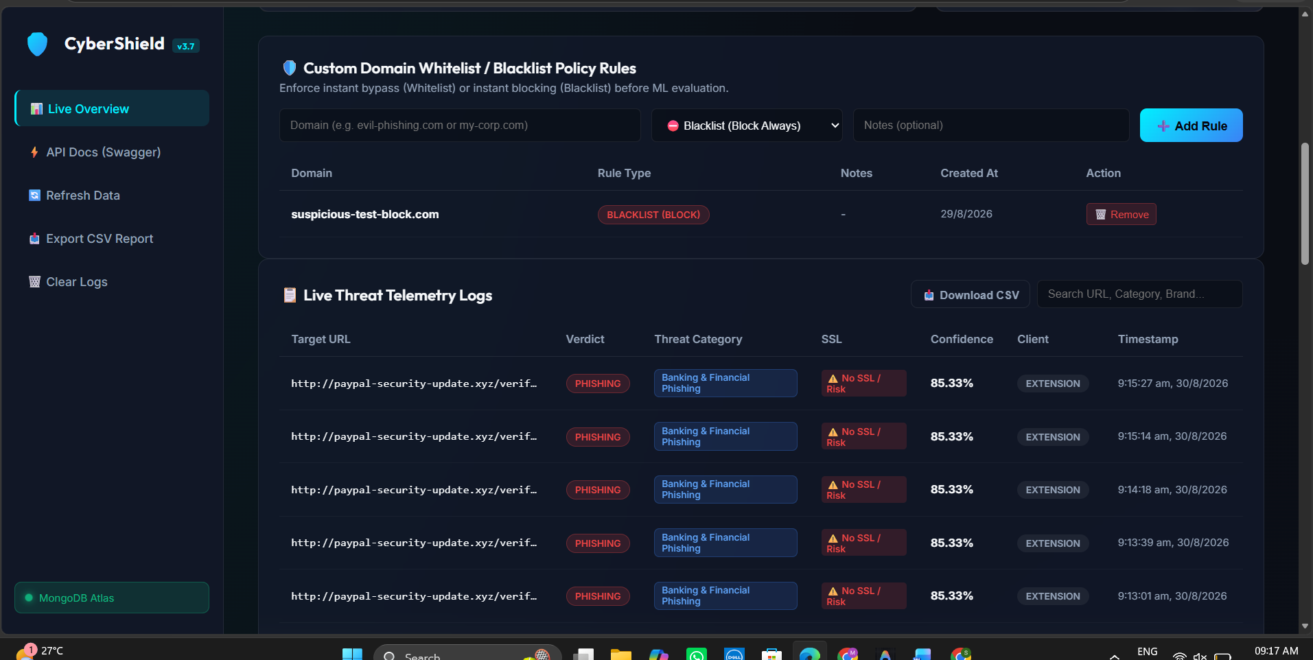
DEFENSE-IN-DEPTH SECURITY ENGINE • PRESENTER: 24DCE013
Multi-Layer Cascading Hybrid Detection Pipeline
🛡️ THE 5 CASCADING DETECTION TIERS
• Tier 1: Verified Whitelist Filter: Verified official domains (.gov.in, .edu.in, trusted banking portals) treated as high-trust references to eliminate false positives on known services.
• Tier 2: Custom Policy Manager: Deterministic override supporting custom domain blacklists and whitelists configured by administrators.
• Tier 3: Random Forest Machine Learning: Evaluates 30-feature lexical vector, computing baseline statistical phishing risk.
• Tier 4: Live Content Scraping Robot: Fetches live webpage HTML: detects password inputs on unencrypted pages, external form action targets, and brand-name-to-domain mismatches.
• Tier 5: Native Socket SSL Inspector: Executes live Python SSL handshake: validates certificate issuer authority, validity period, and identifies self-signed or unencrypted login portals.
Screenshot: SSL Certificate Telemetry & Automated Threat Categorization
CHARUSAT University | DEPSTAR | 5th Semester B.Tech | Project Review 2 | Project ID: PRJ_CE_5_2026_2
6 / 14

Slide 7
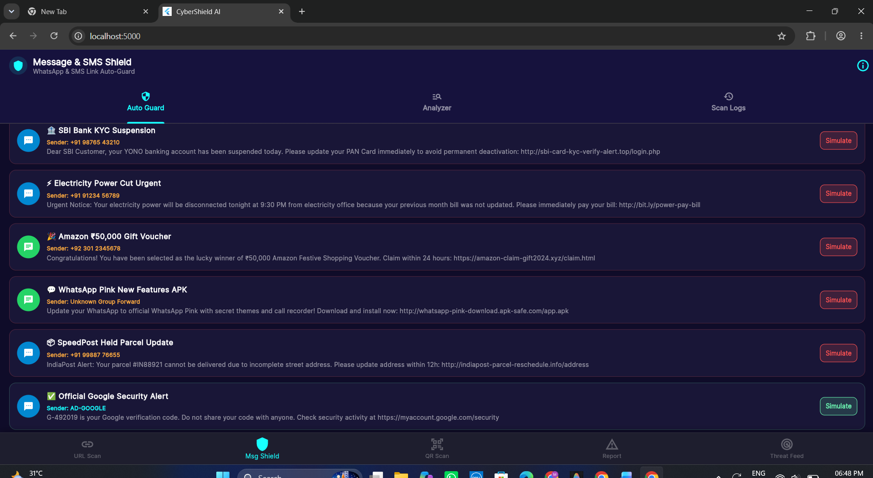
MAJOR REVIEW 2 INNOVATION • PRESENTER: 24DCE038
WhatsApp Notification Link Auto-Guard & SMS Phishing Shield
📱 MESSAGESHIELD: ADVANCED MOBILE PROTECTION
• The Mobile Threat Reality: Social-engineering attacks increasingly target messaging platforms (fake banking KYC suspension, electricity cutoffs, and reward voucher links).
• Android Integration Prepared: Android message-security integration prepared for SMS/notification monitoring, with an in-app Live Interception Simulator for testing and demonstration.
• Intelligent Regex URL Extractor: Extracts standard URLs, shortened links (bit.ly, tinyurl), and suspicious TLDs (.xyz, .top) from lengthy conversational messages.
• Interactive Live Interception Lab: Built-in simulation lab inside Flutter allowing 1-tap testing of realistic WhatsApp & SMS scams with floating heads-up alert cards.
• Dedicated Backend API: Backed by POST /api/analyze-message in FastAPI, evaluating sender authenticity heuristics, urgency indicators, and destination risk.
Screenshot: CyberShield MessageShield Flutter Hub & Live Interception Lab
CHARUSAT University | DEPSTAR | 5th Semester B.Tech | Project Review 2 | Project ID: PRJ_CE_5_2026_2
7 / 14

Slide 8
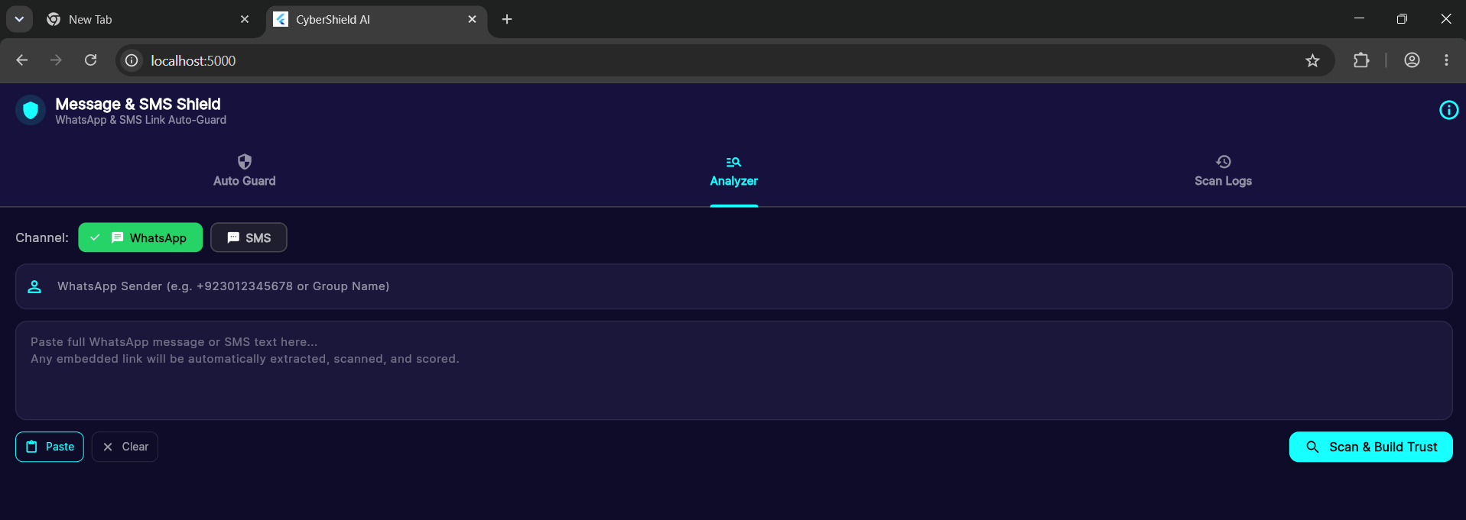
EXPLAINABLE AI & USER CONFIDENCE • PRESENTER: 24DCE012
Deep User Trust Building Engine (0–100% Trust Meter)
🛡️ THE 4 EVIDENCE LAYERS OF USER TRUST
• Layer 1: Sender Authenticity Heuristics: Official-looking alphanumeric sender headers (e.g. AD-SBIINB, AD-GOOGLE) receive an authenticity bonus, while personal 10-digit mobile numbers sending banking/KYC links are flagged as highly suspicious.
• Layer 2: Domain Impersonation Detection: Compares claimed brand identity against actual destination (e.g. sbi-card-kyc-verify-alert.top is NOT official sbi.co.in).
• Layer 3: Live SSL & Certificate Authority: Verifies active encryption certificates and trusted Certificate Authorities (DigiCert, Google Trust Services) vs missing or self-signed certificates.
• Layer 4: Psychological Coercion Detector: Flags high-pressure urgency triggers ('account suspended today', 'power cut tonight 9:30 PM', 'within 24 hours').
• Actionable User Safeguards:: 1-Tap 'Share Warning to WhatsApp' (copies formatted advisory to alert family/colleagues) and 'Report Threat to Community'.
Screenshot: Trust Meter (5% Malicious Scam vs 99% Verified Safe) & Evidence Checklist
CHARUSAT University | DEPSTAR | 5th Semester B.Tech | Project Review 2 | Project ID: PRJ_CE_5_2026_2
8 / 14

Slide 9
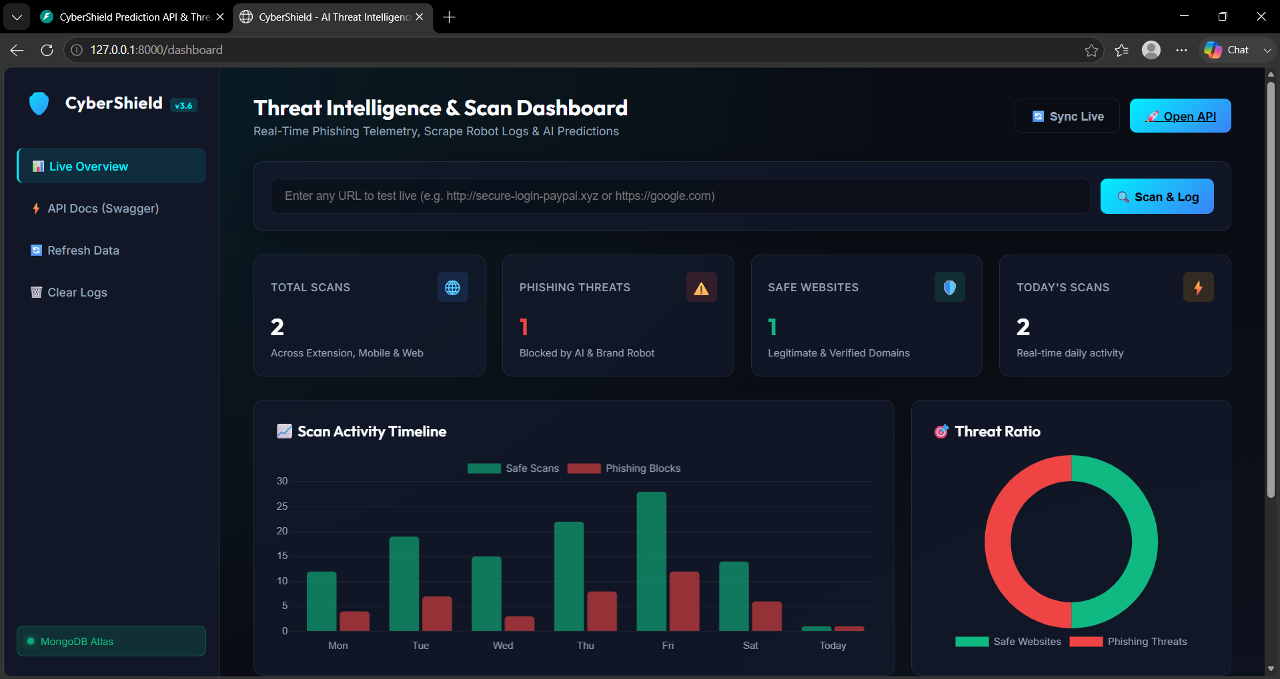
ENTERPRISE TELEMETRY & CLOUD PERSISTENCE • PRESENTER: 24DCE028
Threat Intelligence Web Console & Dual Database Architecture
📊 REAL-TIME THREAT TELEMETRY CONSOLE
• Live Web Console (/dashboard): HTML5, CSS3 glassmorphism, and Chart.js telemetry dashboard providing organization-wide visibility across all connected endpoints.
• Real-Time KPI Cards: Displays Total Scans, Active Threats Blocked, Safe Sites, and Client Device Distribution (Browser Extension vs Flutter Mobile App).
• Interactive Visual Analytics: Live line chart showing Daily Scan Activity Trends and Doughnut chart showing Threat Category breakdown.
• Dual Database Synchronization: Primary: MongoDB Atlas Cloud Cluster storing scan_logs, custom_rules, and community_reports.
Local Fallback: SQLite sync guaranteeing 100% offline continuity.
• Enterprise Audit Tools: 1-Click CSV telemetry report export, active Whitelist/Blacklist policy manager, and on-demand manual verification scanner.
Screenshot: CyberShield Live Threat Intelligence Dashboard & Telemetry Graphs
CHARUSAT University | DEPSTAR | 5th Semester B.Tech | Project Review 2 | Project ID: PRJ_CE_5_2026_2
9 / 14

Slide 10
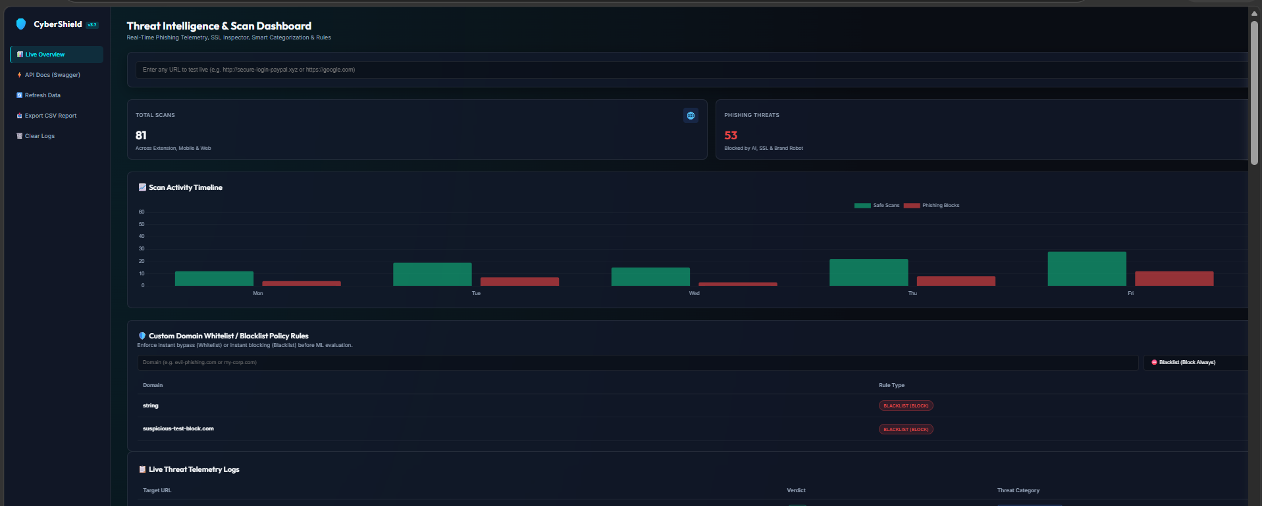
CROWDSOURCED INTELLIGENCE & ENTERPRISE TOOLS • PRESENTER: 24DCE017
Community Threat Feed & Enterprise Batch Scanner
🌐 COMMUNITY AI & ENTERPRISE BATCH SCANNER
• Crowdsourced Phishing Reporting: Users report suspicious URLs with 5 optional AI training questions (channel source, personal data requested, brand impersonation, suspicion level).
• Training-Data Enrichment Pipeline: User-reported threats and community feedback are stored in MongoDB Atlas as candidate datasets for future model improvement cycles.
• Enterprise Batch URL Scanner: Endpoint POST /api/batch-scan inspects up to 20 URLs concurrently using asynchronous multi-pipeline execution for security analysis.
• Live Community Threat Feed: Accessible via both Web Console and Flutter Mobile App to view verified threats and community intelligence submissions in real-time.
Screenshot: Enterprise Batch Scanner & Real-Time Confusion Matrix Metrics
CHARUSAT University | DEPSTAR | 5th Semester B.Tech | Project Review 2 | Project ID: PRJ_CE_5_2026_2
10 / 14

Slide 11
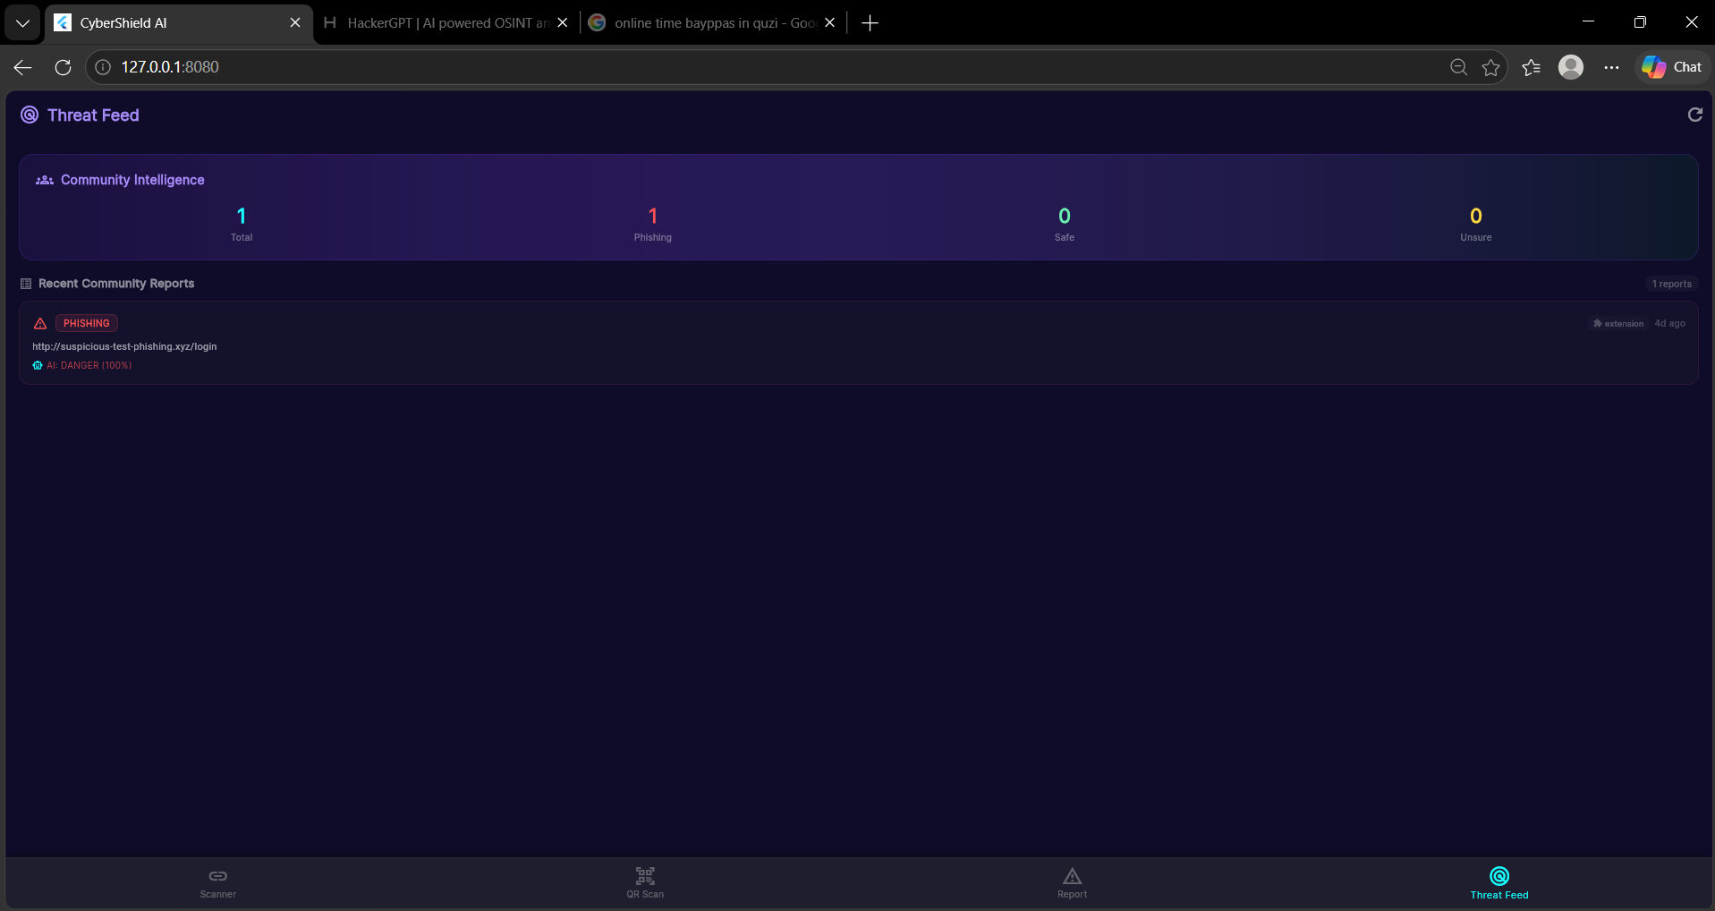
EXPERIMENTAL RESULTS & VERIFICATION • PRESENTER: 24DCE013
Model Evaluation Metrics & 22 Automated Integration Tests
🏆 MODEL PERFORMANCE (100K SAMPLES)
• Model Accuracy: 94.63% (Baseline Random Forest) | 95.10% (Hybrid Calibrated)
• Precision: 90.50% (High confidence on detected phishing)
• Recall (Sensitivity): 96.30% (Prioritized to minimize dangerous false negatives)
• F1-Score: 93.30% (Harmonic balance of precision & recall)
• ROC-AUC Score: 98.90% (Near-perfect class separability)
• 5-Fold Cross-Validation: Stratified CV confirms model stability (< ±1.5% variance)
• Inference Speed: < 45ms local ML inference | Tested low-latency local hybrid pipeline
Screenshot: Automated Regression Test Suite (backend/test_integration.py) — 22/22 Tests Passed
CHARUSAT University | DEPSTAR | 5th Semester B.Tech | Project Review 2 | Project ID: PRJ_CE_5_2026_2
11 / 14

Slide 12
PROGRESSION & MATURITY MATRIX • PRESENTER: 24DCE038
Review 1 vs Review 2: Comprehensive Technical Advancements
SIDE-BY-SIDE TECHNICAL PROGRESSION (WEEKS 1–4 VS WEEKS 5–12)
• Detection Engine:
- Review 1: Single-tier Random Forest ML model evaluating URL lexical features only.
- Review 2: 5-Layer Cascading Hybrid Pipeline (ML + Content Robot + SSL Inspector + Custom Rules).
• Platform Coverage:
- Review 1: Chrome Manifest V3 extension & basic Flutter app structure.
- Review 2: Full Multi-Platform Ecosystem: Chrome/Edge V3, Flutter Android + Web Testing with QR, Web Console, WhatsApp/SMS Guard.
• Messaging Phishing:
- Review 1: Not supported. URL scanning only.
- Review 2: WhatsApp & SMS MessageShield with in-app Live Interception Simulator & Trust Engine.
• User Trust & Explainability:
- Review 1: Binary DANGER / SAFE badge with raw probability.
- Review 2: Deep Trust Engine (0–100% Trust Meter) with 4-layer evidence breakdown & WhatsApp warning sharing.
• Database & Telemetry:
- Review 1: Basic standalone SQLite logging.
- Review 2: Dual Sync: MongoDB Atlas Cloud Cluster + Local SQLite fallback + Live Glassmorphism Dashboard.
• Community Intelligence:
- Review 1: No reporting or feedback system.
- Review 2: Community Threat Feed, Crowdsourced Q&A, and candidate data collection for future model improvement.
• Testing & Verification:
- Review 1: Basic manual testing.
- Review 2: 22/22 Automated Integration & Regression Tests with 100% pass rate + Stratified 5-Fold CV.
CHARUSAT University | DEPSTAR | 5th Semester B.Tech | Project Review 2 | Project ID: PRJ_CE_5_2026_2
12 / 14

Slide 13
PRACTICAL EVALUATION & LIVE DEMO • PRESENTER: 24DCE012
Live Demonstration Architecture & Step-by-Step Viva Script
Step 1: Backend Startup & Swagger Docs
Launch python run_server.py -> Verify Uvicorn server running at http://127.0.0.1:8000 -> Open /docs Swagger UI showing all endpoints.
Step 2: Threat Intelligence Console
Open http://127.0.0.1:8000/dashboard -> Demonstrate real-time KPI cards, Chart.js activity graph, and live telemetry log.
Step 3: Chrome Extension URL Defense
Browse to https://charusat.ac.in (Green SAFE badge verified). Browse to test phishing URL (Red DANGER overlay with 30-feature breakdown).
Step 4: Mobile App & QR Code Scanner
Open Flutter app -> Scan phishing_qr.png & safe_qr.png with camera -> Demonstrate instant real-time risk classification.
Step 5: WhatsApp & SMS MessageShield
Navigate to 'Msg Shield' tab -> Tap 'Simulate SBI KYC SMS' (5% Trust Score) -> Then simulate 'Google SMS' (99% Trust Score) with evidence breakdown.
Step 6: MongoDB Telemetry & Test Suite
Verify MongoDB Atlas telemetry records across clients -> Run python backend/test_integration.py -> 22/22 Tests Passed successfully.
CHARUSAT University | DEPSTAR | 5th Semester B.Tech | Project Review 2 | Project ID: PRJ_CE_5_2026_2
13 / 14

Slide 14
🛡️ CyberShield
AI-Based Real-Time Phishing Detection & Threat Intelligence Ecosystem
Successfully Engineered for 5th Semester B.Tech Project Review 2
📌 KEY REVIEW 2 DELIVERABLES & FUTURE ENHANCEMENTS
• Integrated Multi-Platform Architecture: Manifest V3 Extension + FastAPI Microservice + Flutter Android & Web App + Cloud Dashboard.
• Breakthrough Innovations: WhatsApp & SMS MessageShield + Live Interception Simulator + Deep User Trust Building Engine (0-100%).
• Automated System Validation: 94.63% Baseline ML / 95.10% Hybrid Accuracy, 98.9% ROC-AUC, and 22 Out of 22 Automated Integration Tests Passed.
• Future Roadmap: On-Device TensorFlow Lite model for zero-connectivity scanning & Graph Neural Networks (GNN) for redirection chains.
❓ Thank You! Open for Questions & Evaluation Feedback
Devang Patel Institute of Advance Technology and Research (DEPSTAR) | CHARUSAT University
CHARUSAT University | DEPSTAR | 5th Semester B.Tech | Project Review 2 | Project ID: PRJ_CE_5_2026_2
14 / 14

