Slide 1
Unsupervised Machine Learning

Slide 2
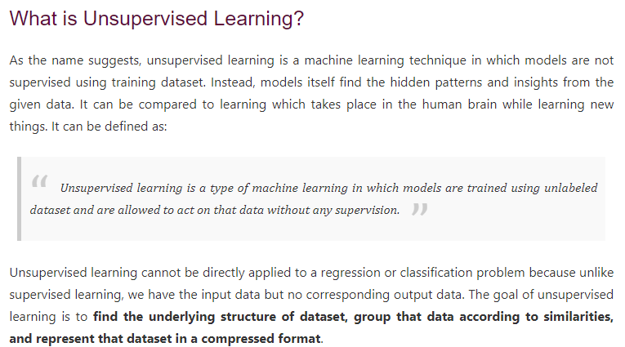

Slide 3
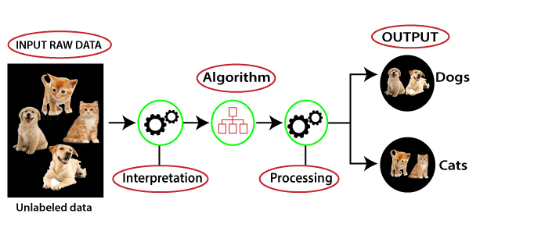

Slide 4
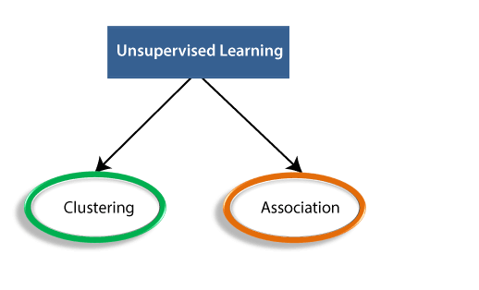

Slide 5
Thank You

