Slide 1
Regression Analysis

Slide 2
Regression Analysis in Machine learning
Regression analysis is a statistical method to model the relationship between a dependent (target) and independent (predictor) variables with one or more independent variables. More specifically, Regression analysis helps us to understand how the value of the dependent variable is changing corresponding to an independent variable when other independent variables are held fixed. It predicts continuous/real values such as temperature, age, salary, price, etc.

Slide 3
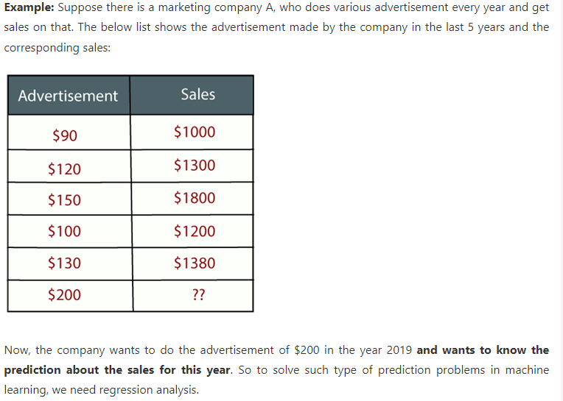

Slide 4
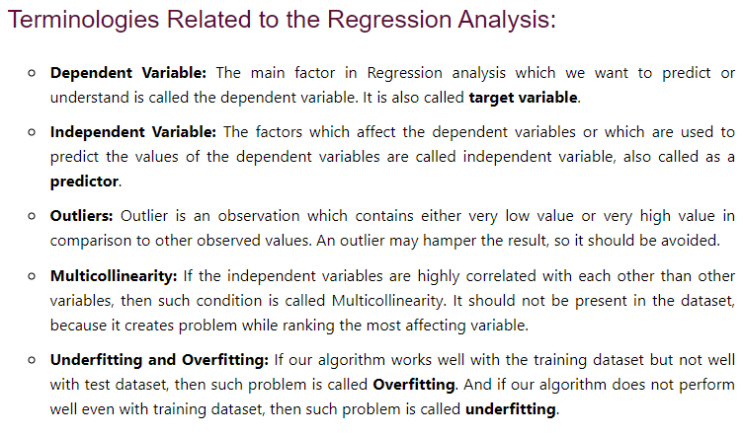

Slide 5
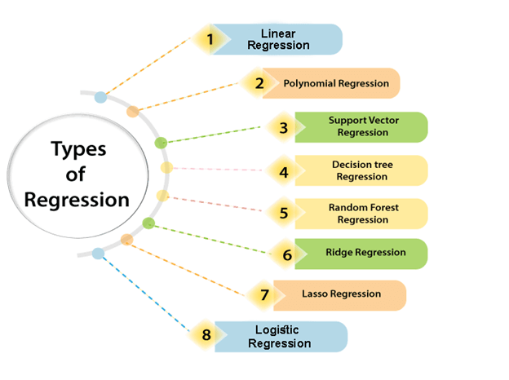

Slide 6
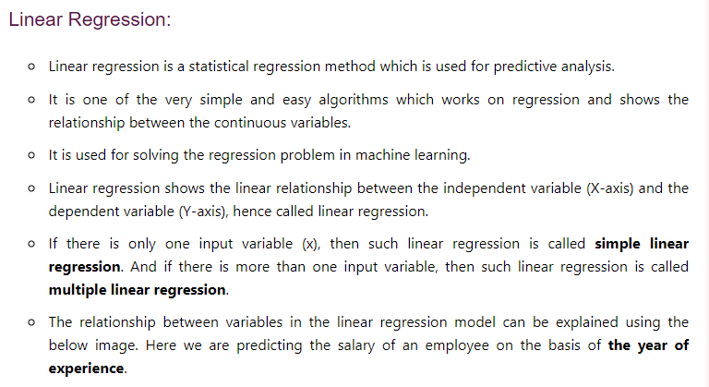

Slide 7
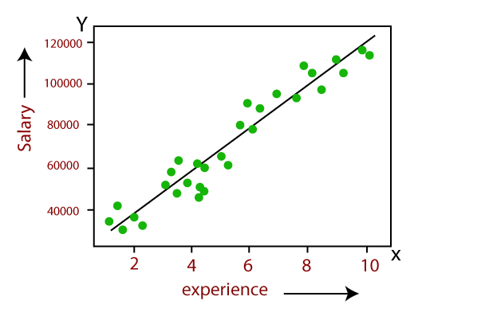

Slide 8
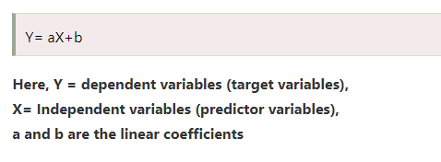

Slide 9
Thank You

