Slide 1
Train Test Split

Slide 2
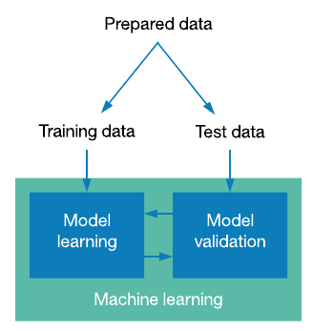

Slide 3
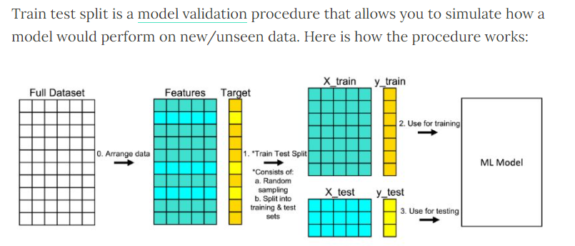

Slide 4
Syntax
from sklearn.model_selection import train_test_split
X_train, X_test, y_train, y_test = train_test_split(X, y, random_state=0, train_size = .75)

Slide 5
Thank You

