Slide 1
Problems on Process Coordination - 1
Team Members
Mentor
Nikhil Singh
1. Jeet Shah ( 2022201009 )
2. Meet Patel ( 2022201002 )
3. Tarun Kumar ( 2022201008 )
4. Adarsh ( 2022201081 )

Slide 2
Problem 1 Editors-Reporters Problem

Slide 3
Problem-1 Explanation
Problem-statement
Here, there will be N editors and M reports/articles.
Each editor can read any of the article, after reading editor can either reject or accept the article.
At a time editor can read only 1 article.
Reading time for any article is 1 second.
At a time one article can be read by only one editor.
If editor wants to read some article say article-1 and if it is not available for reading then it will not wait there and will try for some other article to read.
Once any article is accepted by some editor it can be read by any other editor.
Once editor rejects any article say article-1 then editor can never read that same article-1 again.
Program will stop when no article is left for reading.
It is not compulsory that all the articles must be accepted.

Slide 4
Problem-1 Solution
ALGORITHM
There will be one array of article numbers from 1…N
Now, declare one array of same size (N+1) of semaphores, to take lock on each article individually.
For each editor one different p_thread will be created and all the editors will simultaneously try to read the articles.
So, that at time only one editor can read any article i.
Each editor will try to read articles one by one in any random sequence generated.
If lock is available on that article take it and read the article for 1 second.
Now, either accept it or reject it on basis of odd(reject)-even(accept) random number generation.
Once the article reading is done release the lock of that particular article.
If article is rejected then remove it from the list of articles reading for any editor.
Editor will continue reading the articles till it’s list of articles reading is not completed.
Once, all the editor completes there task of reading they will merge the threads back and program end.

Slide 5
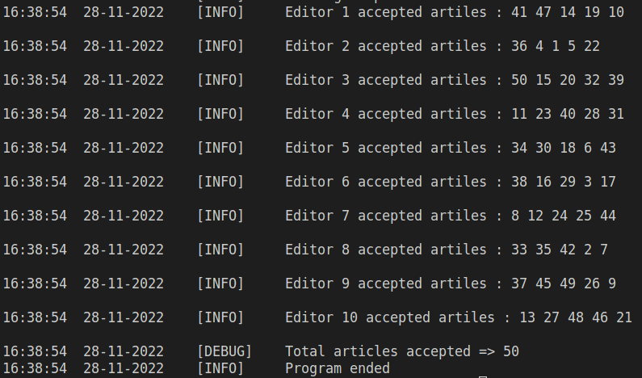
Problem-1 Results
Output
It will show the logs that which article is accepted/rejected by which editor.
At last it will show the list of article number’s accepted by each editor.

Slide 6
IPC Problems - 1
Busy-waiting (Possible)
Consider there are n-1 articles and n editors.
Now let’s say they are accessing the articles to read randomly, but at any point of time only four of the editors will get articles to read.
Suppose, n-1 editors got the articles to read, one article to each editor and now there is one editor which is contiguously checking that is any article available for reading but it will not be available till any one of them completes the reading.
So, till these time it is contiguously checking for the articles availability.
These CPU cycles used for checking the article availability contiguously is called busy waiting happened.
These will be true whenever there will be articles remaining for decision are less then no of editors to read where every article which is remaining is the one which is not yet rejected by atleast on of the editor.

Slide 7
IPC Problems - 2
Deadlock ( Not possible )
Here, at a time an editor can read only one article
So, no wait for article reading cycle (circular wait) is possible.
Race condition ( Possible )
Here, at a time more than one editor can come for reading same article.
Now, article is a shared resource and because of that which article will be accepted by which editor depends on the sequence in which article reading is done by the editors(race condition).
To synchronize these article reading semaphore locks are used.
Starvation ( Not possible )
Here, we are not setting the priority for any editor so whenever it will ask for the article to read it will be assigned according to the arrival of the all the editors who have asked for same article reading.
So, it will never be the case that some editor 2 who comes after the editor 1 for taking lock on article and editor 2 gets the lock on that artilce before editor 1 gets lock on that same article.

Slide 8
Problem 2 Dish-Washing Problem

Slide 9
Problem-2 Explanation
Here, there will be a dishwashing junction with N taps and N-1 scrotch brite in between those taps.
There will be M students all waiting at time t=0, each with three utensils namely Plate, Glass and Spoon, each task has different time associated with it.
Firstly the student acquires a tap and locks it till it washes all the utensils he/she has.
After acquiring the tap, the student tries to acquire the adjacent scrotch brite whichever is available first, it then wash any of the three utensil it has with scrotch brite and releases the scrotch brite.
Then the student washes the utensil mentioned in above step with water.
The above two steps are performed for each utensil the student has.
After Washing all the utensils with scrotch brite and water the student releases the tap, so that the next student can acquire and tap and perform the above mentioned steps.

Slide 10
Problem-2 Solution
ALGORITHM
There will be N taps, N-1 Scrotch brite and M students.
All the M students by pthread_create at time t=0 will try to acquire any of the N taps randomly by generating a (random number % tapCount) and if it is already occupied it tries the next successive taps in a circular manner till it finds an empty tap.
After acquiring the tap it sets the freeTaps[tapNumber] to false and locks the tap using semaphore freeTapArrWriteLock[tapNumber], so that no one else can acquire this particular tap and updates the lastPersonTapAccessed[tapNumber] to the current Student Id who has acquired the tap. It will be using for Time Calculation
Then a random sequence is generated in which the student will perform washing of utensils.
Then until a student acquires a scrotch brite to wash the current utensil in the beginning of the list, it keeps busy waiting for its adjacent scrotch brite
Once it acquires the scrotch brite it updates freeScrotch[scrotchNumber] to false, so that no one else can use that scrotch till the current student finishes washing the utensil with scrotch brite.

Slide 11
Problem-2 Solution (cont.)
ALGORITHM
For the Start Time of the wash it uses the help of vector personEndTime, which stores the time this particular scrotch was last used.
And the End Time for the current wash with Scrotch brite will be calculated on basis of the vector washWithScrotchTime which stores time taken to wash each utensil
Once the wash with scrotch brite with current utensil is performed, the student releases the scrotchBrite and sets freeScrotch[scrotchNumber] to true, so that the next student standing can use it if he wants
After washing the utensil with scrotch brite, the student washes it with water and adds the time taken for washing with water from vector washWithTapTime
It then updates the personEndTime[personId] to the current Time, so that the next student can use its startTime as the endTime of the previously accessed user’s endTime
It repeats the above steps for each utensil and then releases the tap, and sets freeTaps[tapNumber] to true so that the next waiting student can access the tap.

Slide 12
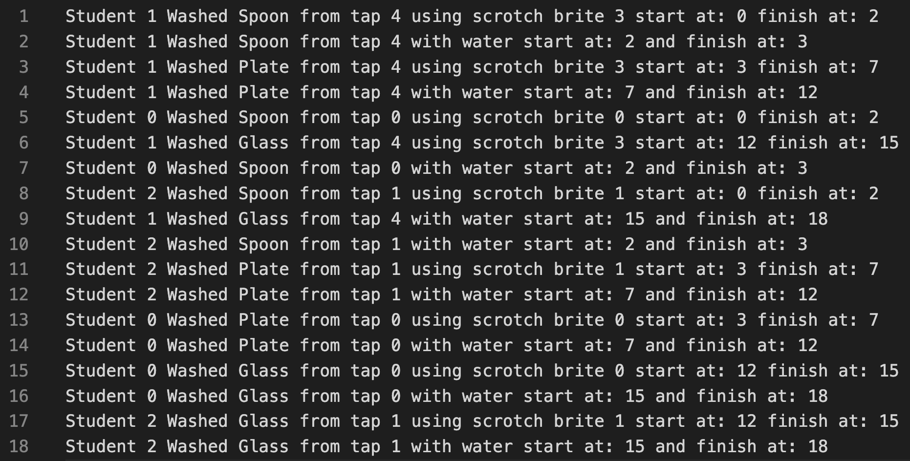
Problem-2 Results
Output
It will show the logs that which student has acquired which tap and what activity the student is performing with the start and end time of each activity. Below are the results for Taps = 5 and Students = 3

Slide 13
IPC Problems - 1
Busy-waiting (Possible)
There will be two cases where the busy waiting occurs,
1) When the student wants to acquire the tap
2) After acquiring the tap if the student wants to acquire the scrotch brite
In the first case, the student first checks if the tapNumber which is randomly generated is already acquired or not, if it is already acquired it will go to the next tap and so on in the circular manner till it gets the free tap.
In the second case, after getting the free tap, student first acquires lock on the tap so that no one case can use that particular tap until the student has washed all his/her utensils, after acquiring the lock on tap student checks whether its adjacent scrotch brite is available or not, if it is available it acquires lock on it till its completion and then releases it, but if the scrotch brite is already acquired by someone else it keeps busy waiting for its adjacent scrotch brite till it gets free scrotch brite.

Slide 14
IPC Problems - 2
Deadlock ( Not possible )
Here, at a time only one scrotch brite is required by any student.
Therefore, there will be no case of circular dependency and thus there will be no deadlock at all.
Race condition ( Possible )
In this problem, students can randomly acquire any taps/scrotch brite and hence output will vary every time the program is executed.
Hence there will be race condition in this problem.
Starvation ( Not possible )
Here, there is no varying priority for different students, i.e all the students have the same priority
Hence there will be no case where a lower priority student is waiting to acquire tap/scrotch brite which is acquired by the higher priority student.
So, there will be no starvation and student will definitely get the resources within a finite amount of time.

Slide 15
Problem 3 Concurrent Merge Sort

Slide 16
Problem-3 Explanation
Here, there we have implement merge sort using 3 ways and compare their performance.
First way is to do normal sequential merge sort , second way is using shared memory
and forking, third way is using multithreading.
We have to use SHMAT,SHMGET while creating shared memory .
For multithreading we have used POSIX thread.

Slide 17
Problem-3 Solution
ALGORITHM
For sequential Merge sort ,first we had declared an array of size n and I am taking input in that array.
After that we had followed the standard way of implementation i.e. two recursive merge sort calls followed by one merge function.
In case of second way i.e. shared memory and fork, first we had taken a input n, after that we created shared memory using FTOK,SHMAT,SHMGET.
After creation of shared memory ,fork will be called 2 times one for left child process and other for right child process.
Each child will call merge sort function one for right half and other for left half. Parent process will wait until child process completes their execution .This will be followed by normal merge function to merge 2 sorted parts of shared array.
After sorting is completed to we have to detach shared memory, for that purpose SHMDT,SHMCTL are used.
In case of third way i.e multithreading merge sort, we had created a global vector of size n(given input) to store input and we are using POSIX threads.

Slide 18
Problem-3 Solution (cont.)
ALGORITHM
Each thread can access the global input vector.Flow of program will almost same as normal implementation, few changes will be that for each recursive merge sort call .
For each recursive call we have created a pthread one for right part and one for the left .For passing arguments in pthread creation we have used a structure for lower and upper bounds of the vector.
We have used pthread join function to make pthreads wait for the completion for both right and left thread .
After that we are merging them.
In this way sorting is completed.

Slide 19
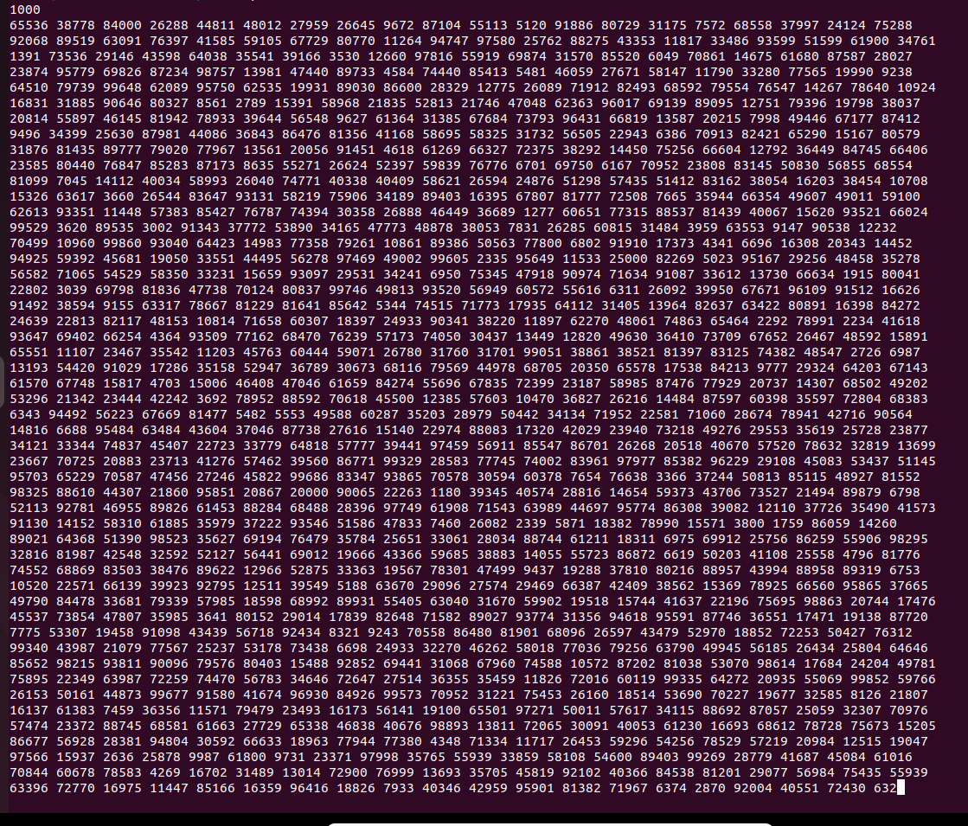
Problem-3 Results
Input
N = 1000

Slide 20

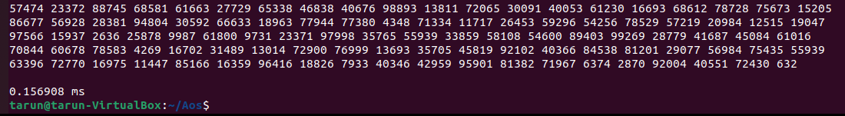
Problem-3 Results (cont.)
OUTPUT
For Normal Sequential Merge Sort

Slide 21
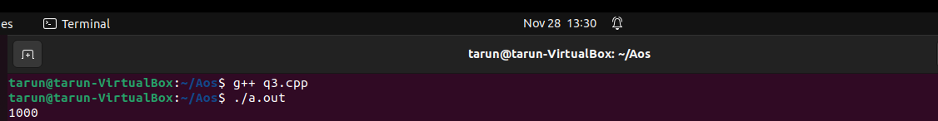
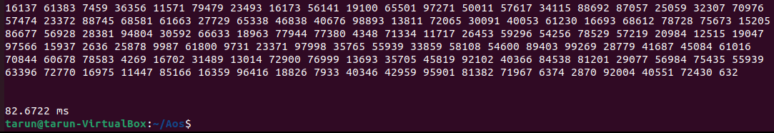
Problem-3 Results (cont.)
OUTPUT
Using Shared Memory and forking

Slide 22
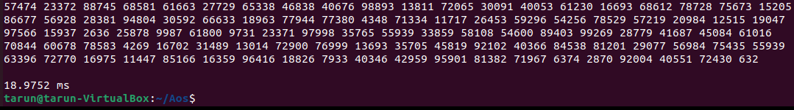
Problem-3 Results (cont.)
OUTPUT
For Multithreaded merge sort

Slide 23
Problem-3 Results (cont.)
OUTPUT
We gave a sample input of 1000 numbers .
For Sequential merge sort time time taken:0.156908 ms
For Shared Memory and fork time taken:82.6722 ms
For Multithreaded merge sort time take:18.9752 ms
We can see from the above pattern that sequential merge sort is better than both multithreaded merge sort and shared memory merge sort.
Multithreaded merge sort is better than shared memory merge sort.This is because in shared memory merge sort for each fork system call a new child process is created and first access of array will always lead to cache miss while in case of multithreading merge sort vector is declared in global space so no such issue exist there .Both are concurrent merge sorts but due to cache miss and fork calls shared memory merge sort take more time.

Slide 24
Take Away
We learnt the concept of multithreading in detailed manner.
We learnt the concept of process synchronization on shared resources using mutexes.
We learnt the how deadlock,starvation,bounded waiting concepts can be related to real life scenarios.
We learnt the concept of shared memory using SHMGET,SHMAT,SHMDT,SHMCTL to create memory ,attach that shared memory and detach it after usage.
We also learnt how multithreading can be done in merge sort and how can we use fork and shared memory in merge sort even though normal merge sort performed better than both of them.

Slide 25
GIT-HUB LINK
Source Code

Slide 26
Thanks !!
Do you have any questions?

