Slide 1
The Belt and Road Initiative
孙琳 袁静怡 张薇

Slide 2
Outline
1. What is the BRI? (development, objective, approach)
2. Why does China introduce the BRI? (background, main drivers)
3. How do other participating countries respond to BRI and why? (responses and its reasons)
4. What are the challenges and opportunities for China and other participating countries?

Slide 3
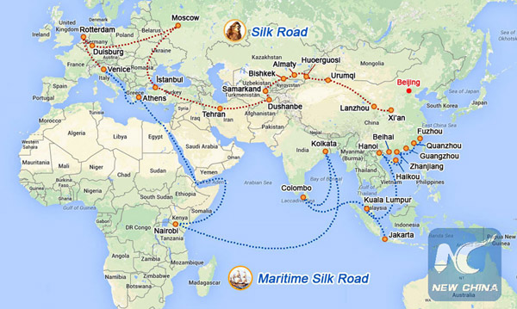
China’s Belt and Road Initiative: Implications for the Middle East
——Maha S. Kamel

Slide 4
Main arguments
By promoting the BRI in the ME region, China stands to achieve energy security, transport connectivity, redefined global supply chains, and deepened trade and investment relations with ME countries (78)
For the ME, the BRI does not stand to benefit all countries equally and despite the positive developments it induces, it poses certain risks as well. (78)
Structure
The Importance of the Middle East for China’s BRI & the Strategies and tools adopted in BRI
BRI’s implication for the Middle East

Slide 5
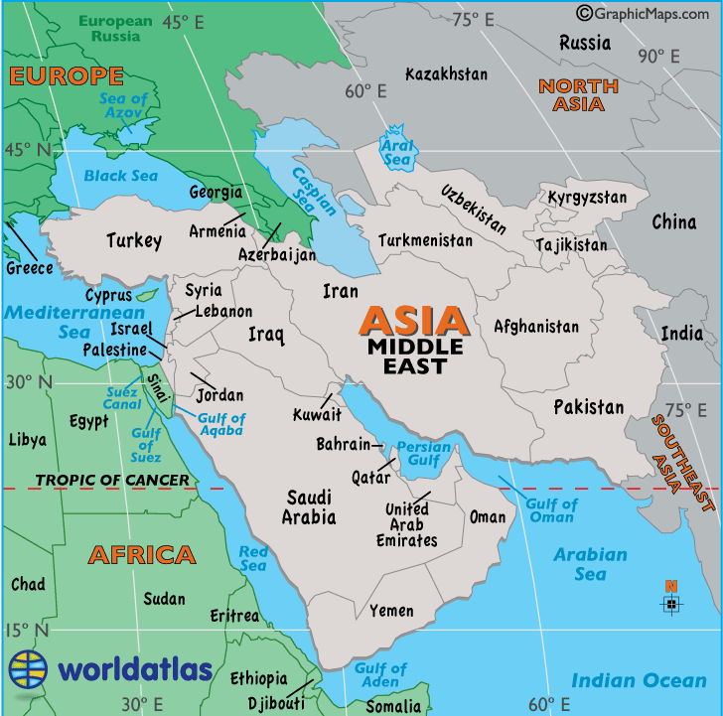
The Importance of the Middle East for China’s BRI
Strategic location
Large market
Energy resources

Slide 6
4-pronged Strategies and 2 types of Tools
framing the BRI in a beneficial and non-threatening way (80)
identifying BRI’s objectives and how they align with the interests of the region (80)
diplomatic toolkit (81)
hedging against an over reliance on any single-energy supplier or trade route (81)
Traditional tools (82)
New tools: monetary linkages, deeper investment and enhanced trade relations (83)

Slide 7
BRI’s implication for the Middle East
What’s happening in the Middle East:
the region’s ongoing economic and political challenges (83)
2008 global crisis; the dramatic fall in oil prices (83)
civil wars; terrorism(84)
Positive developments(84)
the lifting of sanctions on Iran (84)
the recent major economic development and modernization process(84)
cooperation between Israel and Sunni countries (used to be enemies) （84）
Driven by all the factors, these countries have unanimously endorsed the initiative, as it offers vast opportunities (84-85)

Slide 8
BRI’s implication for the Middle East
Geopolitical: the BRI will likely benefit some countries more than others
Unequal Distribution of Benefits-----------------------------------------Iran (85-87)
Potential Competition Between the ME and Central Asia------ Pakistan and Dubai(87)
Increasing Geostrategic Significance of the Suez Canal----gateway to Europe (87-89)
Economic:
change the trade and investment pattern in the ME (89-90)
enhance the ME’s contribution to the global value chain (89-90)
bolster China’s position as a major economic and political partner to the ME. (79)

Slide 9
More African Countries on the Route: the Positive and Negative Impacts of the Belt and Road Initiative
——Michael Mitchell Omoruyi Ehizuelen

Slide 10
Main argument
There is a high possibility as well as an urgent need for China and Africa to cooperate more in the Belt and Road Initiative; for Africa, such cooperation will be of more benefit than harm.
Structure
Current China-Africa relations
Africa’s inclusion in the initiative
Impacts of BRI on African countries

Slide 11
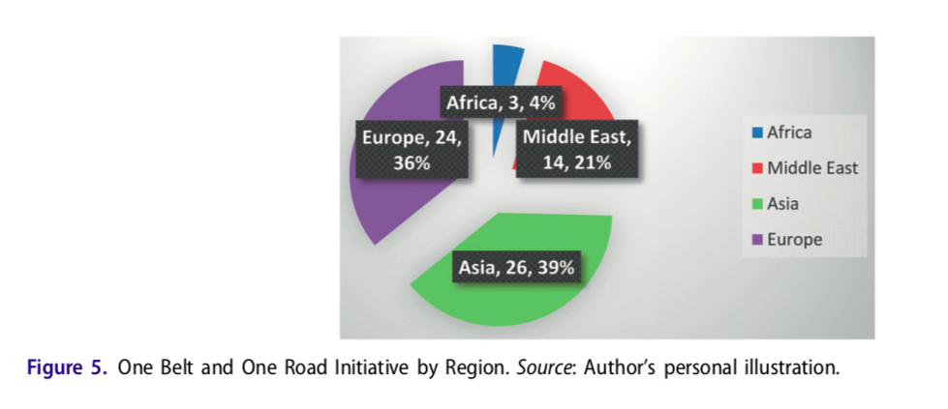
Current China-Africa relations
China has proven to be incredibly successful in connecting with African countries, both diplomatically and commercially. (342-345)
African people view China as a positive influence. (343)
increased trade (342)
infrastructure development (342)
increased investment relationships
the significance that China puts in Africa does not match the optimistic cooperation recently
3 African nations out of the 67 nations; the map(347-348)
a need for more concrete efforts to improve this

Slide 12
The inclusion of more African nations into the Belt and Road Initiative
The synergies and complementarities between OBOR and Africa’s Agenda 2063 (348)
Some proposed potential members of BRI(351-354)
Natural extension
Gateway to other part of Africa
China’s Active participation in infrastructure
Their Expansion of economic relations
Condition: the continent needs to revive its investment environment. (354)

Slide 13
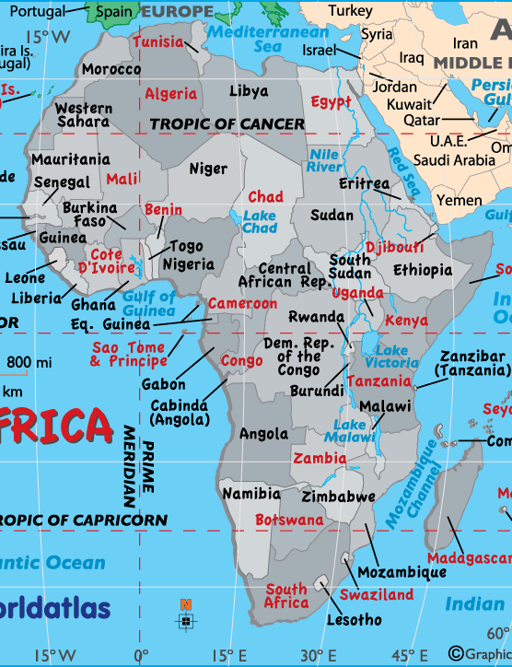
Some proposed potential members of BRI
Mozambique | a natural extension of the twenty-first century Maritime Silk Road
South Africa | signed a MoU with regard to the initiative; Strategic Comprehensive Partner
Nigeria | The expanding trade relations; large Chinese-invested infrastructure projects
Angola | one of the largest recipients of Chinese investment its vast oil deposits; a gateway to central Africa; Angola received the largest share of China’s loans
Congo (DRC) | a new port at Congo’s economic capital enlarge further up into the geostrategically vital Gulf of Guinea.
Togo | China’s participation in its transportation infrastructure; the gateway to West Africa
Tanzania | a historic and natural part of the Maritime Silk Road, and a landing point of the Belt and Road in Africa

Slide 14
The inclusion of more African nations into the Belt and Road Initiative
The synergies and complementarities between OBOR and Africa’s Agenda 2063 (348)
Some proposed potential members of BRI(351-354)
Natural extension
Gateway to other part of Africa
China’s Active participation in infrastructure
Their Expansion of economic relations
Condition: the continent needs to revive its investment environment. (354)

Slide 15
Impacts of BRI to African countries
Positive
Traffic condition improves; (355)
The economic and commercial value-added from infrastructure stacks up (356)
Negative?
Risks and worries are preventable
quality question is dispelled-----Chinese building survived an explosion (356)
employment advantages have been proved not to be true-------Statistics (356)

