Slide 1
Nathaniel Hawthorne and his works
Presented by 张薇

Slide 2
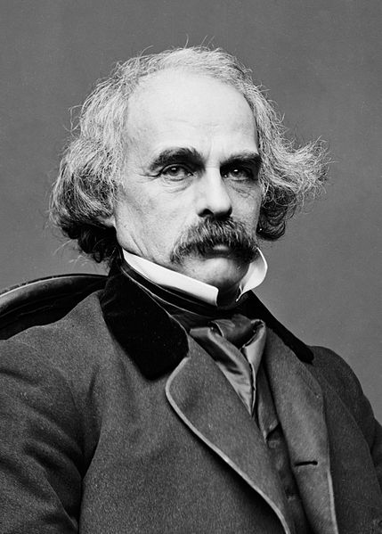
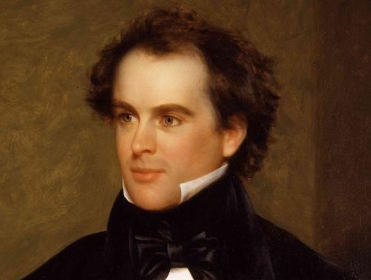
Nathaniel Hawthorne
Author (1804–1864)
Birth place: Salem, Massachusetts
Education: Bowdoin College
Spouse: Sophia Peabody
Notable Works:
The Scarlet Letter (1850)
Twice-Told Tales
The House of Seven Gables (1851)
“Time flies over us, but leaves its shadow behind.”

Slide 3
Biography
Born on July 4, 1804
Family Backgroud
Puritan legacy
Ancesters:
William Hathorne (1630)
John Hwthorne(1690s)
Father: Nathaniel H (1808)
Mother: Elizabeth H
Education
Bowdoin College(1821-1825)
Franklin Pierce
After graduation

Slide 4
Started writing
During 12-year stay at home
Fanshawe
Twice-Told Tales
Didn’t bring much success
Marriage
Got married in 1842
Wife: Sophia Peabody
a painter, transcendentalist.
Settled in Concord, Massachusetts
Three children
The Scarlet Letter
Productive period
Moved to Red House in Lenox, Massachusetts,
The House of the Seven Gables,
Blithedale Romance

Slide 5
Abroad
an American Consul to Britain
The Hawthorne’s stayed in England from 1853-1857.
Our Old Home.
Vacation to France and Italy
The Marble Faun.
Final years
moving past his prime
incoherent and left unfinished Drafts
illness
Died on May 19, 1864

Slide 6
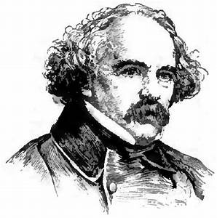
His Works
His published works include novels, short stories, and a biography of his college friend Franklin Pierce, the 14th President of the United States.
His themes often center on the inherent evil and sin of humanity, and his works often have moral messages and deep psychological complexity.
Hawthorne’s high rank among American fiction writers is the result of at least three considerations.

Slide 7
His Works
His published works include novels, short stories, and non-fictions.
Novels
Short story collections
Selected short stories
Nonfiction
Twice-Told Tales (1837)
Grandfather's Chair (1840)
Mosses from an Old Manse (1846)
A Wonder-Book for Girls and Boys (1851)
The Snow-Image, and Other Twice-Told Tales (1852)
Tanglewood Tales (1853)
The Dolliver Romance and Other Pieces (1876)
The Great Stone Face and Other Tales of the White Mountains (1889)
"Roger Malvin's Burial" (1832)
"My Kinsman, Major Molineux" (1832)
"The Minister's Black Veil" (1832)
"Young Goodman Brown" (1835)
"The Gray Champion" (1835)
"The White Old Maid" (1835)
"Wakefield" (1835)
"The Ambitious Guest" (1835)
Fanshawe (1828)
The New Adam and Eve (1843)
The Scarlet Letter (1850)
The House of the Seven Gables (1851)
The Blithedale Romance (1852)
The Marble Faun(1860)
The Dolliver Romance (1863)
Septimius Felton (1872)
Doctor Grimshawe's Secret: A Romance (1882)
*The last three are unfinished
Twenty Days with Julian & Little Bunny (written 1851, published 1904)
Our Old Home (1863)
Passages from the French and Italian Notebooks (1871)

Slide 8
Style and Theme
Dark Romanticism
moral insight
allegory & symbolism
Puritan tradition
rejected transparent optimism and looked more deeply into life: suffering and love.
a firm and resolute observation of mankind
express larger generalizations about the problems of human existence
Emotional and not pasteboard figures
an emphasis on human fallibility
the unintended consequences and complications
"atmospherical medium"
Hawthorne’s work initiated the most durable tradition in American fiction, that of the symbolic romance that assumes the universality of guilt and explores the complexities and ambiguities of man’s choices.

Slide 9
Thanks for watching!
Much of my content is based on Biography.com and britannica.com

