Slide 1
“America Is Back”: The Return of Wilsonianism & Jeffersonianism under the Biden Administration
Presented by Zhang Wei
12 November 2022

Slide 2
Outline
Introduction
Introduction
Biden’s criticism against Trump & Biden’s policy blueprint
Back to Wilsonianism?
Theoretical framework
Walter Russell Mead: 4 schools of US foreign policy traditions.
Hamiltonian, Jeffersonian, Wilsonian and Jacksonian
Literature Review - Works utilizing Mead’s theory to analyze
Obama’s and Trumps foreign policy
Biden’s foreign policy
Analysis: The return of Wilsonianism and Jeffersonianism
Limitations
Theoretical framework
Literature Review
Analysis
Limitations

Slide 3
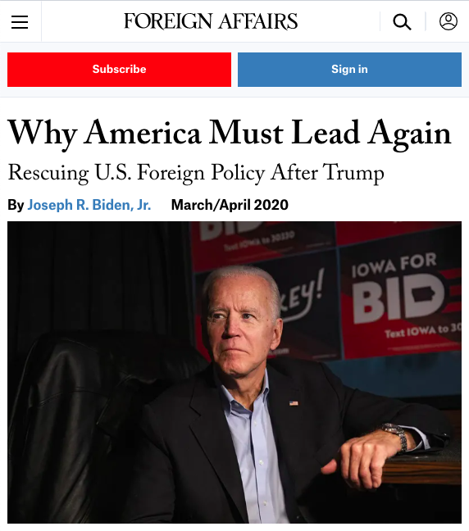
Introduction
“Trump has belittled, undermined, and in some cases abandoned U.S. allies and partners”
“He has emboldened our adversaries and squandered our leverage”
“He has launched ill-advised trade wars that are hurting the American middle class”
“He has abdicated American leadership"
“He has turned away from the democratic values that give strength to our nation and unify us as a people.”
INTRODUCTION | THEORY | LITERATURE REVIEW | ANALYSIS | LIMITATIONS

Slide 4
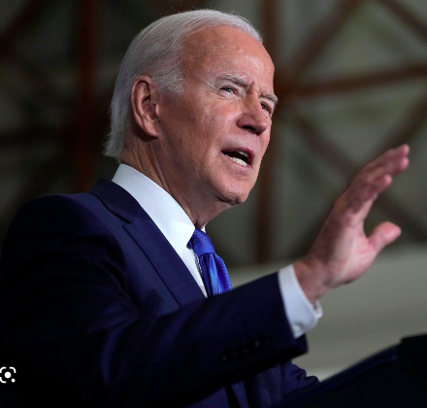
Introduction
“Trump has belittled, undermined, and in some cases abandoned U.S. allies and partners”
“He has emboldened our adversaries and squandered our leverage”
“He has launched ill-advised trade wars that are hurting the American middle class”
“He has abdicated American leadership"
“He has turned away from the democratic values that give strength to our nation and unify us as a people.”
February 2021, DoS Headquarter
“I want the world to hear today: America is back”
INTRODUCTION | THEORY | LITERATURE REVIEW | ANALYSIS | LIMITATIONS

Slide 5
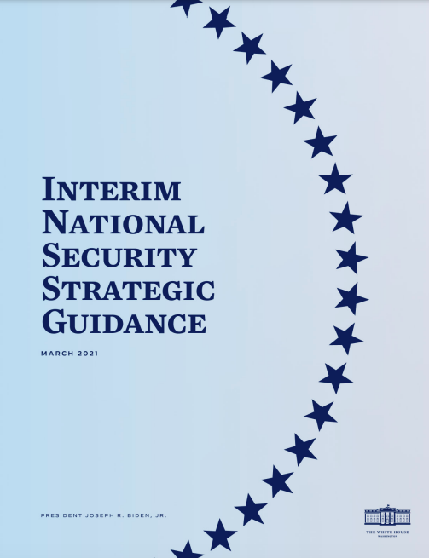
Introduction
Biden ≠ Trump Biden = ?
March 2021, Interim National Security Strategic Guidance:
We [America] must remain committed to realizing and defending the democratic values at the heart of the American way of life. That means more than simply sustaining the status quo – it means reinvigorating our democracy, living up to our ideals and values for all Americans, and standing up for our values abroad, including by uniting the world’s democracies to combat threats to free societies.
INTRODUCTION | THEORY | LITERATURE REVIEW | ANALYSIS | LIMITATIONS
Notes:
So we know that Biden is going to be nothing like Trump, but what exactly is he going to be like

Slide 6
Introduction
Biden ≠ Trump Biden = ?
March 2021, Interim National Security Strategic Guidance:
We [America] must remain committed to realizing and defending the democratic values at the heart of the American way of life. That means more than simply sustaining the status quo – it means reinvigorating our democracy, living up to our ideals and values for all Americans, and standing up for our values abroad, including by uniting the world’s democracies to combat threats to free societies.
Wilsonianism?
INTRODUCTION | THEORY | LITERATURE REVIEW | ANALYSIS | LIMITATIONS
Notes:
So we know that Biden is going to be nothing like Trump, but what exactly is he going to be like

Slide 7
Introduction
Wilsonianism?
Biden ≠ Trump Biden = ?
March 2021, Interim National Security Strategic Guidance:
We [America] must remain committed to realizing and defending the democratic values at the heart of the American way of life. That means more than simply sustaining the status quo – it means reinvigorating our democracy, living up to our ideals and values for all Americans, and standing up for our values abroad, including by uniting the world’s democracies to combat threats to free societies.
Gonzalez (2021)
Gonzalez (2021)
Biden
(1992)
INTRODUCTION | THEORY | LITERATURE REVIEW | ANALYSIS | LIMITATIONS
Notes:
These are just assumptions, we need a research to find out whether his policy
Live up to his promise?

Slide 8
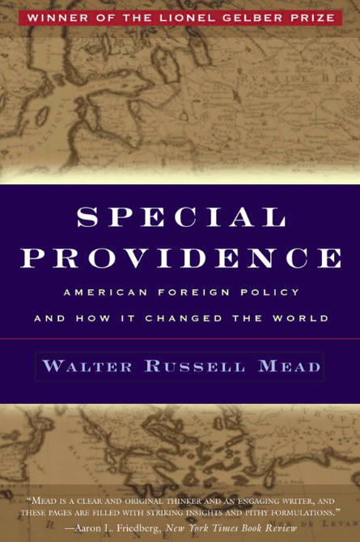
Theoretical Framework
Walter Russell Mead (2002)
The Hamiltonian School
Prioritizes national interests and the economic relationships between America and the international economic system.
The Wilsonian School
Promotes of human rights, democratic governance, and the rule of law
The Jeffersonian School
Regards democracy as a precious plant that is in desperate need of protection and maintain that America should promote democracy “by setting an example rather than by imposing a model”
The Jacksonian School
Takes up a protectionist and isolationist approach
INTRODUCTION | THEORY | LITERATURE REVIEW | ANALYSIS | LIMITATIONS
Notes:
These are just assumptions, we need a research to find out whether his policy
Live up to his promise?
Four Schools that cover up all continuity and changes of US foreign policy

Slide 9
Literature Review
Clarke and Ricketts
(2017a) compares Obama with Jeffersonian tradition through a case study on Obama’s policy vis-à-vis Libya crisis and Syria crisis
(2017b) compares Trump with Jacksonian tradition by examining Trump’s foreign policy towards NATO, Afghanistan, Syria, and the Paris Climate Agreement
Rolf (2021)
he concludes that Trump’s foreign policy is not altogether unpredictable, as he sticks to the tradition to some extent and combines Jacksonianism and Jeffersonianism
Mead (2021)
Criticizes Biden for being incoherent. America is back? America is back – against a wall!
Khan (2021)
Biden falls into the Hamiltonian school, emphasizing investing in small businesses at home and protecting trade relations abroad
Biden’s promotion of human rights complements the Hamiltonian tradition with a Jeffersonian instinct
Episkopos (2022)
Biden: a revised type of Wilsonianism that caters to the changing need of the new century.
INTRODUCTION | THEORY | LITERATURE REVIEW | ANALYSIS | LIMITATIONS
Notes:
These are just assumptions, we need a research to find out whether his policy
Live up to his promise?

Slide 10
Literature Review
Gaps
Hamiltonian? Wilsonian? Jeffersonian?
A new school? Revising Mead’s theory?
Inconsistent?
Words vs Deeds, has Biden lived up to his promise?
Research question
What school(s) does Biden’s foreign policy strategy fall into?
Significance
Testing the validity of Mead’s American foreign policy theory
Adding to the literature on Biden’s foreign policy
INTRODUCTION | THEORY | LITERATURE REVIEW | ANALYSIS | LIMITATIONS
Notes:
These are just assumptions, we need a research to find out whether his policy
Live up to his promise?

Slide 11
Analysis
Method: discourse analysis and case study method
Biden and Wilsonianism:
Democracy Should Prevail
Biden’s Nicaraguan policy; Venezuela; Myanmar
re-engaging in international institutions and repairing alliances
Membership in UNHRC, WHO, and the Paris Agreement.
presidential visits to Europe, the G7 summit, the NATO summit
Biden and Jeffersonianism:
Setting up an example rather than imposing a model
Biden’s inaugural address
Biden’s Afghan policy
Hatred of war: Arabia and Yemen
INTRODUCTION | THEORY | LITERATURE REVIEW | ANALYSIS | LIMITATIONS
Notes:
These are just assumptions, we need a research to find out whether his policy
Live up to his promise?

Slide 12
Analysis
Method: discourse analysis and case study method
Biden and Wilsonianism:
Democracy Should Prevail
Biden’s Nicaraguan policy; Venezuela; Myanmar
re-engaging in international institutions and repairing alliances
Membership in UNHRC, WHO, and the Paris Agreement.
presidential visits to Europe, the G7 summit, the NATO summit
Biden and Jeffersonianism:
Setting up an example rather than imposing a model
Biden’s inaugural address
Biden’s Afghan policy
Hatred of war: Arabia and Yemen
INTRODUCTION | THEORY | LITERATURE REVIEW | ANALYSIS | LIMITATIONS
Notes:
These are just assumptions, we need a research to find out whether his policy
Live up to his promise?

Slide 13
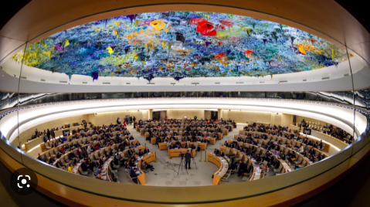
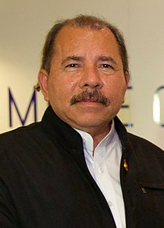
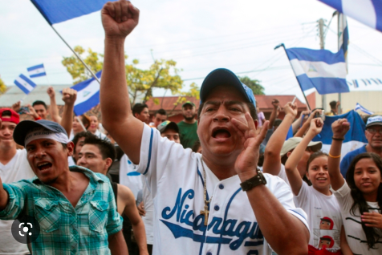

Analysis
Method: discourse analysis and case study method
Biden and Wilsonianism:
Democracy Should Prevail
Biden’s Nicaraguan policy; Venezuela; Myanmar
re-engaging in international institutions and repairing alliances
Membership in UNHRC, WHO, and the Paris Agreement.
presidential visits to Europe, the G7 summit, the NATO summit
Biden and Jeffersonianism:
Setting up an example rather than imposing a model
Biden’s inaugural address
Biden’s Afghan policy
Hatred of war: Arabia and Yemen
Daniel Ortega
INTRODUCTION | THEORY | LITERATURE REVIEW | ANALYSIS | LIMITATIONS
Notes:
These are just assumptions, we need a research to find out whether his policy
Live up to his promise?

Slide 14
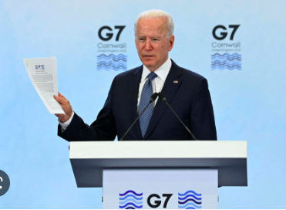
Analysis
Method: discourse analysis and case study method
Biden and Wilsonianism:
Democracy Should Prevail
Biden’s Nicaraguan policy; Venezuela; Myanmar
re-engaging in international institutions and repairing alliances
Membership in UNHRC, WHO, and the Paris Agreement.
presidential visits to Europe, the G7 summit, the NATO summit
Biden and Jeffersonianism:
Setting up an example rather than imposing a model
Biden’s inaugural address
Biden’s Afghan policy
Hatred of war: Arabia and Yemen
INTRODUCTION | THEORY | LITERATURE REVIEW | ANALYSIS | LIMITATIONS
Notes:
These are just assumptions, we need a research to find out whether his policy
Live up to his promise?

Slide 15
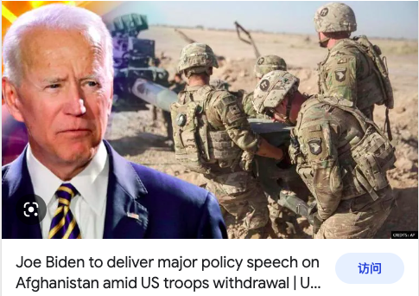
Analysis
Method: discourse analysis and case study method
Biden and Wilsonianism:
Democracy Should Prevail
Biden’s Nicaraguan policy; Venezuela; Myanmar
re-engaging in international institutions and repairing alliances
Membership in UNHRC, WHO, and the Paris Agreement.
presidential visits to Europe, the G7 summit, the NATO summit
Biden and Jeffersonianism:
Setting up an example rather than imposing a model
Biden’s inaugural address
Biden’s Afghan policy
Hatred of war: Arabia and Yemen
INTRODUCTION | THEORY | LITERATURE REVIEW | ANALYSIS | LIMITATIONS
Notes:
These are just assumptions, we need a research to find out whether his policy
Live up to his promise?

Slide 16
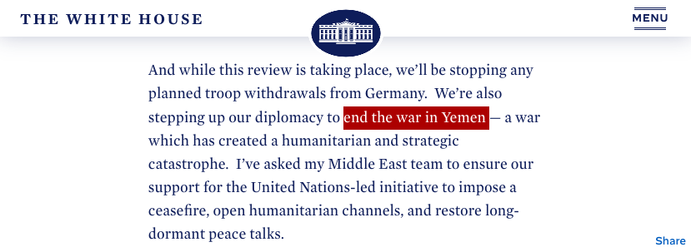
Analysis
Method: discourse analysis and case study method
Biden and Wilsonianism:
Democracy Should Prevail
Biden’s Nicaraguan policy; Venezuela; Myanmar
re-engaging in international institutions and repairing alliances
Membership in UNHRC, WHO, and the Paris Agreement.
presidential visits to Europe, the G7 summit, the NATO summit
Biden and Jeffersonianism:
Setting up an example rather than imposing a model
Biden’s inaugural address
Biden’s Afghan policy
Hatred of war: Arabia and Yemen
INTRODUCTION | THEORY | LITERATURE REVIEW | ANALYSIS | LIMITATIONS
Notes:
These are just assumptions, we need a research to find out whether his policy
Live up to his promise?

Slide 17
Analysis
Method: discourse analysis and case study method
Biden and Wilsonianism:
Democracy Should Prevail
Biden’s Nicaraguan policy; Venezuela; Myanmar
re-engaging in international institutions and repairing alliances
Membership in UNHRC, WHO, and the Paris Agreement.
presidential visits to Europe, the G7 summit, the NATO summit
Biden and Jeffersonianism:
Setting up an example rather than imposing a model
Biden’s inaugural address
Biden’s Afghan policy
Hatred of war: Arabia and Yemen
INTRODUCTION | THEORY | LITERATURE REVIEW | ANALYSIS | LIMITATIONS
Notes:
These are just assumptions, we need a research to find out whether his policy
Live up to his promise?

Slide 18
Limitations
The present paper argues that it is a combination of Wilsonianism and Jeffersonianism that Joe Biden’s foreign policy can be best described as.
2021✅ 2022❌
Russia-Ukraine
Indo-Pacific Economic Framework
2022 National Security Strategy
Confirmation Bias
Content analysis > discourse analysis
INTRODUCTION | THEORY | LITERATURE REVIEW | ANALYSIS | LIMITATIONS
Notes:
These are just assumptions, we need a research to find out whether his policy
Live up to his promise?

Slide 19
Works Cited
Clarke, M., & Ricketts, A. (2017a). Shielding the Republic: Barack Obama and the Jeffersonian Tradition of American Foreign Policy. Diplomacy & Statecraft, 28 (3), 494-517.
Clarke, M., & Ricketts, A. (2017b). Donald Trump and American Foreign Policy: The Return of the Jacksonian Tradition. Comparative Strategy, 36 (4), 366-379.
Episkopos, M. (2022). Is Joe Biden President Woodrow Wilson Come Again? The National Interest. https://nationalinterest.org/blog/reboot/joe-biden-president-woodrow-wilson-come-again-199198
Gonzalez, A. (2021). Biden, the “Wilsonian”. Ultimas Noticias. https://en.ultimasnoticias.com.ve/news/opinion/biden-the-wilsonian/
Khan, M. (2021). Despite Promises of ‘Relentless Diplomacy,’ Biden’s Foreign Policy Agendas Feels Like an Extension of the Trump Ara. The Philadelphia Inquirer. https://www.inquirer.com/opinion/commentary/biden-foreign-policy-opinion-muqtedar-khan-20211019.html
Mead, W. R. (2021b). America’s Back-Against a Wall. The Wall Street Journal. https://www.wsj.com/articles/americas-backagainst-a-wall-11616452400?page=3
The White House. (2021a). Remarks by President Biden on America’s Place in the World. https://www.whitehouse.gov/briefing-room/speeches-remarks/2021/02/04/remarks-by-president-biden-on-americas-place-in-the-world/
The White House. (2021b). Inaugural Address by President Joseph R. Biden, Jr. https://www.whitehouse.gov/briefing-room/speeches-remarks/2021/01/20/inaugural-address-by-president-joseph-r-biden-jr/
The White House. (2021c). Interim National Security Strategic Guidance. https://www.whitehouse.gov/wp-content/uploads/2021/03/NSC-1v2.pdf
Atkinson, P. C. (2021). The Drumbeat of Idealism: Joe Biden, Woodrow Wilson, and the Fourteen Points. The Hill. https://thehill.com/opinion/white-house/533326-the-drumbeat-of-idealism-joe-biden-woodrow-wilson-and-the-fourteen-points
INTRODUCTION | THEORY | LITERATURE REVIEW | ANALYSIS | LIMITATIONS
Notes:
These are just assumptions, we need a research to find out whether his policy
Live up to his promise?

Slide 20
Thanks!
Presented by Zhang Wei
12 November 2022

