Slide 1
Weathering US-China Competition in the Indo-Pacific: Middle Powers’ Institutional Balancing and Lateral Cooperation
Presented by Zhang Wei
28 June 2023

Slide 2
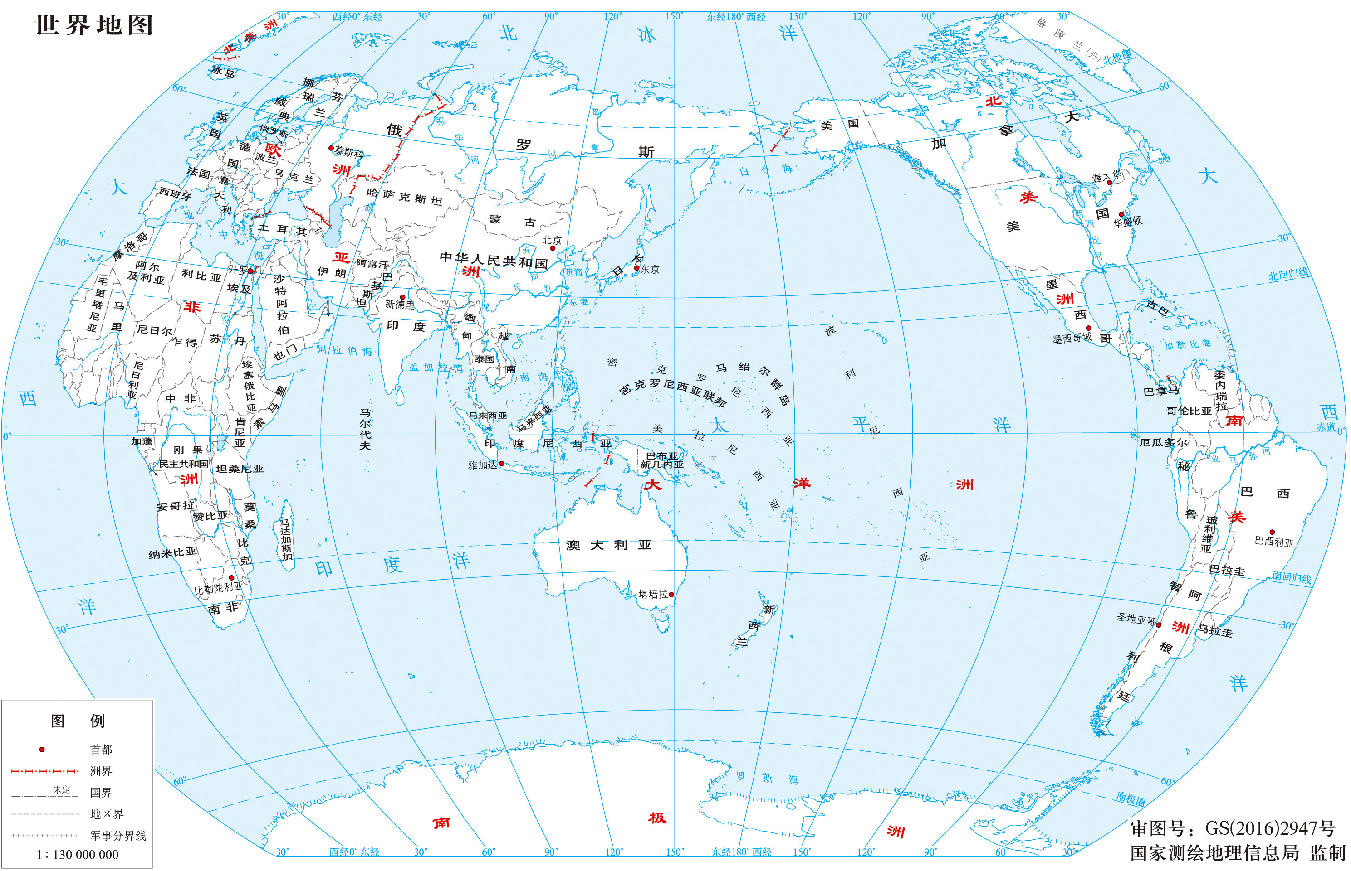

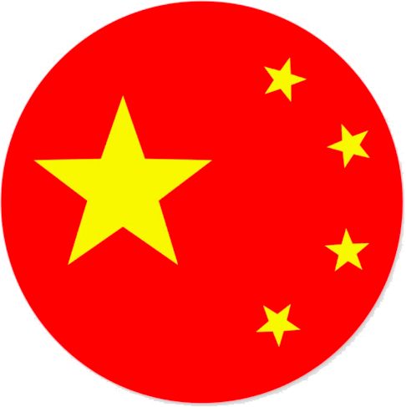
“rise”
“fall”
Intensified competition
“Indo-Pacific”

Slide 3
“rise”
🇯🇵
“fall”
Intensified competition
🇰🇷
🇮🇳
🇸🇬
🇮🇩
🇦🇺
“Indo-Pacific”

Slide 4
Literature Review
Act
?
🇮🇳
🇸🇬
🇮🇩
🇰🇷
🇯🇵
🇦🇺
React
McDougall (2014) : Australia has the potential to maintain positive relations with both, but such potential “depends on how the U.S.-China relationship evolves”
Hwang et al. (2020) and Chung (2023) : South Korea had been utilizing a lukewarm response to avoid taking a side between China and the US
Crowley et al. (2017) : agency only for Japan and India; Countries smaller than these two are left with zero agency.

Slide 5
Literature Review
Hoo and Teo (2022) : “states do not craft their policies only in response to great-power behavior; they also do so in consideration of a broader set of circumstances that encompasses elements such as domestic agenda, self-positioning and economic motivations” (63)
Wilson (2019), De Swielande (2019), Jung et al. (2021), Nagy (2020; 2022), Chin (2022), and Wen Zha (2022). Whichever case they choose to study, their findings all boil down to one common idea, that is, middle powers are not just passive respondents to the behavior of great powers; they are active players in their own right.
Greater agency
Research Question: how Indo-Pacific middle powers weather the US-China strategic competition through acts of agency

Slide 6
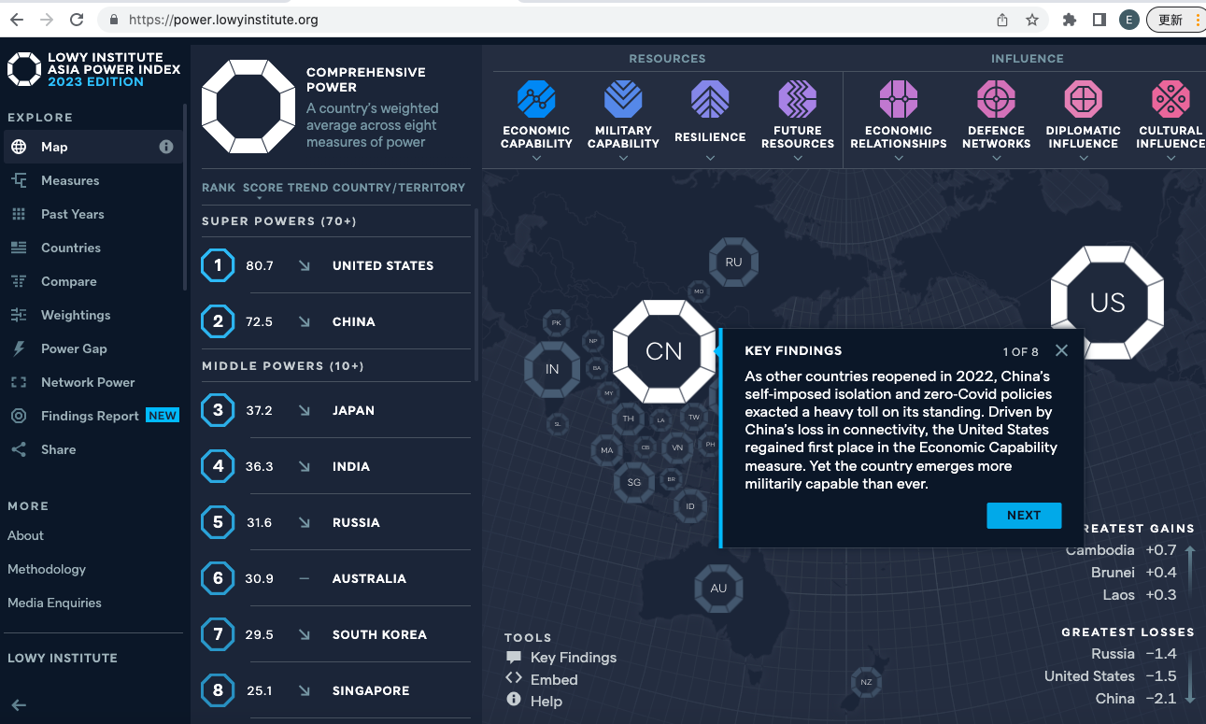
Hoo and Teo (2022) : “states do not craft their policies only in response to great-power behavior; they also do so in consideration of a broader set of circumstances that encompasses elements such as domestic agenda, self-positioning and economic motivations” (63)
Wilson (2019), De Swielande (2019), Jung et al. (2021), Nagy (2020; 2022), Chin (2022), and Wen Zha (2022). Whichever case they choose to study, their findings all boil down to one common idea, that is, middle powers are not just passive respondents to the behavior of great powers; they are active players in their own right.
Greater agency
Theoretical Framework
Research Question: how Indo-Pacific middle powers weather the US-China strategic competition through acts of agency
Middle Powers
Agency: Rationale
Agency: Ways to practice
Lowy Institute’s Asia Power Index (2023):
Japan, India, Russia, Australia, South Korea, Singapore, Indonesia, Thailand, Malaysia, Vietnam, Singapore, Pakistan, Philippines, North Korea

Slide 7
Theoretical Framework
Research Question: how Indo-Pacific middle powers weather the US-China strategic competition through acts of agency
Middle Powers
Agency: Rationale
Agency: Ways to practice
Lowy Institute’s Asia Power Index (2023):
Japan, India, Russia, Australia, South Korea, Singapore, Indonesia, Thailand, Malaysia, Vietnam, Singapore, Pakistan, Philippines, North Korea

Slide 8
Hoo and Teo (2022) : “states do not craft their policies only in response to great-power behavior; they also do so in consideration of a broader set of circumstances that encompasses elements such as domestic agenda, self-positioning and economic motivations” (63)
Wilson (2019), De Swielande (2019), Jung et al. (2021), Nagy (2020; 2022), Chin (2022), and Wen Zha (2022). Whichever case they choose to study, their findings all boil down to one common idea, that is, middle powers are not just passive respondents to the behavior of great powers; they are active players in their own right.
Greater agency
Theoretical Framework
Research Question: how Indo-Pacific middle powers weather the US-China strategic competition through acts of agency
Middle Powers
Agency: Rationale
Agency: Ways to practice
Lowy Institute’s Asia Power Index (2023):
Japan, India, Russia, Australia, South Korea, Singapore, Indonesia, Thailand, Malaysia, Vietnam, Singapore, Pakistan, Philippines, North Korea

Slide 9
Theoretical Framework
Research Question: how Indo-Pacific middle powers weather the US-China strategic competition through acts of agency
Middle Powers
Wen Zha (2022)
Great power competition empowerment theory
the existence of alternatives enhances middle powers’ bargaining power, thus reducing their dependence on either one of them
draw attention to previously neglected middle powers, to enlarge sphere of influence and assure an upper hand in the competition
middle powers’ threat of exit is more powerful when the great power is involved in a strategic competition with a counterpart, for threat under such circumstances is loaded with credibility
Agency: Rationale
Agency: Ways to practice

Slide 10
Theoretical Framework
Research Question: how Indo-Pacific middle powers weather the US-China strategic competition through acts of agency
Kai He: Institutional Balancing
end: to counter pressure
means: inclusive vs exclusive
Inclusive: to bind a target state with the norms and rules of institutions (ASEAN) (influence behavior & encourage cooperation)
Exclusive: to prevent a target state from joining an institution where membership ensures cooperation (TPP)
de Swielande: Lateral Cooperation
Community of practice and management theories
“equivalent social positions and similar power capabilities”
Middle-up-down framework
a horizontal line where lateral cooperation is conducted
Lead from the middle
Middle Powers
Agency: Rationale
Agency: Ways to practice

Slide 11
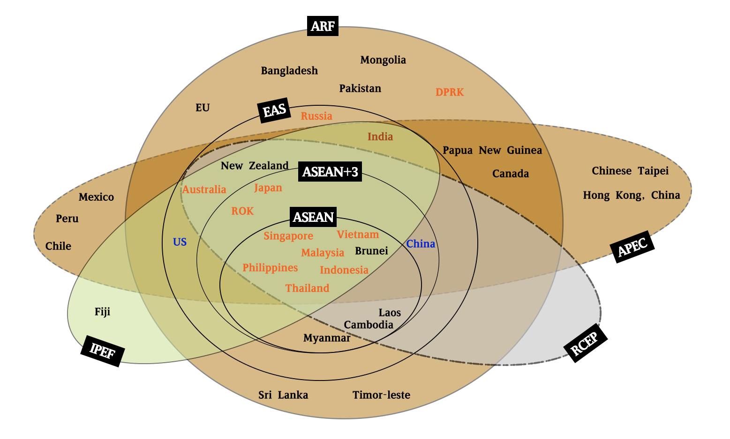
Analysis: a constellation of institutions
APEC 1989
ARF 1994
EAS 2005
They had been serving as the highest-level multilateral and most influential institutions until in recent years, yet another wave joined,
RCEP 2020
IPEF 2022
Source: adapted from Capannelli and Tan (6) and Qi (10)

Slide 12
Analysis: Institutional Balancing in practice
A - join the institution, influencing the norms and decisions from the inside, gaining political and economic interests as a recipient country;
B - initiate one of their own, taking advantage of the first-mover status and having a stronger voice therein.
ASEAN’s adaptation
Inclusive > Exclusive
From EAEC to APT
Malaysia, Japan
RCEP & IPEF
US, China: exclusive
Middle powers: inclusive
India
ASEAN (1967) & ASEAN Centrality
Inclusive > Exclusive
At the beginning:
Malaysia proposed an exclusive plan, i.e., to create an East Asia Economic Caucus (EAEC) and contain the growing influence the US has within APEC and the whole Asia. (basically an APEC without North America and the Oceania)
failed
strong opposition from the US and Australia,
Japan’s “deliberate ambivalence”: desired the effects of the EAEC on the one hand but too dependent on the West for economic restoration on the other
Later on
ASEAN Plus Three (APT) took hold in 1999, with the same membership as EAEC.
Japan Joined: the quality of Japan-US alliance changed and Japan’s national interest shifted back to East and South East Asia.
Malaysia, the 1997 economic crisis caught them off guard
Australia, New Zealand and India joined and enlarged the APT to form the East Asia Summit (EAS) in 2005.
In 2011, the US under the Obama administration participated in the sixth EAS;
From the American perspective = its pivot to Asia strategy,
From the institutional balancing perspective = Asian middle powers welcoming the US in to counterbalance China

Slide 13
ASEAN (1967) & ASEAN Centrality
Inclusive > Exclusive
At the beginning:
Malaysia proposed an exclusive plan, i.e., to create an East Asia Economic Caucus (EAEC) and contain the growing influence the US has within APEC and the whole Asia. (basically an APEC without North America and the Oceania)
failed
strong opposition from the US and Australia,
Japan’s “deliberate ambivalence”: desired the effects of the EAEC on the one hand but too dependent on the West for economic restoration on the other
Later on
ASEAN Plus Three (APT) took hold in 1999, with the same membership as EAEC.
Japan Joined: the quality of Japan-US alliance changed and Japan’s national interest shifted back to East and South East Asia.
Malaysia, the 1997 economic crisis caught them off guard
Australia, New Zealand and India joined and enlarged the APT to form the East Asia Summit (EAS) in 2005.
In 2011, the US under the Obama administration participated in the sixth EAS;
From the American perspective = its pivot to Asia strategy,
From the institutional balancing perspective = Asian middle powers welcoming the US in to counterbalance China
Analysis: Institutional Balancing in practice
A - join the institution, either influencing the norms and decisions from the inside or gaining political and economic interests as a recipient country;
B - initiate one of their own and then invite others to join, taking advantage of the first-mover status and having a stronger voice therein.

Slide 14
Analysis: Institutional Balancing in practice
A - join the institution, influencing the norms and decisions from the inside, gaining political and economic interests as a recipient country;
B - initiate one of their own, taking advantage of the first-mover status and having a stronger voice therein.
ASEAN’s adaptation
Inclusive > Exclusive
From EAEC to APT
Malaysia, Japan
RCEP & IPEF
US, China: exclusive
Middle powers: inclusive
India
ASEAN (1967) & ASEAN Centrality
Inclusive > Exclusive
At the beginning:
Malaysia proposed an exclusive plan, i.e., to create an East Asia Economic Caucus (EAEC) and contain the growing influence the US has within APEC and the whole Asia. (basically an APEC without North America and the Oceania)
failed
strong opposition from the US and Australia,
Japan’s “deliberate ambivalence”: desired the effects of the EAEC on the one hand but too dependent on the West for economic restoration on the other
Later on
ASEAN Plus Three (APT) took hold in 1999, with the same membership as EAEC.
Japan Joined: the quality of Japan-US alliance changed and Japan’s national interest shifted back to East and South East Asia.
Malaysia, the 1997 economic crisis caught them off guard
Australia, New Zealand and India joined and enlarged the APT to form the East Asia Summit (EAS) in 2005.
In 2011, the US under the Obama administration participated in the sixth EAS;
From the American perspective = its pivot to Asia strategy,
From the institutional balancing perspective = Asian middle powers welcoming the US in to counterbalance China
RCEP & IPEF
US, China: exclusive & Middle powers: inclusive
The India case:
once a RCEP member but later withdrew, and has now joined the IPEF.
✅Given the Quadrilateral Security Dialogue’s revival, India’s decision is of little surprise.
❓India’s deep rooted ideological distaste of free trade agreement
A staunchest supporter of economic self-resilience & protectionist approach
Such an ideology preference is shared by two most powerful political parties of India,
Bharatiya Janata Party and
the Indian National Congress,
India’s withdrawal from RCEP = an effortless consensus domestically
India’s participation in IPEF = the same distaste that has driven it away from RCEP,
IPEF is not a free trade agreement,
IPEF’s flexible agenda enables India to stay out of the trade pillar while joining the others
A galaxy-like regional institutional landscape centers around middle powers themselves
Though the recent RCEP and IPEF seem to suggest confrontation, but again, middle powers’ participation in both two institutions has rendered it nothing like the separated blocs of the Cold War period.
ASEAN (1967) & ASEAN Centrality
Inclusive > Exclusive
At the beginning:
Malaysia proposed an exclusive plan, i.e., to create an East Asia Economic Caucus (EAEC) and contain the growing influence the US has within APEC and the whole Asia. (basically an APEC without North America and the Oceania)
failed
strong opposition from the US and Australia,
Japan’s “deliberate ambivalence”: desired the effects of the EAEC on the one hand but too dependent on the West for economic restoration on the other
Later on
ASEAN Plus Three (APT) took hold in 1999, with the same membership as EAEC.
Japan Joined: the quality of Japan-US alliance changed and Japan’s national interest shifted back to East and South East Asia.
Malaysia, the 1997 economic crisis caught them off guard
Australia, New Zealand and India joined and enlarged the APT to form the East Asia Summit (EAS) in 2005.
In 2011, the US under the Obama administration participated in the sixth EAS;
From the American perspective = its pivot to Asia strategy,
From the institutional balancing perspective = Asian middle powers welcoming the US in to counterbalance China

Slide 15
Analysis: Institutional Balancing in practice
RCEP & IPEF
US, China: exclusive & Middle powers: inclusive
The India case:
once a RCEP member but later withdrew, and has now joined the IPEF.
✅Given the Quadrilateral Security Dialogue’s revival, India’s decision is of little surprise.
❓India’s deep rooted ideological distaste of free trade agreement
A staunchest supporter of economic self-resilience & protectionist approach
Such an ideology preference is shared by two most powerful political parties of India,
Bharatiya Janata Party and
the Indian National Congress,
India’s withdrawal from RCEP = an effortless consensus domestically
India’s participation in IPEF = the same distaste that has driven it away from RCEP,
IPEF is not a free trade agreement,
IPEF’s flexible agenda enables India to stay out of the trade pillar while joining the others
A galaxy-like regional institutional landscape centers around middle powers themselves
Though the recent RCEP and IPEF seem to suggest confrontation, but again, middle powers’ participation in both two institutions has rendered it nothing like the separated blocs of the Cold War period.
A - join the institution, influencing the norms and decisions from the inside, gaining political and economic interests as a recipient country;
B - initiate one of their own, taking advantage of the first-mover status and having a stronger voice therein.
ASEAN’s adaptation
Inclusive > Exclusive
From EAEC to APT
Malaysia, Japan
ASEAN (1967) & ASEAN Centrality
Inclusive > Exclusive
At the beginning:
Malaysia proposed an exclusive plan, i.e., to create an East Asia Economic Caucus (EAEC) and contain the growing influence the US has within APEC and the whole Asia. (basically an APEC without North America and the Oceania)
failed
strong opposition from the US and Australia,
Japan’s “deliberate ambivalence”: desired the effects of the EAEC on the one hand but too dependent on the West for economic restoration on the other
Later on
ASEAN Plus Three (APT) took hold in 1999, with the same membership as EAEC.
Japan Joined: the quality of Japan-US alliance changed and Japan’s national interest shifted back to East and South East Asia.
Malaysia, the 1997 economic crisis caught them off guard
Australia, New Zealand and India joined and enlarged the APT to form the East Asia Summit (EAS) in 2005.
In 2011, the US under the Obama administration participated in the sixth EAS;
From the American perspective = its pivot to Asia strategy,
From the institutional balancing perspective = Asian middle powers welcoming the US in to counterbalance China

Slide 16
Analysis: Institutional Balancing in practice
A - join the institution, influencing the norms and decisions from the inside, gaining political and economic interests as a recipient country;
B - initiate one of their own, taking advantage of the first-mover status and having a stronger voice therein.
ASEAN’s adaptation
Inclusive > Exclusive
From EAEC to APT
Malaysia, Japan
RCEP & IPEF
US, China: exclusive
Middle powers: inclusive
India
ASEAN (1967) & ASEAN Centrality
Inclusive > Exclusive
At the beginning:
Malaysia proposed an exclusive plan, i.e., to create an East Asia Economic Caucus (EAEC) and contain the growing influence the US has within APEC and the whole Asia. (basically an APEC without North America and the Oceania)
failed
strong opposition from the US and Australia,
Japan’s “deliberate ambivalence”: desired the effects of the EAEC on the one hand but too dependent on the West for economic restoration on the other
Later on
ASEAN Plus Three (APT) took hold in 1999, with the same membership as EAEC.
Japan Joined: the quality of Japan-US alliance changed and Japan’s national interest shifted back to East and South East Asia.
Malaysia, the 1997 economic crisis caught them off guard
Australia, New Zealand and India joined and enlarged the APT to form the East Asia Summit (EAS) in 2005.
In 2011, the US under the Obama administration participated in the sixth EAS;
From the American perspective = its pivot to Asia strategy,
From the institutional balancing perspective = Asian middle powers welcoming the US in to counterbalance China
RCEP & IPEF
US, China: exclusive & Middle powers: inclusive
The India case:
once a RCEP member but later withdrew, and has now joined the IPEF.
✅Given the Quadrilateral Security Dialogue’s revival, India’s decision is of little surprise.
❓India’s deep rooted ideological distaste of free trade agreement
A staunchest supporter of economic self-resilience & protectionist approach
Such an ideology preference is shared by two most powerful political parties of India,
Bharatiya Janata Party and
the Indian National Congress,
India’s withdrawal from RCEP = an effortless consensus domestically
India’s participation in IPEF = the same distaste that has driven it away from RCEP,
IPEF is not a free trade agreement,
IPEF’s flexible agenda enables India to stay out of the trade pillar while joining the others
A galaxy-like regional institutional landscape centers around middle powers themselves
Though the recent RCEP and IPEF seem to suggest confrontation, but again, middle powers’ participation in both two institutions has rendered it nothing like the separated blocs of the Cold War period.
ASEAN (1967) & ASEAN Centrality
Inclusive > Exclusive
At the beginning:
Malaysia proposed an exclusive plan, i.e., to create an East Asia Economic Caucus (EAEC) and contain the growing influence the US has within APEC and the whole Asia. (basically an APEC without North America and the Oceania)
failed
strong opposition from the US and Australia,
Japan’s “deliberate ambivalence”: desired the effects of the EAEC on the one hand but too dependent on the West for economic restoration on the other
Later on
ASEAN Plus Three (APT) took hold in 1999, with the same membership as EAEC.
Japan Joined: the quality of Japan-US alliance changed and Japan’s national interest shifted back to East and South East Asia.
Malaysia, the 1997 economic crisis caught them off guard
Australia, New Zealand and India joined and enlarged the APT to form the East Asia Summit (EAS) in 2005.
In 2011, the US under the Obama administration participated in the sixth EAS;
From the American perspective = its pivot to Asia strategy,
From the institutional balancing perspective = Asian middle powers welcoming the US in to counterbalance China

Slide 17
Analysis: Lateral Cooperation in practice
Institutions |  | Leading Actor(s) | Formed | Indo-Pacific Middle Power Partners
Regional Economic Partnership | Indo-Pacific Economic Framework | US | 2022 | Australia, Indonesia, Japan, Malaysia, Philippines, Singapore, South Korea, Thailand, Vietnam
 | Regional Comprehensive Economic Partnership (RCEP) | China | 2020 | Australia, Indonesia, Japan, Malaysia, Philippines, Singapore, South Korea, Thailand, Vietnam
Infrastructure Related | Belt and Road Initiative (BRI) | China | 2013 | Indonesia, Malaysia, Philippines, Singapore, South Korea, Thailand, Vietnam
 | Partnership for Global Infrastructure and Investment | G7 | 2022 | N/A
 | Build Back Better B3W | G7 | 2021 | N/A
 | Blue Dot Network (BDN) | US, Japan, Australia | 2019 | Australia, India, Japan, Taiwan,
Infrastructure Investment | US International Development Finance Corporation (DFC) | US | 2019 | India, Indonesia, Philippines, Singapore, South Korea, Thailand, Vietnam
 | Overseas Private Investment Corporation OPIC | US | 1971 | N/A
 | Asian Infrastructure Investment Bank (AIIB) | China | 2016 | Australia, India, Indonesia, Malaysia, Philippines, Singapore, South Korea, Thailand, Vietnam
Mekong Connectivity | Lancang-Mekong Cooperation (LMC) | China | 2016 | Thailand, Vietnam
 | Mekong-US Partnership | US | 2020 | Thailand, Vietnam
 | Lower Mekong Initiative (LMI) | US | 2009 | Thailand, Vietnam

Slide 18
Analysis: Lateral Cooperation in practice
The enhanced strategic influence of Indo-Pacific in the recent decade fueled states’ efforts to craft their own Indo-Pacific strategy.
Japan’s Free and Open Indo-Pacific Vision,
South Korea’s New Southern Policy and
ASEAN’s Indo-Pacific Outlook
aimed at not only filling the huge infrastructure gap therein, but also counterbalancing China’s Belt and Road Initiative (BRI) and guarding against America’s weakened commitment
many other stakeholders start to initiate infrastructure programs and cooperate laterally:
Vietnam-India Ecologic Engineering and Saigontel infrastructure agreement (2021),
BIMP-EAGE infrastructure projects (2021),
Australia-Indonesia RISE intervention (2021),
Japan-Indonesia Patimban Port Development Project (2022).
The concentration of domestic infrastructure project is but one of such indicators
Japan: Partnership for quality infrastructure in 2015
India: joined this effort and put forth the Asia-Africa Growth Corridor (AAGC)
Though AAGC does not benefit the Indo-pacific directly, its taglines such as “free and open world order” and “quality infrastructure” are sure to have an agenda setting effect and therefore exert a subtle yet undeniable influence within this region.

Slide 19
Conclusion: walking a fine line amid great power competition
Middle powers have engaged actively in regional institutions as well as with each other to better position themselves in the changing environment.
They took the initiative in starting and enlarging ASEAN related mechanism and therefore managed to stay at the center of these concentric circles.
They are able to obtain huge economic benefits by joining both RCEP and IPEF, or they can maintain their favored ideology or national interests by avoiding the portion they find objectionable.
They can explore the possibility of preserving their interests by cooperating with each other.
But still, proving the existence of agency does not guarantee it to be omnipotent. Further studies are needed to figure out how much constraint is placed on such agency.

Slide 20
Thanks for Listening!
Presented by Zhang Wei
28 June 2023

