Slide 1
Diaspora:
Evolution & Examples
Presented by ZHANG Wei

Slide 2
Diaspora defined in dictionary
In American English
/daɪˈæspərə/, NOUN
The dispersion of the Jews after the Babylonian Exile
The Jews thus dispersed
The places where they settled
Any scattering of people with a common origin, background, beliefs, etc.
Source: Webster’s New World College Dictionary, 4th Edition

Slide 3
Evolution
01
02
03
04
διασπορά
diaspora
in Ancient Greek
assimilated into English
[people emigrating to a conquered land]
[a loose equivalent for a range of other words]
[people being exiled]
diaspora
διασπορά
As an academic discourse
in Greek Septuagint

Slide 4
Evolution
01
02
03
04
διασπορά
διασπείρω (diaspeirō), "I scatter",
1st person singular conjugation
citizens of a dominant city-state who emigrated to a conquered land with the purpose of colonization, to assimilate the territory into the empire
diaspora
in Ancient Greek
assimilated into English
[people emigrating to a conquered land]
[a loose equivalent for a range of other words]
[people being exiled]
diaspora
διασπορά
As an academic discourse
in Greek Septuagint

Slide 5
Evolution
01
02
03
04
διασπορά
diaspora
in Ancient Greek
assimilated into English
[people emigrating to a conquered land]
[a loose equivalent for a range of other words]
[people being exiled]
diaspora
διασπορά
As an academic discourse
in Greek Septuagint

Slide 6
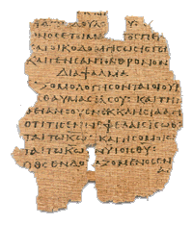
Evolution
01
02
03
04
διασπορά
diaspora
in Ancient Greek
assimilated into English
[people emigrating to a conquered land]
[a loose equivalent for a range of other words]
[people being exiled]
diaspora
διασπορά
As an academic discourse
in Greek Septuagint

Slide 7
Evolution
01
02
03
04
Hebrew Bible ⇾ Greek Septuagint
ἔσῃ ἐν διασπορᾷ ἐν πάσαις ταῖς βασιλείαις τῆς γῆς
[esē en diaspora en pasais tais basileiais tēs gēs]
[thou shalt be a dispersion in all kingdoms of the earth]
διασπορά
diaspora
in Ancient Greek
assimilated into English
[people emigrating to a conquered land]
[a loose equivalent for a range of other words]
[people being exiled]
diaspora
διασπορά
As an academic discourse
in Greek Septuagint

Slide 8
Evolution
01
02
03
04
Hebrew Bible ⇾ Greek Septuagint
The divine expulsion of the Jewish people (Leviticus and Deuteronomy)
People (the Jews) exiled from Israel
The Jews who spread throughout the Mediterranean during the Hellenic period
διασπορά
diaspora
in Ancient Greek
assimilated into English
[people emigrating to a conquered land]
[a loose equivalent for a range of other words]
[people being exiled]
diaspora
διασπορά
As an academic discourse
in Greek Septuagint

Slide 9
Evolution
01
02
03
04
διασπορά
diaspora
in Ancient Greek
assimilated into English
[people emigrating to a conquered land]
[a loose equivalent for a range of other words]
[people being exiled]
diaspora
διασπορά
As an academic discourse
in Greek Septuagint

Slide 10
Evolution
01
02
03
04
διασπορά
widely assimilated into English by the mid 1950s
diaspora as long-term expatriates in significant numbers from other countries or regions
diaspora vs. diasporas
diaspora
in Ancient Greek
assimilated into English
[people emigrating to a conquered land]
[a loose equivalent for a range of other words]
[people being exiled]
diaspora
διασπορά
As an academic discourse
in Greek Septuagint

Slide 11
Evolution
01
02
03
04
διασπορά
diaspora
in Ancient Greek
assimilated into English
[people emigrating to a conquered land]
[a loose equivalent for a range of other words]
[people being exiled]
diaspora
διασπορά
As an academic discourse
in Greek Septuagint

Slide 12
Evolution
01
02
03
04
διασπορά
after the founding of CCCS
African diaspora
Labor diaspora
Religion diaspora
Ethnicity diaspora
…
diaspora
in Ancient Greek
assimilated into English
[people emigrating to a conquered land]
[a loose equivalent for a range of other words]
[people being exiled]
diaspora
διασπορά
As an academic discourse
in Greek Septuagint

Slide 13
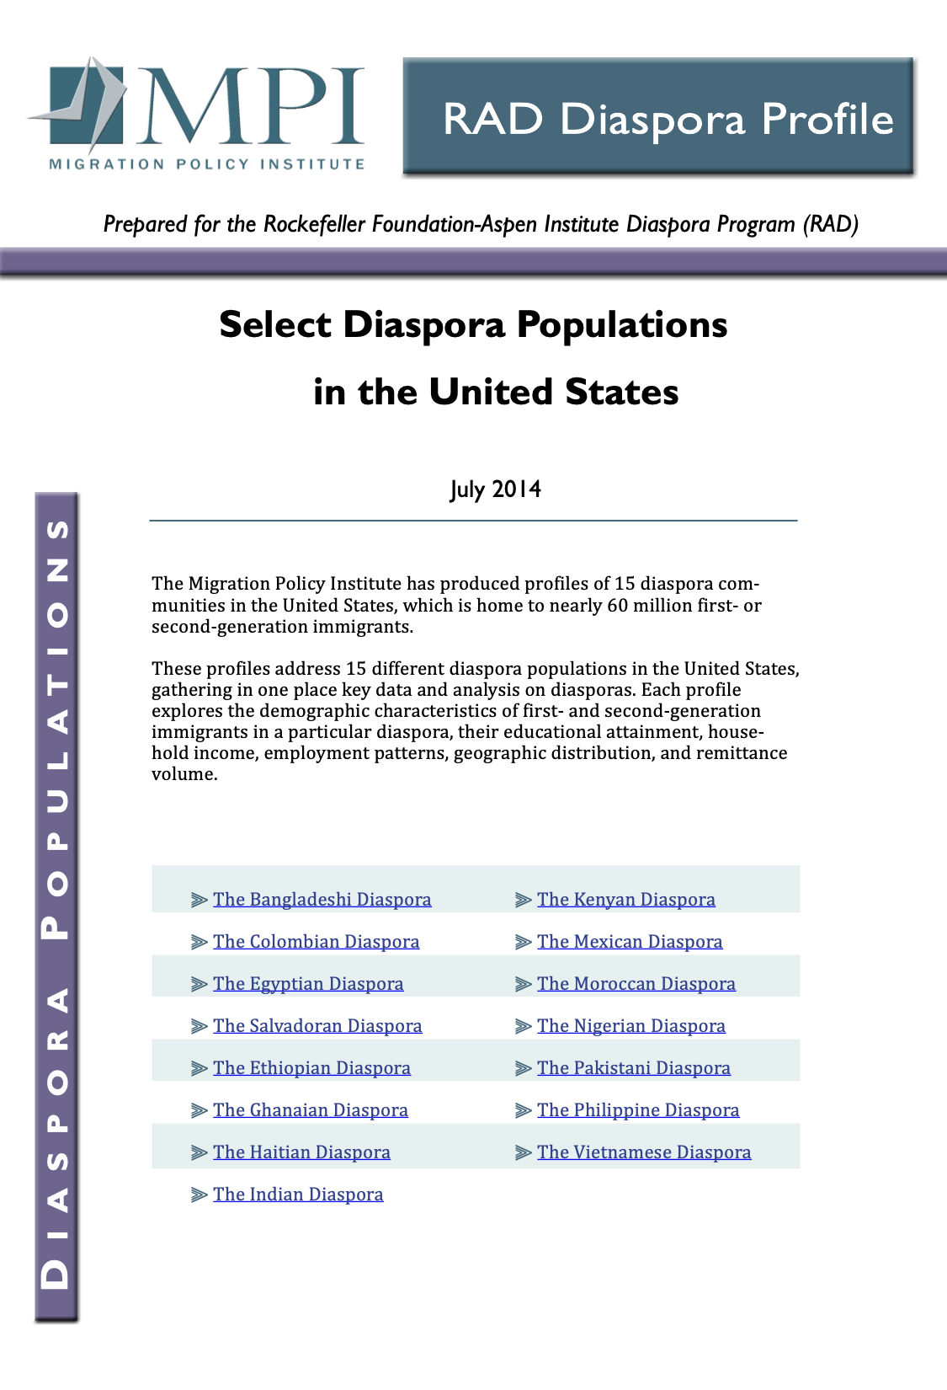
Diasporas in Contemporary America
Source: Migration Policy Institute (MPI)

Slide 14
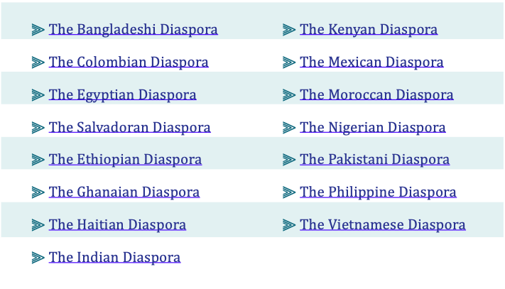
Diasporas in Contemporary America

Slide 15
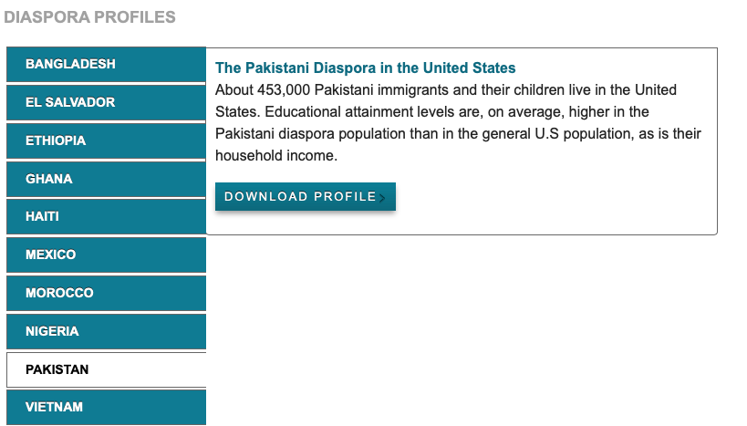
333,000.00
24h 37m 23s
386,000 km
earths is the Sun’s mass
is Jupiter’s rotation period
is the distance between Earth and the Moon

Slide 16
Thanks!
Please keep this slide for attribution

