Slide 1
Exceptionalism Keywords for American Cultural studies
Presented by ZHANG Wei

Slide 2
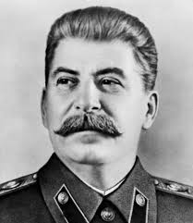
Prior to the Cold war
“the heresy of American Exceptionalism”
Joseph Stalin to exclude the lovestoneites from the Communist International.
American scholars reappropriated it to portray the US as “destined to perform a special role in the world of nations”.

Slide 3
Representation
Aristocracy/monarchy/empire hierarchical society socialist tradition
“redeemer nation” “conqueror of the world’s markets” “global security state”

Slide 4
During the Cold war
Exceptionalism, as an academic discourse
to explain their research practice,
to interpret a scholarly problem,
to teach disciplines ranging from humanities to social sciences, and to live by it as an ethos.

Slide 5
Representation
Superiority
a threat to world order
probable victim of that threat
US
USSR
EC

Slide 6
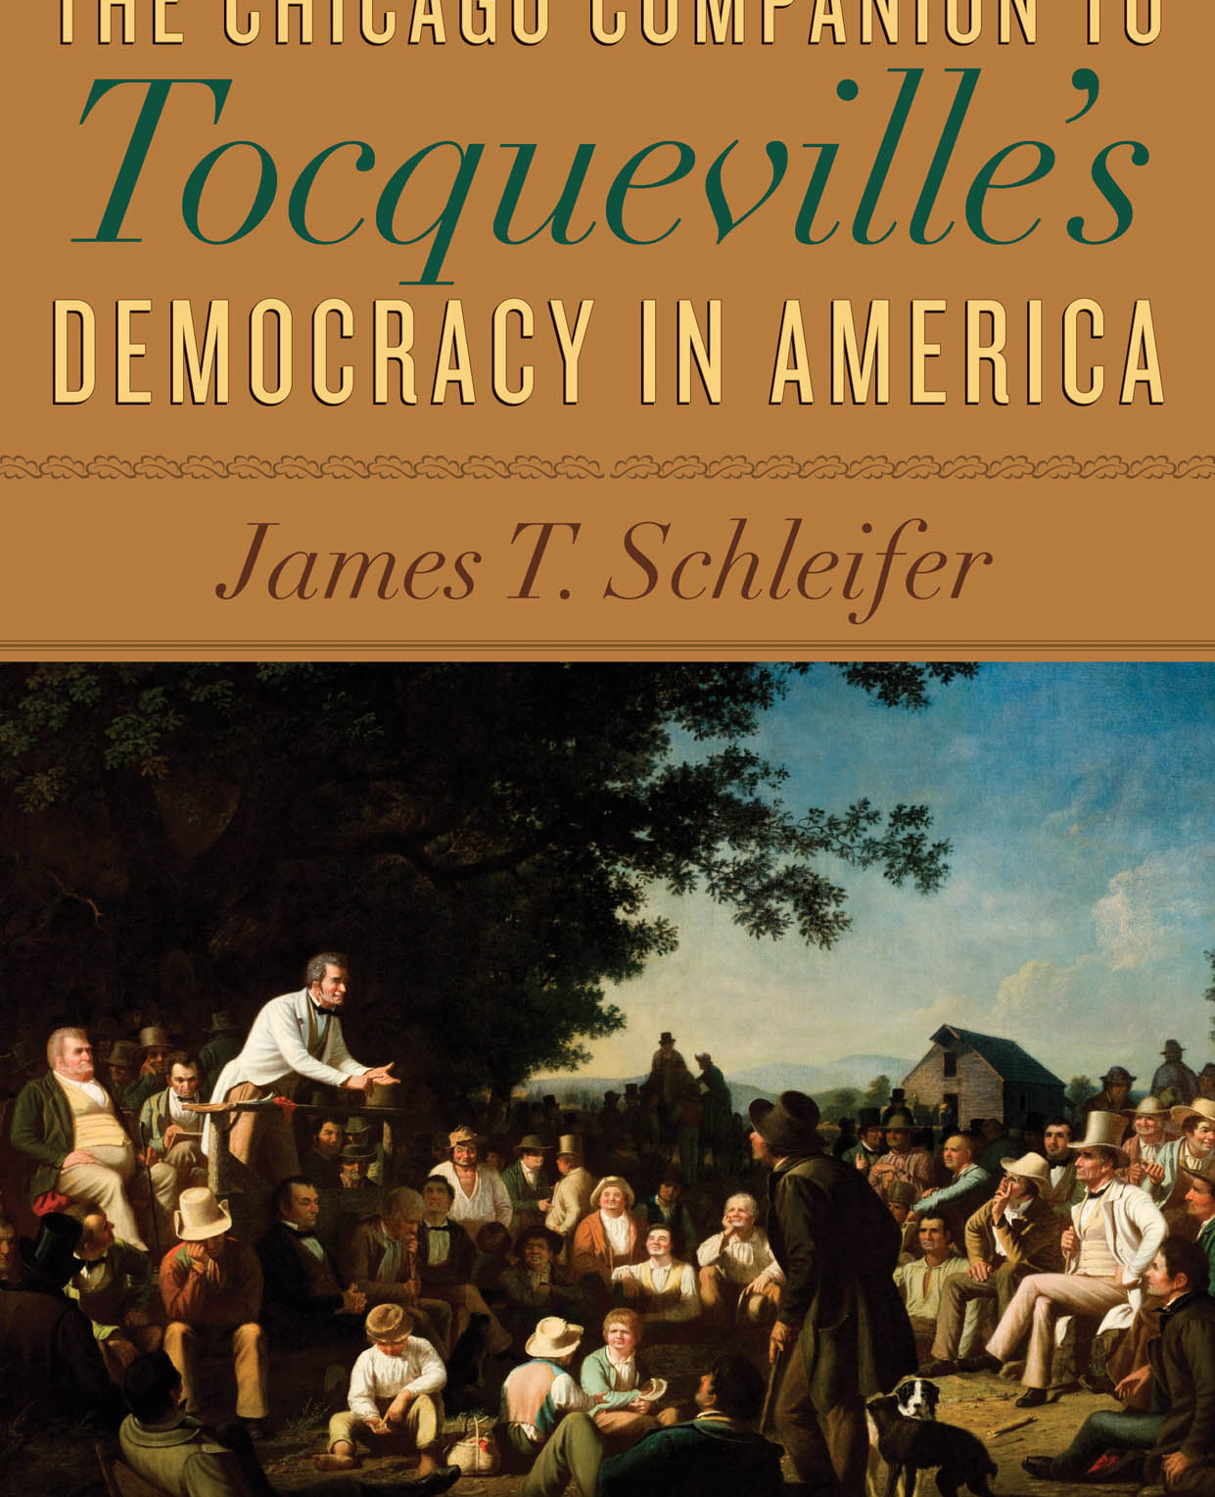
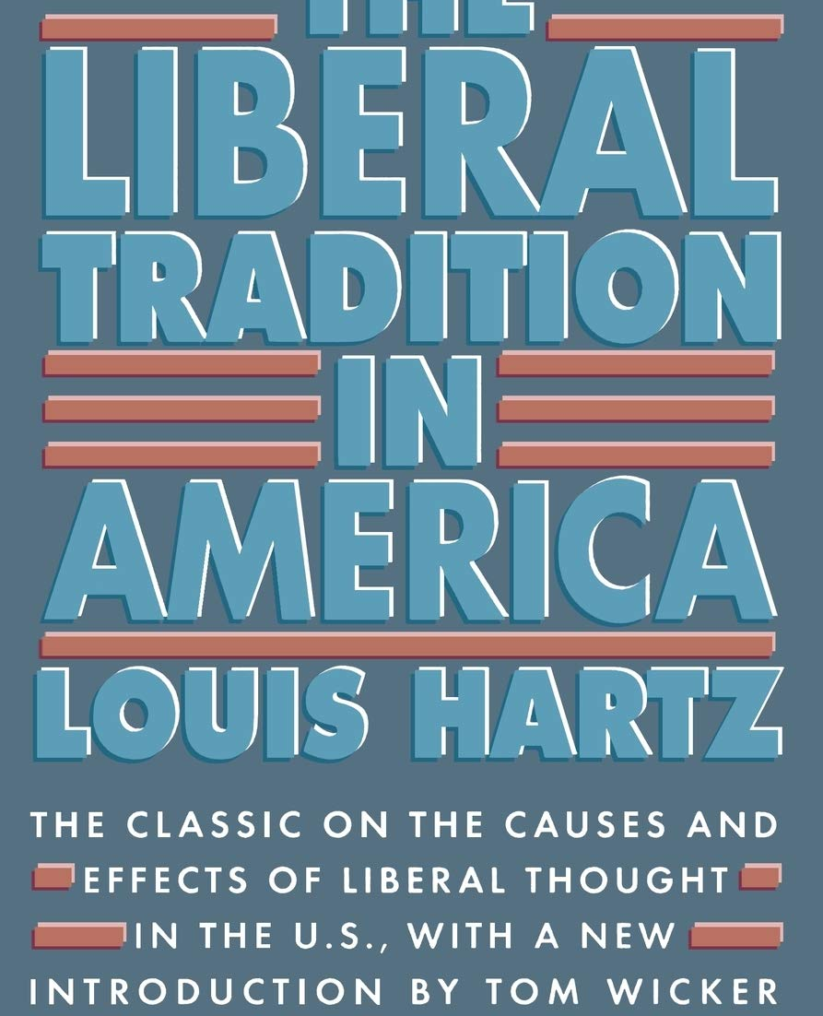
Verification
US had no feudal traditions
US had no class conflicts; no socialism

Slide 7
Verification – the myth and symbol school
the melting pot; the endless frontier; Virgin land
assimilation; political liberation; social mobility.

Slide 8
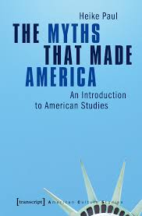
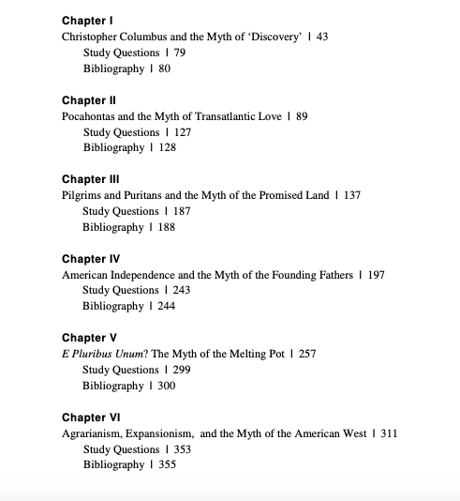

Slide 9
after the Cold war ENDED
National Unity VS. Diversity factors
Gender, class, race, and ethnic differences surfaced
An increasingly postcolonial world VS. A U.S. Monoculture
The shift of the exceptionalist paradigm

Slide 10
Representation
Aristocracy/monarchy/empire hierarchical society socialist tradition
“redeemer nation” “conqueror of the world’s markets” “global security state”

Slide 11
Representation
Aristocracy/monarchy/empire hierarchical society socialist tradition
“redeemer nation” “conqueror of the world’s markets” “global security state”
??

Slide 12
THANKS!
Please keep this slide for attribution

