Slide 1
Data and Method
Research question
Data collection & analysis
Research Significance

Slide 2
RQ: Why do people believe in election fraud theory?
2020 general election
Independent Variable
Dependent Variable
Age
Ignorance
Cognitive reflection
Factual political knowledge
Belief in election fraud theory
Dissatisfaction
Perceived immorality
Perceived incompetence
Partisanship
Polarization
Out-party emotion

Slide 3
Procedure
Step 1: Questionnaire
Step 2: Factor analysis
Step 3: Correlation
Step 4: Regression

Slide 4
Procedure
Step 1: Questionnaire
Design
Survey Monkey
Altogether 50 questions
Distribution
Pilot survey
Snowball sampling
December 2022
N=100
Step 2: Factor analysis
Step 3: Correlation
Step 4: Regression

Slide 5
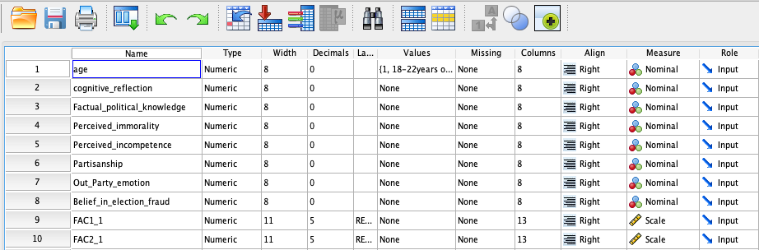
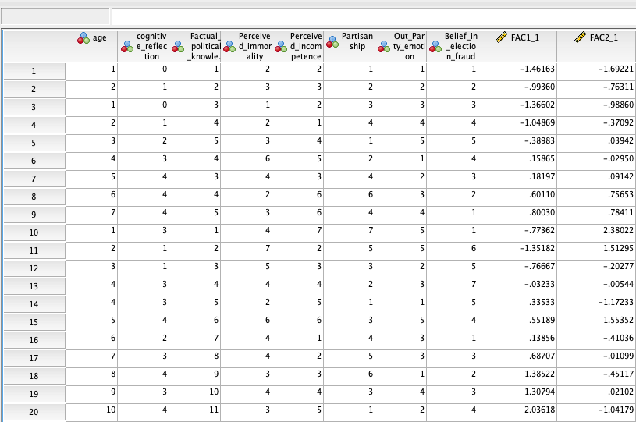
Procedure
Step 1: Questionnaire
Design
Survey Monkey
Altogether 50 questions
Distribution
Pilot survey
Snowball sampling
December 2022
N=100
Step 2: Factor analysis
Step 3: Correlation
Step 4: Regression

Slide 6
Procedure
Step 1: Questionnaire
Design
Survey Monkey
Altogether 50 questions
Distribution
Pilot survey
Snowball sampling
December 2022
N=100
Step 2: Factor analysis
Step 3: Correlation
Step 4: Regression

Slide 7
Procedure
Step 1: Questionnaire
Design
Survey Monkey
Altogether 50 questions
Distribution
Pilot survey
Snowball sampling
December 2022
N=100
Step 2: Factor analysis
Step 3: Correlation
Step 4: Regression

Slide 8
Procedure
Step 1: Questionnaire
Design
Survey Monkey
Altogether 50 questions
Distribution
Pilot survey
Snowball sampling
December 2022
N=100
Step 2: Factor analysis
Step 3: Correlation
Step 4: Regression

Slide 9
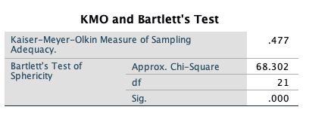
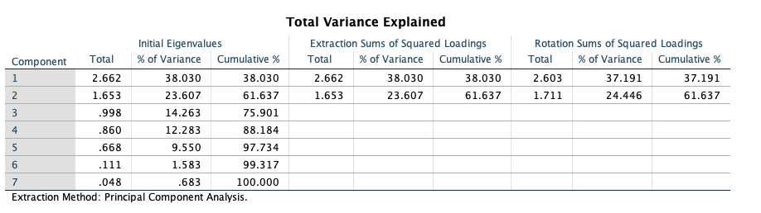
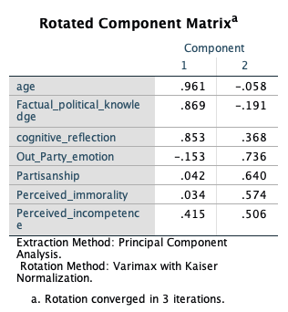
Procedure
Step 1: Questionnaire
Step 2: Factor analysis
To reduce variables into factors
Varimax: independent
KMO and Bartlett’s Test>0.5?
Factors with eigenvalue>1?
Components of new factors
3 factors are expected
Step 3: Correlation
Step 4: Regression

Slide 10
Procedure
Step 1: Questionnaire
Step 2: Factor analysis
To reduce variables into factors
Varimax: independent
KMO and Bartlett’s Test>0.5?
Factors with eigenvalue>1?
Components of new factors
3 factors are expected
Step 3: Correlation
Step 4: Regression

Slide 11
Procedure
Step 1: Questionnaire
Step 2: Factor analysis
To reduce variables into factors
Varimax: independent
KMO and Bartlett’s Test>0.5?
Factors with eigenvalue>1?
Components of new factors
3 factors are expected
Step 3: Correlation
Step 4: Regression

Slide 12
Procedure
Step 1: Questionnaire
Step 2: Factor analysis
To reduce variables into factors
Varimax: independent
KMO and Bartlett’s Test>0.5?
Factors with eigenvalue>1?
Components of new factors
3 factors are expected
Step 3: Correlation
Step 4: Regression

Slide 13
Procedure
Step 1: Questionnaire
Step 2: Factor analysis
To reduce variables into factors
Varimax: independent
KMO and Bartlett’s Test>0.5?
Factors with eigenvalue>1?
Components of new factors
3 factors are expected
Step 3: Correlation
Step 4: Regression

Slide 14
Procedure
Step 1: Questionnaire
Step 2: Factor analysis
Step 3: Correlation
Parallel to factor analysis
To check the relationships between variables
To make sure multiple regression is worthwhile
Correlation Matrix
Step 4: Regression

Slide 15
Step 3: Simple Correlation Coefficients (r) between Research variables
 | 1 | 2 | 3 | 4 | 5 | 6 | 7 | 8
IGNORANCE
1. Age | 1.00
2. Cognitive Reflection |  | 1.00
3. Factual Political knowledge |  |  | 1.00
DISSATISFACTION
4. Perceived immorality |  |  |  | 1.00
5. Perceived incompetence |  |  |  |  | 1.00
POLARIZATION
6. Partisanship |  |  |  |  |  | 1.00
7. Out-Party Emotion |  |  |  |  |  |  | 1.00
BELIEF IN ELECTION FRAUD
8. Belief in election fraud |  |  |  |  |  |  |  | 1.00

Slide 16
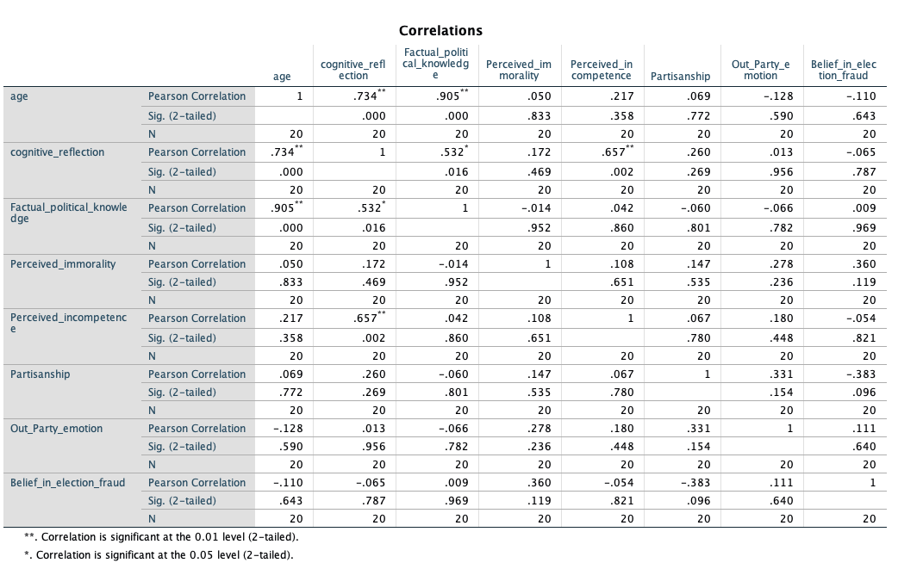
Step 3: Simple Correlation Coefficients (r) between Research variables
 | 1 | 2 | 3 | 4 | 5 | 6 | 7 | 8
IGNORANCE
1. Age | 1.00
2. Cognitive Reflection |  | 1.00
3. Factual Political knowledge |  |  | 1.00
DISSATISFACTION
4. Perceived immorality |  |  |  | 1.00
5. Perceived incompetence |  |  |  |  | 1.00
POLARIZATION
6. Partisanship |  |  |  |  |  | 1.00
7. Out-Party Emotion |  |  |  |  |  |  | 1.00
BELIEF IN ELECTION FRAUD
8. Belief in election fraud |  |  |  |  |  |  |  | 1.00

Slide 17
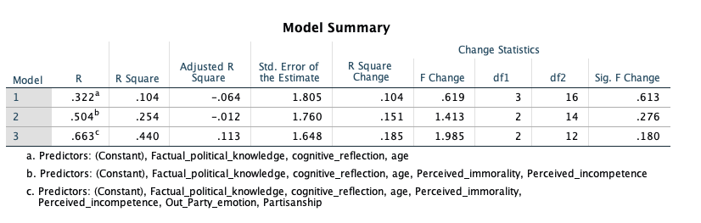
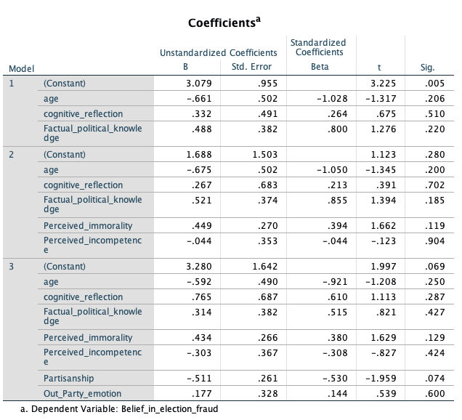
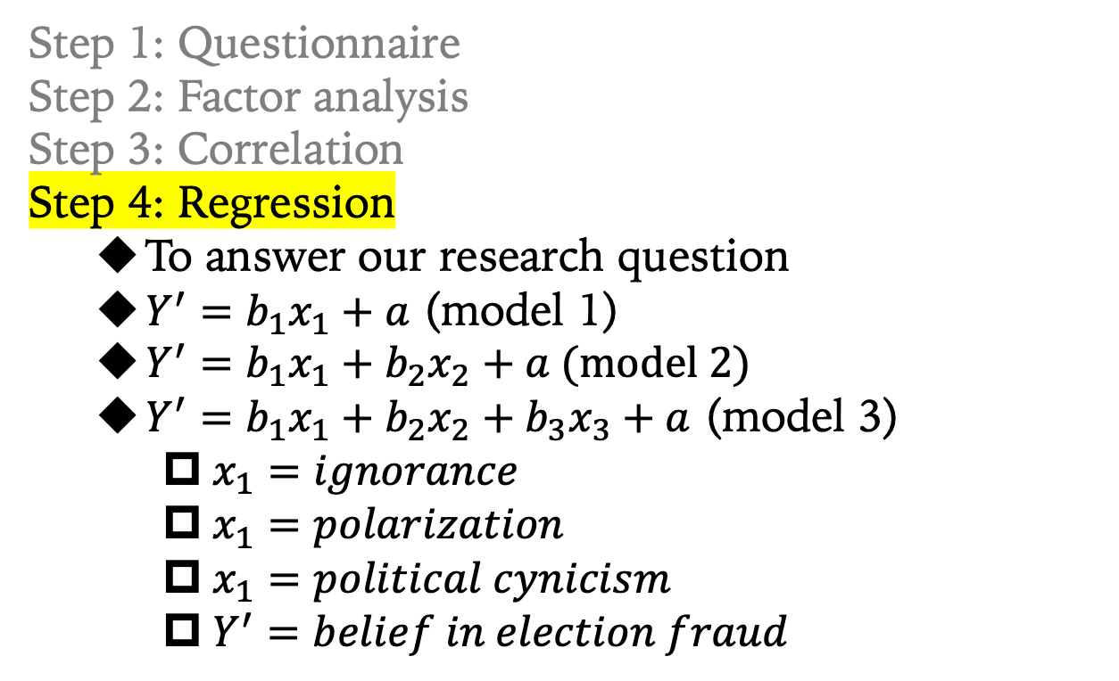
Procedure
Step 1: Questionnaire
Step 2: Factor analysis
Step 3: Correlation
Step 4: Regression
To answer our research question
$Y^{′}=b_{1}x_{1}+a$ (model 1)
$Y^{′}=b_{1}x_{1}+b_{2}x_{2}+a$ (model 2)
$Y^{′}=b_{1}x_{1}+b_{2}x_{2}+b_{3}x_{3}+a$ (model 3)
$x_{1}=ignorance$
$x_{1}=polarization$
$x_{1}=political cynicism$
$Y^{′}=belief in election fraud$

Slide 18
Procedure
Step 1: Questionnaire
Step 2: Factor analysis
Step 3: Correlation
Step 4: Regression
To answer our research question
$Y^{′}=b_{1}x_{1}+a$ (model 1)
$Y^{′}=b_{1}x_{1}+b_{2}x_{2}+a$ (model 2)
$Y^{′}=b_{1}x_{1}+b_{2}x_{2}+b_{3}x_{3}+a$ (model 3)
$x_{1}=ignorance$
$x_{1}=polarization$
$x_{1}=political cynicism$
$Y^{′}=belief in election fraud$

Slide 19
Procedure
Step 1: Questionnaire
Step 2: Factor analysis
Step 3: Correlation
Step 4: Regression
To answer our research question
$Y^{′}=b_{1}x_{1}+a$ (model 1)
$Y^{′}=b_{1}x_{1}+b_{2}x_{2}+a$ (model 2)
$Y^{′}=b_{1}x_{1}+b_{2}x_{2}+b_{3}x_{3}+a$ (model 3)
$x_{1}=ignorance$
$x_{1}=polarization$
$x_{1}=political cynicism$
$Y^{′}=belief in election fraud$

Slide 20
Research Significance
Adds to literature on election fraud
3 theories
quantitative study method
Measures to dissolve the myth of election fraud
Transparency rather than secret ballot?
Stricter voter registration rules?
Or
Political education/socialization
Finding common ground and reduce polarization
A better system with higher levels of morality and competence

