Slide 1
Inequality and Race
A1
Jiménez (2008)
Why Replenishment Strengthens Racial and Ethnic Boundaries?
A2
Bertrand and Mullainathan (2004)
Are Emily and Greg More Employable Than Lakisha and Jamal?
A3
Wilson (1978)
The Declining Significance of Race
Presented by Zhang Wei
6 June 2023

Slide 2
A1
Jiménez (2008)
Why Replenishment Strengthens Racial and Ethnic Boundaries?
European Immigration
Mexican Immigration
Immigration Patterns
Near cessation
Replenishment
Them
Us
Ethnicity Identity
Them
Us
Them
Us
Canonical assimilation theory
Jiménez (2008)
Race: symbolic and optional
Strengthened boundaries

Slide 3
A1
Jiménez (2008)
Why Replenishment Strengthens Racial and Ethnic Boundaries?
European Immigration
Mexican Immigration
Immigration Patterns
Replenishment
Near cessation
Them
Us
Ethnicity Identity
Them
Us
Them
Us
Canonical assimilation theory
Jiménez (2008)
Race: symbolic and optional
Strengthened boundaries

Slide 4
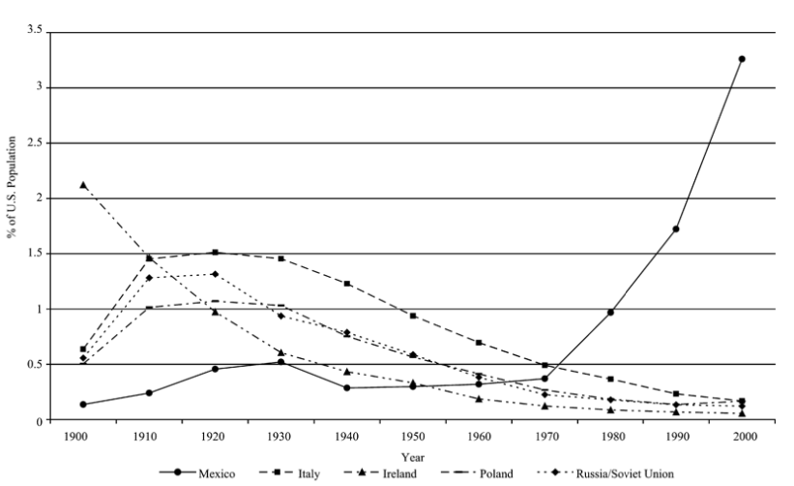
Jiménez (2008), page 1534
Mexico
Others

Slide 5
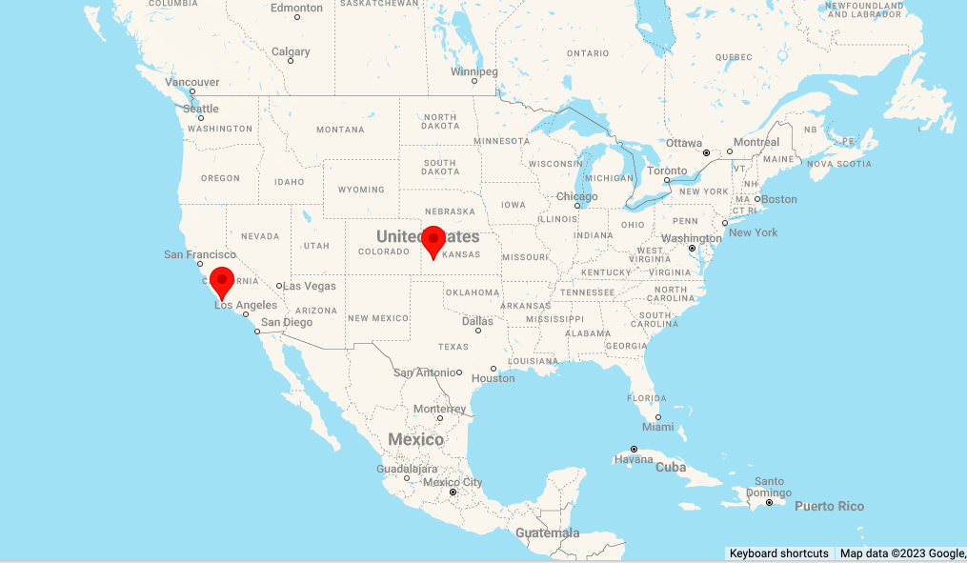
123 In-depth Interviews
👩🏽‍💼👨🏽‍💼👩🏽‍💼👨🏽‍💼👩🏽‍💼👨🏽‍💼
👩🏽‍💼👨🏽‍💼👩🏽‍💼👨🏽‍💼👩🏽‍💼👨🏽‍💼
👩🏽‍💼👨🏽‍💼👩🏽‍💼👨🏽‍💼👩🏽‍💼👨🏽‍💼
👩🏽‍💼👨🏽‍💼👩🏽‍💼👨🏽‍💼👩🏽‍💼👨🏽‍💼
👩🏽‍💼👨🏽‍💼👩🏽‍💼👨🏽‍💼👩🏽‍💼👨🏽‍💼
👩🏽‍💼👨🏽‍💼👩🏽‍💼👨🏽‍💼👩🏽‍💼👨🏽‍💼
later-generation Mexican Americans
-whose ancestors have been in the US since 1940 or before,
-who are of Mexican descent on both their mother’s and father’s side,
-who have lived in these two cities for most of their lives

Slide 6
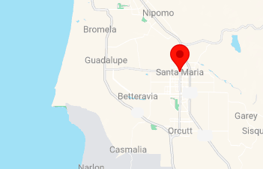
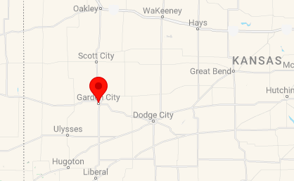
123 In-depth Interviews
Santa Maria
Garden City
👩🏽‍💼👨🏽‍💼👩🏽‍💼👨🏽‍💼👩🏽‍💼👨🏽‍💼
👩🏽‍💼👨🏽‍💼👩🏽‍💼👨🏽‍💼👩🏽‍💼👨🏽‍💼
👩🏽‍💼👨🏽‍💼👩🏽‍💼👨🏽‍💼👩🏽‍💼👨🏽‍💼
👩🏽‍💼👨🏽‍💼👩🏽‍💼👨🏽‍💼👩🏽‍💼👨🏽‍💼
👩🏽‍💼👨🏽‍💼👩🏽‍💼👨🏽‍💼👩🏽‍💼👨🏽‍💼
👩🏽‍💼👨🏽‍💼👩🏽‍💼👨🏽‍💼👩🏽‍💼👨🏽‍💼
later-generation Mexican Americans
-whose ancestors have been in the US since 1940 or before,
-who are of Mexican descent on both their mother’s and father’s side,
-who have lived in these two cities for most of their lives

Slide 7
Findings
∴ Race& ethnicity can never be symbolic/optional
Replenishment
Ethnicity Identity
1
Nativism/
Anti-immigrant antipathy
5
2
3
4
Ryan Bradley
1
Them: Attacking the Unauthorized status (interpersonal encounters)
Marcela Muñoz
2
Them: Complaining about the Spanish language (job scenario)
3
Them: Expressing nativist fear over language, policy and resources (Public forum)
Mike Fernandez
4
Us: Internalizing this nativism as part of our own ethnic identity (empathy).
Kyle Gil
5
Us: Challenging ingroup members for being inauthentic (language, style)

Slide 8
Findings
∴ Race& ethnicity can never be symbolic/optional
Replenishment
Ethnicity Identity
1
Nativism/
Anti-immigrant antipathy
5
2
3
4
Other
American
Mexican
America
Generational Line
∵No replenishment
∵Fewer racial markers
∴Freed from the racialized foreign status
1st/2nd Gen
Later
Gen
Ethnic Line

Slide 9
Inequality and Race
A1
Jiménez (2008)
Why Replenishment Strengthens Racial and Ethnic Boundaries?
A2
Bertrand and Mullainathan (2004)
Are Emily and Greg More Employable Than Lakisha and Jamal?
A3
Wilson (1978)
The Declining Significance of Race
Presented by Zhang Wei
6 June 2023

Slide 10
A2
Bertrand and Mullainathan (2004)
Are Emily and Greg More Employable Than Lakisha and Jamal?
When faced with observably similar
African-American and White applicants
do employers favor the White one?
👩🏾‍💼
👨🏾‍💼
👩‍💼
👨‍💼

Slide 11
When faced with observably similar
African-American and White applicants
do employers favor the White one?
👩🏾‍💼
👨🏾‍💼
👩‍💼
👨‍💼
👨‍💼👨‍💼👨‍💼👨‍💼
👨‍💼👨‍💼👩‍💼👩‍💼
👩‍💼👨🏾‍💼👨🏾‍💼👩🏾‍💼
Yes!
Employer prejudice:
race ≈ productivity

Slide 12
When faced with observably similar
African-American and White applicants
do employers favor the White one?
👩🏾‍💼
👨🏾‍💼
👩‍💼
👨‍💼
👨‍💼👨‍💼👨‍💼👨‍💼
👨‍💼👨‍💼👩‍💼👩‍💼
👩‍💼👨🏾‍💼👨🏾‍💼👩🏾‍💼
👨‍💼👨‍💼👨‍💼👨‍💼
👩‍💼👩‍💼👨🏾‍💼👨🏾‍💼
👩🏾‍💼👨🏾‍💼👨🏾‍💼👩🏾‍💼
Yes!
No!
Employer prejudice:
race ≈ productivity
Employer enlightenment;
Affirmative action (reverse);
Profit-maximization motive

Slide 13
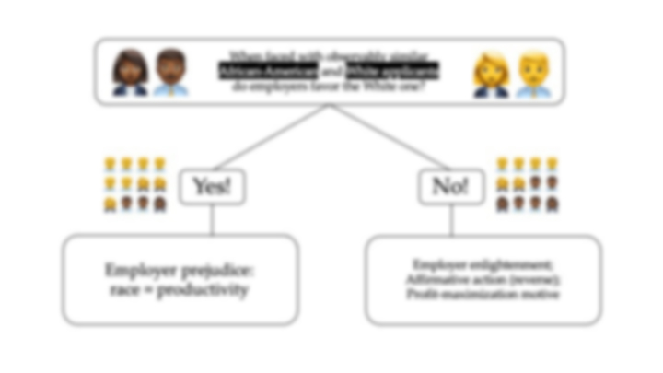
When faced with observably similar
African-American and White applicants
do employers favor the White one?
👩🏾‍💼
👨🏾‍💼
👩‍💼
👨‍💼
???
Which side tells the truth?
Empirical data?
👨‍💼👨‍💼👨‍💼👨‍💼
👨‍💼👨‍💼👩‍💼👩‍💼
👩‍💼👨🏾‍💼👨🏾‍💼👩🏾‍💼
👨‍💼👨‍💼👨‍💼👨‍💼
👩‍💼👩‍💼👨🏾‍💼👨🏾‍💼
👩🏾‍💼👨🏾‍💼👨🏾‍💼👩🏾‍💼
Yes!
No!
Employer prejudice:
race ≈ productivity
Employer enlightenment;
Affirmative action (reverse);
Profit-maximization motive

Slide 14


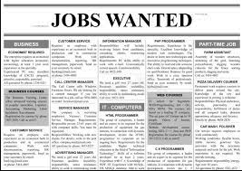
When faced with observably similar
African-American and White applicants
do employers favor the White one?
👩🏾‍💼
👨🏾‍💼
👩‍💼
👨‍💼
Field Experiment
1
2
3
Made-up
Resumes
Chicago and Boston newspapers Ads
Callback
for interview

Slide 15
When faced with observably similar
African-American and White applicants
do employers favor the White one?
👩🏾‍💼
👨🏾‍💼
👩‍💼
👨‍💼
Field Experiment
1
2
3
Made-up
Resumes
Chicago and Boston newspapers Ads
Callback
for interview

Slide 16
When faced with observably similar
African-American and White applicants
do employers favor the White one?
👩🏾‍💼
👨🏾‍💼
👩‍💼
👨‍💼
Field Experiment
Higher quality AA applicant
Executives & managers
Administrative supervisor
Lower quality AA applicant
Sales representatives
Higher quality WA applicant
Sales workers
Lower quality WA applicant
Secretaries and legal assistants
Clerical workers
1
2
Made-up
Resumes
Chicago and Boston newspapers Ads
3
Callback
for interview
Altogether 5,000 resumes
1,300 employment ads

Slide 17
When faced with observably similar
African-American and White applicants
do employers favor the White one?
👩🏾‍💼
👨🏾‍💼
👩‍💼
👨‍💼
Field Experiment
Higher quality AA applicant
Executives & managers
Administrative supervisor
Lower quality AA applicant
Sales representatives
Higher quality WA applicant
Sales workers
Lower quality WA applicant
Secretaries and legal assistants
1
2
Clerical workers
Made-up
Resumes
Chicago and Boston newspapers Ads
3
Callback
for interview
Altogether 5,000 resumes
1,300 employment ads

Slide 18
DV
When faced with observably similar
African-American and White applicants
do employers favor the White one?
IV
👩🏾‍💼
👨🏾‍💼
👩‍💼
👨‍💼
Race
(name)
Callback
rates
Field Experiment
Higher quality AA applicant
Executives & managers
Quality
(degree, experience..)
Administrative supervisor
Lower quality AA applicant
Sales representatives
Job/Industry categories
Higher quality WA applicant
Sales workers
Wealth
(address)
Lower quality WA applicant
Secretaries and legal assistants
Clerical workers
1
2
Made-up
Resumes
Chicago and Boston newspapers Ads
3
Callback
for interview
Altogether 5,000 resumes
1,300 employment ads

Slide 19
Finding 1
DV
When faced with observably similar
African-American and White applicants
do employers favor the White one?
IV
👩🏾‍💼
👨🏾‍💼
👩‍💼
👨‍💼
Race
(name)
Callback
rates
WA 1/10
AA 1/15
Field Experiment
Higher quality AA applicant
Sales
The Racial Gap in Callback
Lower quality AA applicant
Administrative support
Higher quality WA applicant
clerical
Quality
(degree, experience..)
Job/Industry categories
Lower quality WA applicant
Wealth
(address)
Customer service
1
2
Made-up
Resumes
Chicago and Boston newspapers Ads
3
Callback
for interview
Altogether 5,000 resumes
1,300 employment ads

Slide 20
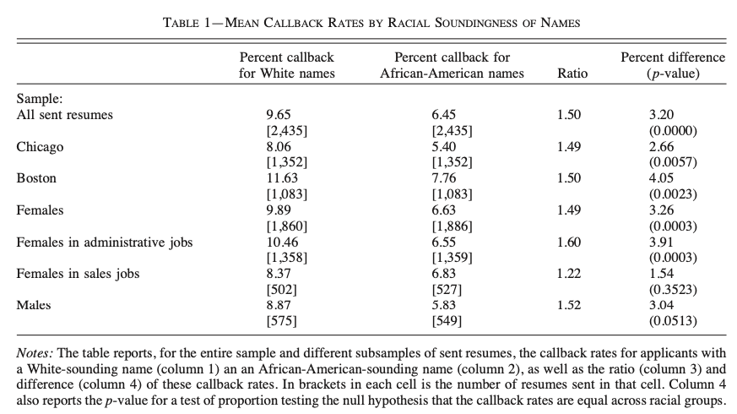
Bertrand and Mullainathan (2004), page 997

Slide 21
Bertrand and Mullainathan (2004), page 997
1/10
1/15
Very
significant

Slide 22
Finding 2&3&4
DV
When faced with observably similar
African-American and White applicants
do employers favor the White one?
IV
👩🏾‍💼
👨🏾‍💼
👩‍💼
👨‍💼
Race
(name)
Callback
rates
WA 1/10
AA 1/15
Field Experiment
Higher quality AA applicant
Sales
The Racial Gap in Callback
Lower quality AA applicant
Administrative support
Widening the gap
no difference
Higher quality WA applicant
clerical
Widening the gap
Quality
(degree, experience..)
Job/Industry categories
Lower quality WA applicant
Wealth
(address)
Customer service
1
2
Made-up
Resumes
Chicago and Boston newspapers Ads
3
Callback
for interview
Altogether 5,000 resumes
1,300 employment ads

Slide 23
Finding 2&3
Callback
WA
AA
Quality/Wealth

Slide 24
Finding 4
Racial Gap in Callback
Job/industry categories

Slide 25
DV
When faced with observably similar
African-American and White applicants
do employers favor the White one?
IV
👩🏾‍💼
👨🏾‍💼
👩‍💼
👨‍💼
Race
(name)
Callback
rates
WA 1/10
AA 1/15
Field Experiment
Higher quality AA applicant
Sales
The Racial Gap in Callback
Lower quality AA applicant
Administrative support
Widening the gap
no difference
Higher quality WA applicant
clerical
Widening the gap
Quality
(degree, experience..)
Job/Industry categories
Lower quality WA applicant
Wealth
(address)
Customer service
1
2
Made-up
Resumes
Chicago and Boston newspapers Ads
3
Callback
for interview
Altogether 5,000 resumes
1,300 employment ads

Slide 26
DV
When faced with observably similar
African-American and White applicants
do employers favor the White one?
Race
(name)
Callback
rates
IV
👩🏾‍💼
WA 1/10
👨🏾‍💼
👩‍💼
👨‍💼
Racial Gap in Callback (smpl)
=
discrimination (ppltn)
AA 1/15
?
The Racial Gap in Callback
Field Experiment
Higher quality AA applicant
Sales
Widening the gap
“race-blind selection rule: equal treatment”
Callback gap = Discrimination✅
“Rules where Callback rates match Population rates”
实验只能控制发去多少份resume，
不能控制公司总共收到多少份AA resume
Callback gap ≠ Discrimination
No return on skills
No Job category difference
Callback gap = Discrimination✅
Lower quality AA applicant
Administrative support
Widening the gap
Higher quality WA applicant
no difference
clerical
Quality
(degree, experience..)
Lower quality WA applicant
Customer service
Wealth
(address)
Job/Industry categories
1
2
Made-up
Resumes
Chicago and Boston newspapers Ads
3
Callback
for interview
Altogether 5,000 resumes
1,300 employment ads

Slide 27
Class
DV
When faced with observably similar
African-American and White applicants
do employers favor the White one?
Race
(name)
Callback
rates
IV
👩🏾‍💼
WA 1/10
👨🏾‍💼
👩‍💼
👨‍💼
?
AA 1/15
Reliability & Validity
The Racial Gap in Callback
Field Experiment
“Tyrone”, “Latoya” = Race ? Class ?
better address, greater callback❌
managerial jobs, higher gap❌
“Tyrone”, “Latoya” = Race
Reverse Discrimination ?
AA Overqualified
AA Overrepresented
no job difference, no reverse discrimination
Higher quality AA applicant
Sales
Widening the gap
Lower quality AA applicant
Administrative support
Widening the gap
Higher quality WA applicant
no difference
clerical
Quality
(degree, experience..)
Lower quality WA applicant
Customer service
Wealth
(address)
Job/Industry categories
1
2
Made-up
Resumes
Chicago and Boston newspapers Ads
3
Callback
for interview
“The racial gap does not vary across jobs with different skill requirements, nor does it vary across occupation categories” (P248)
Altogether 5,000 resumes
1,300 employment ads

Slide 28
DV
When faced with observably similar
African-American and White applicants
do employers favor the White one?
Race
(name)
Callback
rates
?
IV
👩🏾‍💼
WA 1/10
👨🏾‍💼
👩‍💼
👨‍💼
Existing Theories
AA 1/15
Taste-based models
a. Consumer/coworker discrimination
❌Finding 4
“The amount of customer contact and the fraction of WA vary a lot across jobs/industries”
b. Employer discrimination
❌Finding 2
higher credentials ->maximization of profit
Statistical discrimination models
a. observable race = unobservable skills
❌Finding 2
b. Information contained in a credential
same set of credentials which are verifiable
3. Lexicographic search
The Racial Gap in Callback
Field Experiment
Higher quality AA applicant
Sales
Widening the gap
Lower quality AA applicant
Administrative support
Widening the gap
Higher quality WA applicant
no difference
clerical
Quality
(degree, experience..)
Lower quality WA applicant
Customer service
Wealth
(address)
Job/Industry categories
1
2
Made-up
Resumes
Chicago and Boston newspapers Ads
3
Callback
for interview
Altogether 5,000 resumes
1,300 employment ads

Slide 29
Inequality and Race
A1
Jiménez (2008)
Why Replenishment Strengthens Racial and Ethnic Boundaries?
A2
Bertrand and Mullainathan (2004)
Are Emily and Greg More Employable Than Lakisha and Jamal?
A3
Wilson (1978)
The Declining Significance of Race
Presented by Zhang Wei
6 June 2023

Slide 30
A3
Wilson (1978)
The Declining Significance of Race
Preindustrial race relations
Race relations
The Economy
(The system of production)
Racial group access to privileges
3 stages
Industrial race relations
The polity
(The laws and policies)
Racial antagonism
Modern industrial race relations
race
Life Chances
class

Slide 31
Class conflicts theory:
“Racial conflict is merely a special manifestation of class conflict”
A. The Orthodox Marxist theory
B. The Split Labor-Market theory
“A split labor market occurs when the price of labor for the same work differs for at least two groups”
(1) Employers
(2) Higher-paid labor
(3) Cheaper labor
The higher-paid labor will try to exclude the cheap labor from entering the job market, or utilizes the following methods to create ethnic stratification:
a. Monopoly of skills,
b. Control of government regulation
The capitalist class, in pursuit of profit maximization, intentionally divides workers into smaller groups, rendering their demands for better treatment suppressed and their bargaining power weakened.
The existence of a marginalized African working class is not only conducive to their further exploitation, but also prevents white working class from asking for more.
The split
❌ Solidarity
❌ Mobility

Slide 32
A3
Wilson (1978)
The Declining Significance of Race
Preindustrial race relations
Race relations
The Economy
(The system of production)
Racial group access to privileges
3 stages
Industrial race relations
The polity
(The laws and policies)
Racial antagonism
Modern industrial race relations
race
Life Chances
class

Slide 33
A3
Wilson (1978)
The Declining Significance of Race
Preindustrial race relations
Race relations
The Economy
(The system of production)
Racial group access to privileges
3 stages
Industrial race relations
The polity
(The laws and policies)
Racial antagonism
Modern industrial race relations
Existing theories not enough
The white economic elites were responsible for exploitation (slavery)
The white working class people were responsible for split (segregation)
Both were responsible for racial inequality
Dynamics of interaction??? Modern stage???
race
Life Chances
class

Slide 34
A3
Wilson (1978)
The Declining Significance of Race
Preindustrial race relations
Race relations
The Economy
(The system of production)
Racial group access to privileges
3 stages
Industrial race relations
The polity
(The laws and policies)
Racial antagonism
Modern industrial race relations
Stage 1
Antebellum and early postbellum era
Nonmanufacturing/plantation economy
Paternalism: “close symbiotic relationship marked by dominance and subservience”
White aristocracy (eco, judicial power, norms)
exploitation
No complex division of labor, weak white workers
segregation, ideological racism可以但没必要
race
Life Chances
class

Slide 35
A3
Wilson (1978)
The Declining Significance of Race
Preindustrial race relations
Race relations
The Economy
(The system of production)
Racial group access to privileges
3 stages
Industrial race relations
The polity
(The laws and policies)
Racial antagonism
Modern industrial race relations
Stage 2
Late 19th C - early 20th C
Industrial capitalism, Competition
Complex division of labor, Stronger working class
Jim Crow segregation, ideological racism
Economic power translated into political power
Brazil vs US
Two class society
Slower industrialization,
low mobility
race
Life Chances
class

Slide 36
A3
Wilson (1978)
The Declining Significance of Race
Preindustrial race relations
Race relations
The Economy
(The system of production)
Racial group access to privileges
3 stages
Industrial race relations
The polity
(The laws and policies)
Racial antagonism
Modern industrial race relations
Stage 3
Economic❌
Politics✅
race
The 20th C – present
Talented & educated blacks
Competition
Affirmative action
Black underclass
?
1.Black vote
2.An independent African state (Increased Sense of power)
3.Growth of black middle class
4.Sensitivity to World opinion
Life Chances
class

Slide 37
A3
Wilson (1978)
The Declining Significance of Race
Uniformity of race and class
Preindustrial race relations
Race relations
The Economy
(The system of production)
Racial group access to privileges
3 stages
Segregation: race>class
Industrial race relations
The polity
(The laws and policies)
Racial antagonism
Modern industrial race relations
Structural changes in economy
race
Life Chances
class

Slide 38
Critiques & Questions
1. Field Experiment
What if the recruiting team discovers the fictitious applicants?
What if certain types of job do not publish their recruitment on newspapers?
What revisions are needed for a replication of this study?
2. Interviews on later generation Mexican Americans
Does the existence of new comers translate into immigration replenishment?
Where can you identify the notion of replenishment in respondents’ accounts?
3. The Black Professionals vs. Bourgeois Bohemians
Do the black professionals belong to Bobos?
Why are they disassociating with the black mass (contradicts Jeménez’s study)?
How can they achieve the reconciliation?

Slide 39
When faced with observably similar
African-American and White applicants
do employers favor the White one?
👩🏾‍💼
👨🏾‍💼
👩‍💼
👨‍💼
Field Experiment
1
2
3
Made-up
Resumes
Chicago and Boston newspapers Ads
Callback
for interview

Slide 40
If there’s a threat that’s apparent on somebody else who is of the same descent that I am, and the other person is being totally racist about it, and it’s all just hate of color, that’s when my background comes to be more important to me…I have a friend…And he was picking on this guy that I didn’t know. And he was Mexican and they were bagging on him because he was Mexican and I’m just sitting there going, “Hey, I’m Mexican too.” [He said,] “No, no, no, this doesn’t concern you. You’re cool. This guy is not.” And I’m just like, “Hey back up.” And I just totally got in his face because I was getting mad…they were calling him a wetback and just totally dissing on him because he was Mexican.
Someone will say something about Mexicans or something like that and it’s not said towards me, it’s not directed towards me. But at that point, I’ll feel myself discriminated against. I’ll put the discrimination on myself, feeling that even though they’re not directing it towards me, I can’t help but feel that it’s degrading towards me in some way, when in fact I know it’s not meant directly towards me – it’s a general comment. But it just kind of makes me uncomfortable… Just because they’re speaking about a Mexican family or a Mexican person and I know that, though my family is not in that position, that I know somewhere along down before me, somebody in my family, I’m sure, has been in that position. And although I’. not in it, and probably never will be in that position, I just think that back when my ancestors were in that position and people were the same way towards them.
(Jiménez 300)
(Jiménez 300-301)
Although the income levels and life-styles of the black professionals were noticeably and sometimes conspicuously different from those of the black masses, the two groups had one basic thing in common, a racial status contemptuously regarded by most whites in society. If E. Franklin Frazier’s analysis of the black Bourgeoisie is correct, the black professionals throughout the industrial period of American race relations tended to react to their low position in the social order by an ostentatious display of material possessions and a conspicuous effort to disassociate themselves from the black masses. (Wilson 281 )

Slide 41
Thanks for Listening
Presented by Zhang Wei
6 June 2023

Slide 42
Works Cited
Bertrand, Marianne and Sendhil Mullainathan. “Are Emily and Greg More Employable Than Lakisha and Jamal? A Field Experiment on Labor Market Discrimination.” The Inequality Reader, edited by David B. Grusky and Szonja Szelényi, 2nd ed. Westview Press, 2011, pp. 245-250.
Bertrand, Marianne and Sendhil Mullainathan. “Are Emily and Greg More Employable Than Lakisha and Jamal? A Field Experiment on Labor Market Discrimination.” The American Economic Review, vol. 94, no. 4, 2004, pp. 991-1013.
Jiménez, Tomas, R. “Why Replenishment Strengthens Racial and Ethnic Boundaries.” Inequality in the 21st Century, edited by David B. Grusky and Jasmine Hill, Westview Press, 2018, pp. 298-303.
Jiménez, Tomas, R. “Mexican Immigrant Replenishment and the Continuing Significance of Ethnicity and Race.” American Journal of Sociology, vol. 113, no. 6, 2008, pp. 1527-1567.
Wilson, William Julius. “The Declining Significance of Race: Blacks and Changing American Institutions.” The Inequality Reader, edited by David B. Grusky and Szonja Szelényi, 2nd ed. Westview Press, 2011, pp. 272-284.

