Slide 1
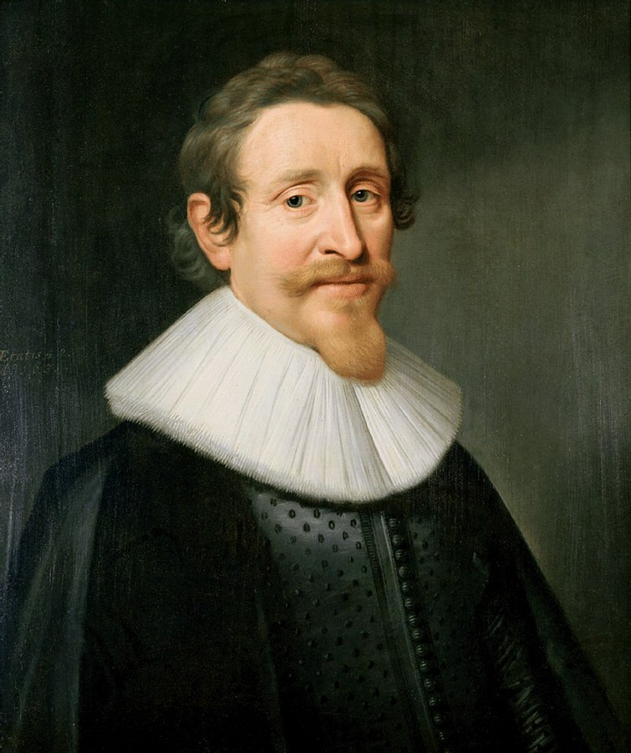
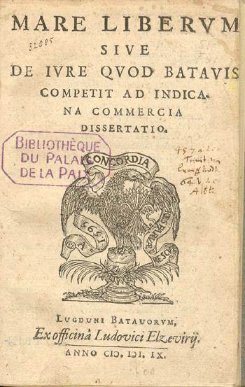

essence of the text
Father of international law
Dutch, 1583-1645
01
Argument 1 : “There is a common law among nations, which is valid alike for war and in war” (257).
Argument 2 : “Every nation is free to travel to every other nation, and to trade with it” (259).
“Mare Liberum” (Latin)
“Freedom of the Sea”
“De Jure Belli ac Pacis”
“The Law of War and Peace”

Slide 2
The nature of man
Laws
The law of nature
Municipal laws
The law of nations
Freedom of the sea
Well examined & understood
Not so

Slide 3
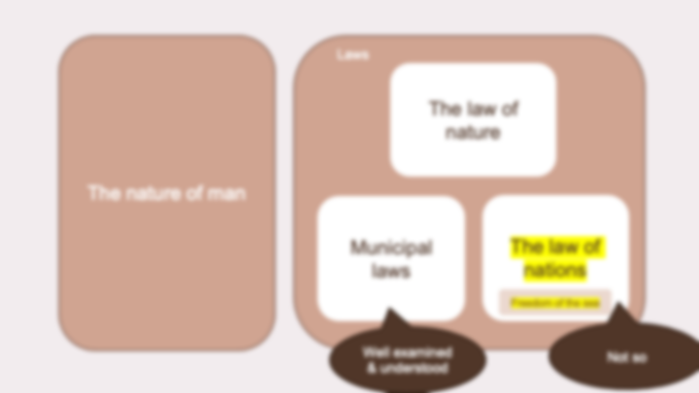
The nature of man
Laws
The law of nature
Grotius:
Why do we need laws?
(esp. the law of nations)
Municipal laws
The law of nations
Freedom of the sea
Well examined & understood
Not so

Slide 4
Popular view: expediency
justice is not a concern for IR; men by nature seek only their own good (Melian dialogue) (Grotius:🙅‍♂️ )
The nature of man
Laws
The law of nature
Sociableness:
human beings’ innate desire for peaceful and organized society
Municipal laws
The law of nations
Discrimination:
The nature of man needs to follow the direction of a well-tempered judgment (to avoid discrimination/wrongdoings)
Freedom of the sea
Well examined & understood
Not so

Slide 5
The nature of man
Laws
Popular view: expediency
justice is not a concern for IR; men by nature seek only their own good (Melian dialogue) (Grotius:🙅‍♂️ )
The law of nature
Therefore laws are necessary
Sociableness:
human beings’ innate desire for peaceful and organized society
Municipal laws
The law of nations
Discrimination:
The nature of man needs to follow the direction of a well-tempered judgment (to avoid discrimination/wrongdoings)
Freedom of the sea

Slide 6
The nature of man
Popular view: expediency
justice is not a concern for IR; men by nature seek only their own good (Melian dialogue) (Grotius:🙅‍♂️ )
Laws
The law of nature
Therefore laws are necessary
Sociableness:
human beings’ innate desire for peaceful and organized society
Municipal laws
The law of nations
Discrimination:
The nature of man needs to follow the direction of a well-tempered judgment (to avoid discrimination/wrongdoings)

Slide 7
The nature of man
Popular view: expediency
justice is not a concern for IR; men by nature seek only their own good (Melian dialogue) (Grotius:🙅‍♂️ )
Laws
The law of nature
Therefore laws are necessary
Unwritten laws that nature prescribes
always the same
Sociableness:
human beings’ innate desire for peaceful and organized society
mother
mother
Municipal laws
The law of nations
generalization
(mutual consent)
people associated with some group, implicitly/explicitly promised
to abide by these laws
that are either decided by the majority or by authority.
No single nation is powerful enough → alliance
Valid be it at peace times or war times
War = chaos, lawless ?
War = greater justice
(judicial processes not enough to held them in check)
Discrimination:
The nature of man needs to follow the direction of a well-tempered judgment (to avoid discrimination/wrongdoings)

Slide 8
Freedom of the sea
“the most specific and unimpeachable axiom of the law of nations”
Laws cover both public and private property
every man is entitled to freedom of travel
Every nation is free to travel to every other nation, and to trade with it
God ordains that some nations excel in one art and others in another; (comparative advantage)
Evidence from Nature: Ocean, navigable in every direction; Occasional winds, uniting the scattered peoples and distributing products
Therefore: The Dutch have the right to sail to the East Indies
The nature of man
Popular view: expediency
justice is not a concern for IR; men by nature seek only their own good (Melian dialogue) (Grotius:🙅‍♂️ )
Laws
The law of nature
Therefore laws are necessary
Sociableness:
human beings’ innate desire for peaceful and organized society
Municipal laws
The law of nations
Discrimination:
The nature of man needs to follow the direction of a well-tempered judgment (to avoid discrimination/wrongdoings)

