Slide 1
Free and Fair Election?
A Factorial Analysis of Variance
of the effects of Personal efforts and Network Support on 2022 U.S. House Election Outcomes
18 October 2022
Presented by Zhang Wei, Huang Xiaohan, Zheng Qi

Slide 2
Introduction
Kamala Harris’ withdrawal
from the bid for Democratic presidential nomination
Introduction | Theoretical Framework | Data and Method

Slide 3
Theoretical Framework
Two models leading to electoral success
Evaluations of representation & Extended Party Network
Introduction | Theoretical Framework | Data and Method

Slide 4
Data & Method
A Factorial ANOVA examining the effects of personal efforts and the network support on election outcome
Introduction | Theoretical Framework | Data and Method

Slide 5
Data & Method
Independent
Variable 1
A Factorial ANOVA examining the effects of personal efforts and the network support on election outcome

Slide 6
Data & Method
Independent
Variable 1
A Factorial ANOVA examining the effects of personal efforts and the network support on election outcome
Independent
Variable 2

Slide 7
Data & Method
Independent
Variable 1
A Factorial ANOVA examining the effects of personal efforts and the network support on election outcome
Independent
Variable 2
Dependent
Variable

Slide 8
DV: House Election Outcome
Open Seat
to Exclude incumbent advantage
Newcomers with large fundings
Republican
More excessive fundraising activities
House
A larger sample
435>>100
Primary Election Outcome
VARIABLE LABEL | TYPE | VALUE | VALUE LABEL
House Election Result | Numerical | 1 | win
 |  | 0 | lost

Slide 9
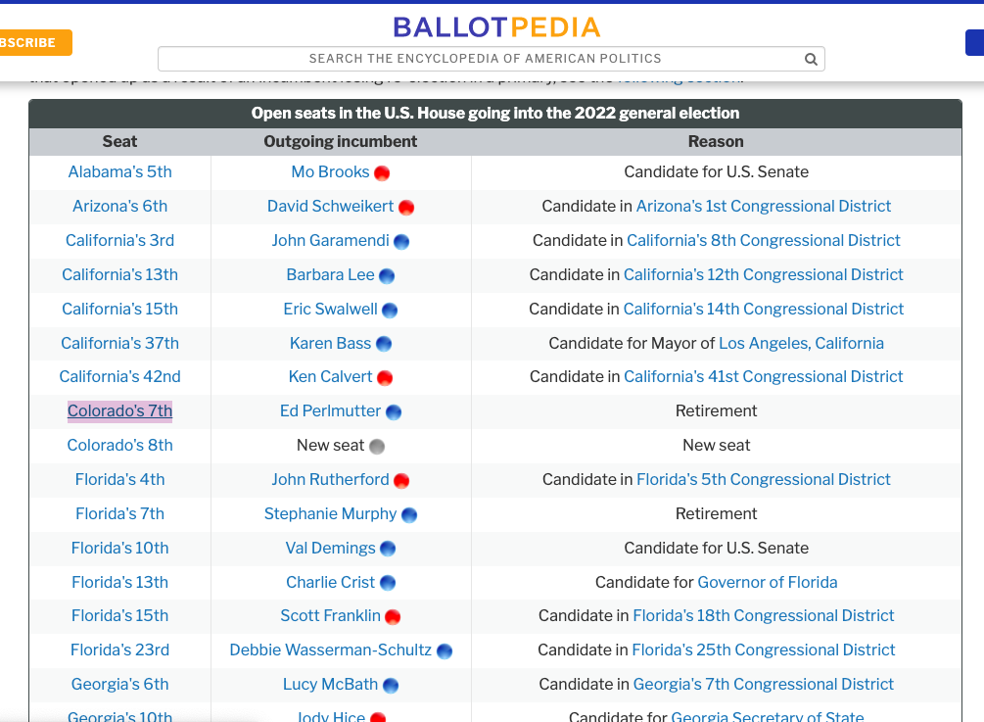
Data-BallotPedia

Slide 10
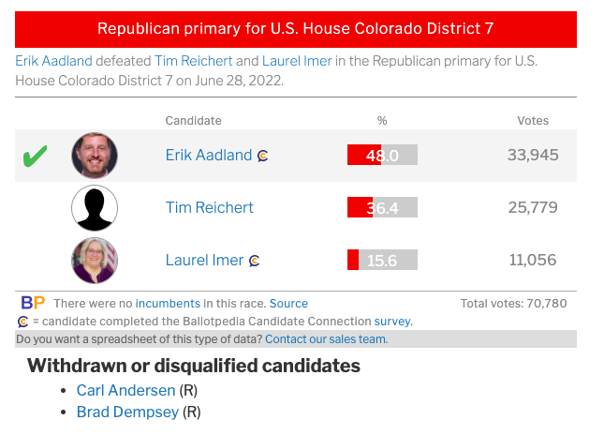
Data-Ballot Pedia

Slide 11
IV: Personal Efforts
VARIABLE NAME | EXPLANATION | TYPE | VALUE | VALUE LABEL
Years of experience | (there’s no single way for you to quantify one’s capability; we assume here that the longer you stay in office, the more capable you are) | Numerical | 0 | no experience
 |  |  | 1 | some experience
 |  |  | 2 | highly experienced
Campaign Activities | what the candidate did during the campaign, including speeches, debates, etc. | Numerical | 1 | below average
 |  |  | 2 | average
 |  |  | 3 | above average

Slide 12
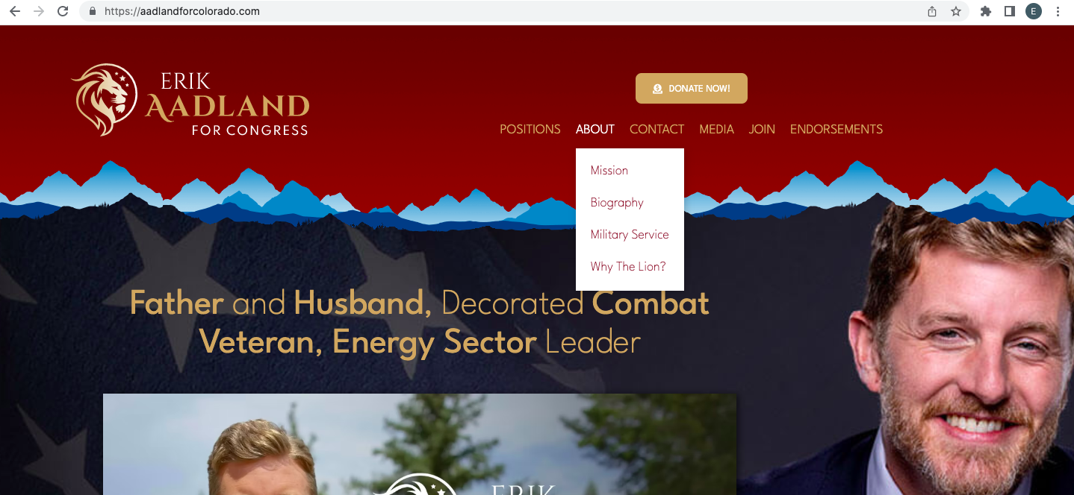
Data-Candidates’ Campaign Website

Slide 13
IV: Network Support
VARIABLE NAME | EXPLANATION | TYPE | VALUE | VALUE LABEL
Total funding amount | contributions from PACs contributions from individuals contributions and loans from candidate | Numerical | 1 | below average
 |  |  | 2 | average
 |  |  | 3 | above average
Endorse- ment | quality quantity | Numerical | 1 | below average
 |  |  | 2 | average
 |  |  | 3 | above average

Slide 14
IV: Network Support
VARIABLE NAME | EXPLANATION | TYPE | VALUE | VALUE LABEL
Total funding amount | contributions from PACs contributions from individuals contributions and loans from candidate | Numerical | 1 | below average
 |  |  | 2 | average
 |  |  | 3 | above average
Endorse- ment | quality quantity | Numerical | 1 | below average
 |  |  | 2 | average
 |  |  | 3 | above average

Slide 15
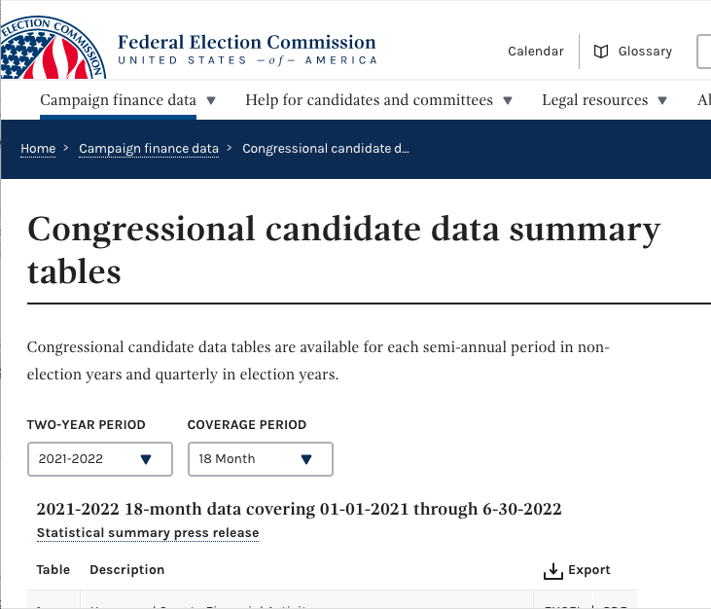
Data- Federal Election Commission (FEC)

Slide 16
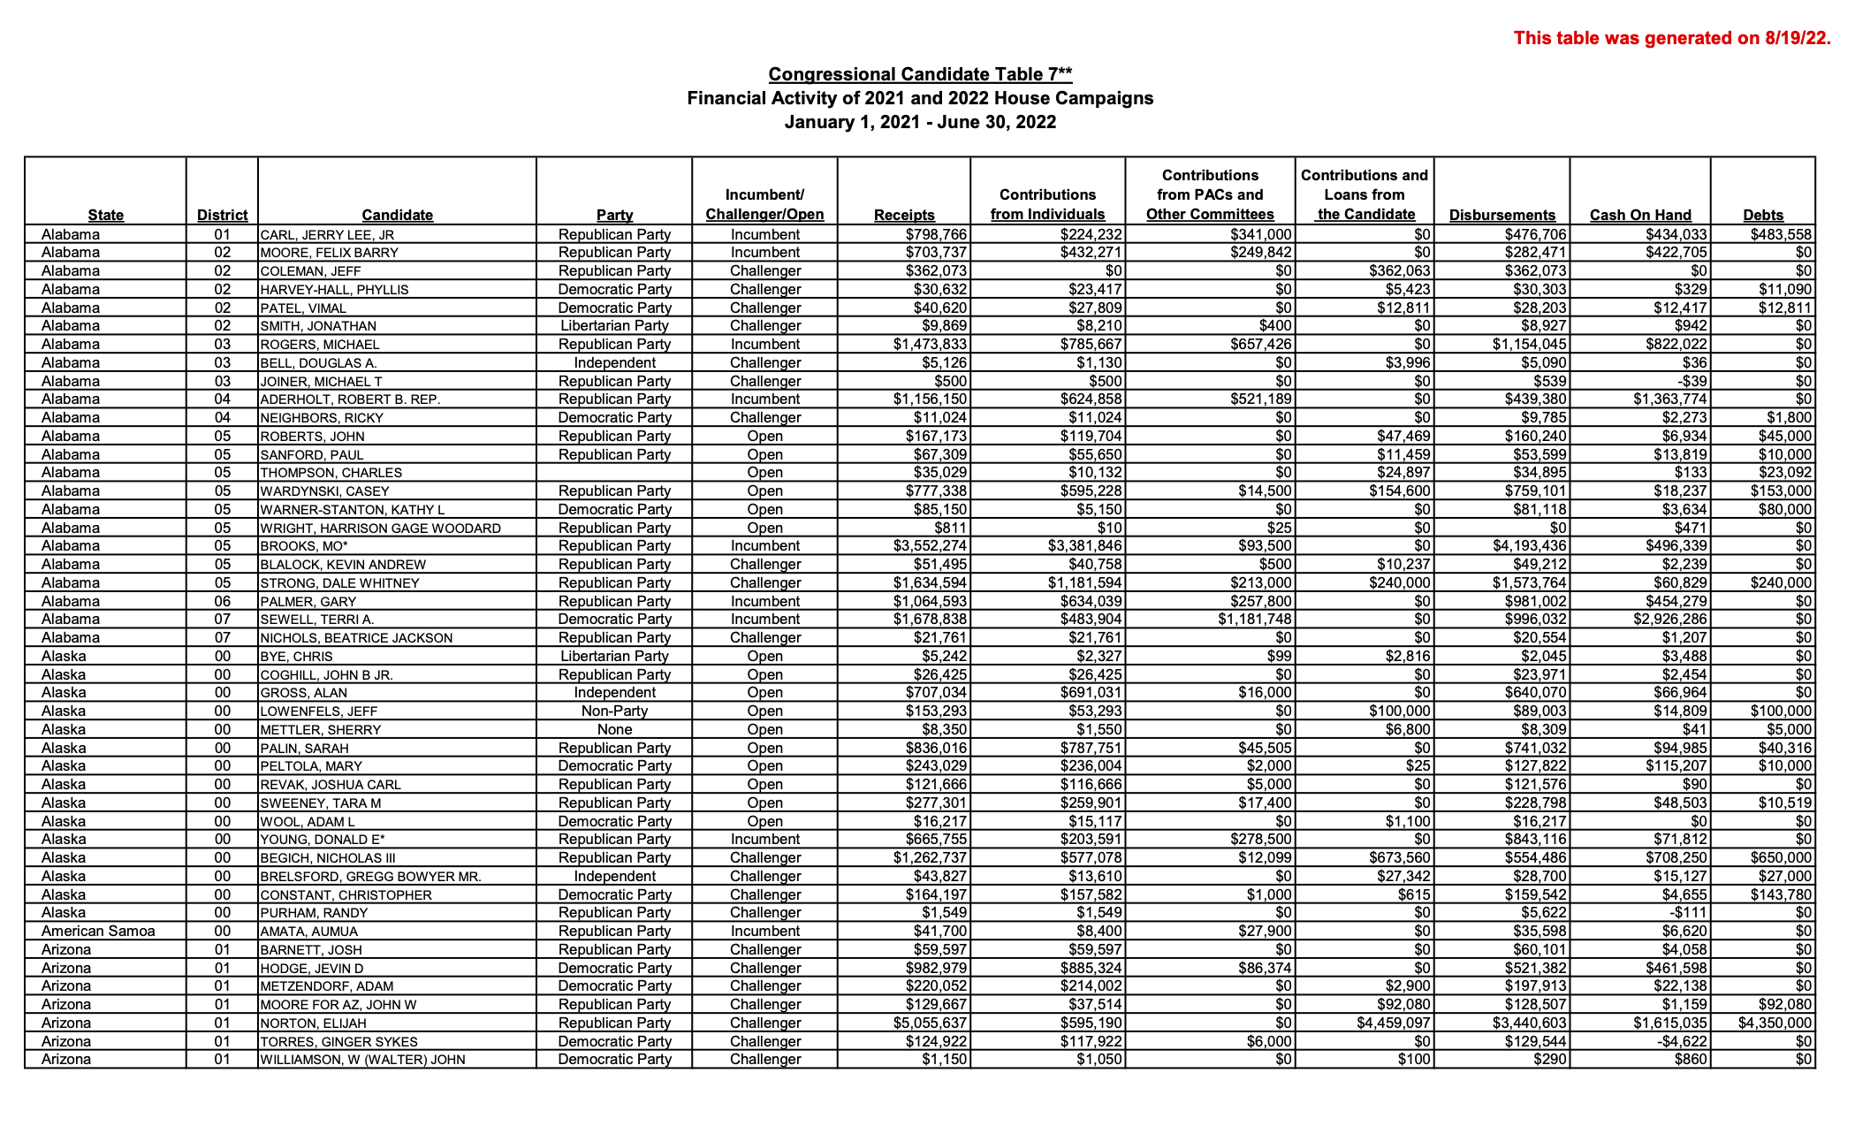
Data- Federal Election Commission (FEC)

Slide 17
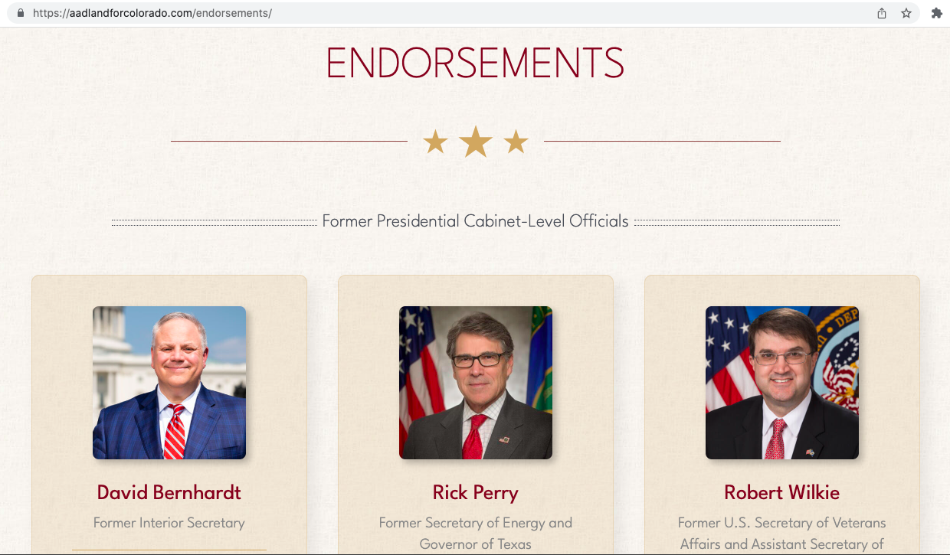
Data-Campaign Website

Slide 18
Method: Factorial ANOVA
Personal Efforts
Network Support
Years of Experience
Total Funding Amount
Campaign Activities
Endorsement
House Election Result
A Factorial ANOVA examining the effects of personal efforts and the network support on election outcome.

Slide 19
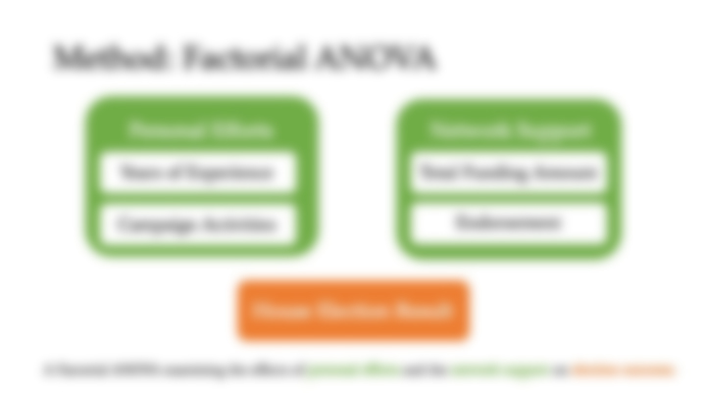
Method: Factorial ANOVA
Personal Efforts
Network Support
Years of Experience
Total Funding Amount
FOUR PHASES
Campaign Activities
Endorsement
House Election Result
A Factorial ANOVA examining the effects of personal efforts and the network support on election outcome.

Slide 20
Method: Factorial ANOVA
✅
Phase I
Phase II
Phase III
Phase IV
Personal Efforts
Network Support
Years of Experience
Total Funding Amount
Campaign Activities
Phase I
Endorsement
Phase I
House Election Result
A Factorial ANOVA examining the effects of personal efforts and the network support on election outcome.

Slide 21
Method: Factorial ANOVA
Phase I
Phase II
Phase III
Phase IV
✅
Personal Efforts
Network Support
Years of Experience
Total Funding Amount
Campaign Activities
Endorsement
Phase II
Phase II
House Election Result
A Factorial ANOVA examining the effects of personal efforts and the network support on election outcome.

Slide 22
Method: Factorial ANOVA
Phase I
Phase II
Phase III
Phase IV
✅
Personal Efforts
Network Support
Years of Experience
Total Funding Amount
Campaign Activities
Endorsement
Phase III
Phase III
House Election Result
A Factorial ANOVA examining the effects of personal efforts and the network support on election outcome.

Slide 23
Method: Factorial ANOVA
Phase I
Phase II
Phase III
Phase IV
✅
Personal Efforts
Network Support
Years of Experience
Total Funding Amount
Campaign Activities
Endorsement
Phase IV
Phase IV
House Election Result
A Factorial ANOVA examining the effects of personal efforts and the network support on election outcome.

Slide 24
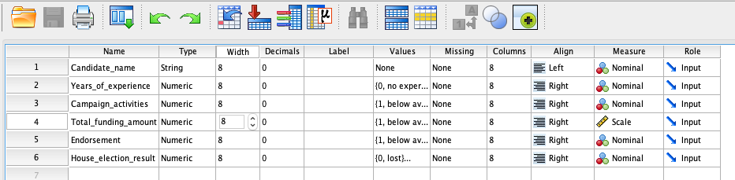
Method: Factorial ANOVA
A Factorial ANOVA examining the effects of personal efforts and the network support on election outcome.

Slide 25
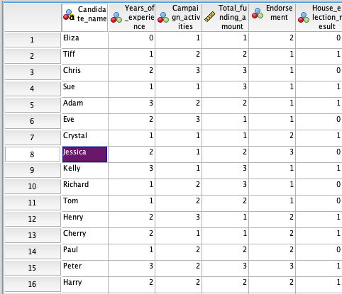
Method: Factorial ANOVA
A Factorial ANOVA examining the effects of personal efforts and the network support on election outcome.

Slide 26
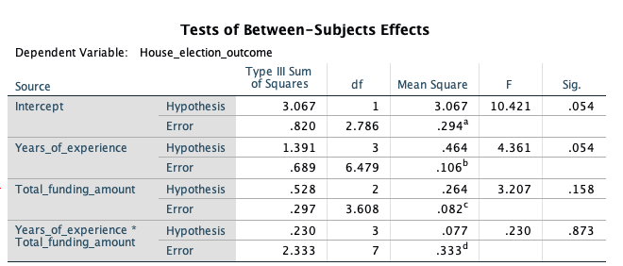
Method: Factorial ANOVA
A Factorial ANOVA examining the effects of personal efforts and the network support on election outcome.

Slide 27
Thanks for Listening!
A Factorial Analysis of Variance
of the effects of Personal efforts and Network Support on 2022 U.S. House Election Outcomes
18 October 2022
Presented by Zhang Wei, Huang Xiaohan, Zheng Qi

