Slide 1
EXECUTIVE PRIVILEGE
ZHANG Wei
UNITED STATES v. NIXON
December 7, 2021

Slide 2
TABLE OF
01
Facts
02
Arguments
03
Decision
04
Impact
CONTENTS
Watergate Scandal
Development of the case
Arguments for US
Arguments for Nixon
A unanimous 8-0 decision
Majority opinion
Nixon’s resignation
Presidential Privilege

Slide 3
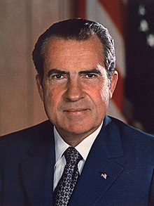
FACTS -
WATERGATE SCANDAL
Richard Nixon
37th President of the United States
January 20, 1969 – August 9, 1974
Republican
Watergate Scandal (1972 Election)
June 1972: Five men broke into Democratic National Committee Headquarter (in Watergate Complex)

Slide 4
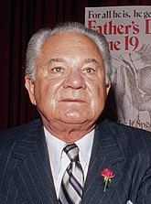
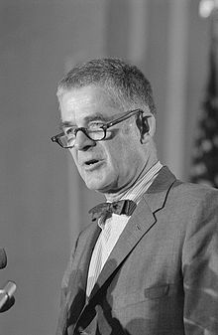
FACTS -
INVESTIGATIONS
May 1973:
Attorney General appointed Archibald Cox to the position of special prosecutor, charged with investigating the break-in.
Notes:
Nixon fired Cox,
precipitating the immediate departures of both Attorney General and Deputy Attorney General (“Saturday Night Massacre”)
A firestorm of protest, forcing Nixon to appoint a new special prosecutor, Leon Jaworski.

Slide 5
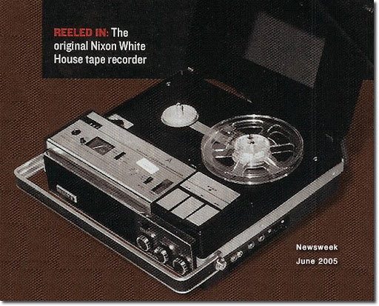
FACTS -
NIXON’S TAPES
a tape-recording device in the Oval Office

Slide 6
FACTS -
SATURDAY NIGHT MASSACRE
October 1973:
Nixon fired Cox
Attorney General and Deputy Attorney General left office.
Protest, forcing Nixon to appoint a new special prosecutor, Leon Jaworski.
Notes:
Nixon fired Cox,
precipitating the immediate departures of both Attorney General and Deputy Attorney General (“Saturday Night Massacre”)
A firestorm of protest, forcing Nixon to appoint a new special prosecutor, Leon Jaworski.

Slide 7

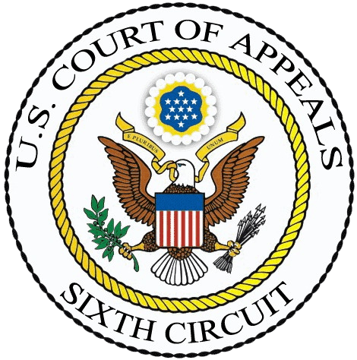
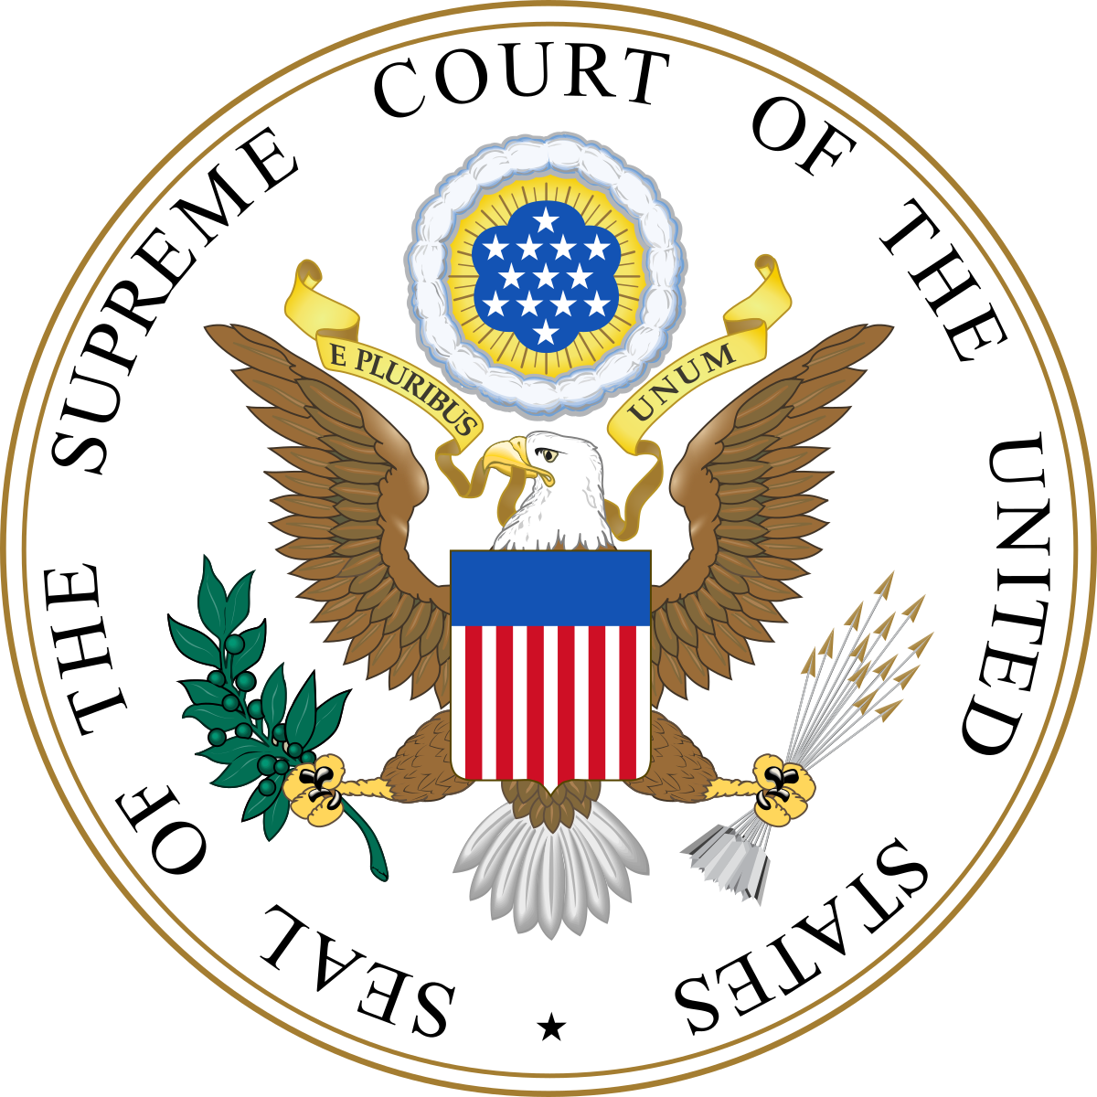
HOW IT MOVED THROUGH THE COURT SYSTEM
District Court
Circuit Court
Supreme Court
1: issued a subpoena ordering Nixon to turn over tape recordings (transcripts)
2: ruled against Nixon and insisted the release of more tapes
Nixon appealed the District Court’s decision and requested to quash the subpoena.
Jaworski asked the Supreme Court to hear the case.
United States v. Nixon (1974)
Argued: July 8, 1974
Decided: July 24, 1974

Slide 8
ISSUE
Does the president have an absolute right to withhold certain information based on ”executive privilege“?

Slide 9
Does the president have an absolute right to withhold certain information based on executive privilege?
NO
YES
Judicial Review: The courts must be able to hear challenges to the president’s executive privilege, as this case raises a constitutional question
Separation of Powers: This case cannot be heard in the courts because it involves a dispute within the executive branch.
Executive privilege is not absolute.
Checks and Balances
Limited ≠ cease to exist
Confidentiality = candid advice.
Absolute & Extended

Slide 10
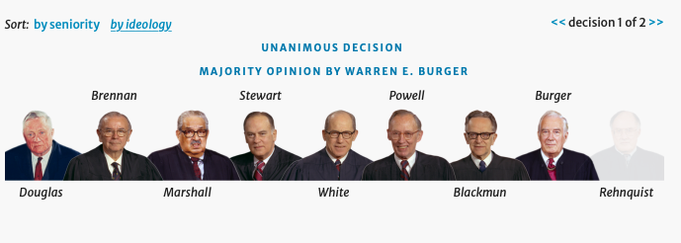
DECISION
8-0
The Court ruled in favor of the United States and against President

Slide 11
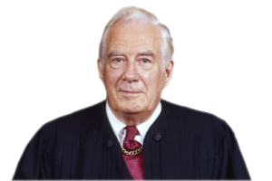
DECISION
8-0
Chief Justice Burger asserted:
1. ∵The executive privilege flows from the Constitution and the Court is the ultimate interpreter of that Constitution;
∴ it was for the Court and not the president to define the scope of the privilege. (Marbury v. Madison)
2. ∵ The claim of privilege did not rest on the ground that the tapes contained military or diplomatic secrets;
∴ it was appropriate to subordinate the privilege to the search for truth in a criminal trial. (Fifth Amendment‘s guarantee of due process).
Burger

Slide 12
—Chief Justice
“Absent a claim of need to protect military, diplomatic, or sensitive national security secrets, we find it difficult to accept the . . . [absolute] confidentiality of presidential communications .”
Warren Burger

Slide 13
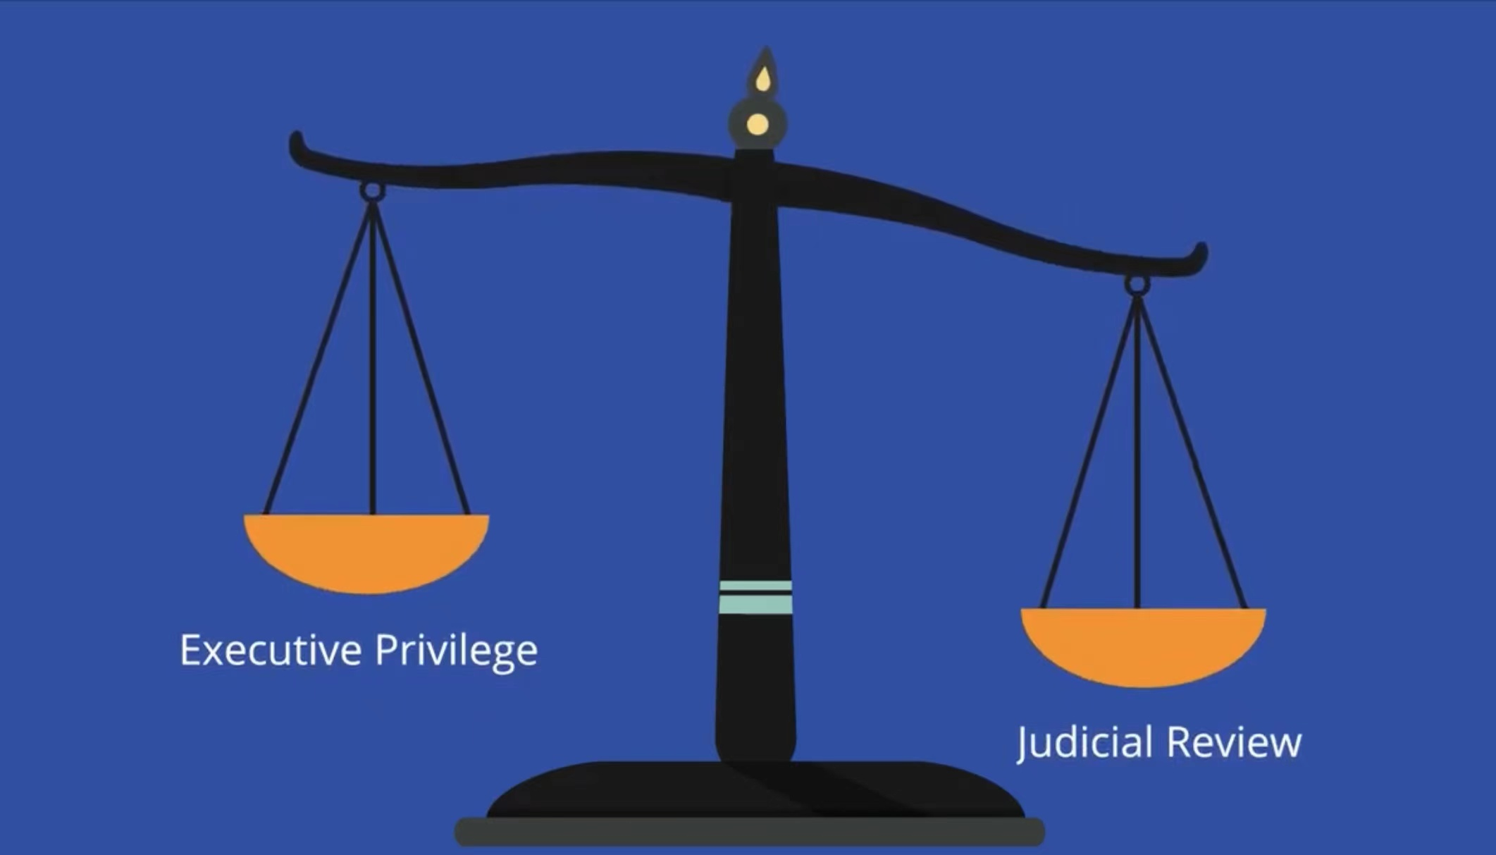
DECISION
8-0
Judicial Review: The courts must be able to hear challenges to the president’s executive privilege, as this case raises a constitutional question
Burger
The Court ruled in favor of the United States and against President

Slide 14
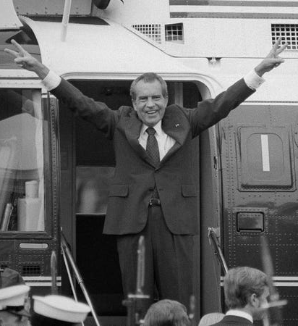
IMPACT
On Richard Nixon
Nixon turned over the tapes
Nixon Resigned
On Executive Privilege
The first time the Supreme Court acknowledged that an executive privilege exists

Slide 15
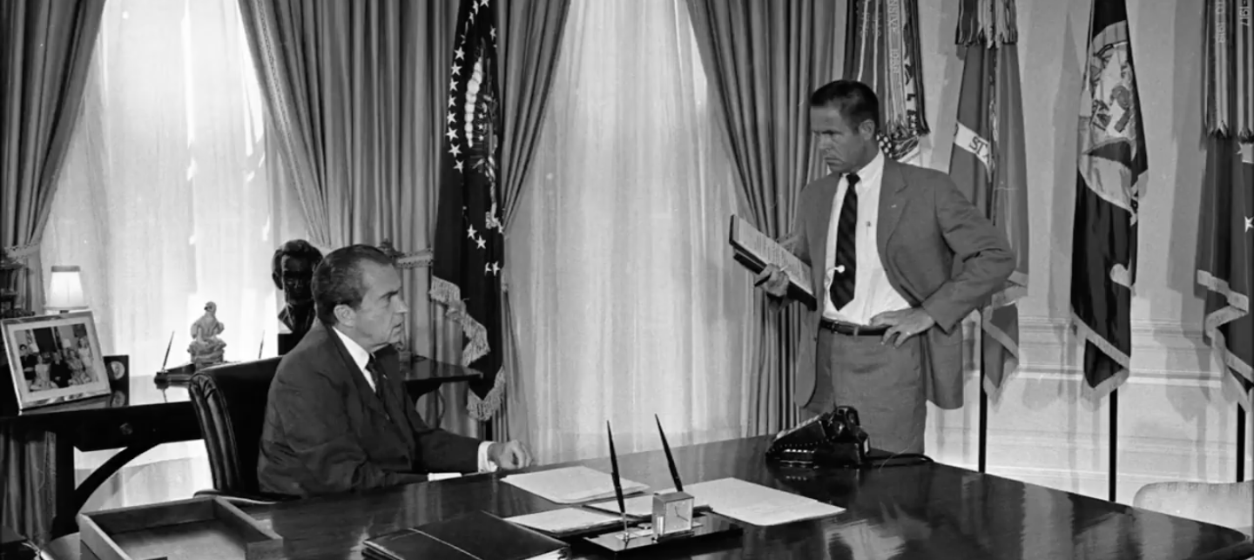
IMPACT -
NIXON’S TAPES
On June 23, 1972, President Richard Nixon met with Chief of Staff Haldeman in the White House.
This meeting was captured by recording devices in the Oval Office.

Slide 16
IMPACT
On Richard Nixon
Nixon turned over the tapes
Nixon Resigned
On Executive Privilege
The first time the Supreme Court acknowledged that an executive privilege exists

Slide 17
POST-WATERGATE ERA:
USAGE OF EP
Ford administration | ----
Reagan administration | 35%
Bush Sr. administration | 83%
Clinton administration | invoked EP on 14 occasions (Lewinsky Scandal)
Bush Jr. administration | invoked EP on 6 occasions (presidential advisors)
Obama administration | invoked (Fast and Furious Scandal)
Trump administration | invoked (Russian interference)

Slide 18
Works Cited
Chemerinsky, E. (2019). Constitutional law: principles and policies. New York, NY. Wolters Kluwer.
Waxman, O. B. (2019, June). President Trump invoked executive privilege. Here’s the History of that Presidential Power. Time. Retrieved from: https://time.com/5605930/executive-privilege-history/
"Smoking Gun": Richard Nixon and Bob Haldeman discuss the Watergate break-in, June 23, 1972. https://www.youtube.com/watch?v=ehKRQ0N-dIg
"United States v. Nixon." Oyez, www.oyez.org/cases/1973/73-1766. Accessed 5 Dec. 2021.

Slide 19
MANY
THANKS!
Do you have any questions?
Powers of President – Executive Privilege
United States v. Nixon
PRESENTED BY ZHANG WEI
DECEMBER 7TH 2021, AMERICAN CONSTITUTION

