Slide 1

A CLOSE-KNIT COMMUNITY AMONG FEMALE MILL OPERATIVES
Based on Dublin’s “Women, Work, and the Family: Female Operatives in the Lowell Mills”

Slide 2
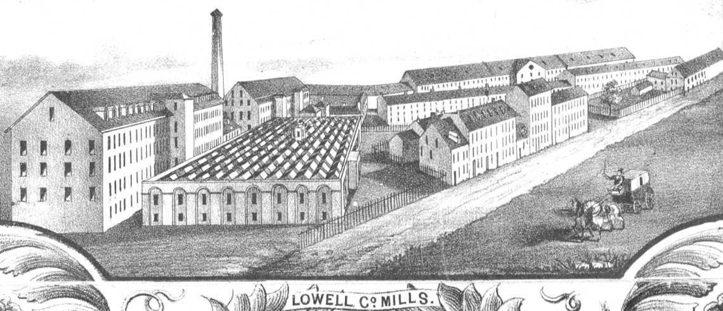

Slide 3
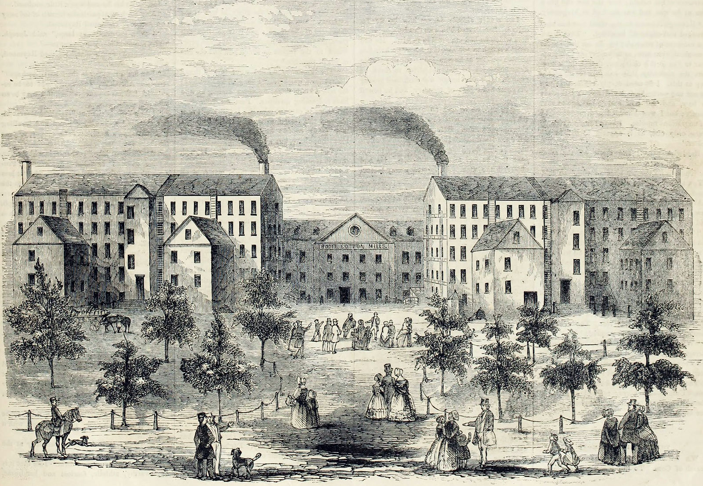

Slide 4
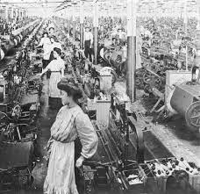

Slide 5
DEVELOPMENTS OF FEMALE COMMUNITY
Divided into two time periods:
In the 1830s
Young, single, native-born women
A period of growth and protests
After 1845:
the growth of Irish Immigrant family workforce
the decline of Yankee community and the labor movement it nurtured

Slide 6

TABLE OF CONTENTS
01
02
03
04
05
How the community was formed
What constituted the community
What were its impacts
Why it changed after 1845
implication of Irish immigrants
Conclusion
06

Slide 7
Q1: How the community was formed (chart)
Mutual dependence
worked together with experienced operatives teaching new comers
lived together in company boarding houses
Separated from families (chart)
Isolated from men

Slide 8
Basic info of mill operatives of the Hamilton Lowell Manufacturing Company in July 1836
gender | 74% female
nativity | 96% native-born
age | 4/5 15-30
residence | 3/4 of female operatives in company boarding houses

Slide 9


Slide 10
Q1: How the community was formed
Mutual dependence
Separated from families
The absence of significant numbers of workers living in families contributed to the importance of the operative peer group.
Isolated from men

Slide 11
Q1: How the community was formed
Mutual dependence
Separated from families
Isolated from men
A typical workroom: 2 male supervisors, 80 female operatives, children
Patterns of residence: company tenements, all-male/all-female boarding houses

Slide 12
Q2: What constituted the community
Female operatives
Boarding houses
A collective living situation
The center for social life of operatives
Where New comer’s first contact with fellow operatives took place
Focal points of female labor protests (chart)
Committees

Slide 14
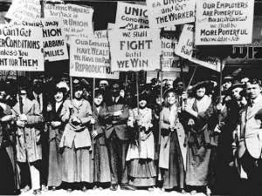

Slide 15
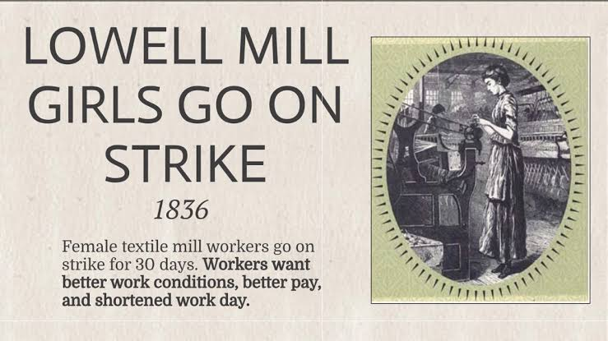

Slide 16
Q2: What constituted the community
Female operatives
Boarding houses
A collective living situation
The center for social life of operatives
New comer’s first contact with fellow operatives took place here
Focal points of female labor protests
Committees

Slide 17
Q3: What was the community’s influence
The pressure to conform to group patterns of speech and dress
The enforcement of an unwritten code of moral conduct
The promotion of campaigns and protests
1834-1836: Women operatives – the most vocal advocates of a reduction in work hour
1845: dominating the Ten-Hour Movement, ¾ of petition signers, the Lowell Female Labor Reform Association

Slide 18
Q4: Why the community changed after 1845
The changing make-up of the mill work force (chart)
The declining importance of company boarding houses (chart)
Growth of residence in private boarding houses and at home
The increasing number of males to perform work formerly done by women

Slide 19
Proportion of foreign born employed at the Hamilton Company
Year | Foreign born operatives in Hamilton Company
1836 | 4%
1860 | 62% (3/4 were Irish)

Slide 20
Proportion of female operatives lived in boarding houses
1836 | 3/4 of female operatives in company boarding houses
1860 | 1/3 of female operatives in company boarding houses

Slide 21

Q5: What was the implication of nativity on the community
Yankee
Irish immigrants
Came with families
Resided with families
The general trend between 1836 and 1860 was
the increase in residence at home
the decrease in residence in company boarding houses

Slide 22
Conclusion
Segregation at work and in housing, coupled with the predominance of women in early Lowell, contributed to the growth of a distinct female operative community.
Women could not have entirely private lives within the boarding house, they probably had to conform to group norms, whether these involved speech, clothing, relations with men, or attitudes towards the ten-hour day.
The decisive trend between 1836 and 1860 was the increase in the proportion of female operatives living at home with their families at the expense of the women residing in company boarding houses.

Slide 23
THANKS
Presented by ZHANG Wei
July 13, 2021

