Slide 1
The Auteur Theory and Orson Welles
Presented by Zhang Wei, Zheng Qi
11 November, 2022

Slide 2
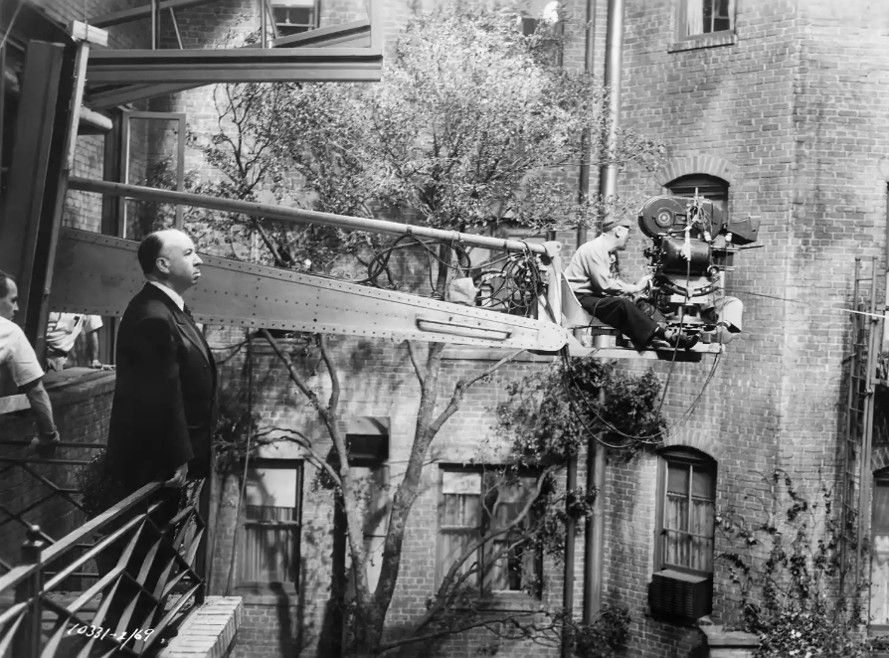

Slide 3
Rear Window (1954)
Mystery/Thriller
Hitchcock’s work
(Genre)
(Auteur)

Slide 4
Rear Window (1954)
Mystery/Thriller
Hitchcock’s work
(Genre)
(Auteur)

Slide 5
Rear Window (1954)
Mystery/Thriller
Hitchcock’s work
(Genre)
(Auteur)
Q1: Why examining the authorship?
Q2: What is the auteur theory about? Who is an auteur?
Q3: How to apply the auteur theory in film studies?

Slide 6
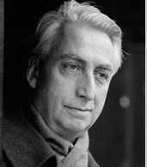
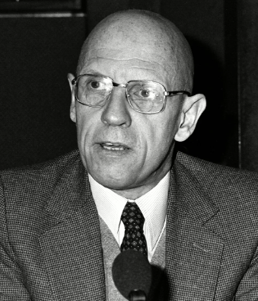
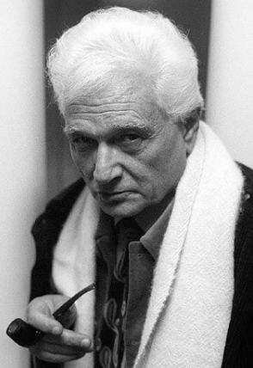
Q1: Why examining the authorship?
1950s

Slide 7
Q1: Why examining the authorship?
New Critics
1950s

Slide 8
Q1: Why examining the authorship?
New Critics
Authorship was neglected
✅ literary text
❌ author’s info
1950s

Slide 9
Q1: Why examining the authorship?
New Critics
1950s

Slide 10
Q1: Why examining the authorship?
Roland Barthes: “The Death of the Author”
The idea of authorship is tyrannical.
Texts created by the author & by other texts.
When the author finishes writing, the subject he or she created slips away and is no longer dependent on the author.

Slide 11
Q1: Why examining the authorship?
Michel Foucault: “What is an Author”
Writing ≠ the author expressing himself/herself
Writing = creating a space where the author disappears
???contradiction
“The same gesture that refutes any relevance of the identity of the author nevertheless affirms its irreducible necessity” (Simmons 217)

Slide 12
Q1: Why examining the authorship?
Author & Author-function
Author (the real person)
Author-function:
rights and responsibility
distinguishing between literary texts and scientific text
authenticating texts
trans-discursive functions
Michel Foucault: “What is an Author”
Writing ≠ the author expressing himself/herself
Writing = creating a space where the author disappears
???contradiction
“The same gesture that refutes any relevance of the identity of the author nevertheless affirms its irreducible necessity” (Simmons 217)

Slide 13

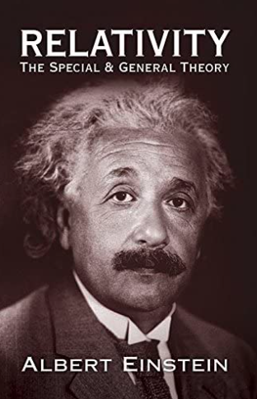
Q1: Why examining the authorship?
Author & Author-function
Author (the real person)
Author-function:
rights and responsibility
distinguishing between literary texts and scientific text
authenticating texts
trans-discursive functions
Michel Foucault: “What is an Author”
Writing ≠ the author expressing himself/herself
Writing = creating a space where the author disappears
???contradiction
“The same gesture that refutes any relevance of the identity of the author nevertheless affirms its irreducible necessity” (Simmons 217)

Slide 14
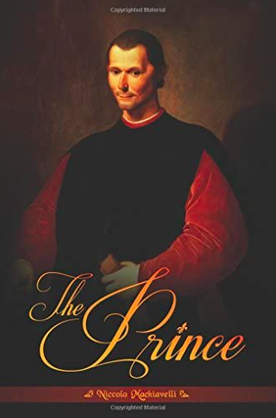
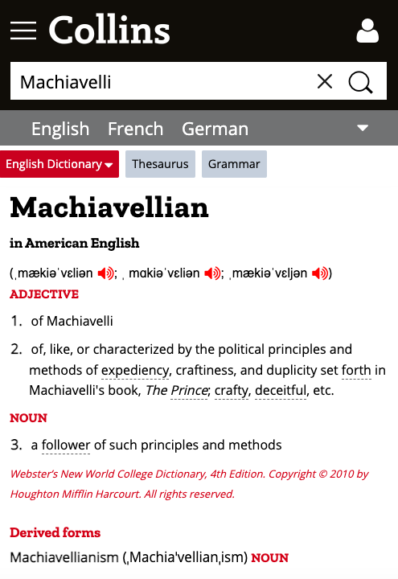
Q1: Why examining the authorship?
Author & Author-function
Author (the real person)
Author-function:
rights and responsibility
distinguishing between literary texts and scientific text
authenticating texts
trans-discursive functions
Michel Foucault: “What is an Author”
Writing ≠ the author expressing himself/herself
Writing = creating a space where the author disappears
???contradiction
“The same gesture that refutes any relevance of the identity of the author nevertheless affirms its irreducible necessity” (Simmons 217)

Slide 15


Q1: Why examining the authorship?
Author & Author-function
Author (the real person)
Author-function:
rights and responsibility
distinguishing between literary texts and scientific text
authenticating texts
trans-discursive functions
Michel Foucault: “What is an Author”
Writing ≠ the author expressing himself/herself
Writing = creating a space where the author disappears
???contradiction
“The same gesture that refutes any relevance of the identity of the author nevertheless affirms its irreducible necessity” (Simmons 217)

Slide 16
Q1: Why examining the authorship?
Author & Author-function
Author (the real person)
Author-function:
rights and responsibility
distinguishing between literary texts and scientific text
authenticating texts
trans-discursive functions
Michel Foucault: “What is an Author”
Writing ≠ the author expressing himself/herself
Writing = creating a space where the author disappears
???contradiction
“The same gesture that refutes any relevance of the identity of the author nevertheless affirms its irreducible necessity” (Simmons 217)

Slide 17
Q1: Why examining the authorship?
Jacques Derrida: Signsponge
Authors sign their texts in different ways.
Signature is a textual element.
Signature effects:
The literal sense
Signature as style
Signature of the signature

Slide 18
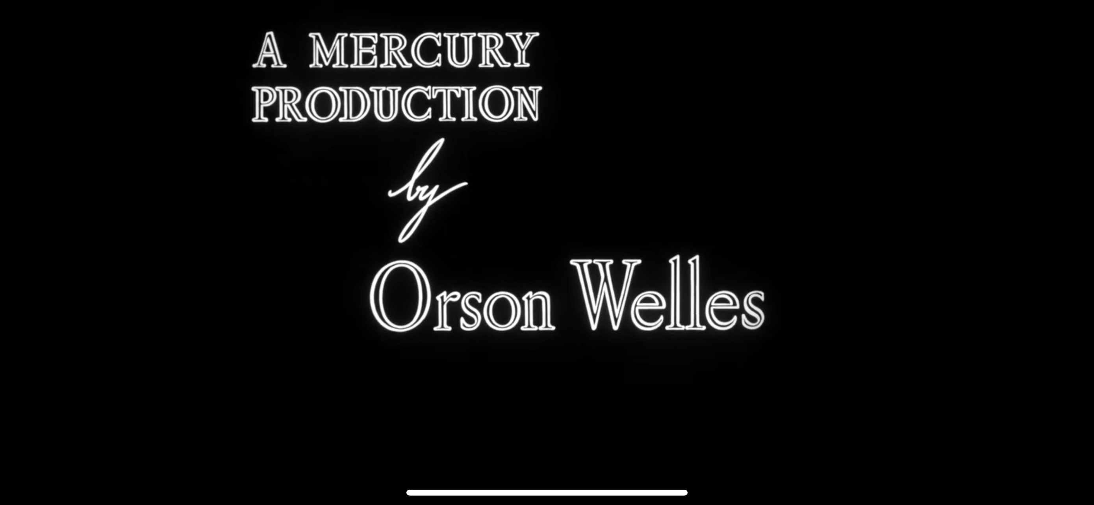
Q1: Why examining the authorship?
Jacques Derrida: Signsponge
Authors sign their texts in different ways.
Signature is a textual element.
Signature effects:
The literal sense
Signature as style
Signature of the signature

Slide 19
Q1: Why examining the authorship?
Jacques Derrida: Signsponge
Authors sign their texts in different ways.
Signature is a textual element.
Signature effects:
The literal sense
Signature as style
Signature of the signature

Slide 20
Q2: What is the auteur theory about? Who is an auteur?

Slide 21
Q1: Why examining the authorship?
Q2: What is the auteur theory about? Who is an auteur?
Authorenfilm
Auteur

Slide 22
Q1: Why examining the authorship?
Q2: What is the auteur theory about? Who is an auteur?
Authorenfilm
Auteur
1913 Germany
“author’s film”
“author”= screenwriter
1950s France
Cahier du cinéma
Politique des auteurs

Slide 23
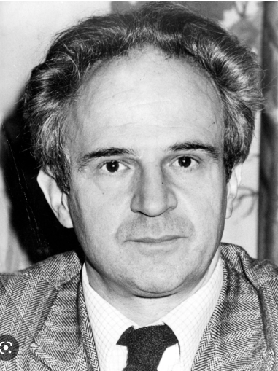
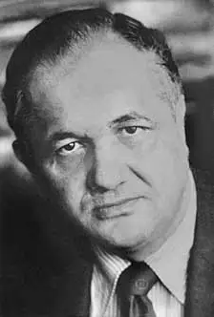
Q1: Why examining the authorship?
Q2: What is the auteur theory about? Who is an auteur?
Authorenfilm
Auteur
1913 Germany
“author’s film”
“author”= screenwriter
1950s France
Cahier du cinéma
Politique des auteurs

Slide 24
Q2: What is the auteur theory about? Who is an auteur?
François Truffaut: “A Certain Trend in French Cinema ”
Psychological realism >> literary mastery
Auteurs >> Metteur en scene(stagers)
French filmmakers receiving acclaim for their well-crafted, but voiceless, literature adaptations
American Hollywood films entered the French market; Hitchcock, Ford, Welles…
The best directors are who had unique personal visions

Slide 25
Q2: What is the auteur theory about? Who is an auteur?
Andrew Sarris: “Notes on the Auteur Theory in 1962”
To be an auteur:
Technical competence
Distinguishable personality:
recurring characteristics of style which serve as signature;
the way a film looks and moves should have some relationship to the way a director thinks and feels
Interior meaning:
beyond the pure entertainment-oriented purposes,
layers of meanings revealing unique perspectives on life.

Slide 26
Q2: What is the auteur theory about? Who is an auteur?
Technical
competence
Andrew Sarris: “Notes on the Auteur Theory in 1962”
To be an auteur:
Technical competence
Distinguishable personality:
recurring characteristics of style which serve as signature;
the way a film looks and moves should have some relationship to the way a director thinks and feels
Interior meaning:
beyond the pure entertainment-oriented purposes,
layers of meanings revealing unique perspectives on life.
Distinguishable Personality
Interior meaning

Slide 27
Q3: How to apply the auteur theory in film studies?

Slide 28
Citizen Kane
Q3: How to apply the auteur theory in film studies?
Orson Welles

Slide 29
Thanks!
Zhang Wei & Zheng Qi
2022.11.12

