Slide 1
The Veto Power of P5 in UNSC
Presented by 张薇

Slide 2
Outline
Definition
Usage
Attitudes towards veto power
Reform proposals
One particular argument

Slide 3
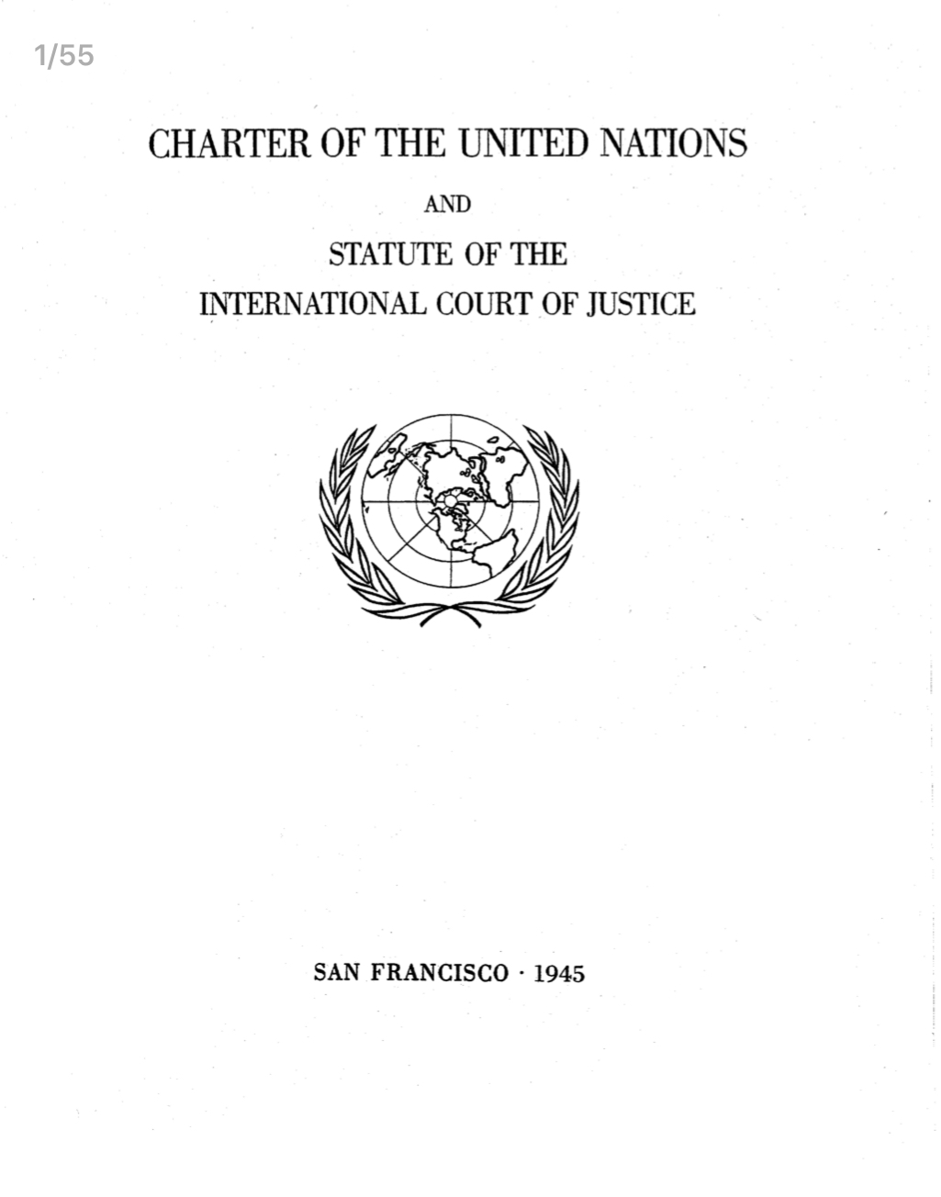
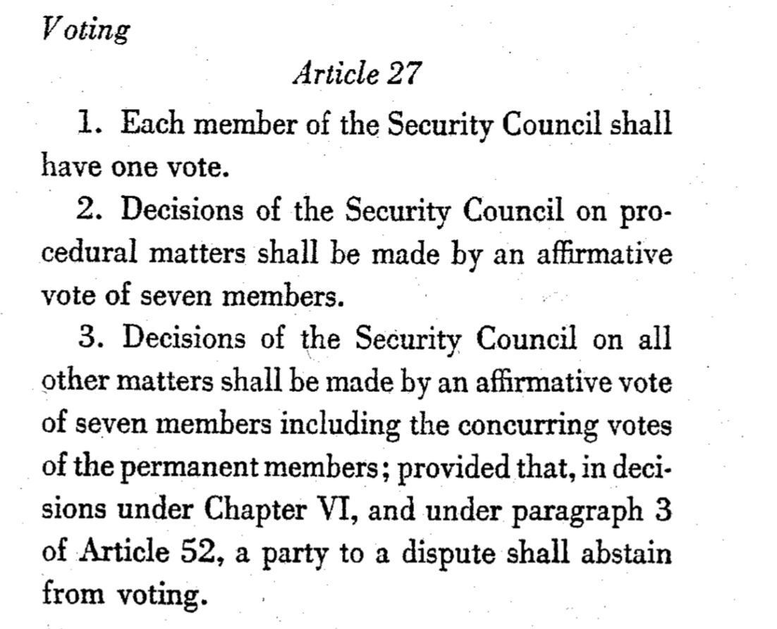
Definition

Slide 4
Definition
Origin of the word “veto” = “I forbid” in Latin
United Nations Security Council "veto power" refers to the power of the five permanent members of the UN Security Council to veto any "substantive" resolution
China, France, Russia, the UK, and the US
to block the admission of member-states
to block nominations for Secretary-General

Slide 5
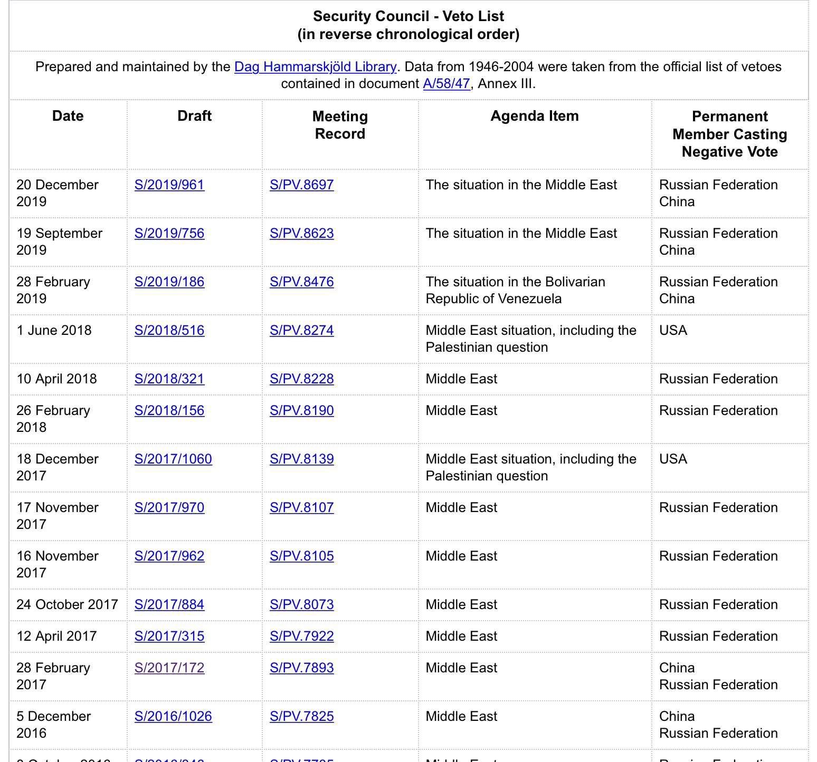
Usage
https://www.un.org/Depts/dhl/resguide/scact_veto_table_en.htm

Slide 6
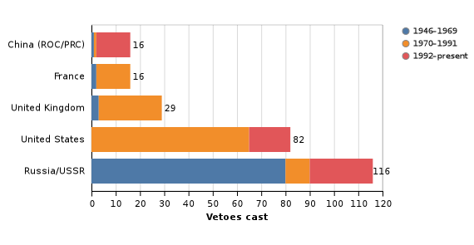
Usage
By now, Russia has used its veto 116 times, United States 82 times, UK 29 times, France 16 times and China 16 times

Slide 7
Usage
Why P5 use the veto power?
to to defend their national interests, to uphold a tenet of their foreign policy or, in some cases, to promote a single issue of particular importance to a state.
Several distinct phases
1946-1969: USSR cast most of the vetoes
1970-1991: US cast most of the vetoes
1991-now: usage of the veto by the different permanent members have emerged
France and the UK
Russia and China

Slide 8
Attitudes
Supporters
Method of promoting international stability
A check against military intervention
A critical safeguard against US domination
Critics
Undemocratic
Main cause of inaction on war crimes and crimes against humanity

Slide 9
Attitudes
Reform proposals
1. waiving the veto power (launched by Australia & supported by France)
2. Restriction on the exercise of the veto (advanced by the Non-Aligned Movement)
3. two or more permanent members veto simultaneously (African Union and several individual UN Member States)
4. extension of the veto to possible additional permanent members (Germany, Japan, India and Brazil)
The US and Russia, have repeated time and again that they will not accept any limitations to the veto.

Slide 10
Attitudes
Argument: The veto power is fundamentally problematic:
Problems:
1. which States are to be considered as important enough?
2. the veto power = larger responsibilities in the United Nations?
3. States will only use the veto when matters of vital national interest are at stake?
Goal of the power:
to guarantee peaceful relations among the world’s main powers
to assure the new body of their support

Slide 11
Thanks!

