Slide 1
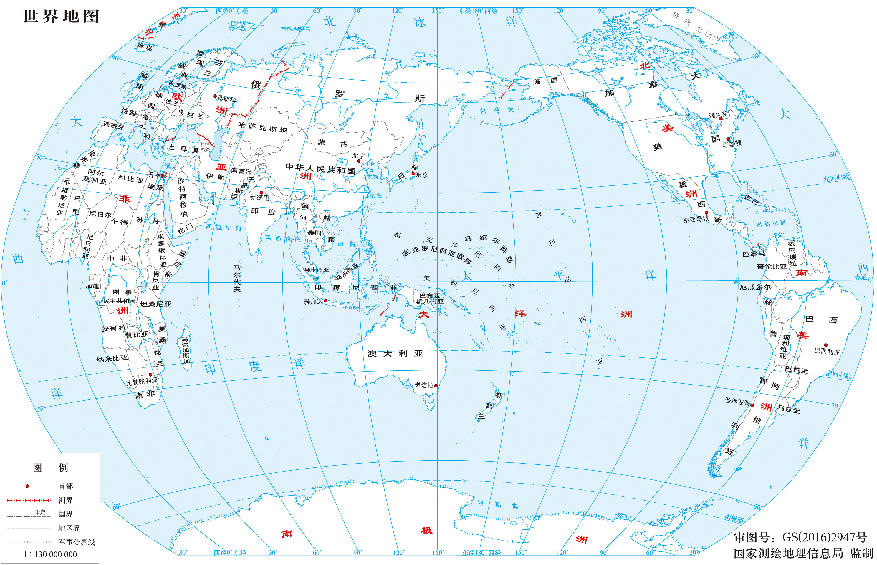



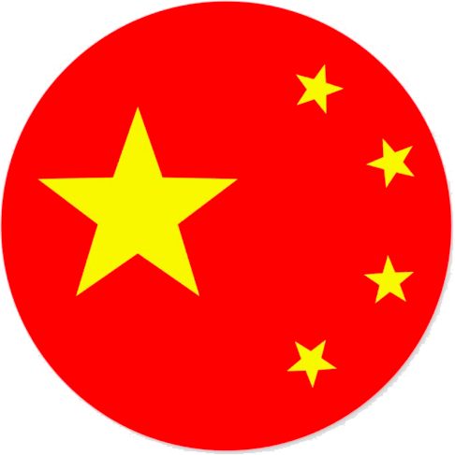

Q1: China-US/Japan Competition in ASEAN good or bad?
Q2: ASEAN centrality high or low?
AIP and ASEAN
Presented by Zhang Wei
24 November 2022

Slide 2
Chirathivat, Suthiphand and Rolf J. Langhammer. “ASEAN and the EU Challenged by ‘Divide and Rule’ Strategies of the US and China Evidence and Possible Reaction.” International Economics and Economic Policy, vol. 17, 2020, pp. 659-670.
A1
Trade tensions
Nation States:
≠nation state
Widening Integration
vs
Rising Heterogeneity
vulnerable
Integration schemes:
Success based on economic integration
Success based on ASEAN Centrality

Slide 3




Chirathivat & Langhammer (2020)
Trade tensions

Slide 4
Chirathivat & Langhammer (2020)
Trade tensions
Divide and Rule

Slide 5
Chirathivat & Langhammer (2020)
Trade tensions
DRP
DRP

Slide 6
Chirathivat & Langhammer (2020)
Trade tensions
DRP
DRP

Slide 7
Chirathivat & Langhammer (2020)
Trade tensions
Possible Counter-policy

Slide 8
Chirathivat & Langhammer (2020)
Part I
Rationale for the US:
To deal with trade deficits (zero-/negative sum)
To delay China’s technological advancement
Measures for the US
Protectionism/trade policy retaliation
Boycotting China’s tech products and denying them financial access
Part II
Part II
Trade tensions
Part III

Slide 9
Trade
Chirathivat & Langhammer (2020)
US to EU
Supported Brexit & preferred a bilateral deal
Supported CEE countries to resist EU policy
Held EU hostage of their tension on technology
Germany---benign neglect
The UK-----partial compliance
US to ASEAN
Not much
Preferred Vietnam, the Philippines, Malaysia and Thailand to the others
Imposed punitive duties on members that facilitated Chinese transshipment
Started to relocate high tech production from China to ASEAN countries
Part I
Part II
Part II
Trade tensions
Part III

Slide 10
Trade
Chirathivat & Langhammer (2020)
US to EU
Supported Brexit & preferred a bilateral deal
Supported CEE countries to resist EU policy
Held EU hostage of their tension on technology
Germany---benign neglect
The UK-----partial compliance
US to ASEAN
Not much
Preferred Vietnam, the Philippines, Malaysia and Thailand to the others
Imposed punitive duties on members that facilitated Chinese transshipment
Started to relocate high tech production from China to ASEAN countries
China to EU
“Digital Silk Road” as part of BRI to sell Chinese tech products
Eastern EU members: strict
CEE countries: receptive
China to ASEAN
China benefited from ASEAN-China FTA
ASEAN depended on China’s import
ASEAN welcomed BRI and Chinese tech products
Part I
Part II
Part II
Trade tensions
Part III

Slide 11
Technology
Chirathivat & Langhammer (2020)
US to EU
Supported Brexit & preferred a bilateral deal
Supported CEE countries to resist EU policy
Held EU hostage of their tension on technology
Germany---benign neglect
The UK-----partial compliance
US to ASEAN
Not much
Preferred Vietnam, the Philippines, Malaysia and Thailand to the others
Imposed punitive duties on members that facilitated Chinese transshipment
Started to relocate high tech production from China to ASEAN countries
China to EU
“Digital Silk Road” as part of BRI to sell Chinese tech products
Eastern EU members: strict
CEE countries: receptive
China to ASEAN
China benefited from ASEAN-China FTA
ASEAN depended on China’s import
ASEAN welcomed BRI and Chinese tech products
Part I
Part II
Part II
Trade tensions
Part III

Slide 12
Technology
Chirathivat & Langhammer (2020)
US to EU
Supported Brexit & preferred a bilateral deal
Supported CEE countries to resist EU policy
Held EU hostage of their tension on technology
Germany---benign neglect
The UK-----partial compliance
US to ASEAN
Not much
Preferred Vietnam, the Philippines, Malaysia and Thailand to the others
Imposed punitive duties on members that facilitated Chinese transshipment
Started to relocate high tech production from China to ASEAN countries
Part I
China to EU
“Digital Silk Road” as part of BRI to sell Chinese tech products
Eastern EU members: strict
CEE countries: receptive
China to ASEAN
China benefited from ASEAN-China FTA
ASEAN depended on China’s import
ASEAN welcomed BRI and Chinese tech products
Part II
Part II
Trade tensions
Part III

Slide 13
As a result..
Chirathivat & Langhammer (2020)
Part I
Political Cost
One common policy
Compromise ≠ the best policy
One common policy = authoritative?
Economic Cost
IT&AI Economies of scale unreachable, impeded by successful DRPs
Links between Trade policy and investment policy destroyed
Part II
Part II
Trade tensions
Part III

Slide 14
Chirathivat & Langhammer (2020)
Part I
What EU & ASEAN can do individually
EU:
Seek policies that has extensive public support
Pursue project-oriented cooperation (bottom-up)>>vague market-oriented integration
Encourage private EU investors cooperate closely with US/China local companies to prevent DRPs
ASEAN:
Envision a long-term US-China trade disputes and make counter policy
Balance its relations with China and the US (BRI & FOIP)
Strengthen ASEAN integration
What EU & ASEAN can do jointly
Part II
Part II
Trade tensions
Part III

Slide 15
Chirathivat & Langhammer (2020)
Part I
What EU & ASEAN can do individually
What EU & ASEAN can do jointly
Challenges
Different level of integration
Different level of democracy
Prospect
Formats to explore questions related to DRP
“[A] shared destiny of DRP, one of mutual benefit and respect”
Part II
Part II
Trade tensions
Part III

Slide 16


Slide 17
A2
Valockova, Barbora. “ASEAN’s Limited Centrality in Connectivity: Managing Infrastructure Competition between China and Japan.” Asia Policy, vol. 16, no. 1, 2021, pp. 129-153.
Some argue for a infrastructure forum
Option 1
EPQI
competition
Option 2
BRI

Slide 18
A2
Valockova, Barbora. “ASEAN’s Limited Centrality in Connectivity: Managing Infrastructure Competition between China and Japan.” Asia Policy, vol. 16, no. 1, 2021, pp. 129-153.
Some argue for a infrastructure forum
Option 1
EPQI
competition
limited centrality in connectivity
Option 2
BRI
=
Scope setter
≠
Leader, Convener, Convenience, Necessity

Slide 19
A2
Valockova, Barbora. “ASEAN’s Limited Centrality in Connectivity: Managing Infrastructure Competition between China and Japan.” Asia Policy, vol. 16, no. 1, 2021, pp. 129-153.
Some argue for a infrastructure forum
Internal factors
Option 1
EPQI
competition
Member states
limited centrality in connectivity
Option 2
BRI
Stakeholders
=
Scope setter

Slide 20
A2
Valockova, Barbora. “ASEAN’s Limited Centrality in Connectivity: Managing Infrastructure Competition between China and Japan.” Asia Policy, vol. 16, no. 1, 2021, pp. 129-153.
Some argue for a infrastructure forum
External factors
Internal factors
Option 1
EPQI
competition
Member states
limited centrality in connectivity
Option 2
BRI
Stakeholders
=
Scope setter

Slide 21
A2
Valockova, Barbora. “ASEAN’s Limited Centrality in Connectivity: Managing Infrastructure Competition between China and Japan.” Asia Policy, vol. 16, no. 1, 2021, pp. 129-153.
Some argue for a infrastructure forum
External factors
Internal factors
Option 1
EPQI
competition
Socializing
Member states
limited centrality in connectivity
Option 2
BRI
Stakeholders
=
Scope setter

Slide 22
Valockva (2021)
External factors
Option 1
EPQI
Internal factors
Socializing
Member states
limited centrality in connectivity
Option 2
BRI
Concept
Stake-holders
=
Scope setter
“to perform a central role in regional security, institutional and strategic architecture.” (133)
Leader, convener, hub/node, driver of progress, convenience
ASEAN centrality =
ASEAN connectivity =
ASEAN centrality in connectivity =
To benefit all members and to promote ASEAN centrality
MPAC 2010, MPAC 2025; mobilizing external partners
“the ability to set up a multilateral mechanism to maneuver effectively vis-à-vis the interests of external partners in connectivity”

Slide 23
Valockva (2021)
External factors
Option 1
EPQI
Internal factors
Socializing
Member states
limited centrality in connectivity
Option 2
BRI
Concept
Stake-holders
LOW
But in a good way
=
Scope setter
“to perform a central role in regional security, institutional and strategic architecture.” (133)
Leader, convener, hub/node, driver of progress, convenience
ASEAN centrality =
ASEAN connectivity =
ASEAN centrality in connectivity =
To benefit all members and to promote ASEAN centrality
MPAC 2010, MPAC 2025; mobilizing external partners
“the ability to set up a multilateral mechanism to maneuver effectively vis-à-vis the interests of external partners in connectivity”

Slide 24
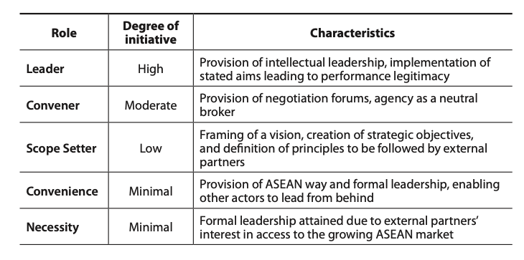


Valockva (2021)
External factors
Option 1
EPQI
Internal factors
Socializing
Member states
limited centrality in connectivity
Option 2
BRI
Stake-holders
LOW
But in a good way
=
Scope setter
“to perform a central role in regional security, institutional and strategic architecture.” (133)
Leader, convener, hub/node, driver of progress, convenience
ASEAN centrality =
ASEAN connectivity =
ASEAN centrality in connectivity =
To benefit all members and to promote ASEAN centrality
MPAC 2010, MPAC 2025; mobilizing external partners
“the ability to set up a multilateral mechanism to maneuver effectively vis-à-vis the interests of external partners in connectivity”

Slide 25
Valockva (2021)
External factors
Option 1
EPQI
Internal factors
5 strategic areas:
sustainable infrastructure,
digital innovation,
seamless logistics,
regulatory excellence,
people mobility
3 goals for infrastructure:
increase investment in each state,
enhance the sharing of best infrastructure practice
deploy model for smart urbanization
Scope setter = setting goals & principles
Socializing
Member states
limited centrality in connectivity
Option 2
BRI
Stake-holders
A Vision✅
A mechanism❌
LOW
But in a good way
=
Scope setter
“to perform a central role in regional security, institutional and strategic architecture.” (133)
Leader, convener, hub/node, driver of progress, convenience
ASEAN centrality =
ASEAN connectivity =
ASEAN centrality in connectivity =
To benefit all members and to promote ASEAN centrality
MPAC 2010, MPAC 2025; mobilizing external partners
“the ability to set up a multilateral mechanism to maneuver effectively vis-à-vis the interests of external partners in connectivity”

Slide 26
Valockva (2021)
External factors
Option 1
EPQI
Internal factors
Socializing
Why low/limited?
Member states
limited centrality in connectivity
Option 2
BRI
(Negotiation) Member states
Difference (China’s Maritime Silk Road)
Bandwagoning: Cambodia and Laos (China); Vietnam (Japan)
Hedging: Malaysia, the Philippines
Common patterns
Keep both engaged to gain bargaining power:
rapid transit line (China in Hanoi; Japan in Ho Chi Minh)
Attach conditions to infrastructure deals
Jakarta-Surabaya (technology transfer; local labor; environment)
Keep in line with MPAC 2025 and highlight recipient-oriented cooperation
Japan revised loan making procedures & China lowered the price in Malaysia
(Implementation) Stakeholders
Stake-holders
=
Scope setter

Slide 27
Valockva (2021)
External factors
Option 1
EPQI
Internal factors
Socializing
Why low/limited?
Member states
limited centrality in connectivity
Option 2
BRI
(Negotiation) Member states
Difference (China’s Maritime Silk Road)
Bandwagoning: Cambodia and Laos (China); Vietnam (Japan)
Hedging: Malaysia, the Philippines
Common patterns
Keep both engaged to gain bargaining power:
rapid transit line (China in Hanoi; Japan in Ho Chi Minh)
Attach conditions to infrastructure deals
Jakarta-Surabaya (technology transfer; local labor; environment)
Keep in line with MPAC 2025 and highlight recipient-oriented cooperation
Japan revised loan making procedures & China lowered the price in Malaysia
(Implementation) Stakeholders
Stake-holders
=
Scope setter
They are Main player; not ASEAN
No need for a forum where there has to be a common voice, decreasing their bargaining power

Slide 28
Valockva (2021)
External factors
Option 1
EPQI
Internal factors
Socializing
Member states
limited centrality in connectivity
Option 2
BRI
Why low/limited?
Stake-holders
=
(Negotiation) Member states
(Implementation) Stakeholders
National leaders pursuing political objectives
Malaysia former PM Mohamad’s attitudinal shift towards BRI
Companies differ in views and perception of risks
Japanese Private companies reluctant to bear risks
Chinese SOEs using their own labor rather than local labor
Scope setter

Slide 29
Valockva (2021)
External factors
Option 1
EPQI
Internal factors
Socializing
Member states
limited centrality in connectivity
Option 2
BRI
Why low/limited?
Stake-holders
=
(Negotiation) Member states
(Implementation) Stakeholders
National leaders pursuing political objectives
Malaysia former PM Mohamad’s attitudinal shift towards BRI
Companies differ in views and perception of risks
Japanese Private companies reluctant to bear risks
Chinese SOEs using their own labor rather than local labor
Scope setter
A forum will not be effective

Slide 30
Valockva (2021)
External factors
Option 1
EPQI
Internal factors
Socializing
Member states
limited centrality in connectivity
Option 2
BRI
Limited ≠ insignificant
Stake-holders
=
Scope setter
ASEAN defines the playing field
(Compatibility of EPQI and BRI with MPAC 2025)
ASEAN-Japan:
Japan works with ASEAN Connectivity Coordinating Committee
Japan-ASEAN Integration Fund and Technical Cooperation Agreement
ASEAN-China:
ASEAN-China Strategic Partnership Vision 2030
Joint statement of the second Belt and Road Forum

Slide 31
Valockva (2021)
External factors
Option 1
EPQI
Internal factors
Socializing
Member states
limited centrality in connectivity
Option 2
BRI
Limited ≠ insignificant
Stake-holders
=
Scope setter
ASEAN’s socializing effect
(enhancing convergence between BRI and EPQI)
BRI-EPQI coexist/complement each other
Horizontal connectivity (north and south)
Vertical connectivity (east and west)
BRI-EPQI cooperate
2018 memorandum on cooperation in third-party markets
A cross-department working mechanism on promoting bilateral cooperation in third-party markets
Acquiring the same norms and approaches

Slide 33
A3
Fujita, Masataka. “Can ASEAN Retain Centrality in Indo-Pacific Region? – From a GVC Point of View.” Journal of Contemporary East Asia Studies, vol. 10, no. 1, 2021, pp. 108-122.
Indo-Pacific
Before = ASEAN alone

Slide 34
A3
Fujita, Masataka. “Can ASEAN Retain Centrality in Indo-Pacific Region? – From a GVC Point of View.” Journal of Contemporary East Asia Studies, vol. 10, no. 1, 2021, pp. 108-122.
No, it can’t.
∵ASEAN centrality ≈ ASEAN Participation in GVCs
∵ ASEAN Participation in GVCs Before > That After
∴ASEAN centrality⇩⇩⇩
Indo-Pacific
Before = ASEAN alone
After = ASEAN within IP

Slide 35
Fujita (2021)
Concepts
Foreign Value Added (FVA)
Domestic Value Added (DVA)
Value-added incorporated in other countries’ export (DVX)
Global Value Chain (GVC)
GVC Participation
Country A
(Upstream)
Country C
(Downstream)
factory
Good A 2.0
Good A 1.0
Tech A
Country B
factory
Good B
Country B.FVA ∋ (Good A 1.0- Tech A)
Country B.DVA ∋ Good B
Country B.DVX ∋ Good A 1.0
Country B.GVC Participation = FVA+DVX

Slide 36
Fujita (2021)
62% + 8% = 70%
∴ very good centrality
ASEAN Export in 2019
62% DVA Value created by ASEAN companies in their own countries e.g., Laos company doing business in Laos | 8% FVA1 Value created by ASEAN companies in foreign ASEAN countries e.g., Laos company doing business in Vietnam | 30% FVA2
1.6 USD trillion

Slide 37
Fujita (2021)
ASEAN GVC Participation
Upstream/supplier
FVA
Downstream/buyer
DVX
38% | 26%

Slide 38
Fujita (2021)
38% + 26% = 64% > 31% + 31% = 62%
∴ very good participation in GVCs
Upstream/supplier
FVA
Downstream/buyer
DVX
38% | 26%
38% | 26%
ASEAN
31% | 31%
World average

Slide 39
Fujita (2021)
ASEAN
IP
1.6 USD trillion
Export
ASEAN
62% DVA | 8% FVA1 | 30% FVA2
77% DVA | 23% FVA
Indo-P
5.3 USD trillion

Slide 40
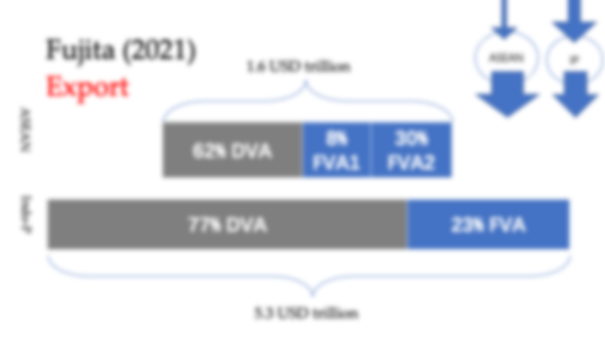
Fujita (2021)
ASEAN
IP
1.6 USD trillion
Export
ASEAN
62% DVA | 8% FVA1 | 30% FVA2
ASEAN uses inputs from non-ASEAN IP countries
Non-ASEAN IP countries do not use many inputs from ASEAN
77% DVA | 23% FVA
Indo-P
5.3 USD trillion

Slide 41
Fujita (2021)
GVC participation
Utilized by others
Upstream/supplier
FVA
Downstream/buyer
DVX
38% | 26%
=64%
ASEAN
22% | 34%
=56%
Indo-P

Slide 42
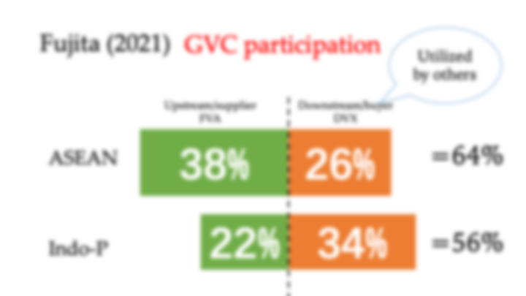
Fujita (2021)
GVC participation
Upstream/supplier
FVA
Downstream/buyer
DVX
38% | 26%
=64%
ASEAN
Exported products from non-ASEAN IP countries, tend to be utilized more by non-IP countries than by ASEAN exports.
22% | 34%
=56%
Indo-P

Slide 43
Fujita (2021)
GVC participation
Upstream/supplier
FVA
Downstream/buyer
DVX
38% | 26%
=64%
ASEAN
22% | 34%
=56%
Indo-P
Notes:
Comparing them as a whole won’t tell you anything about ASEAN centrality (internal factor)

Slide 44
Fujita (2021)
GVC participation
Upstream/supplier
FVA
Downstream/buyer
DVX
30% | 8% ASEAN | 8% ASEAN | 16%
=64%
ASEAN
18% | 4% | 6% | 28%
=56%
Indo-P
Notes:
Therefore, these are divided

Slide 45
Fujita (2021)
GVC participation
16% of ASEAN value chains are for ASEAN’s involvement as input provider or input receivers.
Upstream/supplier
FVA
Downstream/buyer
DVX
30% | 8% ASEAN | 8% ASEAN | 16%
=64%
ASEAN
10% of Indo-P value chains are for ASEAN’s involvement as input provider or input receivers.
18% | 4% | 6% | 28%
=56%
Indo-P
Notes:
Therefore, these are divided

Slide 46
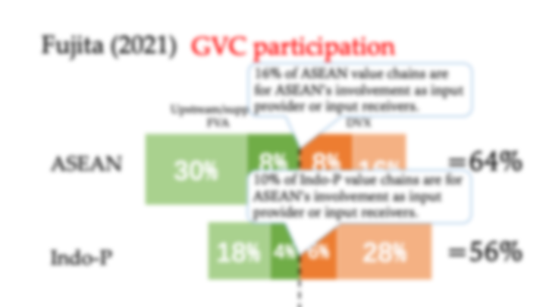
Fujita (2021)
GVC participation
16% of ASEAN value chains are for ASEAN’s involvement as input provider or input receivers.
Upstream/supplier
FVA
Downstream/buyer
DVX
30% | 8% ASEAN | 8% ASEAN | 16%
=64%
ASEAN
“In Indo-Pacific, ASEAN loses centrality to a certain extent or cannot retain the same level of strength in involving GVCs” (114)
10% of Indo-P value chains are for ASEAN’s involvement as input provider or input receivers.
18% | 4% | 6% | 28%
=56%
Indo-P
Notes:
Therefore, these are divided

Slide 47
Fujita (2021)
Policy Prescriptions
IP should create a better environment to boost GVC;
IP should enhance production capability & expand production network;
IP should institutionalize regional integration & utilizes existing programs;
IP should promote FDI;
IP should integrate African countries;
IP should attract ASEAN FDI.

Slide 48
Thanks
Presented by Zhang Wei
24 November 2022

