Slide 1
Arms Control: US Nuclear Diplomacy towards Iran
Presented by Zhang Wei

Slide 2
The Joint Comprehensive Plan of Action (JCPOA)
01
Major Events between the US and Iran
02
Synthesis and Analysis
03
References
04
Nuclear Diplomacy Legacy of the Obama Administration
From January 12, 2017 to October 26, 2020
Explaining Trump’s Iranian policy
Arms Control Association

Slide 3
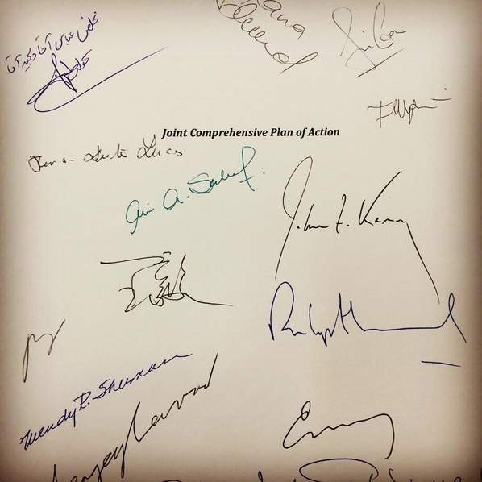

Policy Legacy
Iran Joint Comprehensive Plan of Action (JCPOA)
reached by Iran and the P5+1 on July 14, 2015
JCPOA Annex 1 - Nuclear Related Commitments
JCPOA Annex 2 - Sanctions Related Commitments
JCPOA Annex 2 - Attachments
JCPOA Annex 3 - Civil Nuclear Cooperation
JCPOA Annex 4 - Joint Commission
JCPOA Annex 5 - Implementation Plan

Slide 4
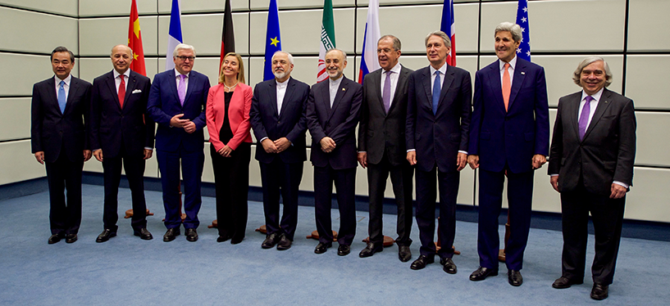
Policy Legacy: The Joint Comprehensive Plan of Action
Ernest Moniz, an American nuclear physicist and political figure. From May 2013 to January 2017, Moniz served as United States Secretary of Energy in the Obama Administration.

Slide 5
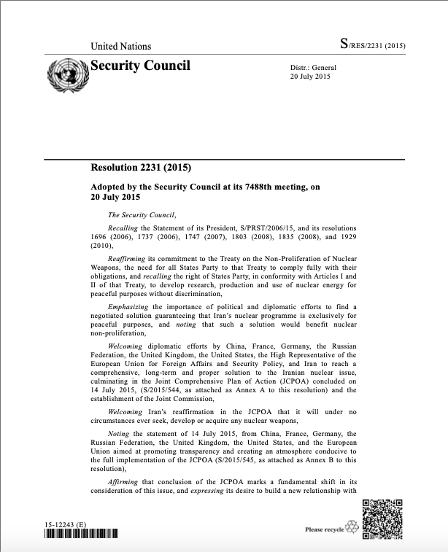
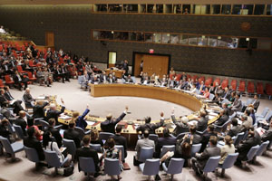
Policy Legacy: The Joint Comprehensive Plan of Action
The nuclear deal was endorsed by UN Security Council Resolution 2231, adopted on July 20, 2015.

Slide 6
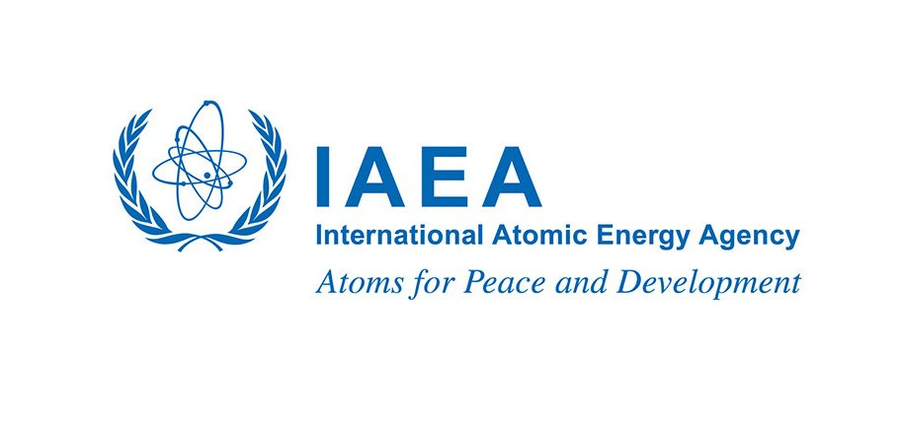
Policy Legacy: The Joint Comprehensive Plan of Action
Iran’s compliance with the nuclear-related provisions of the JCPOA will be verified by the International Atomic Energy Agency (IAEA) according to certain requirements set forth in the agreement.

Slide 7
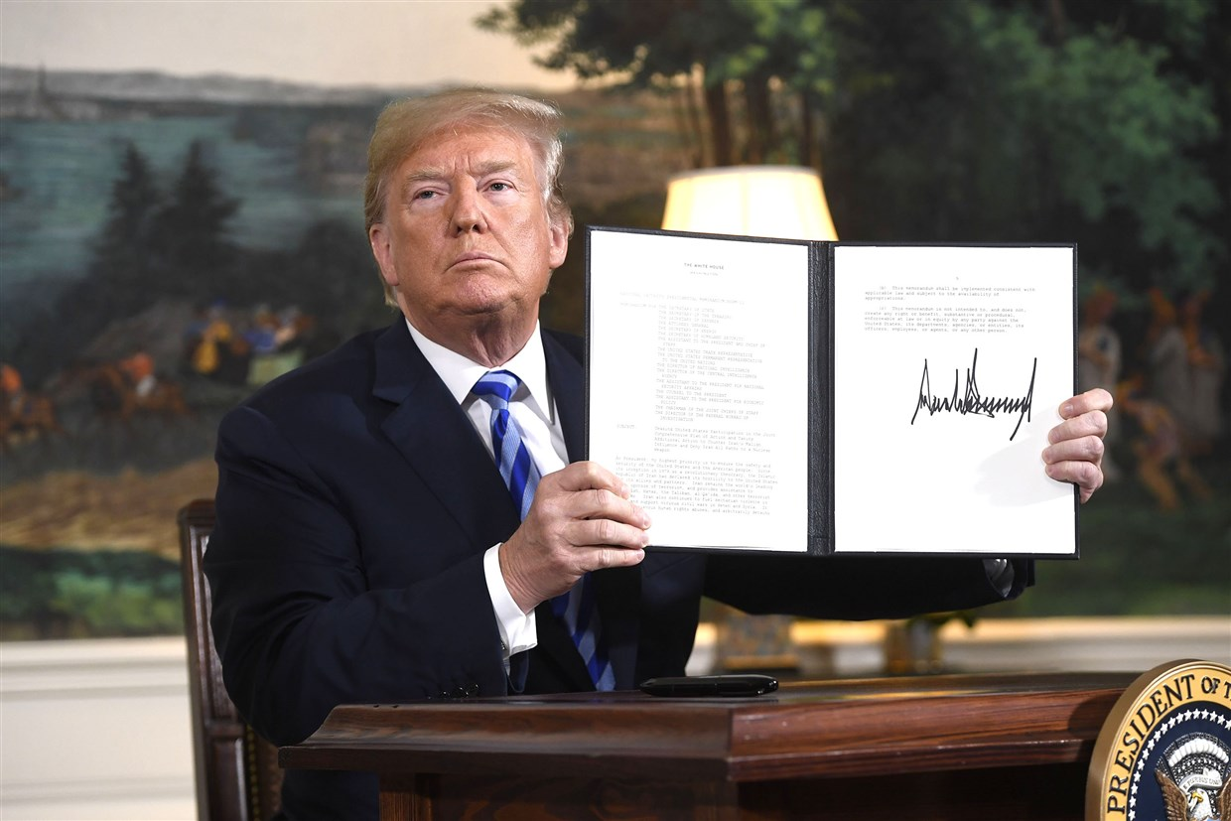
Policy Legacy: The Joint Comprehensive Plan of Action
On May 8, 2018, President Trump announced that the United States would withdraw from the JCPOA and reinstate U.S. nuclear sanctions on the Iranian regime.

Slide 8
Q:
Why Trump withdrew from the JCPOA?
Is he pro-arms control and nonproliferation at all?

Slide 9
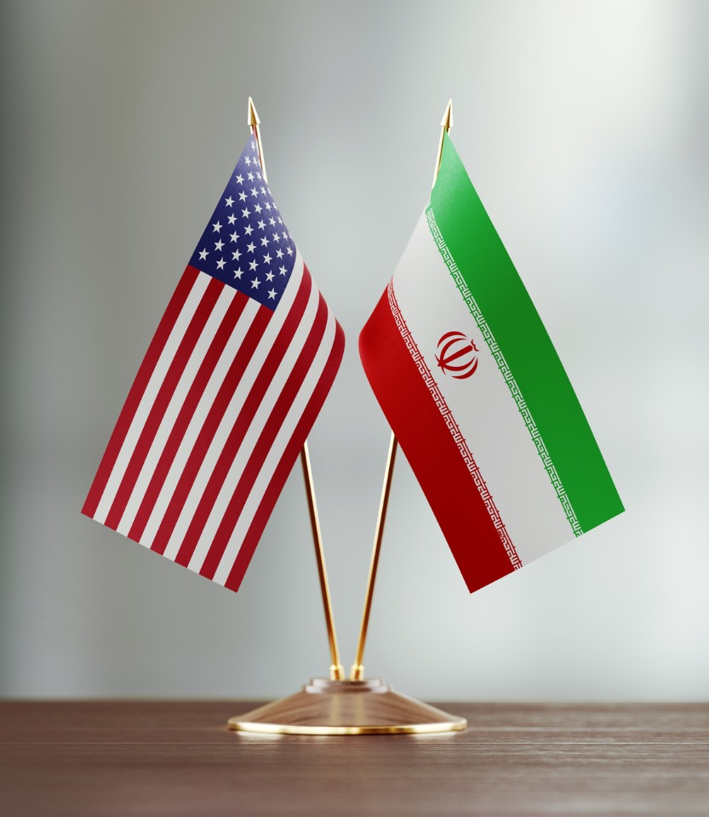
Timeline of Major Events

Slide 10
Iran test fires a medium-range ballistic missile. NSA Michael Flynn, on February 1, declared the United States had placed Iran “on notice.”
January 12, 2017
In confirmation hearing for the position of Secretary of Defense, Jim Mattis, “while I believe the JCPOA is an imperfect agreement, when America gives her word, we have to live up to it and work with our allies.”
January 28, 2017

Slide 11
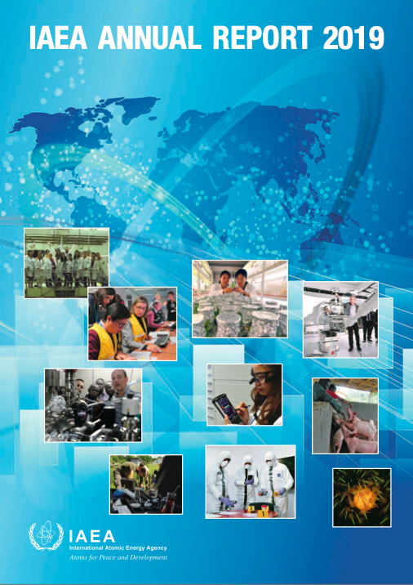
IAEA report
Verification – meaning the process of determining whether or not a nation is complying with the terms of an agreement, and involves a combination of release of such information by participants
Quarterly reports

Slide 12
IAEA Verifications
January 15, 2017: IAEA verifies that Tehran has taken certain steps to remove infrastructure and excess centrifuges from Fordow within the necessary timeframe required by the JCPOA (one year after Implementation Day) February 24, 2017: IAEA releases its first quarterly report on Iranian nuclear activity in 2017, reporting on the size of Iran’s stockpile of uranium enriched to 3.67 percent, 101.7(300) kilograms.

Slide 13
Iran test fires a medium-range ballistic missile. NSA Michael Flynn, on February 1, declared the United States had placed Iran “on notice.”
January 12, 2017
In confirmation hearing for the position of Secretary of Defense, Jim Mattis, “while I believe the JCPOA is an imperfect agreement, when America gives her word, we have to live up to it and work with our allies.”
January 28, 2017

Slide 14
Iranian President Hassan Rouhani is re-elected to a second term.
March 23, 2017
US introduced a new Iran sanctions bill, the Countering Iran’s Destabilizing Activities Act of 2017, targeting Iran’s ballistic missile program and support for terrorism.
May 19, 2017

Slide 15
Former Deputy Secretary of State Tony Blinken and six former Obama administration officials release an op-ed in Foreign Policy outlining their opposition to the Countering Iran’s Destabilizing Activities Act of 2017.
Secretary of State Rex Tillerson certifies to Congress that Iran is compliant in meeting its obligations under the JCPOA.
Ambassador Wendy Sherman, the lead U.S. negotiator for the JCPOA, states her opposition to the Countering Iran’s Destabilizing Activities Act of 2017, noting its potential to undermine the nuclear accord.
May 17, 2017: The U.S. renews sanctions waivers as required by its JCPOA obligations, marking the first time the Trump administration has waived sanctions and taken a proactive step to implement the deal.
Venus has a beautiful name and is the second planet from the Sun. It’s terribly hot
March 23, 2017
US introduced a new Iran sanctions bill, the Countering Iran’s Destabilizing Activities Act of 2017, targeting Iran’s ballistic missile program and support for terrorism.
02

Slide 16
Iranian President Hassan Rouhani is re-elected to a second term.
March 23, 2017
US introduced a new Iran sanctions bill, the Countering Iran’s Destabilizing Activities Act of 2017, targeting Iran’s ballistic missile program and support for terrorism.
May 19, 2017

Slide 17
IAEA Verifications
January 15, 2017: IAEA verifies that Tehran has taken certain steps to remove infrastructure and excess centrifuges February 24, 2017: 1st quarterly report in 2017 on the size of Iran’s stockpile of uranium enriched to 3.67 percent = 101.7 kg (Max300) . June 2, 2017: The IAEA releases its second quarterly report in 2017 on Iran’s implementation of the JCPOA, reporting that Iran is meeting its obligations under the nuclear deal.

Slide 18
*Trump encouraged foreign leaders not to do business with Iran, and reluctantly certified Iran's compliance with the JCPOA
*The House s passes the Countering Adversarial Nations Through Sanctions Act, which would impose new sanctions on Iran.
June 15, 2017
Countering Iran’s Destabilizing Activities Act of 2017 passes the Senate. Iran assert that the bill contradicts the spirit of the deal.
July 2017

Slide 19
*Trump encouraged foreign leaders not to do business with Iran, and reluctantly certified Iran's compliance with the JCPOA
*The House s passes the Countering Adversarial Nations Through Sanctions Act, which would impose new sanctions on Iran.
June 20, 2017: The UN Secretary General releases the biannual report on UN Security Council Resolution 2231, affirming that Iran is complying with the JCPOA but raising concerns about Iran’s ballistic missile activity.
June 15, 2017
Countering Iran’s Destabilizing Activities Act of 2017 passes the Senate. Iran assert that the bill contradicts the spirit of the deal.
July 2017

Slide 20
*Trump encouraged foreign leaders not to do business with Iran, and reluctantly certified Iran's compliance with the JCPOA
*The House s passes the Countering Adversarial Nations Through Sanctions Act, which would impose new sanctions on Iran.
June 15, 2017
Countering Iran’s Destabilizing Activities Act of 2017 passes the Senate. Iran assert that the bill contradicts the spirit of the deal.
July 2017

Slide 21
IAEA Verifications
1st quarterly report: Iran’s stockpile of uranium enriched to 3.67 percent = 101.7 kilograms (Max300) 2nd quarterly report: Iran is meeting its obligations under the nuclear deal. August 31, 2017: In its third quarterly report, the IAEA finds that 1. Iran’s stock of low-enriched uranium was 88.4 kg, well below a 202.8-kg limit, 2. Iran’s level of enrichment did not exceed a 3.67 percent cap 3. Iran’s stock of heavy water, stood at 111 tons, below the 130 ton limit.

Slide 22
Trump encourages Congress to enact legislation against the JCPOA's "sunset clauses" Trump says if his concerns about the deal are not resolved he will terminate the agreement.
September 22, 2017
Iran parades its new medium-range ballistic missile tested in January, the Khoramshahr, with a range of about 2,000 km, in a military parade.
October 13, 2017

Slide 23
IAEA Verifications
1st quarterly report: Iran’s stockpile of uranium enriched to 3.67 percent = 101.7 kilograms (Max300) 2nd quarterly report: Iran is meeting its obligations under the nuclear deal. 3rd quarterly report: Iran’s stock of low-enriched uranium = 88.4 kg, (Max202.8); level of enrichment < a 3.67 percent cap; stock of heavy water = 111 tons (Max130) November 13, 2017: The IAEA issues its fourth quarterly report for 2017 on Iran's implementation of the JCPOA. IAEA Director General Yukiya Amano tells the agency's Board of Governors that the nuclear-related commitments are being implemented and that IAEA inspectors have had access to all locations they have needed to visit.

Slide 24
UN Biannual Report
1st biannual report: Iran is complying with the JCPOA; Iran’s ballistic missile activity. December 15, 2017: UN Secretary General Antonio Guterres issues the biannual report on the implementation of Resolution 2231. The report notes that the nuclear deal is being implemented but finds that Iran has violated the arms embargo provisions of Resolution 2231.

Slide 25
Trump says his administration is also engaging with European allies on a supplemental agreement of unlimited duration that would impose sanctions if Iran tests long-range missiles, thwarts inspections, or makes progress toward a nuclear weapon.
January 12, 2018
Trump would not re-issue the waivers again and would withdraw from the deal unless Congress passes legislation addressing “flaws in the agreement”.

Slide 26
IAEA Verifications
1st quarterly report: Iran’s stockpile of uranium enriched to 3.67 percent = 101.7 kilograms (Max300) 2nd quarterly report: Iran is meeting its obligations under the nuclear deal. 3rd quarterly report: Iran’s stock of low-enriched uranium = 88.4 kg, (Max202.8); level of enrichment < a 3.67 percent cap; stock of heavy water = 111 tons (Max130) 4th quarterly report: the nuclear-related commitments are being implemented February 22, 2018: The IAEA issues its first quarterly report for 2018 reporting that, the quantity of Iran’s uranium enriched up to 3.67% U-235 was 109.5 kg.

Slide 27
President Trump announces that he is withdrawing the United States from the JCPOA and signs a presidential memorandum to institute the "highest level" of economic sanctions on Iran.
March 15, 2018
State Department Director of Policy Planning Brian Hook meets with representatives from the E3 to continue discussions Trump's demand for a 'supplemental' agreement
May 2018

Slide 28
Mike Pompeo lists 12 demands for Iran, including stopping enrichment, ending the proliferation of ballistic missiles and the development of nuclear-capable missile systems and allowing the International Atomic Energy Agency to have "unqualified access to all sites throughout the entire country.
May 17, 2018
The European Commission announces that it will pursue a "blocking statute" to ban European companies and courts from complying with U.S. sanctions against Iran.
May 21, 2018

Slide 29
IAEA Verifications
1st quarterly report: Iran’s stockpile of uranium enriched to 3.67 percent = 101.7 kilograms (Max300) 2nd quarterly report: Iran is meeting its obligations under the nuclear deal. 3rd quarterly report: Iran’s stock of low-enriched uranium = 88.4 kg, (Max202.8); level of enrichment < a 3.67 percent cap; stock of heavy water = 111 tons (Max130) 4th quarterly report: the nuclear-related commitments are being implemented 1st quarterly report: the quantity of Iran’s uranium enriched up to 3.67% = 109.5 kg. May 24, 2018: The International Atomic Energy Agency (IAEA) reports that Iran is implementing all nuclear related commitments under the JCPOA in a quarterly report. Iran’s stockpile of uranium enriched to 3.67 percent uranium-235 is 123.9 kg, below the 300 kg limit set by the accord, according to the report.

Slide 30
EU efforts to do legitimate business with Iran were warned by the US, "particularly troubling if you sought to undermine American statutes" and doing so "could well prompt Congressional action."
June 6, 2018
Iran opens a new facility for centrifuge production, an act which does not violate the JCPOA.
July 2018

Slide 31
Pompeo announces the creation of the Iran Action Group, responsible for "directing, reviewing, and coordinating all aspects" of the State Department's Iran strategy and led by Brian Hook with the title Special Representative for Iran.
September 25, 2018
U.S. President Donald Trump speaks at the UN General Assembly in New York. He said that many countries in the Middle East supported his decision to withdraw from the JCPOA and reimpose nuclear-related sanctions on Iran
August 16, 2018

Slide 32
IAEA Verifications
1st quarterly report: Iran’s stockpile of uranium enriched to 3.67 percent = 101.7 kilograms (Max300) 2nd quarterly report: Iran is meeting its obligations under the nuclear deal. 3rd quarterly report: Iran’s stock of low-enriched uranium = 88.4 kg, (Max202.8); level of enrichment < a 3.67 percent cap; stock of heavy water = 111 tons (Max130) 4th quarterly report: the nuclear-related commitments are being implemented 1st quarterly report: the quantity of Iran’s uranium enriched up to 3.67% = 109.5 kg. 2nd reports: Iran’s stockpile of uranium enriched to 3.67 percent uranium-235 is 123.9 kg September 12, 2018: The International Atomic Energy Agency (IAEA) reports that Iran is implementing all nuclear-related commitments under the JCPOA in a quarterly report. Iran’s stockpile of uranium enriched to 3.67 percent uranium-235 is 139.4 kg, below the 300 kg of UF6 limit set by the accord, according to the report. Iran's stock of heavy water is 122.9 metric tons, below the 130 metric ton limit.

Slide 33
2019-present
Iran First Breach – May 8, 2019 Second Breach – July 7, 2019 Third Breach – September 5, 2019. Fourth Breach – November 5, 2019 Fifth Breach – January 5, 2020

Slide 34
Analysis & Conclusion

Slide 35
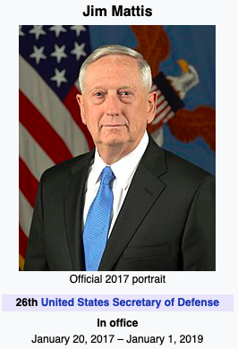
the 26th US secretary of defense from January 2017 through January 2019. Mattis was nominated as secretary of defense by president-elect Donald Trump. Mattis occasionally voiced his disagreement with certain Trump administration policies such as the withdrawal from the Iran nuclear deal: "We are just going to have to recognize that we have an imperfect arms control agreement. Second, that what we achieved is a nuclear pause, not a nuclear halt". Mattis argues that inspections may fail to prevent Iran from seeking to develop nuclear weapons, but that "[i]f nothing else at least we will have better-targeting data if it comes to a fight in the future."[11] Additionally, he criticized Obama for being "naive" about Iranian intentions and Congress for being "pretty much absent" on the nuclear deal.[160]

Slide 36
Analysis
Additional agreement
Sanctions restricting Iran's purchase of U.S. dollars, trade in gold, precious metals, aluminum, steel, coal, software, and transactions related to sovereign debt and the automotive sector
Second round of sanctions targeting Iran's banking, oil, shipping and ship-building sectors, come back into effect.
Urging the EU to follow the sanctions as well
Forge alliance with other Middle East countries to contain Iran

Slide 37
THANK YOU

Slide 38
RESOURCES
JCPOA document <https://2009-2017.state.gov/e/eb/tfs/spi/iran/jcpoa//index.htm>
UNSC Resolution 2231 <https://www.un.org/securitycouncil/content/2231/background>
Arms Control Association <https://www.armscontrol.org>

