Slide 1





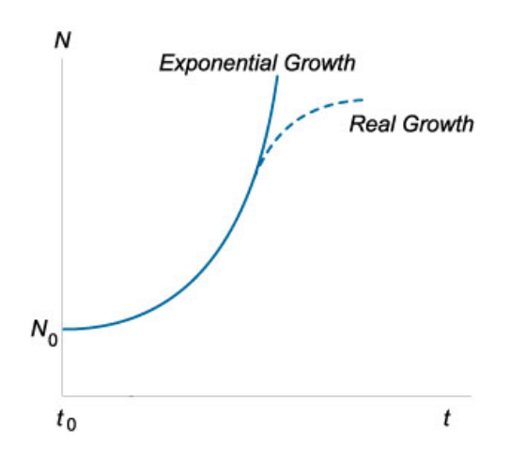
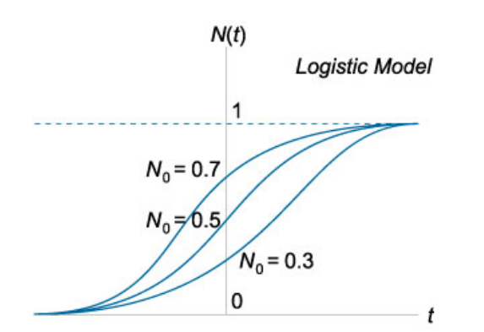
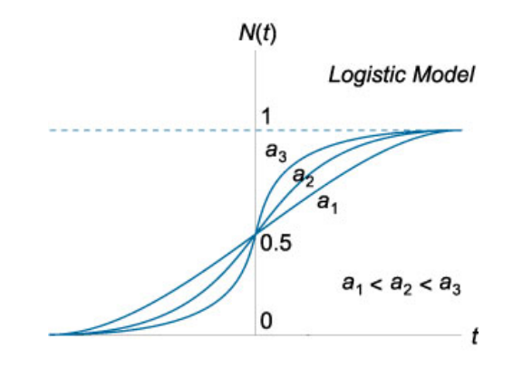
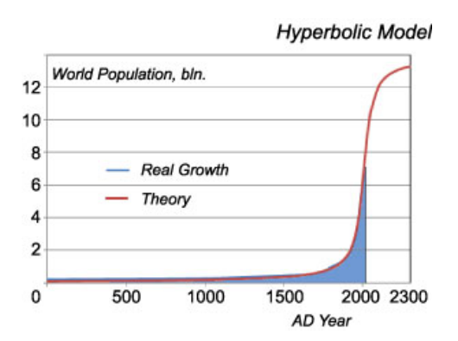


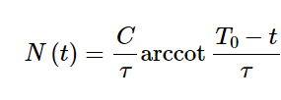
K. J. Somaiya College of Engineering, Mumbai – 400 077
(A Constituent College of Somaiya Vidyavihar University) Dept. of Science and Humanities
F.Y. B. Tech. Semester –II (2021-22)
Applied Mathematics-II
IA-II
Differential Equations
for
Population Growth
An equation which contains one or more terms and their derivatives is called a differential Equation .
A dynamic process that can be effectively described using differential equations
Logistic Model
Malthusian Growth Model
Equation :- dN/dt = aN(1- N/M) {M == Maximum size of Population}
Equation :- dN/dt = aN
{Here a == growth rate }
Here aN is responsible for growth of population and aN/M limits this growth due to lack of available resources .
Solution of equation :- N(t) = N0 e^{at}
{Here N0 is initial population}
Name :- Meet Gala Batch :- A3
Roll No. 16010121051
Equation:-
Solution:-
Function describes explosive growth.Model covers the demographic transition phase when the population growth reaches saturation.

Slide 2


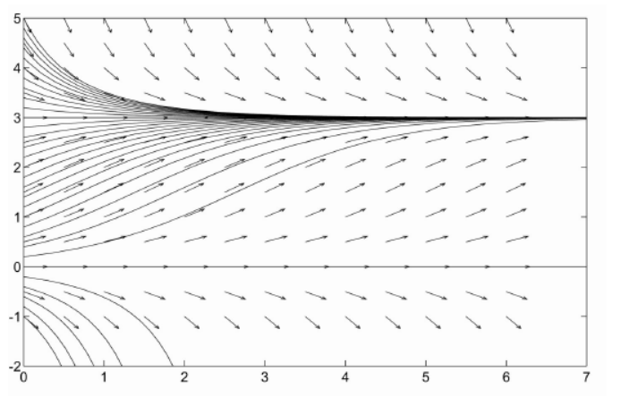


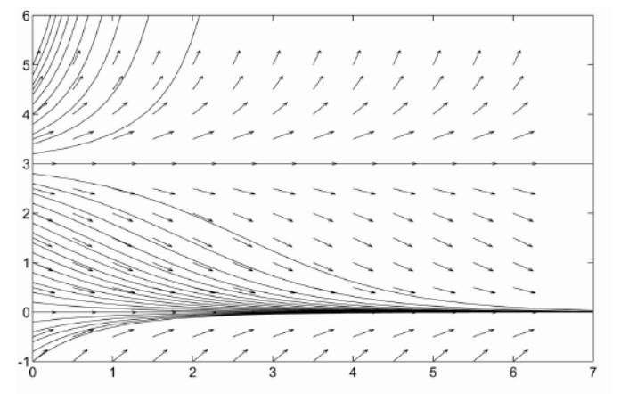
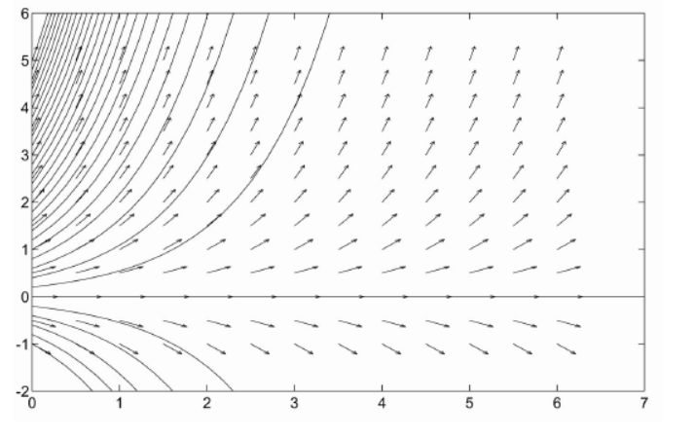


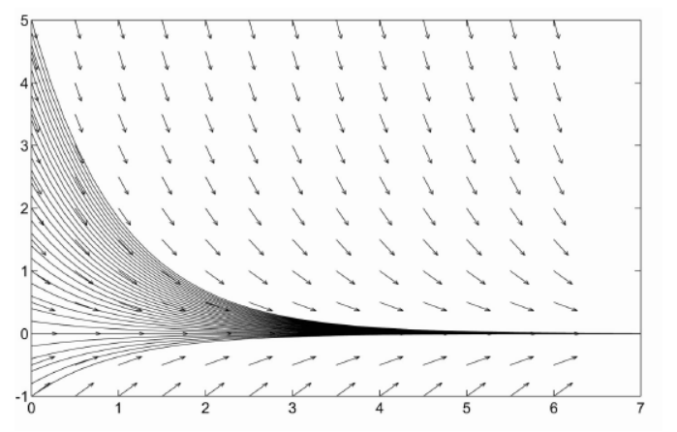

K. J. Somaiya College of Engineering, Mumbai – 400 077
(A Constituent College of Somaiya Vidyavihar University) Dept. of Science and Humanities
F.Y. B. Tech. Semester –II (2021-22)
Applied Mathematics-II
IA-II
Exponential Growth :
The population growth which continues indefinetly.
Eg . P = bacteria present now
rp = new bacteria grow per hour {r is constant of probability
in this example the bacteria growth increases exponentially.
Logistic Growth:
In addition to exponential growth here rate of death is also taken into consideration.
Exponential growth with Threshold:
The equilibrium points for this equation are p = 0 and p= c/r where c/r is the threshold.
Also p = 0 is stable and p = c/r is unstable.
Exponential Decay:
Reference links
1.https://onlinehw.math.ksu.edu/math340book/chap1/pop.php
2. https://math24.net/population-growth.html
Name :- Meet Gala Batch :- A3
Roll No. 16010121051

