Slide 1



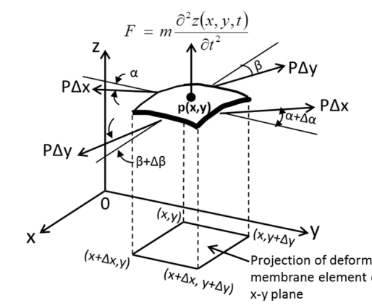

Use of partial differential operators in field of engineering
K. J. Somaiya College of Engineering, Mumbai – 400 077
(A Constituent College of Somaiya Vidyavihar University) Dept. of Science and Humanities
F.Y. B. Tech. Semester –I (2021-22)
Applied Mathematics-I
IA-II
NAME : Meet Gala
Roll No. : 16010121051
DIV: A BATCH: A3
General Meaning
Partial derivative is the rate of change of a function with respect to another function involving more than one variable
Equation form
Partial Derivatives can be used for
Some Known Differential Equations
Cooling Law :- dT/dt = α (T – Tm) Or T(t) = Tm + c2e αt
Population Growth and Decay :- dN(t)/dt = k N(t)
Carbon Dating Equation :- dN/dt = – λN
Drug Distribution in Human Body :- y(t) = yp e –kt
Transverse Vibrations of Cable Structures
Differential Equation for Plate Vibration
Transverse vibrations of membranes
Steady State Heat Conduction Analysis
Transient Heat Conduction Analysis
Heat Conduction In Solids
Figure Shows a free-body diagram of forces in an element of vibrating membrane at time

Slide 2


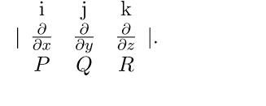
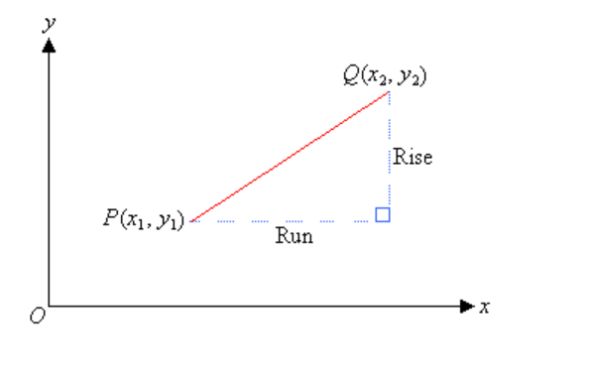
K. J. Somaiya College of Engineering, Mumbai – 400 077
(A Constituent College of Somaiya Vidyavihar University) Dept. of Science and Humanities
F.Y. B. Tech. Semester –I (2021-22)
Applied Mathematics-I
IA-II
NAME : Meet Gala
Roll No. : 16010121051
DIV: A BATCH: A3
DIVERGENCE
Divergence is an operation on a vector field that tells us how the field behaves toward or away from a point.
A formula for the divergence of a vector field can immediately be written down in Cartesian coordinates by constructing a hypothetical infinitesimal cubical box oriented along the coordinate axes around an infinitesimal region of space. There are six sides to this box, and the net "content" leaving the box is therefore simply the sum of differences in the values of the vector field along the three sets of parallel sides of the box
CURL
The second operation on a vector field that we examine is the curl, which measures the extent of rotation of the field about a point.
The definition of curl can be difficult to remember. To help with remembering, we use the notation to stand for a “determinant” that gives the curl formula:
The determinant of matrix = curl F
Gradient of a Straight Line
Gradient = dy/dx
=( y2 –y1)/(x2-X1 x1)
1)https://www.sjsu.edu/me/docs/hsu-Chapter%209%20Application%20of%20PDEs_04-25-19.pdf
2)https://www.ijaiem.org/Volume6Issue7/IJAIEM-2017-07-13-30.pdf
3)https://mathworld.wolfram.com/Divergence.html
4)https://opentextbc.ca/calculusv3openstax/chapter/divergence-and-curl/
REFERENCES:

