Slide 1

Data Structurers IA2
SUDOKU SOLVER
Meet Gala 16010121051 Isha Joshi 16010121075

Slide 2

AGENDA
1.What are Data structures?
2.Problem Statement 3.Apropriate of Alogrithm used. 4.Implementation Details 5.Test Cases 6.Conclusion/Result

Slide 3

Data Structures……..
--->>It provides a way of organizing, managing, and storing data efficiently.
--->>It also provides efficiency, reusability and abstraction.
--->>With the help of ds, data items can be traversed easily.
--->> It plays an important role in enhancing the performance of a program .

Slide 4
PROBLEM STATEMENT
Solving Sudoku has been a challenging problem among the users. The purpose has been to develop more effective algorithm in order to reduce the computing time and utilize lower memory space. This project develops an algorithm for solving Sudoku puzzle by using a method, called BackTracking algorithm.
We have tried to implement the backtracking algorithm that simulate how user would solve the puzzle by using some simple strategies that can be employed to solve the majority of Sudoku.

Slide 5
BackTracking
Backtracking can be defined as a general algorithmic technique that considers searching every possible combination in order to solve a computational problem.
It is used for solving problems recursively by trying to build a solution incrementally, one piece at a time, removing those solutions that fail to satisfy the constraints of the problem at any point in time

Slide 6
Implementation
Driver Code
Functions

Slide 7
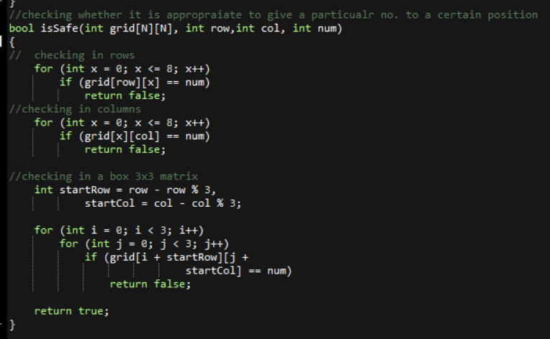
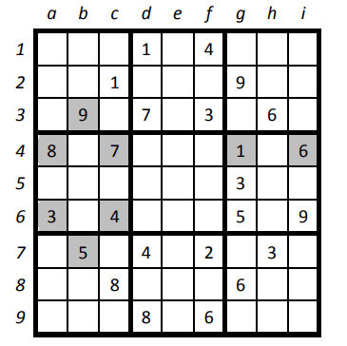



Slide 8

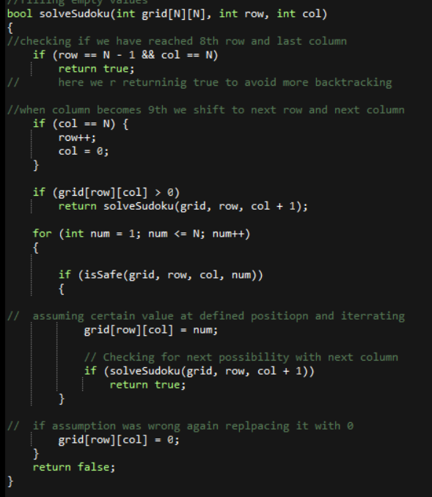



Slide 9
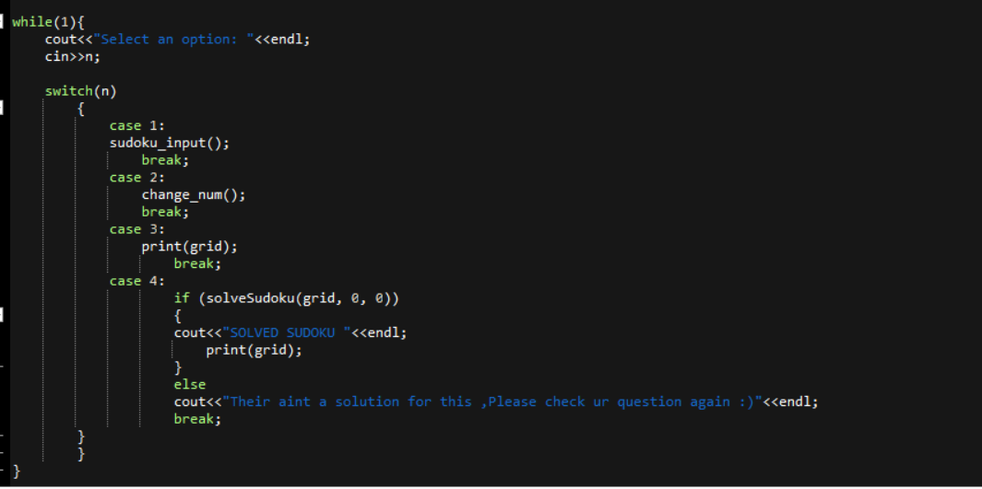
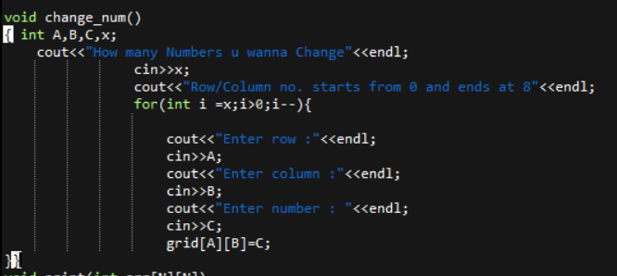
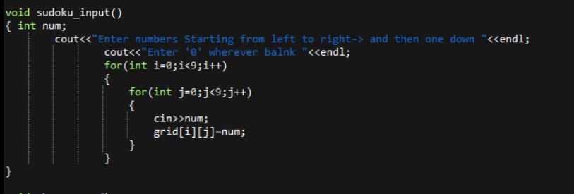
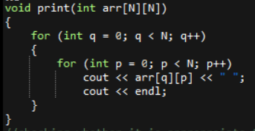
Driver Code
Change function
Print Function
Input function

Slide 10
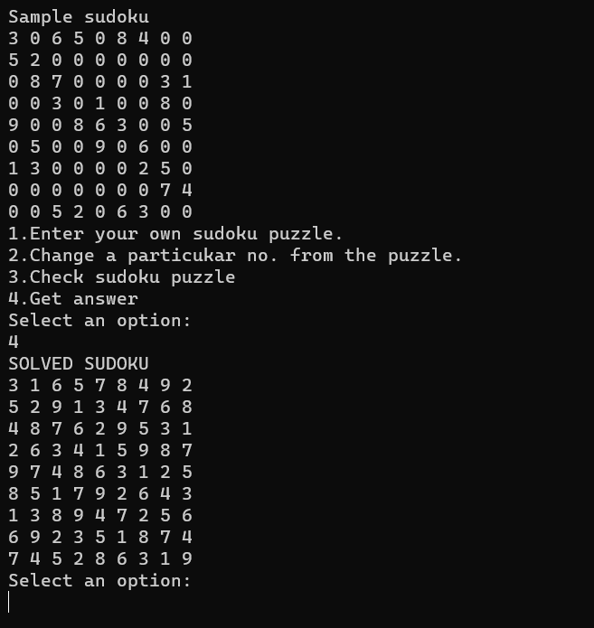
TEST CASES
1.Getting answer of sample sudoku defined by the coder.

Slide 11
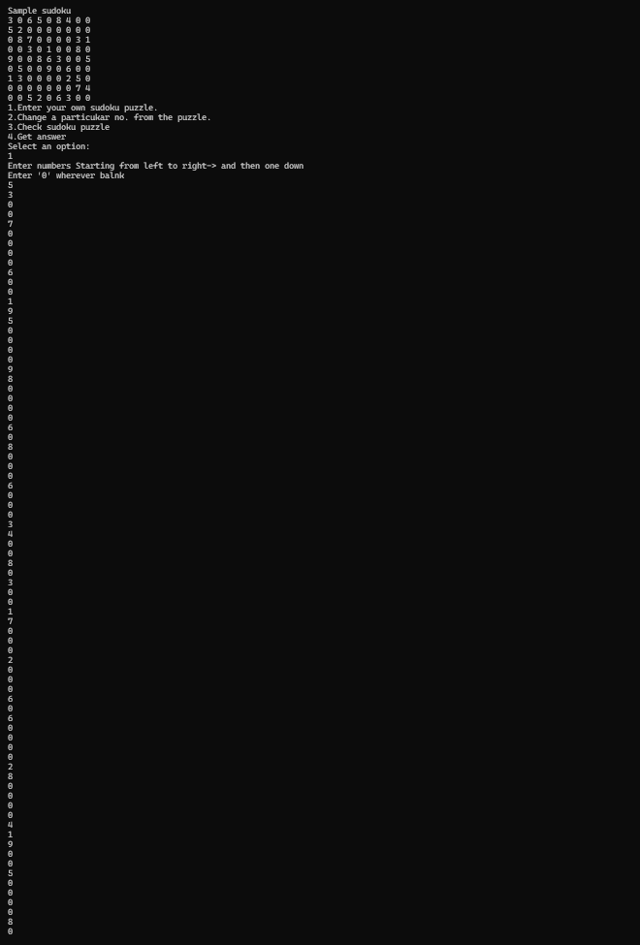
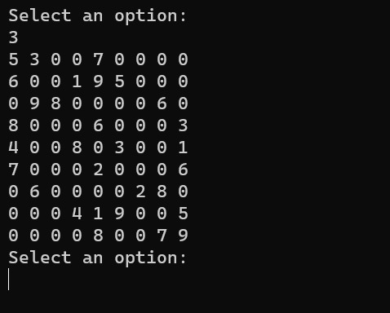
2.Enter your own sudoku puzzle.
3.View your entered sudoku puzzle.

Slide 12
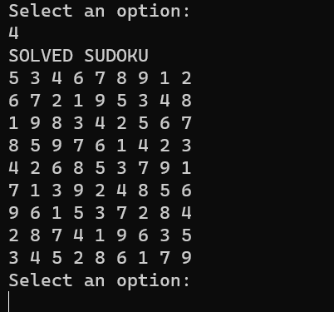
4.Solved ans.

Slide 13
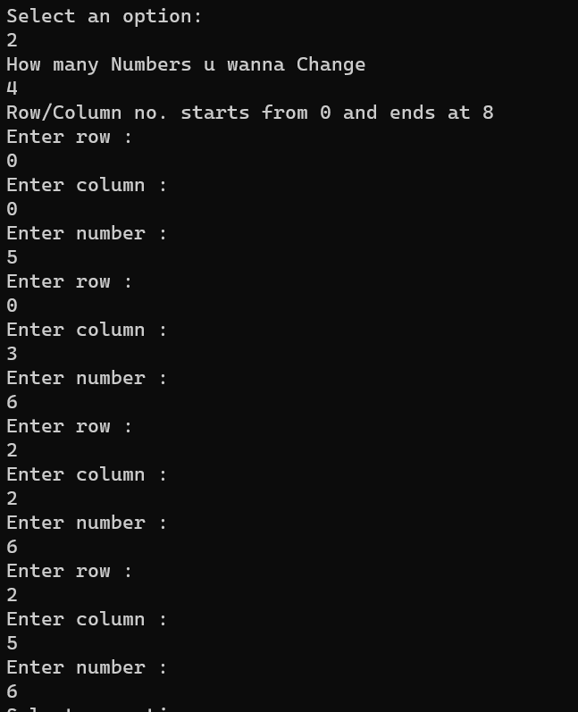
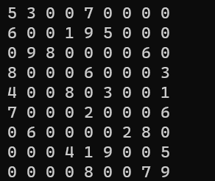
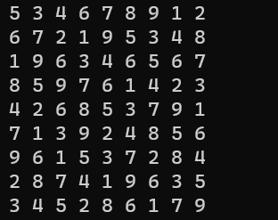
5.Manual changing certain numbers
BEFORE
AFTER

Slide 14
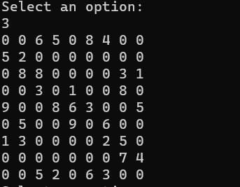
6.Wrong input

Slide 15
https://github.com/meetg21/Sudoku.git

