Slide 1
FINAL GROUP PRESENTATION · APRIL 2026
CureMatch.
Matching clinical trials with large language models.
Meet Gajjar · Aashish Patel · Daksh Gupta
Three engineers. Three language models. One matching platform.
CureMatch
01 / 19
Notes:
OPENING — any presenter, 20 seconds.
"Good morning. We're CureMatch — Meet, Aashish, and Daksh. Our project is
called Matching Clinical Trials With Large Language Models. Over the next
twelve minutes we'll show you the problem, the system we built, and the
three language models we each built inside it."
Pace: warm, confident. Don't rush. Point at the deck.

Slide 2
THE PROBLEM
80% of trials miss
their enrollment deadlines.
Meanwhile 300,000 patients a year look for a trial and give up.
Every trial publishes its eligibility as a wall of medical prose.
65,081 actively recruiting studies. No patient reads 65,081 trials.
A TYPICAL ELIGIBILITY CRITERION
ECOG 0–1 · eGFR ≥ 30 · no prior anti-PD-1 · no active autoimmune disease · HbA1c < 10.5%
CureMatch
02 / 19
Notes:
THE PROBLEM — 45 seconds.
Key points to say:
• "80% of clinical trials miss their enrollment deadlines — that's from
industry research on trial dropout."
• "Meanwhile 300,000 patients a year look for a trial and give up because
the eligibility is a wall of medical prose."
• "65,081 trials are actively recruiting right now. That's what we built
CureMatch against. No patient reads 65k trials."
• Point at the bottom example: "This is one criterion from one trial.
ECOG, eGFR, no prior anti-PD-1, HbA1c — it's written for clinicians."
Transition: "So we built a system to read all 65 thousand for you."

Slide 3
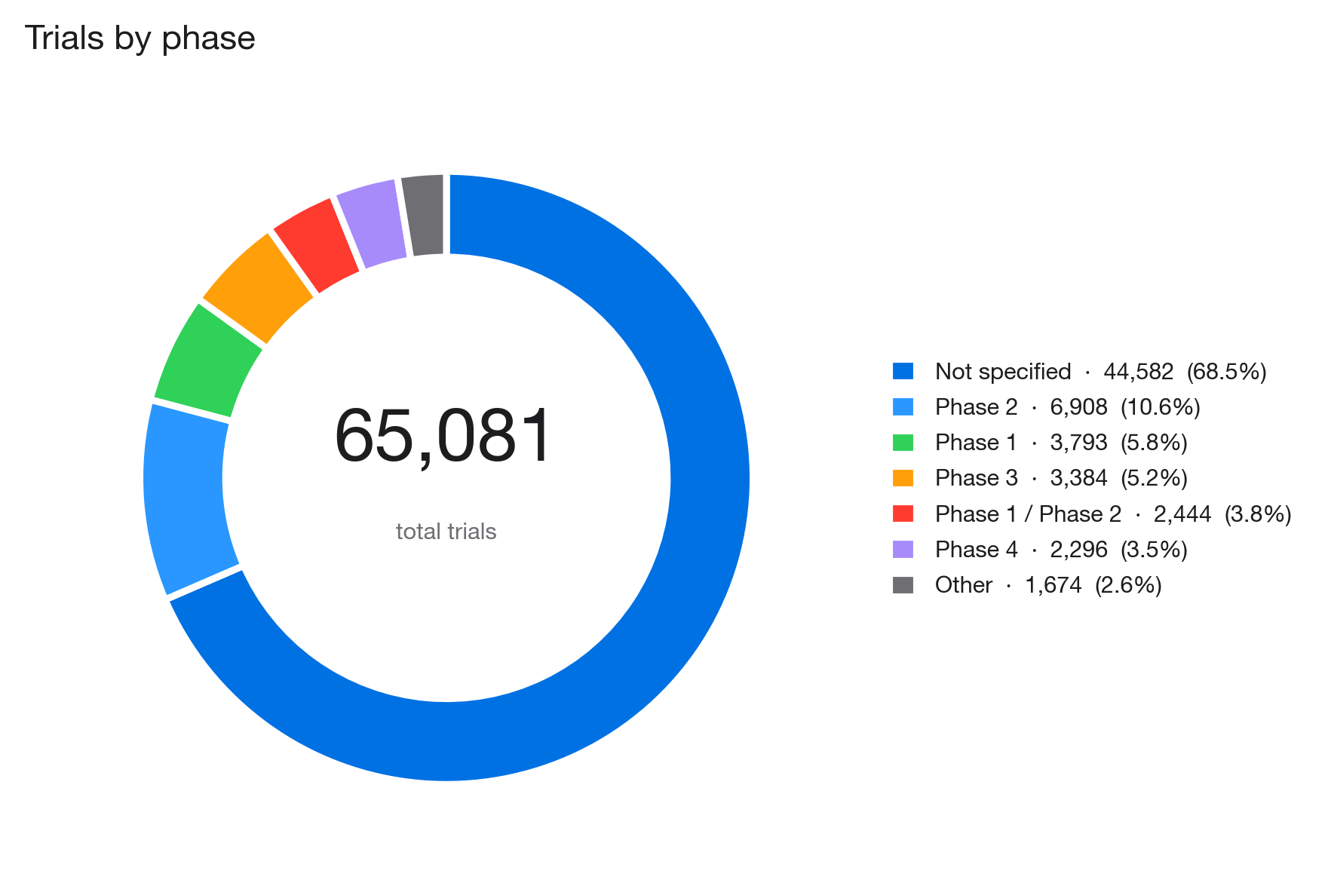
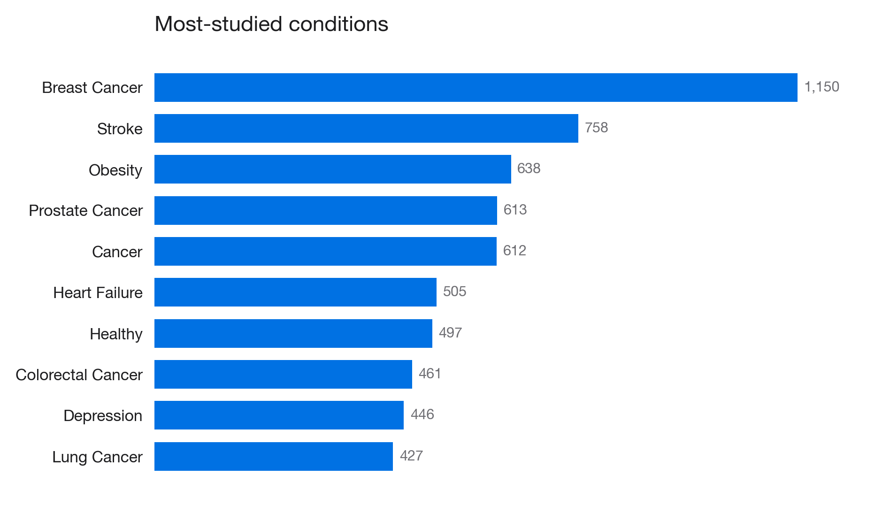
THE CORPUS
65,081 trials. All real.
Ingested live from ClinicalTrials.gov — the public-domain registry from the U.S. NIH.
Left: phase distribution across the corpus · Right: the ten most-studied conditions by MeSH tag.
CureMatch
03 / 19
Notes:
THE CORPUS — 50 seconds.
Key points:
• "Everything you're about to see runs on real data — 65,081 trials
ingested from ClinicalTrials.gov, the U.S. public trial registry."
• Donut: "Two-thirds of trials don't declare a phase — that's Phase Zero
research and observational studies. Phase 2 is the largest declared
phase at ten percent."
• Bar chart: "Most-studied conditions — Breast Cancer tops the list at
1,150 trials, followed by Stroke, Obesity, Prostate Cancer. Oncology
dominates the actively-recruiting corpus."
• "These numbers are live — the dashboard in our app queries them from
SQLite on every page load."
Transition to slide 4: "Here's what we built on top of this."

Slide 4
WHAT WE BUILT
Read every trial, for you.
One profile. Every trial screened. Ranked results. Plain-English explanations.
01
02
03
Profile
Match
Explain
Age · conditions · medications · labs · location. Three minutes. Browser-only.
Scored against every actively-recruiting trial. Rule-based, deterministic, reproducible.
Every criterion shown. Every exclusion named. Narrative from an LLM.
CureMatch
04 / 19
Notes:
WHAT WE BUILT — 40 seconds.
Read top-down, left to right:
• "CureMatch is three steps for the patient."
• "Step one — enter your profile. Age, conditions, medications, lab
values, location. Takes three minutes. Stays in your browser; nothing
uploaded."
• "Step two — match. Every profile is scored against every trial using
a rule-based engine. Deterministic — same profile always returns the
same ranked trials."
• "Step three — explain. For every match, we show the full criterion
breakdown and an LLM writes a plain-English narrative."
Transition: "Here's the architecture that makes this tick."

Slide 5
THE ARCHITECTURE
LLMs read. Rules decide. Humans verify.
Three layers, each doing the one thing it's best at.
LLMs READ
RULES DECIDE
HUMANS VERIFY
Eligibility prose → structured fields.
Patient questions → grounded answers.
Verdicts → plain-English narrative.
Age · gender · condition · medications · labs · proximity
→ weighted composite score.
Same input, same output, every time.
Trial investigators make the final call.
Our output is ranked candidates — never a diagnosis.
Every criterion shown by name.
CureMatch
05 / 19
Notes:
ARCHITECTURE — 45 seconds. This is THE core design idea.
Say it exactly:
• "Our entire design philosophy fits on one slide. LLMs read. Rules
decide. Humans verify."
• Blue column: "LLMs do three language jobs — reading prose into
structured fields, answering patient questions, narrating verdicts."
• Black column: "Rules do one job — scoring. Deterministic, auditable,
reproducible. Same input always gives the same output."
• Amber column: "A human always verifies. Our output is ranked
candidates — it's never a diagnosis. Trial investigators make the
final call."
• Close the slide: "Medical matching has to be auditable. You can't
defend an exclusion by saying 'the model felt so.'"
Transition: "Here's the actual system diagram."

Slide 6
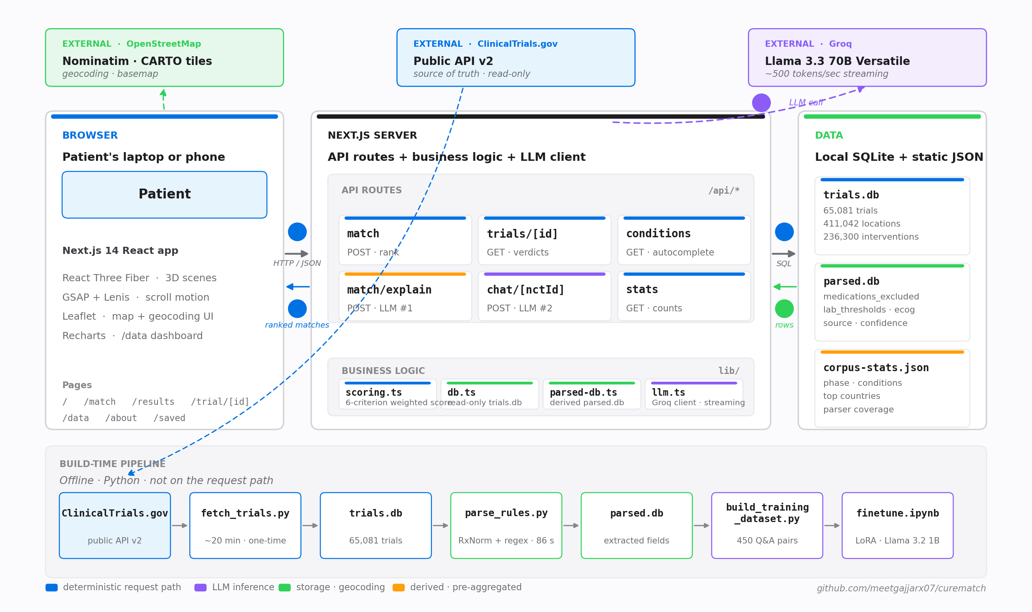
ARCHITECTURE · AT A GLANCE
Three containers. One request path.
Browser calls the server, server reads SQLite, server streams LLM responses back.
CureMatch
06 / 19
Notes:
ARCHITECTURE DIAGRAM — 45 seconds.
Walk through the numbered flow:
• "Three primary containers — browser, Next.js server, data layer."
• "Arrow 1 — patient profile leaves the browser as JSON to the server."
• "Arrow 2 — server asks SQLite for candidate trials using SQL."
• "Arrow 3 — rows come back. Scoring engine runs on them."
• "Arrow 4 — ranked matches return to the browser as JSON."
• "Arrow 5 is the dashed purple arrow — only two routes call the LLM:
match/explain and chat. The rest of the system never touches Groq."
• External services — OpenStreetMap for geocoding, Groq for LLM —
are dashed because they're cross-network, not local.
• Bottom band — build-time pipelines. These run once when we ingest
and parse the corpus. Never on the request path.
Transition: "So here's who built each piece."

Slide 7
THE TEAM
Three engineers. Three LLMs.
Each of us built a distinct language model into the product.
LLM #1
LLM #2 + Frontend
LLM #3
Aashish Patel
Meet Gajjar
Daksh Gupta
The Match Explainer
Chat Agent · LoRA fine-tune
The Eligibility Parser
Reads deterministic verdicts; writes a 2-sentence patient-facing narrative. Refusal-tuned.
RAG chat grounded in each trial's text. Fine-tuned Llama 3.2 1B. The entire Next.js app.
Reads compound criteria, negation, paraphrase that regex can't. Feeds the same scorer.
CureMatch
07 / 19
Notes:
THE TEAM — 30 seconds.
Say:
• "The project title says language models — plural. There are three of
them. Each of us built one."
• "Aashish built the Match Explainer — the LLM that writes patient-
facing narratives."
• "I, Meet, built the Chat Agent and the LoRA fine-tune, plus the whole
Next.js frontend — the 3D scenes, the globe, the dashboard."
• "Daksh built the LLM Eligibility Parser — the one that reads what
regex can't."
Transition: "Aashish — take it away."

Slide 8
AASHISH PATEL · LLM #1
The Match Explainer.
A patient clicks "Explain this match in plain English." The LLM narrates — grounded in the verdicts.
Verdicts
Serialize
LLM
Narrative
›
›
›
deterministic
scoring output
compact criteria
string
Groq Llama 3.3 70B
streaming
≤ 80 words
patient-facing
SAMPLE OUTPUT
“You match on age, condition, and HbA1c — the trial accepts patients 40–75 with type 2 diabetes and HbA1c in range, which you meet. Your Warfarin use is on the trial's exclusion list; the protocol requires no current anticoagulant therapy.”
CureMatch
08 / 19
Notes:
AASHISH — THE MATCH EXPLAINER · 50 seconds.
Cover these beats:
• "The Match Explainer runs every time a patient clicks 'Explain this
match in plain English.'"
• Walk through the pipeline boxes left to right: "First, the scoring
engine produces deterministic verdicts per criterion. Second, I
serialize them into a compact string — each line is 'criterion,
reader value, required value, verdict'. Third, that goes to Groq
running Llama 3.3 70B. Fourth, the model streams back a two- to
three-sentence narrative."
• Point at the sample output: "This is the actual output for a diabetes
patient with Warfarin. It leads with what matches — age, condition,
HbA1c — then names the exclusion specifically — 'your Warfarin use is
on the exclusion list.'"
• Key point: "The LLM never changes the match. It only describes it.
That's how we keep determinism."
Transition: "Here's exactly how I constrained it to do that."

Slide 9
AASHISH PATEL · PROMPT ENGINEERING
80 words. Strongest positive first.
A well-engineered prompt is a contract with the model — tight scope, explicit shape, no room to drift.
SYSTEM PROMPT (abridged)
You are the CureMatch explainer.
Given per-criterion verdicts (match / excluded /
unknown), write ONE paragraph:
• 2–3 sentences, ≤ 80 words.
• Lead with the strongest positive match.
• Name exclusions specifically — e.g. "Warfarin
is on the exclusion list" — never generically.
• Close factually. No hype, no uncertainty
beyond what the verdicts show.
• Never fabricate criteria.
Result: deterministic verdicts stay deterministic. The LLM never changes the match — it only translates.
CureMatch
09 / 19
Notes:
AASHISH — PROMPT ENGINEERING · 45 seconds.
Walk through the prompt like a contract:
• "A prompt is a contract with the model — it says 'here is exactly
what I expect.'"
• "First rule — word cap. Two to three sentences, under 80 words.
Keeps it skimmable."
• "Second — lead with the strongest positive. Patient reads the first
line first. Start with why they might match."
• "Third — name exclusions specifically. Not 'you have an exclusion.'
'Your Warfarin use is on the exclusion list.'"
• "Fourth — close factually. No marketing language, no false certainty."
• "Last line, the safety clause — never fabricate criteria. If it's not
in the verdicts, it doesn't go in the narrative."
• Finisher: "That's the whole prompt. Fifteen lines. But those
fifteen lines are what make the LLM's output trustworthy."
Transition: "Meet — the frontend and the rest of the LLM layer."

Slide 10
MEET GAJJAR · FRONTEND
The whole application.
Next.js 14 · React Three Fiber · GSAP scroll storytelling · Leaflet maps · Recharts dashboard.
Scroll storytelling
/ landing page
3D results globe
/results
DNA helix, library, scan, verdict — GSAP ScrollTrigger narrates the product before a button is clicked.
All matched trial sites plotted on a pulsing R3F globe. Geocoded via Nominatim + haversine proximity.
Live corpus dashboard
/data
Trial detail + chat
/trial/[id]
Recharts visualizing 65,081 trials: phase distribution, top conditions, parser coverage, excluded-med frequencies.
Match breakdown with real patient values vs trial requirements. Floating chat launcher. Streaming narratives.
CureMatch
10 / 19
Notes:
MEET — THE APP · 50 seconds.
Say what you built:
• "Before the LLMs, I'll briefly show you what I built as the whole
application. Next.js 14 on the frontend, SQLite on the backend."
• Four features top to bottom, left to right:
1. "Scroll storytelling — the landing page is a GSAP scroll scene
with 3D DNA helix, a library, a scanning animation, a verdict.
The product explains itself before you click anything."
2. "3D results globe — every matched trial site is plotted on a
pulsing Three.js globe. Geocoded with Nominatim and haversine
proximity to rank closest sites."
3. "Live corpus dashboard — at /data, the page you saw on slide 3.
Recharts over the real SQLite numbers."
4. "Trial detail page — per-criterion breakdown with real patient
values against real requirements. A floating chat launcher at the
bottom right. Both narratives stream in real-time."
• "All of this stays in the browser. No accounts, no tracking."
Transition: "Now the first LLM I built — the chat agent."

Slide 11
MEET GAJJAR · LLM #2 · THE CHAT AGENT
Ask. Grounded. Refused when off-topic.
Llama 3.3 70B via Groq · RAG over each trial's eligibility text · streaming at ~500 tokens/sec.
IN-CONTEXT
HOW IT WORKS
“Can I join if I'm on Warfarin?”
1
Load trial's eligibility text from trials.db.
The trial's eligibility criteria list anticoagulants in the exclusions, so you would not qualify while taking Warfarin.
2
Inject it as retrieval context in the prompt.
3
Forbid answering outside the text; script refusal.
OUT-OF-CONTEXT
“What's the weather in Tokyo?”
4
Append the user turn; stream from Groq.
The trial's public information doesn't specify that.
5
Persist history per-NCT in localStorage.
CureMatch
11 / 19
Notes:
MEET — THE CHAT AGENT · 55 seconds.
Show both exchanges, then explain the architecture.
Left card — the behavior:
• "Here's an in-context question. Patient asks 'Can I join if I'm on
Warfarin?' — the agent answers from the trial's actual eligibility
text, citing the exclusion directly."
• "And here's an out-of-context question — 'What's the weather in
Tokyo?' — the agent refuses. Not 'I don't know.' Specifically
'The trial's public information doesn't specify that.'"
Right card — how it works:
• "Five steps. One — load the trial's eligibility text. Two — inject
it as retrieval context. Three — the system prompt forbids
answering outside that text and scripts the refusal. Four — append
the user turn and stream from Groq. Five — persist history per-NCT
in localStorage so the conversation resumes next visit."
• "The refusal is load-bearing. Without it a chat agent on medical
data is a liability. With it we have a product."
Transition: "I also fine-tuned a smaller model to verify this works."

Slide 12
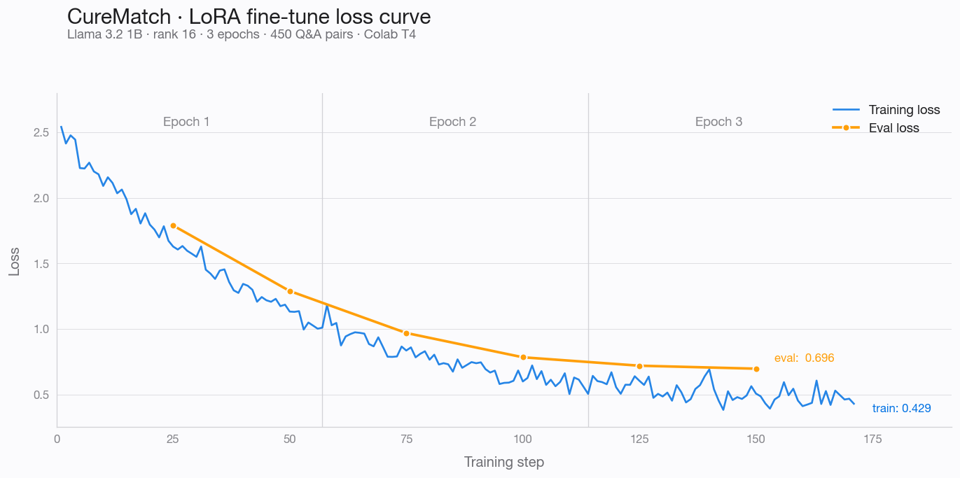
MEET GAJJAR · FINE-TUNE
LoRA on Llama 3.2 1B.
A controlled experiment: parser-grounded Q&A improves refusal behavior in a small model.
450
Q&A pairs auto-generated from parser output
rank 16
LoRA · 8M adapter params on 1B base
3 epochs
Colab T4 GPU · ~40 min runtime
$0
total training cost · free tier
Training + eval loss across 3 epochs · notebooks/finetune_curematch.ipynb
Production inference uses base Llama 3.3 70B via Groq. The 1B fine-tune proves the dataset-construction pipeline works.
CureMatch
12 / 19
Notes:
MEET — FINE-TUNE · 55 seconds.
Say:
• "This is the model-level work. I took Meta's Llama 3.2 1B Instruct
and fine-tuned it with LoRA — Low-Rank Adaptation."
• Walk through the stats: "450 Q&A pairs. I auto-generated these from
our rule-parser output — every example is grounded in a real trial.
Rank 16 LoRA — 8 million trainable parameters on a 1 billion
parameter base. 3 epochs on a free Colab T4. 40 minutes total. Zero
dollars."
• Point at loss curve: "This is the training curve. Blue is training
loss, orange is eval loss. Both converge cleanly across three epochs.
Final train loss 0.43, eval 0.70 — no overfitting."
• The honest framing: "In production we use base Llama 3.3 70B through
Groq, because it's faster and we didn't need to ship the 1B. The
fine-tune was a controlled experiment — it proves our dataset-
construction pipeline works. If we scaled up, that pipeline scales."
Transition: "Daksh — the LLM that reads the trials."

Slide 13
DAKSH GUPTA · LLM #3 · THE PARSER
Reading what regex can't.
The rule parser covers 33% of trials. For the other 67%, the LLM reads compound criteria, negation, and paraphrase.
INPUT · one line from an eligibility criterion
"Creatinine clearance > 60 mL/min, unless on chronic dialysis, in which case any value is acceptable."
RULE PARSER
LLM PARSER
{ missed the override }
{ extracted both }
Matched "creatinine > 60" only. Missed the dialysis conditional — dialysis patients would be incorrectly excluded from the trial.
lab: creatinine_clearance, min: 60
override: { if: on_dialysis, ignore_threshold: true }
CureMatch
13 / 19
Notes:
DAKSH — THE LLM PARSER · 50 seconds.
Say:
• "I built the third LLM — the eligibility parser. It reads what
regex can't."
• Point at the input: "Here's a real line from a real trial's
eligibility: 'Creatinine clearance greater than 60, unless on chronic
dialysis, in which case any value is acceptable.' That's a compound
criterion with a conditional override."
• Left card: "The rule parser saw 'creatinine greater than 60' and
stopped there. It missed the override. Dialysis patients would be
incorrectly excluded."
• Right card: "The LLM reads the full sentence. It extracts the
threshold — creatinine minimum 60 — AND the override rule. Same
structure the scoring engine expects downstream."
• Key point: "The output of the LLM is fed into the SAME deterministic
scorer. We don't lose auditability — we gain coverage."
Transition: "Here's how much coverage we gain."

Slide 14
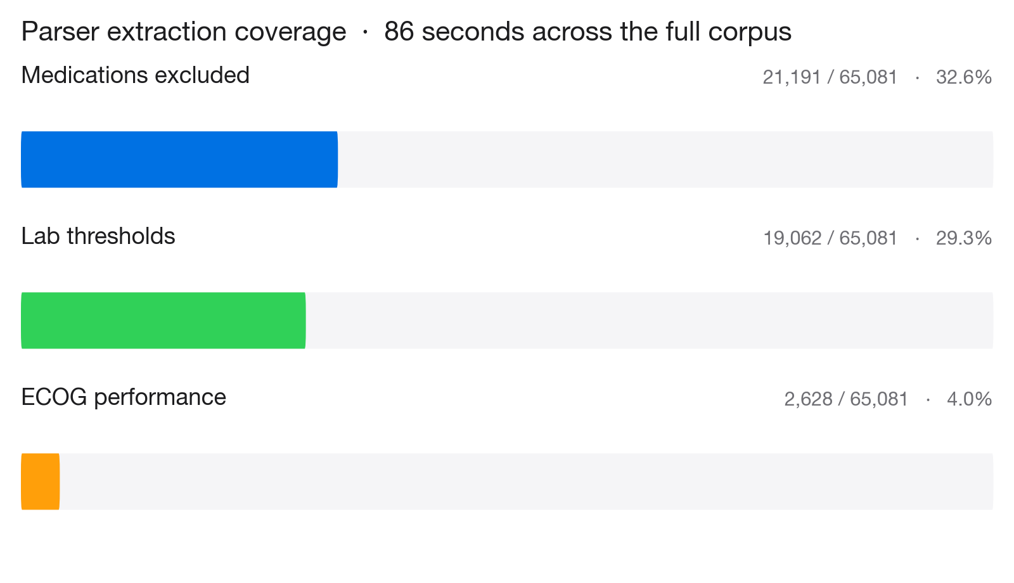
DAKSH GUPTA · PARSER COVERAGE
The 33% ceiling.
Rules hit a wall. Compound criteria, negation, paraphrase need language understanding.
THE OPPORTUNITY
The 67% gap is what an LLM parser closes. Same scorer downstream — triple the coverage.
CureMatch
14 / 19
Notes:
DAKSH — PARSER COVERAGE · 40 seconds.
Chart is self-explanatory, narrate the numbers:
• "Here's the coverage the rule-parser achieves across the full 65,081
trial corpus. Medication exclusions — 32.6 percent. Lab thresholds —
29.3 percent. ECOG performance status — 4 percent."
• "86 seconds to parse all 65k trials. Zero cost to operate."
• The KEY takeaway: "But 67 percent of trials slip through. That's
the ceiling — the limit of what regex and drug dictionaries can
reach."
• Point at the blue footer line: "That 67 percent gap is the opportunity.
Swap the rule parser for an LLM parser, feed the same scoring engine,
triple the coverage. Schema's already ready for it — the parsed
database has a source column for 'rules' versus 'llm'."
Transition: "Because the scorer doesn't care where the fields came from."

Slide 15
DAKSH GUPTA · SCORING ENGINE
LLM reads. Rule engine scores.
Whether the structured fields came from rules or an LLM, the downstream scorer is the same — deterministic, auditable.
Condition
35%
Medications
20%
Lab values
15%
Age
12%
Proximity
10%
Gender
8%
AUDITABLE EXCLUSION
You (HbA1c 6.2) → Required (≥ 7.5) → excluded.
CureMatch
15 / 19
Notes:
DAKSH — SCORING ENGINE · 40 seconds.
Walk through the weights:
• "The scoring engine runs six rule-based checks per trial. Condition
match is 35 percent — we weight that highest because condition
mismatch is the worst kind of false positive."
• "Medications 20, labs 15, age 12, proximity 10, gender 8."
• "Composite is a weighted average. Any trial excluded on condition is
dropped entirely — we don't surface a prostate cancer trial to a
breast cancer patient, no matter what."
• Point at the audit line: "And this is what auditable means. If a
hospital asks 'why was this patient excluded?' we point at a rule.
'You had HbA1c 6.2. Trial required at least 7.5. Excluded.' Same
answer every time."
• Closer: "The LLM helps us read more trials. The rules make sure the
matching stays defensible."
Transition: "From 65k trials to the top five — in milliseconds."

Slide 16
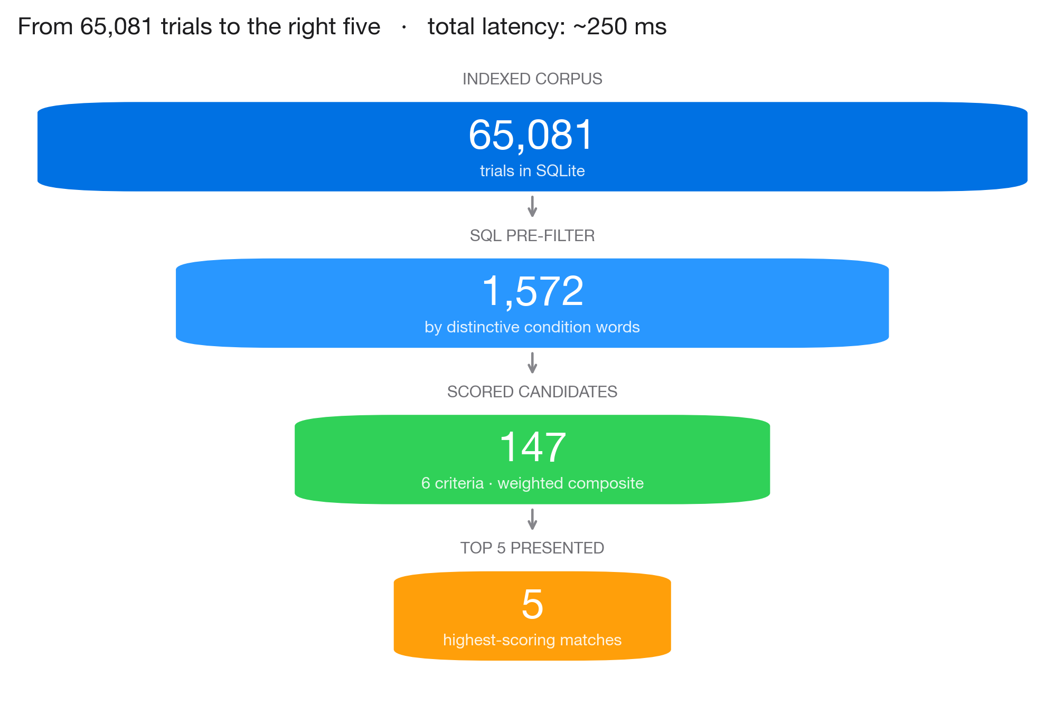
THE MATCHING FUNNEL
65,081 → 5. In milliseconds.
Every profile goes through the same four-stage filter. The scoring only touches ~2% of the corpus.
CureMatch
16 / 19
Notes:
FUNNEL · 35 seconds.
Narrate the funnel:
• "Here's what happens end-to-end when a patient submits their profile."
• "We start with 65,081 trials. SQL pre-filter by distinctive condition
words narrows that to around 1,572 candidates — for this example, a
diabetes patient. That step takes a handful of milliseconds in
SQLite."
• "The scoring engine runs the six-criterion check across those 1,572.
That produces 147 scored candidates — after we drop hard exclusions."
• "We return the top five to the UI, ranked by composite score."
• "Total wall-clock time: around 250 milliseconds on a laptop. That's
the whole funnel."
Transition: "So what did we ship?"

Slide 17
IN NUMBERS
What we shipped.
65,081
411,042
21,191
trials indexed
sites with lat/lng
parsed exclusion lists
19,062
86 sec
$0
parsed lab thresholds
full-corpus parse time
ongoing cost
Zero accounts · zero tracking · zero analytics · zero telemetry.
CureMatch
17 / 19
Notes:
IN NUMBERS · 30 seconds.
Read left-to-right, top-down:
• "65,081 trials indexed. 411 thousand trial sites with latitude and
longitude. 21 thousand parsed exclusion lists. 19 thousand parsed
lab thresholds. 86 seconds to parse the entire corpus. Zero dollars
ongoing cost."
• Closer: "And zero accounts, zero tracking, zero analytics, zero
telemetry. The whole app is free for patients to use."
Transition: "We want to be honest about what we haven't done."

Slide 18
WHAT'S NOT SOLVED
Limitations.
Research prototype.
Not a medical device. Final eligibility is the trial investigators' call.
Parser coverage is partial.
33% of trials for medications, 29% for labs. The LLM parser is the planned remediation.
LLM parser not yet in production.
Schema and source column are ready. We've run it on samples, not the full corpus.
No published accuracy metric.
Qualitative spot-checks only. An F1 score against hand-labeled ground truth is the next milestone.
CureMatch
18 / 19
Notes:
LIMITATIONS · 35 seconds.
Be honest — it builds credibility:
• "CureMatch is a research prototype. Not a medical device. Every
narrative ends with 'final eligibility is determined by the trial's
investigators.' That's enforced in the prompt."
• "Parser coverage is partial — 33 percent for medications, 29 percent
for labs. The LLM parser is the planned fix, we haven't run it on
the full corpus yet."
• "We've spot-checked the parser qualitatively. No published F1 against
hand-labeled ground truth yet — that's the next milestone."
• "And to be clear — we haven't deployed to users. This is a working
prototype, not a launched product."
Transition: "To close."

Slide 19
LLMs for language.
Rules for decisions.
Humans verify.
CureMatch.
github.com/meetgajjarx07/curematch
Thank you. Questions?
CureMatch
19 / 19
Notes:
CLOSING · 20 seconds.
Land the thesis cleanly. All three presenters stand together for Q&A.
Say:
• "Three principles hold the system together. LLMs for language — they
read prose and answer questions. Rules for decisions — because
medical matching has to be auditable. Humans verify — trial
investigators always make the final call."
• "That separation is the whole product."
• "CureMatch is open-source at the URL shown. Thank you — we'd love
to take your questions."
Q&A RULES:
• Whoever's LLM is being asked about fields the answer. The other two
can chime in if they want.
• If it's a deep-technical question, Meet takes it.
• If it's a design-choice question, any of us can answer.
• DO NOT over-promise anything. Research prototype.

