Slide 1
Crash Proof Drone
ECE592-063 E2
Dr. Mihail Sichitiu
Eric Beppler, Alex Gavric, Anmol Nayak, Diwakar Posam, Meet Thakkar

Slide 2
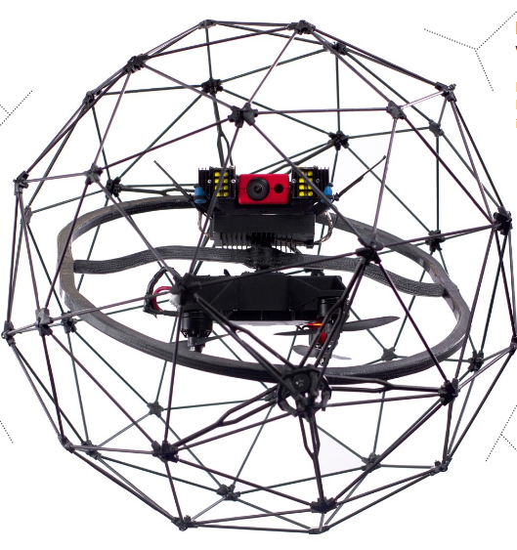
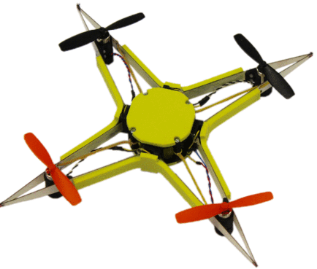

Why need this feature in a drone?
Safety of the drone: Highly useful if the pilot is inexperienced or an amateur
Better flying experience for the pilot: Doesn't need to worry about crashing the drone to the ground
Previous attempts made to make drones crash proof:
Carbon fiber cage around the drone - Most notable attempt the “Elios” , Increased overall weight, Reduced maneuverability etc.
Flexible fiberglass frame that can expand & contract on impact, Needs additional protection for parts like propellers (increases overall weight), Requires large magnets to hold the core (Autopilot etc.)
Notes:
Giving the drone the ability to be crash proof is essential as it will prevent catastrophic damages that might incur due to pilot errors. It will also give a better flying experience to the pilot as he/she does not have to worry about crashing it.
In the past, people have attempted to make drones crash resilient most notably the Elios which has a carbon fiber cage. The other notable attempt was made to make the drone with shock absorbing material. Both of these though are unique ideas, increase the weight of the drone, decrease the maneuverability etc.

Slide 3
Goal
Build a drone ( in our case a hexacopter) with the required hardware and software components to give it a “crash proof” capability.
The drone should not crash to the ground under any circumstance while the “crash proof” mode is active (even if the pilot attempts to).
The drone must eventually hover at a set altitude threshold below which it does not descent when the “crash proof” mode is active.
Notes:
So our primary goal was to give the drone crash proof capability without making any significant changes to the frame that might for example increase its weight. Our differentiator is that the crash proof ability is done mostly through software using
an ultrasonic sensor. In the crash proof mode, the drone will not descend below a certain height even if the pilot tries to.

Slide 4
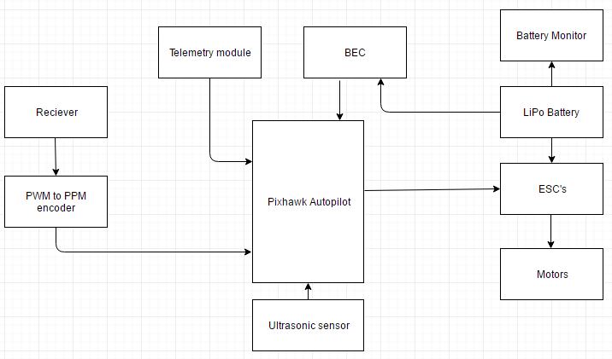
System architecture
Notes:
This is the overall system architecture of our drone. The hardware setup will now be explained by Alex.

Slide 5
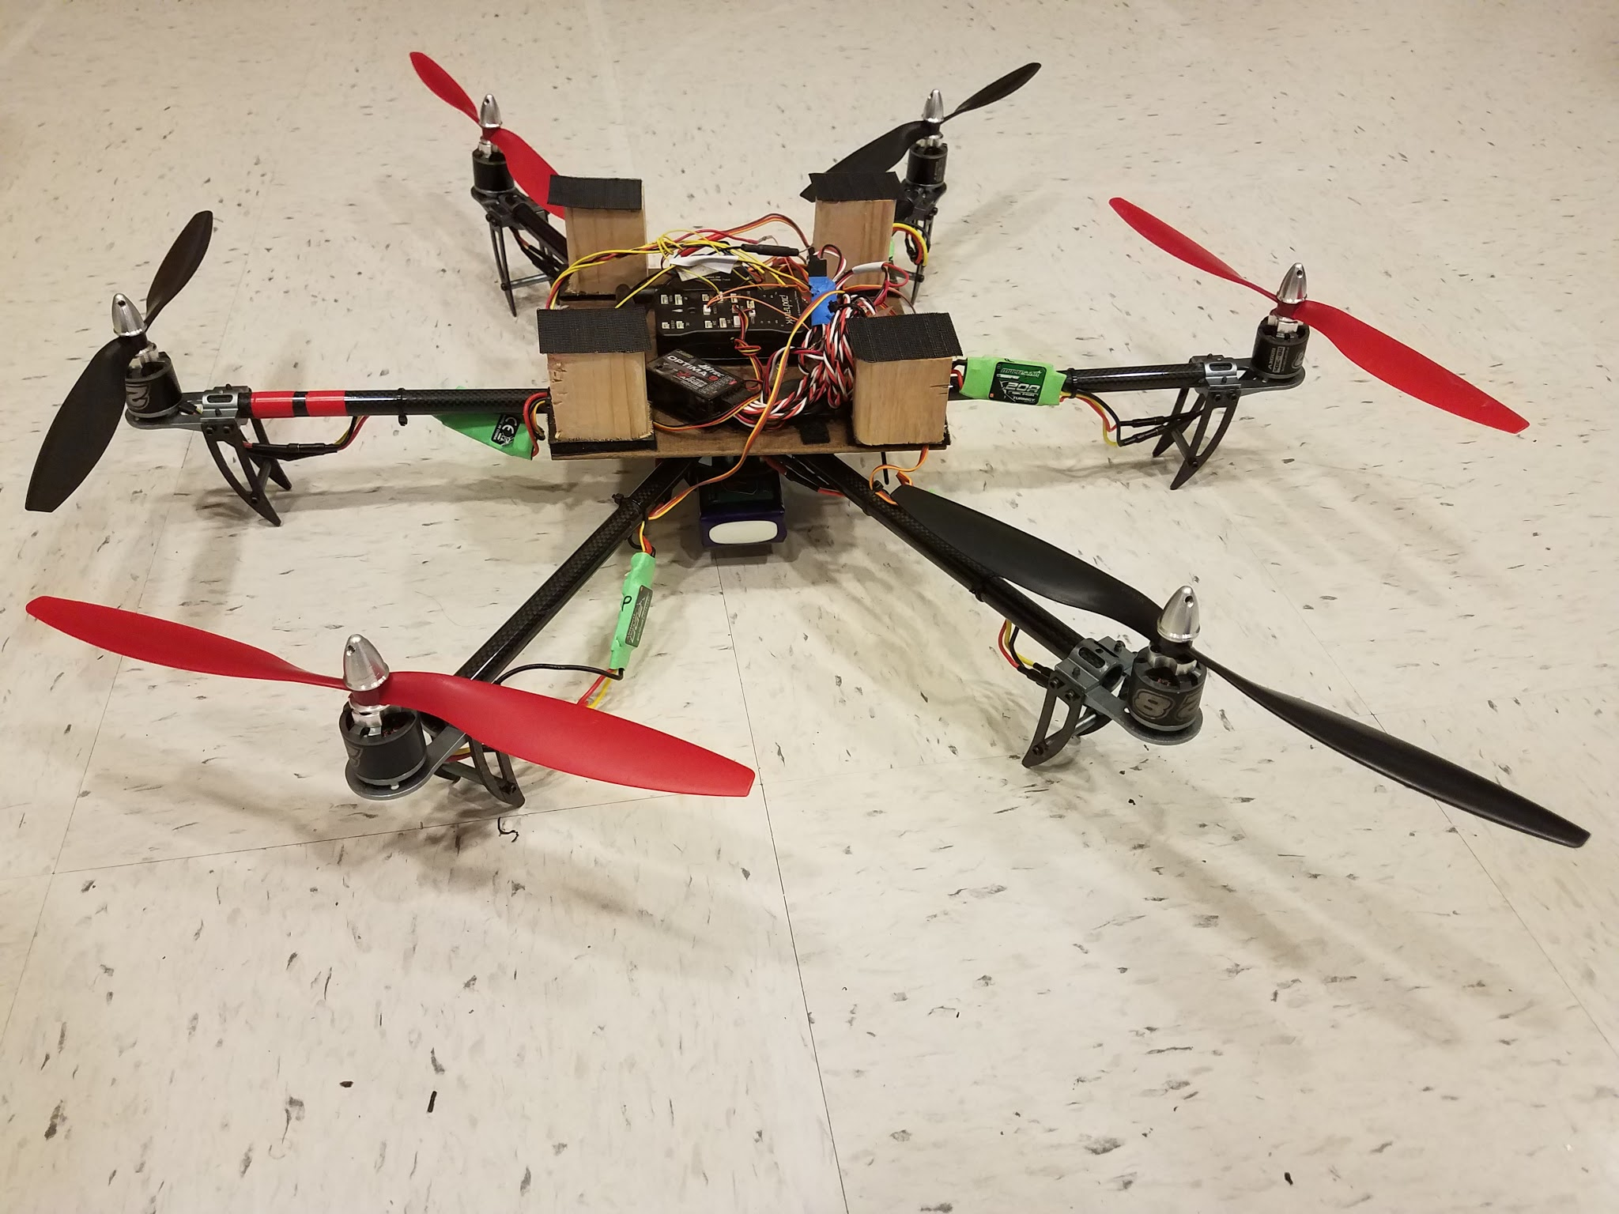
The Drone
Pixhawk
PPM-PWM converter
Optima9/Aurora9
Propdrive 28-30s
Turnigy Multistar 20A ESC
12x4.5 Gemfan Propellers
Turnigy 5000mAh
Notes:
As displayed in front of us and on the screen to the right we used a carbon fiber frame hexacopter provided to us by Dr. Sichitu. The flight control module for the drone is the pixhawk. We ended up going with the Pixhawk after multiple unknown crashes while using the BBB and BBM setup, as soon as we would take-off the drone would flip immediately. The Pixhawk is running a modified version of Ardupilot which will be discussed more in the software section. We have a PPM-PWM converter that takes the signal that is being received from the Aurora9 transmitter and converts it into a signal that can be understood by the Pixhawk Flight controller. To control the drone we are using the the Optima 9 channel receiver and the Aurora 9 channel transmitter. The motors we are using are propdrive 28-30s spinning 12inch propellers with a 4.5 degree angle of attack at a max speed of 800rpm/v. To control these motors we ae using the turnigy Multistar 20A ESC. The power source for the whole system is a Turnigy 3 cell 500mAh li-po battery.

Slide 6
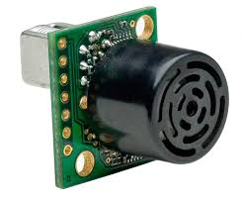
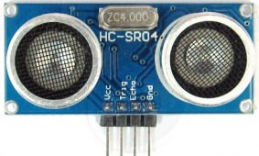
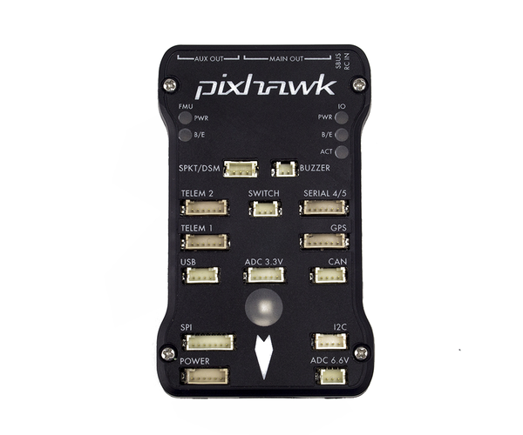
Sensors
XCSR04 ultrasonic sensor
MAXbotix EZ0 ultrasonic sensor
Laser distance sensor
Accelerometer
Notes:
For our sensor selection we started by testing the XCSR04 ultrasonic sensor, the blue one to the right. We chose this sensor because it was the most commonly available and was a common one used in recreational equipment. We created a breadboard test circuit for this sensor and connected it to a function generator and an oscilloscope to see the measured outputs. We found that this sensor had a max range of 1 meter which is a lot lower than what we want. Since we will be flying at high altitudes and there is a possibility of falling quickly we want to have a sensor with a larger max range so we can pickup the ground earlier. We ended up using the MAXbotix EZ0 which has a 7 meter range. Another sensor that was considered was a Laser distance detector but we ended up dismissing this before we switched to the Pixhawk. We are using the integrated accelerometer in the Pixhawk to get acceleration reads. The accelerometer helps us establish the decent when in crash proof mode is enabled.

Slide 7
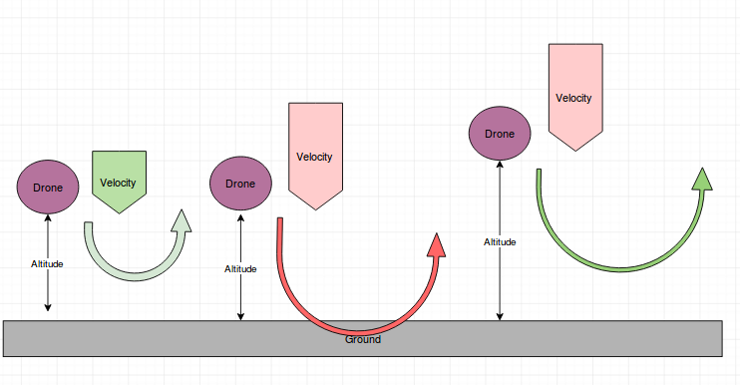
How It determines crash Conditions
High School Physics Projectile Motion

Slide 8
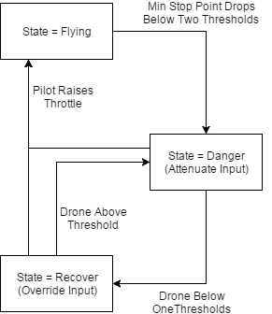
Software - Algorithm
Danger Mode: float alpha = (MIN(current_alt,target_stop_alt) - g2.cp_min_alt) / g2.cp_min_alt; target_climb_rate= constrain_float(target_climb_rate, -1*g.pilot_velocity_z_max*alpha,g.pilot_velocity_z_max);
Recover Mode: pos_control.set_speed_z(-1,g.pilot_velocity_z_max); target_climb_rate = g.pilot_velocity_z_max*0.1;
Always Uses Max of User Input and Calculated Value

Slide 9
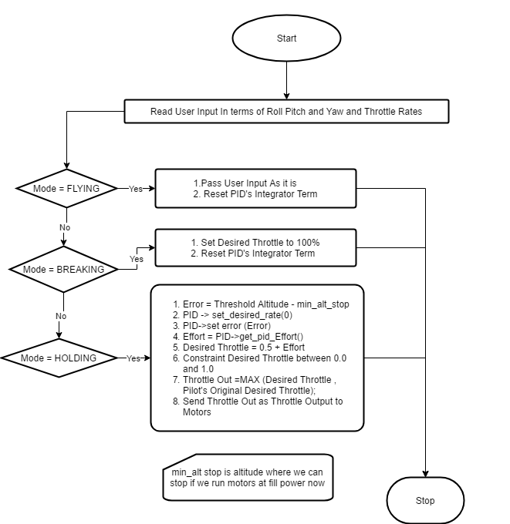
Software - Algorithm Alternative Approach
There is one more approach which gives more power to user.
Here, Instead of controlling velocity of drone we control throttle
This will allow faster maneuver of drone

Slide 10
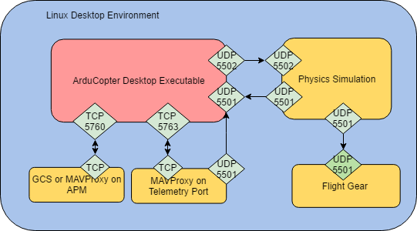
SITL Simulation and Visualization
Used standard SITL
Notes:
We are using Standard SITL simulation with Flightgear Visualization
We tested our flight mode using the SITL.

Slide 11
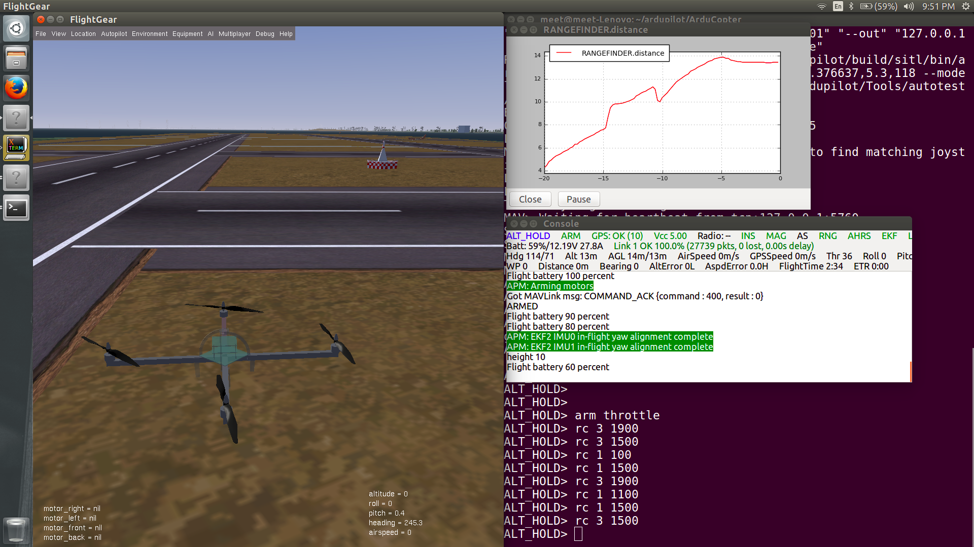
SITL and Visualization
On the Screen
Flightgear Visualization
Rangefinder distance graph
Simulation Console
MAVProxy console ( in background)

Slide 12
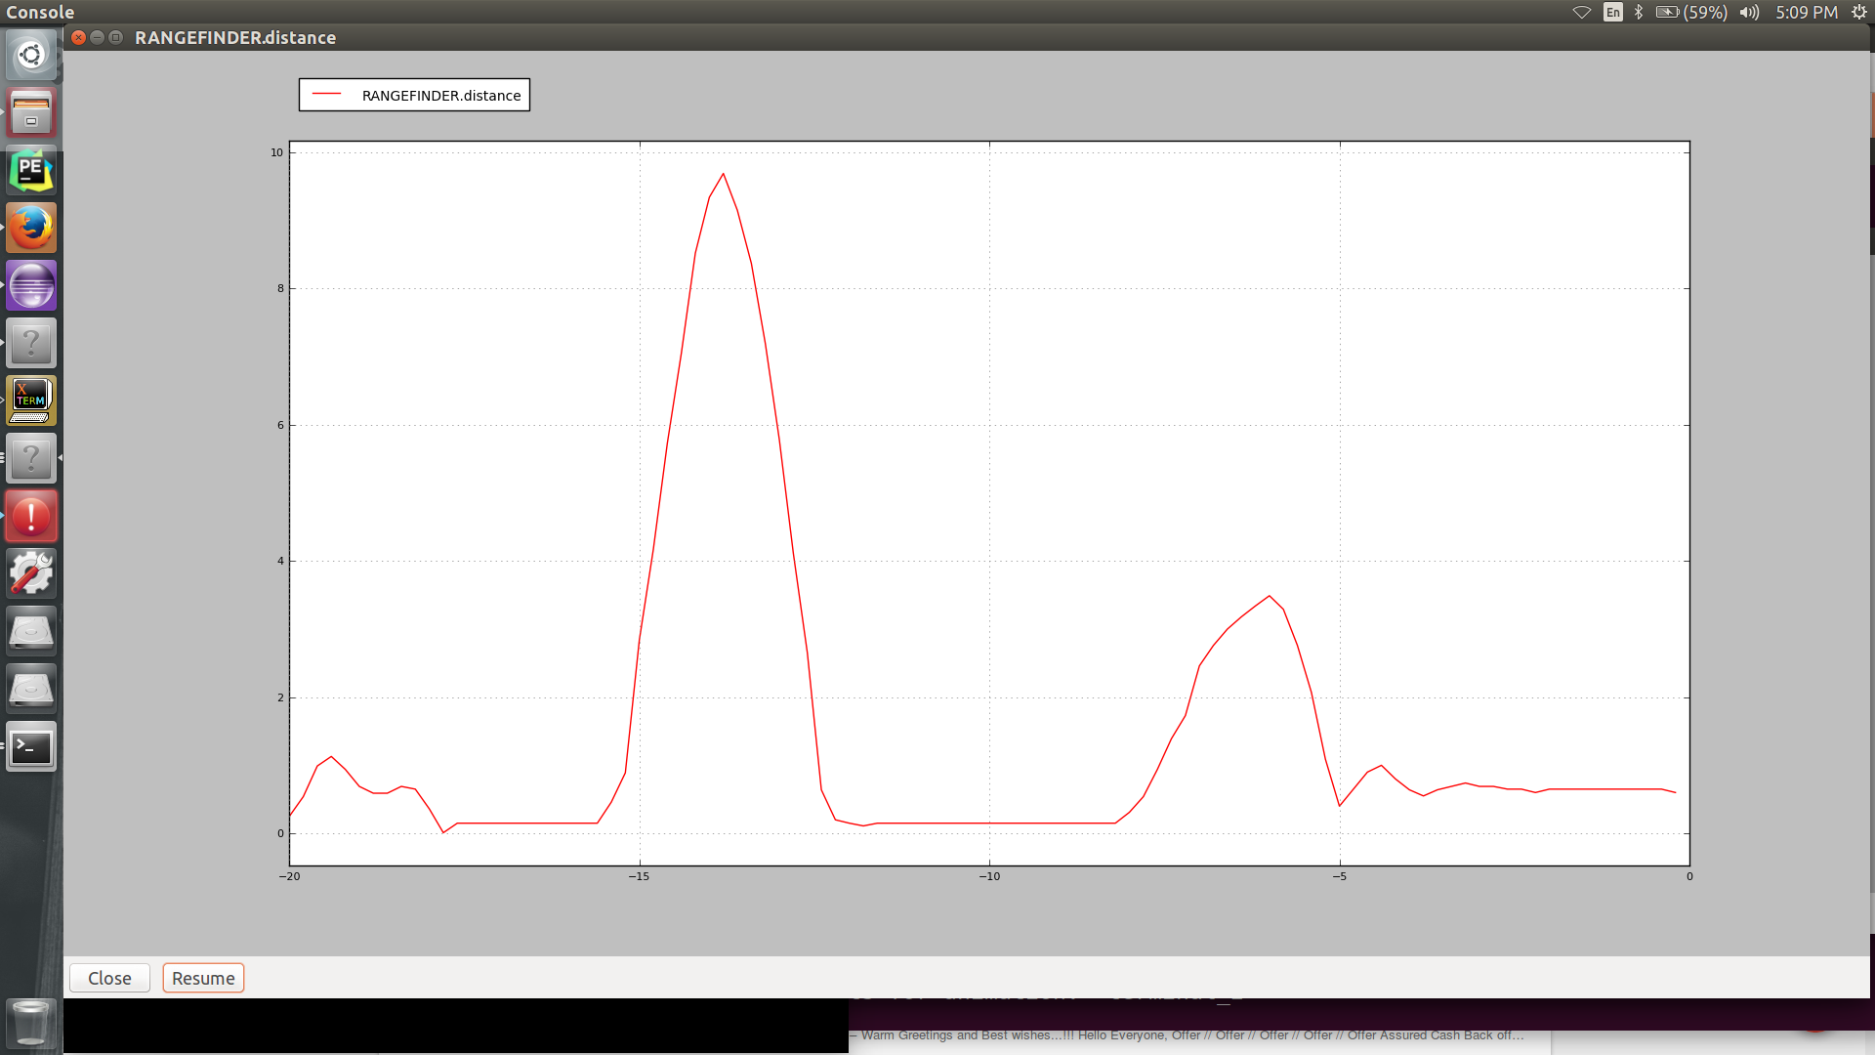
Results
Threshold Altitude = .65 meters
1
2
Notes:
Before we did real life testing we did some simulations to see if drone was behaving the way we wanted it to. Graph here shows the altitude in two modes: stabilize mode and crashproof mode. In the stabilize mode, the drone behaves normally where if the throttle is pushed up the altitude increases while when no throttle is given the drone drops to the ground. In stabilize mode, the we give the thrust and increase altitude, when we let go the of throttle, the drone comes back to around half a meter. You can see here that the altitude oscillates due to the fact that the drone is trying to correct itself from over throttling and eventually evens out at the desired height. as the drone comes back to the ground normally as shown by the decrease altitude. Here u can see the altitude is pretty close to the zero but not exactly zero due to the sensor offset.

Slide 13
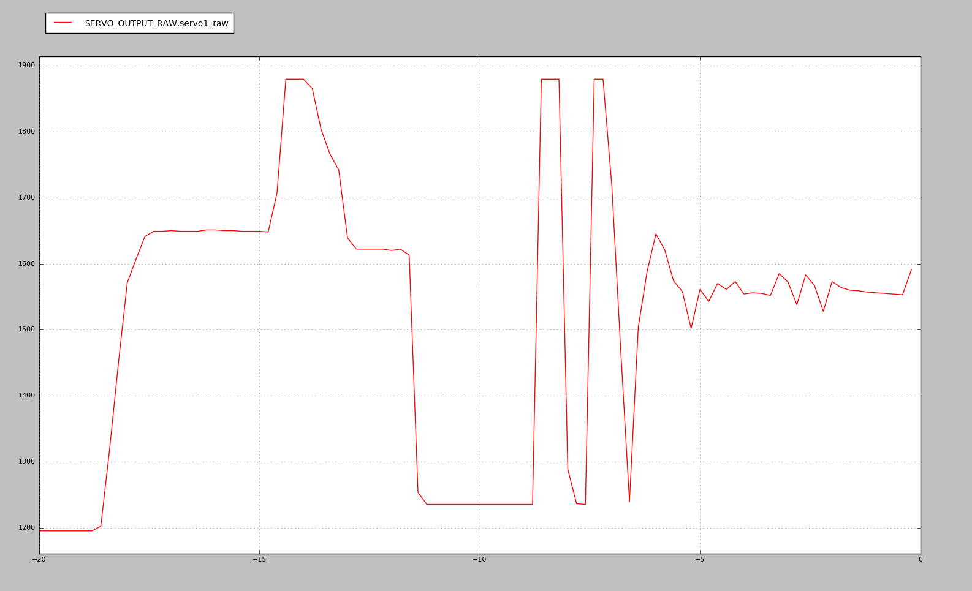
Results
Throttle down
Throttle up
Throttle up
Throttle down
Notes:
This simulation tracks the power given to the servo motors at the ascent and descent in both stabilize and crash proof mode. In stabilize mode where the drone just listens to users commands as it either goes up if throttle is given or comes crashing down if no throttle is given. It shows the behavior of the servo motors increasing in power. In crash proof mode as throttle up and down commands are given, the drone automatically increases power in the servo motor to increase altitude and stop itself from crashing. The oscillation in power is due to the fact that as the drone reaches above its hover altitude, it reduces power in the motors and to bring it down and realizing that its under the threshold altitude, it increases power in the servo motors to eventually stabilize at threshold altitude is achieved.

Slide 14
Field Testing
Test Summary:
https://drive.google.com/file/d/0B4VqEPB7_vKlNm9memdTTGVPbUk/view?usp=sharing
Full Testing Run:
https://drive.google.com/file/d/0B4VqEPB7_vKlQTVjUlZBSVNMdUU/view?usp=sharing

Slide 15
Questions?

