Slide 1
Agentic AI for Android PR Reviews
Automated, context-aware code review — commented directly on GitHub
Key idea: This is agentic AI — not just generating text, but participating in an engineering workflow and producing accountable, line-level review actions inside GitHub.
Built on Gemini 2.5 Flash · GitHub Actions · Python · MVVM Android project

Slide 2
The Problem
▸ Manual reviews are slow — developers wait hours or days for feedback.
▸ Quality varies by reviewer — same mistakes get through on different PRs.
▸ Repetitive checks waste senior engineer time: lint, magic numbers, hardcoded values.
▸ Test-coverage gaps go unnoticed until production.

Slide 3
Why This Is an Agent — Not Just a Prompt
▸ Trigger-aware: starts automatically when a PR is opened or updated.
▸ Context-aware: reads PR diff, lint output, and test coverage.
▸ Role-aware: reasons through specialist reviewer personas (Architecture, UI, Security, QA).
▸ Action-oriented: posts structured review comments at the exact line of code.
▸ Feedback-loop: developer fixes → pushes → agent re-reviews in the same PR.
"The agent behaves like a Staff Engineer: it reads context, reasons across specialties, and acts where the developer needs to."

Slide 4
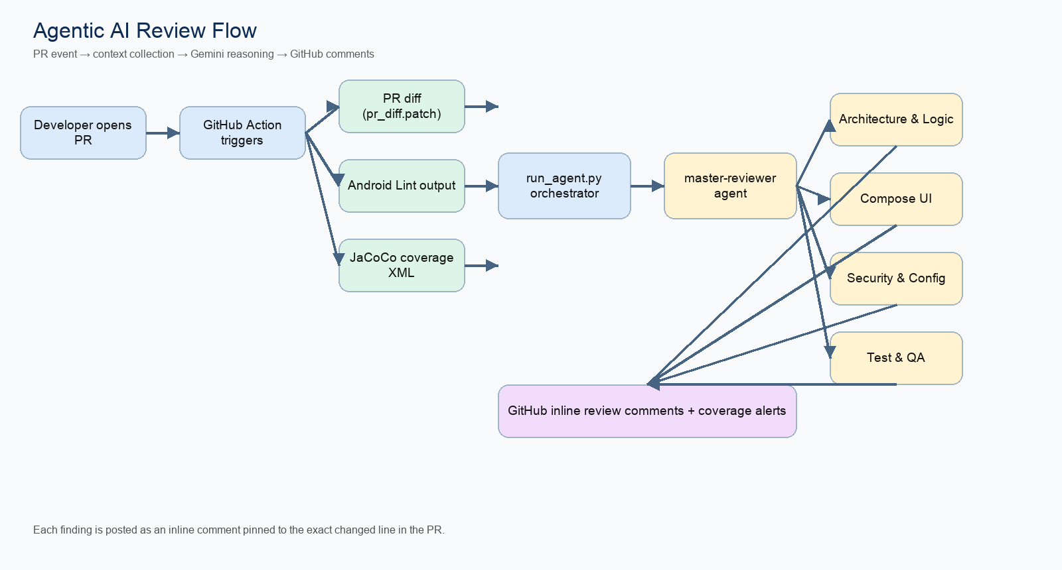
End-to-End Flow
PR event → diff + lint + coverage collection → Gemini master reviewer → specialist sub-agents → structured findings → GitHub inline comments

Slide 5
How It Is Built
① Orchestration
• GitHub Actions workflow
• Diff (pr_diff.patch)
• Android Lint context
• JaCoCo coverage XML
• run_agent.py controller
② Intelligence
• master-reviewer-agent.md
• arch-logic-agent.md
• compose-ui-agent.md
• security-config-agent.md
• test-qa-agent.md
③ Output
• Structured XML findings
• Severity ranking
• Exact file + line pinning
• Inline GitHub comments
• Coverage alerts (< 75 %)

Slide 6
What the Agent Reviews
▸ Hardcoded strings, colours, magic numbers → suggests BuildConfig or resource XML.
▸ Android Lint + Kotlin lint rules and code formatting.
▸ Compose UI quality, accessibility, and recomposition hygiene.
▸ Architecture boundaries: ViewModel / Repository / Data layers.
▸ Security risks in build scripts, API usage, and Manifest.
▸ Test coverage gaps in business-logic files (Repository, UseCase).

Slide 7
What the Live Demo Shows
▸ Open a PR with intentional issues in MainActivity.kt.
▸ GitHub Action auto-triggers: diff → lint → coverage → Gemini call.
▸ Agent returns structured XML findings ordered by severity.
▸ Each finding is posted as an inline comment on the exact changed line.
▸ Coverage alert posted separately when a business-logic file is below 75 %.
Demo tip: 4 bugs planted — hardcoded API key · hardcoded log tag magic number 5000 · hardcoded welcome string

Slide 8
Business Impact
▸ Review feedback in ~2 minutes — not hours.
▸ Consistent quality: same bar on every PR, every repo.
▸ Senior engineer time freed from repetitive checks.
▸ Reusable policy: rules are version-controlled agent prompts.
Cycle time: Earlier feedback → fewer back-and-forth rounds
Quality gate: Lint + coverage + structured review in one automated pass
Scale: Copy 3 files → works on any Android project

Slide 9
How to Add This to Any Android Project
▸ Copy .github/workflows/ai-pr-reviewer.yml to your repo.
▸ Copy .github/scripts/run_agent.py and master-reviewer-agent.md.
▸ Add LLM_API_KEY to GitHub → Settings → Secrets.
▸ Optionally edit the .md prompt files to match your project's rules.
▸ Open a PR — the agent runs automatically.
Total setup time: ~15 minutes

Slide 10
Next Steps
▸ Pilot on one Android repo — run in review-only mode for 2 sprints.
▸ Tune the prompt files based on false-positive feedback.
▸ Track: review turnaround time, escaped defects, coverage trend.
▸ Templatise and roll out across additional mobile projects.
"This is practical agentic AI: not generating text, but participating in an engineering workflow and producing accountable review actions."

