Slide 1
Data visualization in D3.js
Paweł Łukaszuk
pawel@lukaszuk.pl
meet.js Białystok #10 03.11.2016

Slide 2
The Data processing
acquire
parse
filter
mine
present
refine
interact

Slide 3
Why data visualization matters?
comprehend information quickly
pinpoint emerging trends
customers make decisions, too

Slide 4
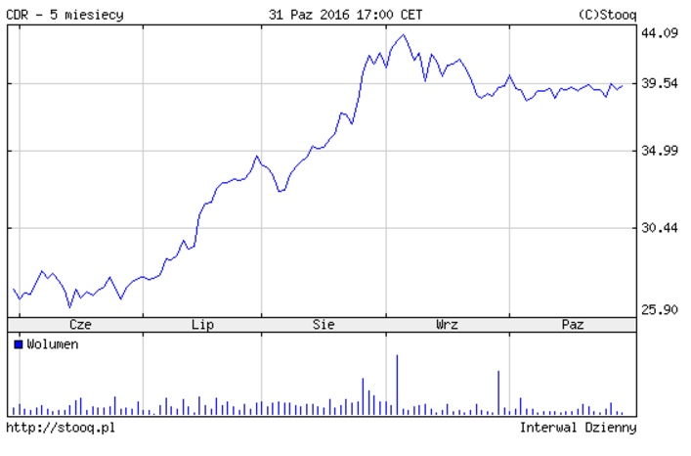
Nr. | Data | Otwarcie | Najwyższy | Najniższy | Zamknięcie
23 | 4 Lis 2016 | 39.65 | 40.19 | 39.63 | 39.88
22 | 28 Paź 2016 | 40.00 | 40.73 | 38.47 | 39.55
21 | 21 Paź 2016 | 39.00 | 39.99 | 38.96 | 39.96
20 | 14 Paź 2016 | 39.50 | 39.99 | 38.70 | 39.61
19 | 7 Paź 2016 | 40.65 | 41.30 | 38.30 | 39.00
18 | 30 Wrz 2016 | 39.20 | 40.60 | 38.25 | 39.86
17 | 23 Wrz 2016 | 41.50 | 42.44 | 39.10 | 39.20
16 | 16 Wrz 2016 | 42.09 | 43.40 | 39.60 | 41.50
15 | 9 Wrz 2016 | 43.14 | 44.50 | 41.42 | 42.50
14 | 2 Wrz 2016 | 41.50 | 43.00 | 40.57 | 42.79
13 | 26 Sie 2016 | 36.36 | 40.99 | 36.20 | 40.90
12 | 19 Sie 2016 | 35.44 | 36.36 | 34.59 | 36.32
11 | 12 Sie 2016 | 32.75 | 35.53 | 32.75 | 35.42
10 | 5 Sie 2016 | 34.80 | 35.45 | 31.81 | 32.55
9 | 29 Lip 2016 | 33.00 | 34.84 | 32.49 | 34.80
8 | 22 Lip 2016 | 30.80 | 33.70 | 30.55 | 33.02
7 | 15 Lip 2016 | 28.50 | 31.00 | 28.20 | 31.00
6 | 8 Lip 2016 | 27.19 | 28.95 | 27.00 | 28.41
5 | 1 Lip 2016 | 26.60 | 27.68 | 26.22 | 27.45
4 | 24 Cze 2016 | 26.70 | 27.65 | 24.50 | 26.92
3 | 17 Cze 2016 | 27.35 | 27.35 | 25.11 | 26.70
2 | 10 Cze 2016 | 26.20 | 27.85 | 26.20 | 27.30
1 | 3 Cze 2016 | 27.75 | 28.16 | 25.98 | 26.55

Slide 5

D3.js – Data-Driven Documents
JavaScript library for producing dynamic, interactive data visualizations in web browsers
open-source – BSD license
web compliant: HTML, CSS, SVG, CANVAS
works with FF, Chrome, Safari, iOS, Android, IE9+
v1.0: 18 February 2011 → v4.3: 27 October 2016
low-level
widely adopted
extremely popular, with great community

Slide 6
D3 v4
almost all code has been rewritten
strict mode
performance tunning
v4 is modular – ES6 modules
some modules can work independently
no backwards compatibility … but version switch is quite easy
90% of cases require switch from nested namespace to flat one
d3.scale.linear → d3.scaleLinear d3.layout.treemap → d3.treemap
Notes:
https://github.com/d3/d3/blob/master/CHANGES.md

Slide 7
D3 v4 modules
Arrays (d3-array)
Axes (d3-axis)
Brushes (d3-brush)
Chords (d3-chord)
Collections (d3-collection)
Colors (d3-color)
Dispatches (d3-dispatch)
Dragging (d3-drag)
Delimiter-Separated Values (d3-dsv)
Easings (d3-ease)
Forces (d3-force)
Number Formats (d3-format)
Geographies (d3-geo)
Hierarchies (d3-hierarchy)
Interpolators (d3-interpolate)
Paths (d3-path)
Polygons (d3-polygon)
Quadtrees (d3-quadtree)
Queues (d3-queue)
Random Numbers (d3-random)
Requests (d3-request)
Scales (d3-scale)
Selections (d3-selection)
Shapes (d3-shape)
Time Formats (d3-time-format)
Time Intervals (d3-time)
Timers (d3-timer)
Transitions (d3-transition)
Voronoi Diagrams (d3-voronoi)
Zooming (d3-zoom)

Slide 8
Basics
selections
dynamic properties
real-time data binding
animation & transitions
interactivity

Slide 9
DEMO

Slide 10
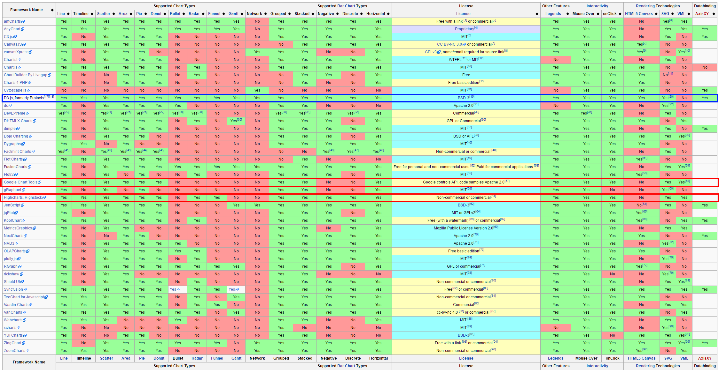
D3.js vs *
Notes:
https://en.wikipedia.org/wiki/Comparison_of_JavaScript_charting_frameworks

Slide 11
D3 in the trenches
New York Times
Bloomberg
ComputerWorld
Datameer
OpenStreetMap
Pluralsight
AppDynamics

Slide 12
To D3…
complex, non standard visualization
high customization
interactivity
performance
extensions for R

Slide 13
…or not to D3
charting library
SVG/CANVAS polyfill
deadline-driven development

Slide 14
D3++
dimplejs.org
Graffeine
Mermaid
Parallel Coordinates
Insights.js
iopctrl.js
RAW
Tributary
rCharts – R package
Rickshaw
JSNetworkX
CodeFlower
Vega
Dance.js
Dynamic-Charts
dc.js
Rickshaw
DVL
NVD3
Cubism.js
DataMaps
xCharts.js
…
Notes:
http://mikemcdearmon.com/portfolio/techposts/charting-libraries-using-d3

Slide 15
Questions?

Slide 16
Links
https://d3js.org/
https://github.com/d3/d3
https://square.github.io/intro-to-d3
https://www.dashingd3js.com/
http://nvd3.org/
http://bl.ocks.org/
http://blockbuilder.org/
http://bl.ocksplorer.org/
https://datahub.io
http://driven-by-data.net/
http://flowingdata.com/
Notes:
http://gallery.htmlwidgets.org
http://benschmidt.org/mvp/
http://jfire.io/animations - animacje przy użyciu D3 i nie tylko
http://driven-by-data.net – przykładowe wizualizacje
http://syntagmatic.github.io/parallel-coordinates – jedna z ciekawszych bibliotek opartych no D3
http://www.bloomberg.com/graphics/dataview/how-americans-die – wizualizacja ze strony Bloomberga – ostatnie demo prezentacji

Slide 17
„The greatest value of a picture is when it forces us to notice what we never expected to see”. John W. Tukey. Exploratory Data Analysis. 1977
Paweł Łukaszuk pawel@lukaszuk.pl

